Slide 2
Plan for today
Mosaic videos with zero-crossing
Ran experiment at GPU memory limit
Fixed an important bug: Parameters were not initialized randomly

Slide 3
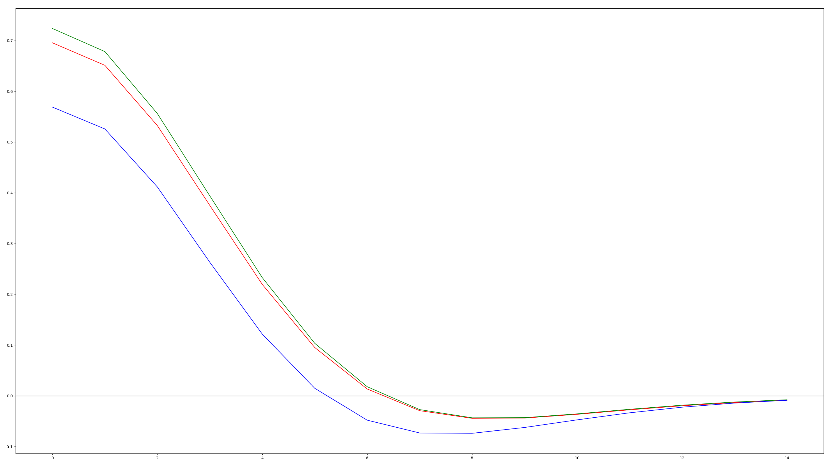
How I determined zero-crossings

Slide 4
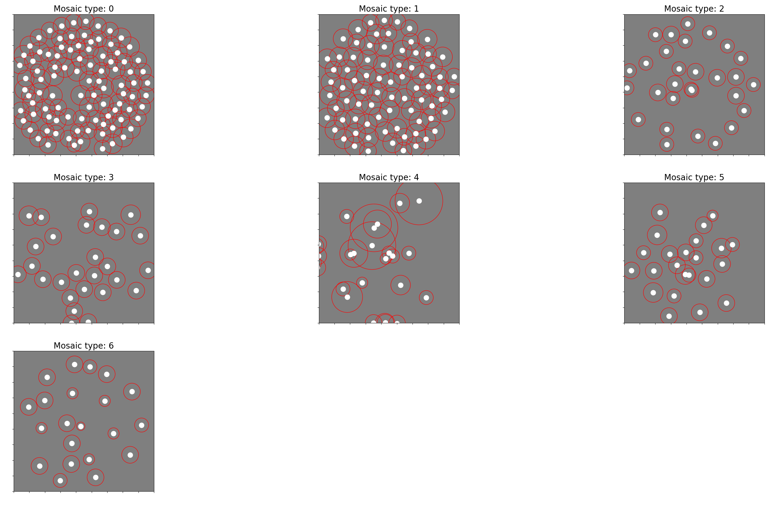

Slide 5
Video

Slide 6
Memory limit
What does influences the limit:
Number of neurons, batch size
What doesn’t influence the limit:
Kernel size, number of channels
Why is that?
Ran experiment at limit: 500 neurons, batch size = 128 -> 64, 18x18x3 inputs.

Slide 7
Fixing bugs
What I thought I was doing:
Sampling the initial parameters for each neuron from a normal distribution with means (-3, -3, 0, 0) and standard deviation of 1.
What I was actually doing:
All parameters but d were initialized to be the same for each neuron.
d was drawn from a normal distribution with mean = 0 and std = 1.
What I’m doing now
Sampling initial parameters from each neuron from a normal distribution with means that correspond to the converged parameter values and std = 1.
Unfortunately, that didn’t fix the mosaics

Slide 8
Fixing this bug does not fix mosaic problem

