Slide 1
Debugging the code with Empirical Cx
I need help please

Slide 2



Inferring ktilde from lambda

Slide 3
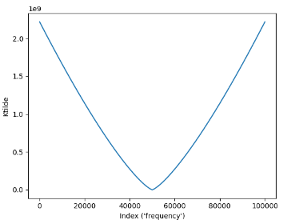
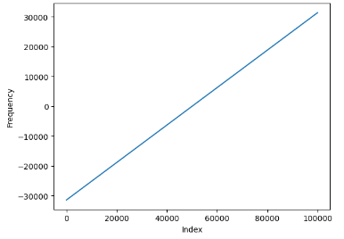
Original code has negative frequencies

Slide 4
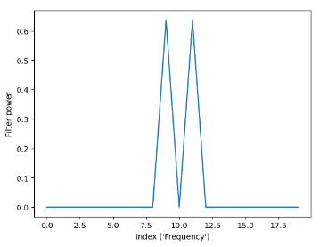
Original code: Filters in Fourier space

Slide 5
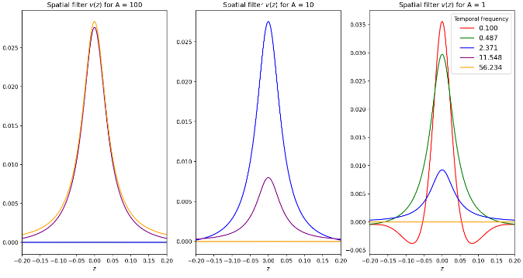
Filters in physical space

Slide 6
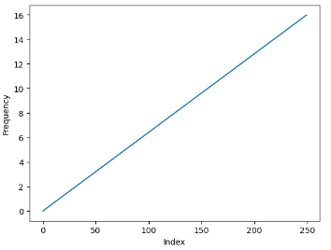
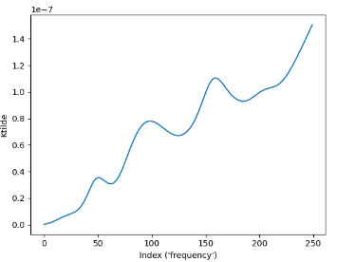
Empirical Cx: Only positive frequencies

Slide 7
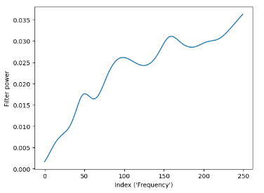
Filter power looks like a mess…
Look at the math, there’s a bug here!!! Look at filter power with ktilde

Slide 8
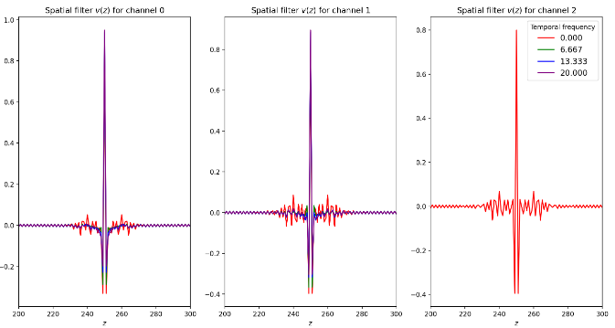
Physical filters also look shitty
These plots should be
WAY zoomed in

Slide 9
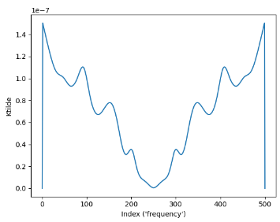
Solution: Pad and reflect ktilde

Slide 10
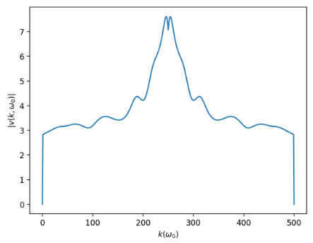
Filter power in frequency space
This thing does have to go
To zero in the edges.
A problem here is that
It only goes to zero at the
Edges. It should go there before!!

Slide 11
