Slide 1
Weekly meeting
September 9th, 2024

Slide 2
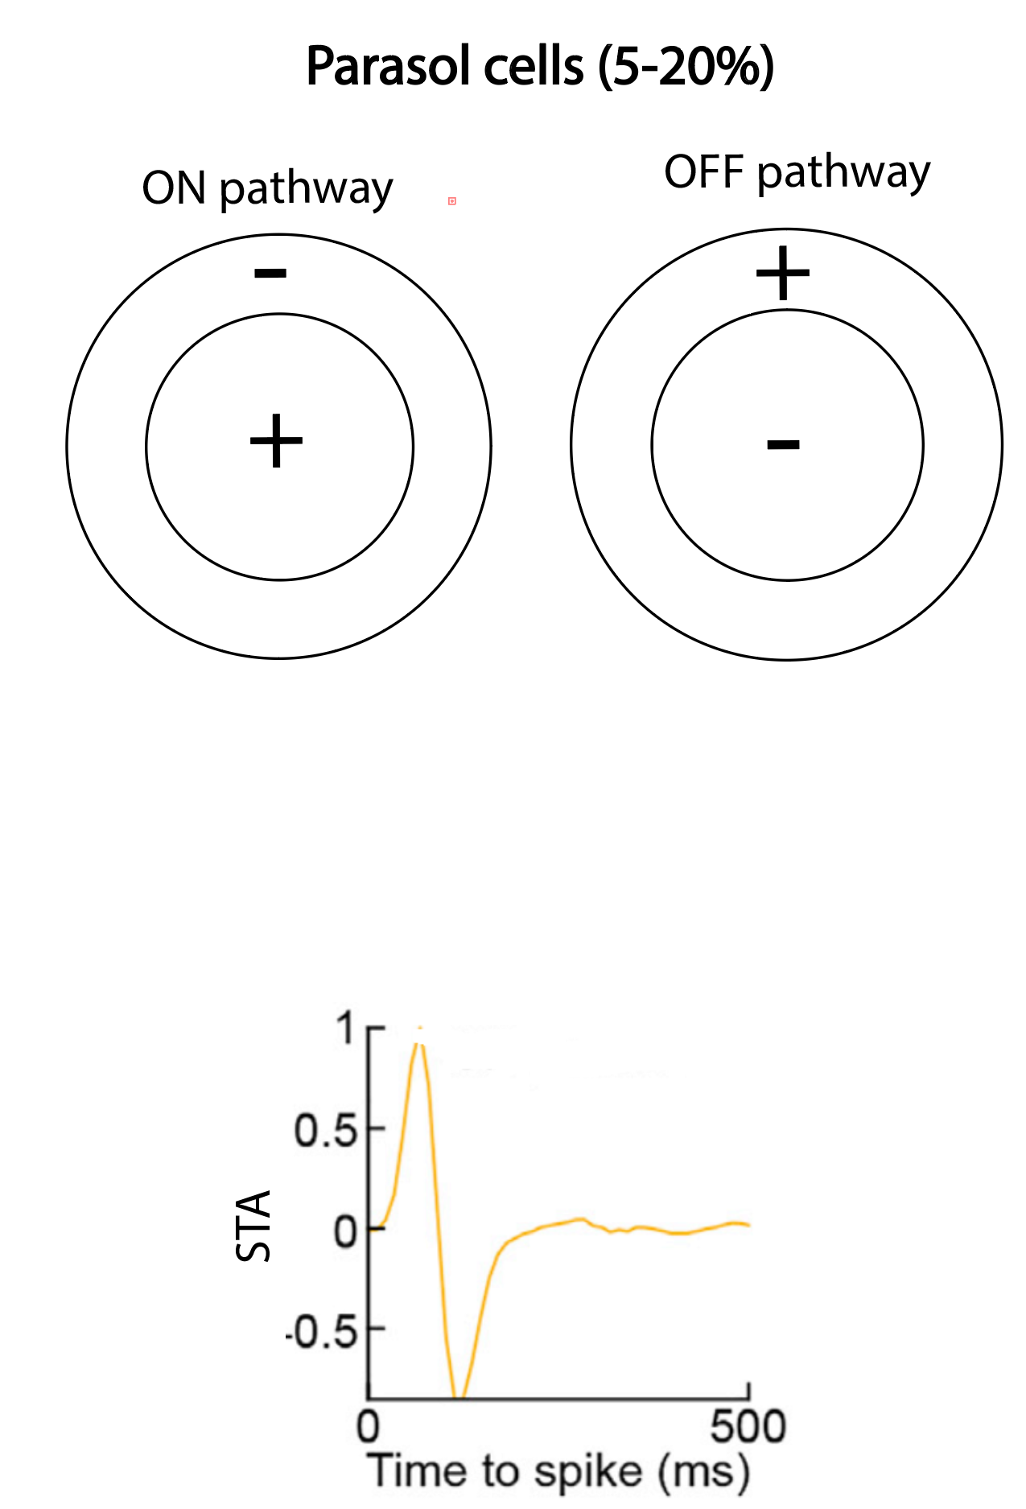
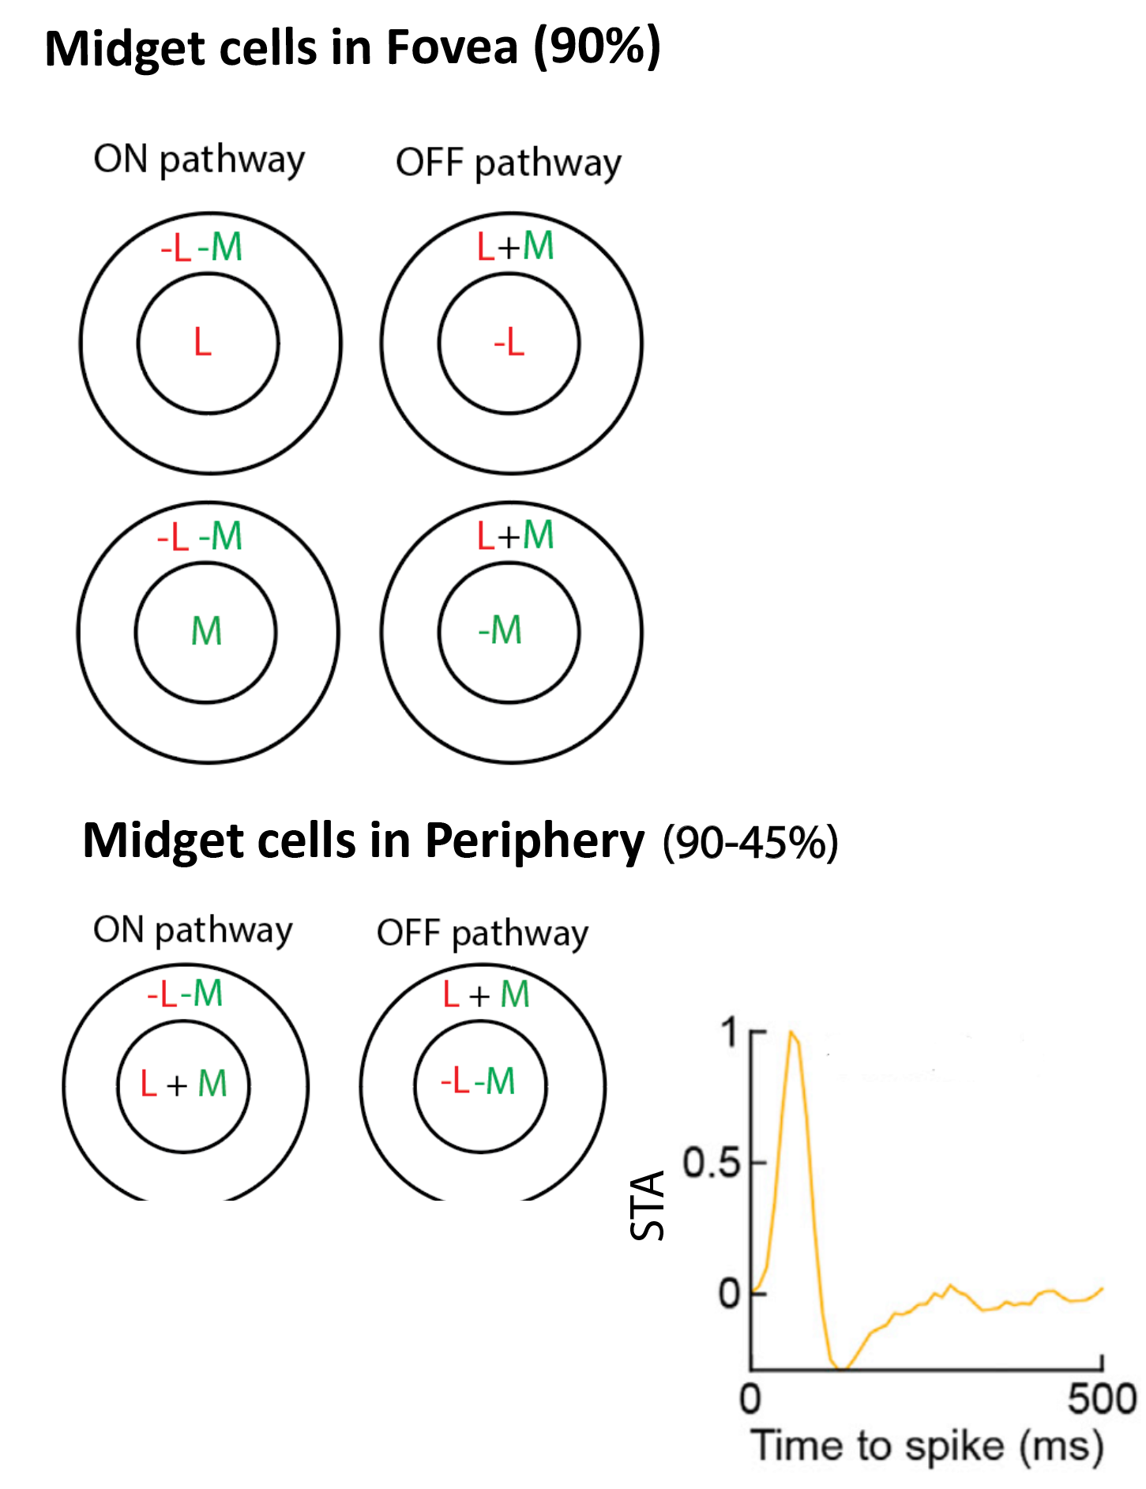
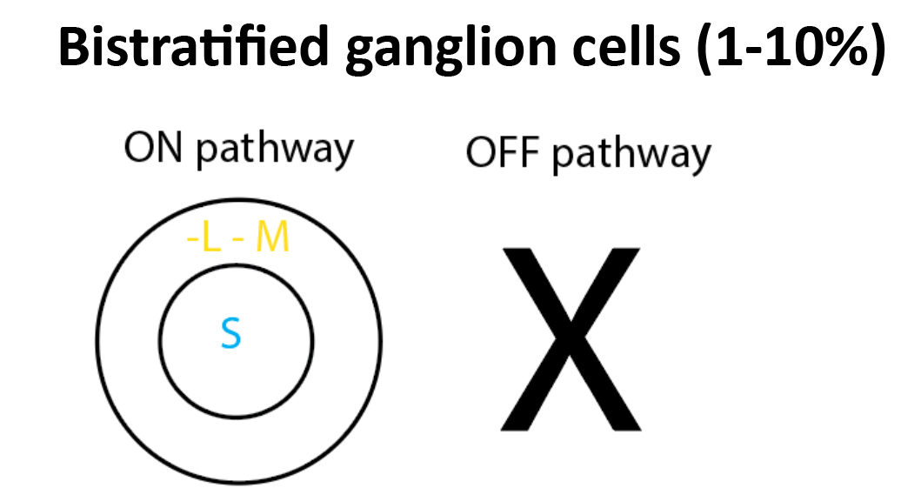
Properties of 3 major cell classes
Notes:
Cell type = mosaic
Use classes for parasol vs midget vs bistratified
Greg guesses 50/20 parasol/10 bistratified ratio in fovea
Greg thinks the difference in fovea and periphery is due to sampling bias. Fovea might also have ~50% midget cells

Slide 3
Hypothesis: Retina needs to “equalize” information across eigenmosaics
First eigenmosaic: L + M + S (Parasol cells)
Second eigenmosaic: L + M – S (Bistratified cells)
Third eigenmosaic: L – M (midget cells)
Hypothesis: The third mosaic might only have power at low temporal and high spatial frequencies in natural movies (> noise floor). In which case, need a lot of midget cells to equalize information across eigenmosaics.

Slide 4
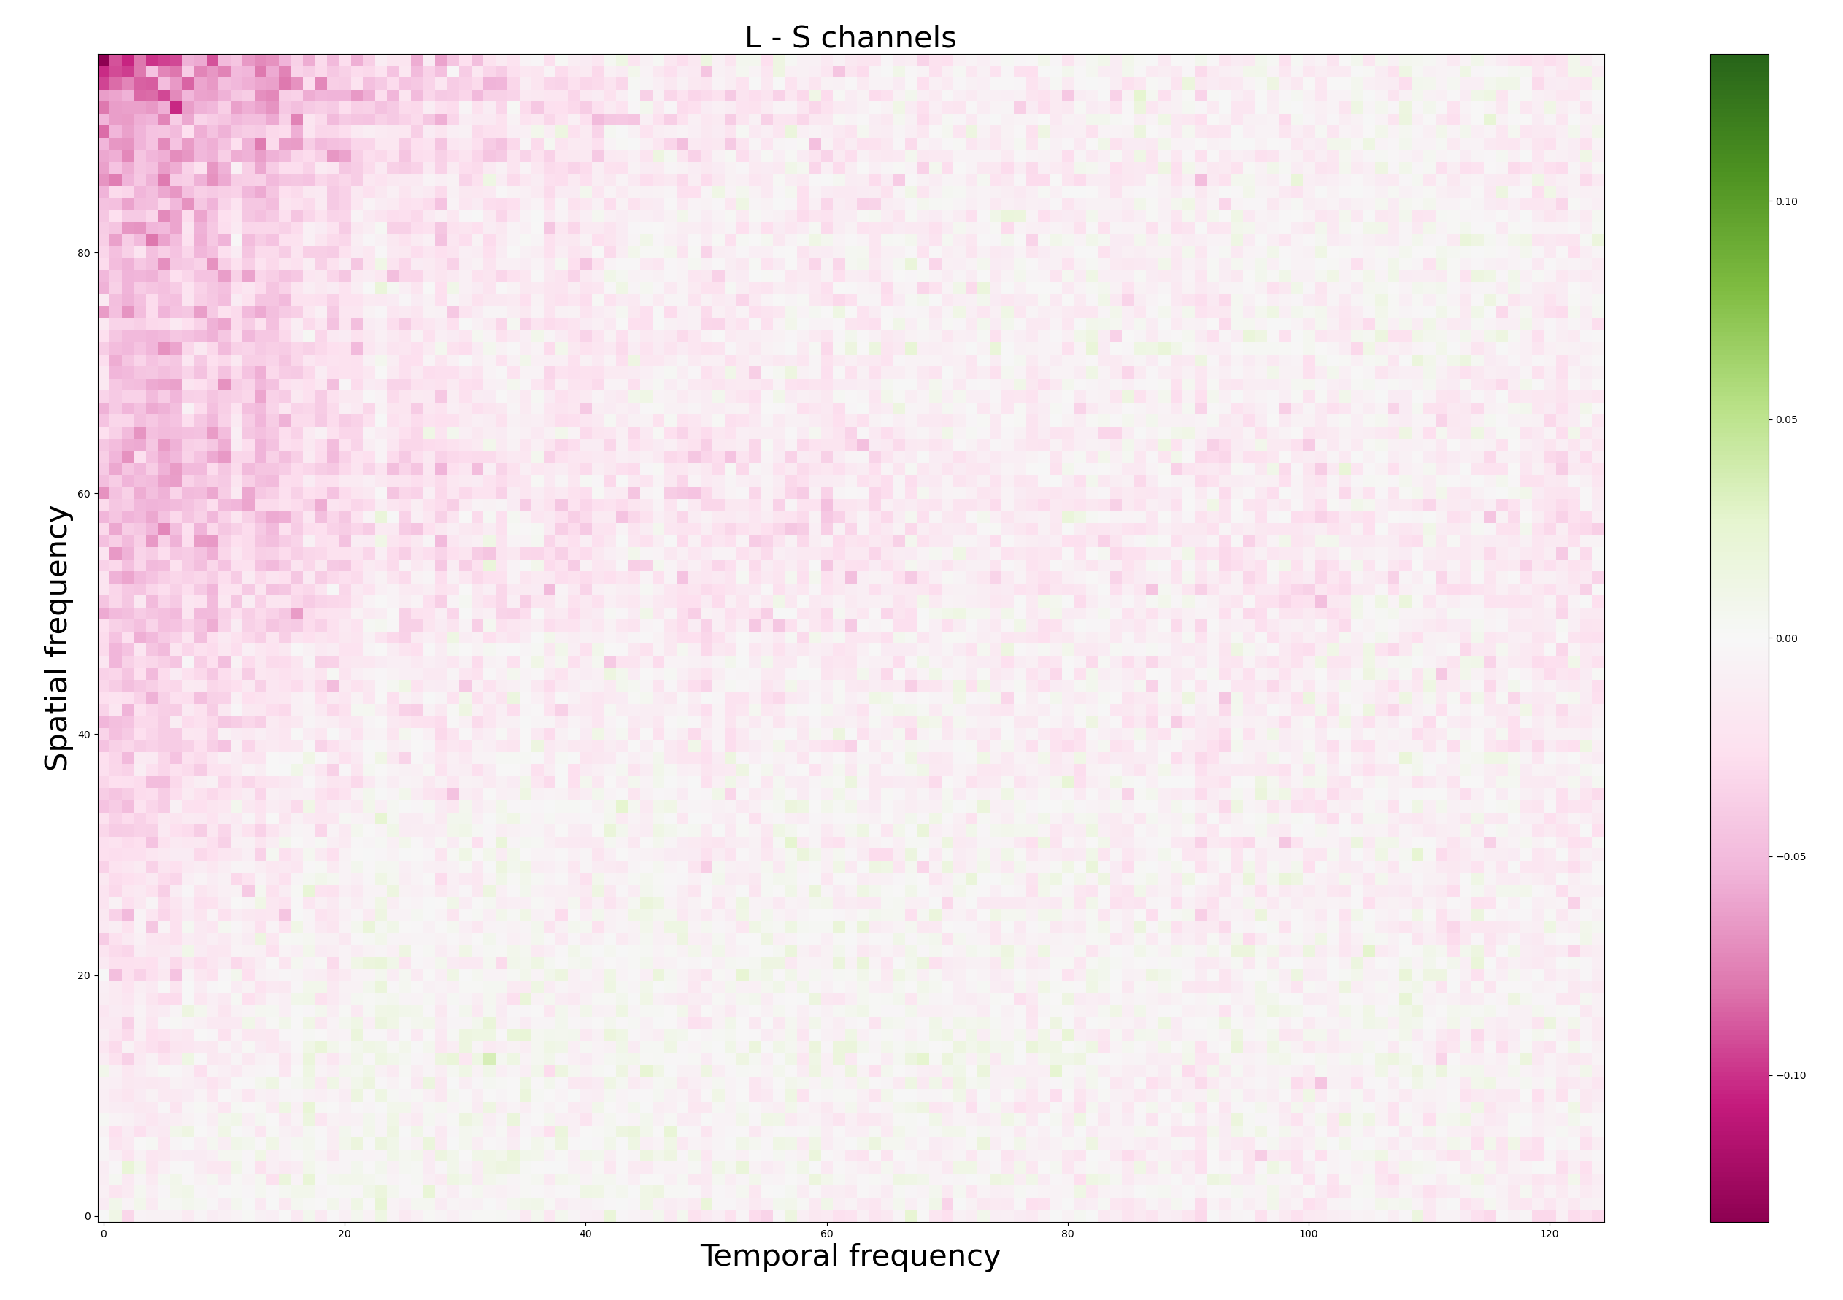
The difference between channels is at low temporal and high spatial frequencies
Maybe we can replicate prevalence of midget cells from properties of natural movies and first principles

Slide 5

What do we need to compute optimal filters?
We need the eigenvalues of the covariance matrix in fourier space.

Slide 6
We need to compute a 3x3 Cx matrix at each spatial and temporal frequencies
Problem: To run this in parallel, I cannot use for loops.
Solution: Einstein summation notation
Result: A 3x3 channel covariance matrix at each temporal and spatial frequency

Slide 7
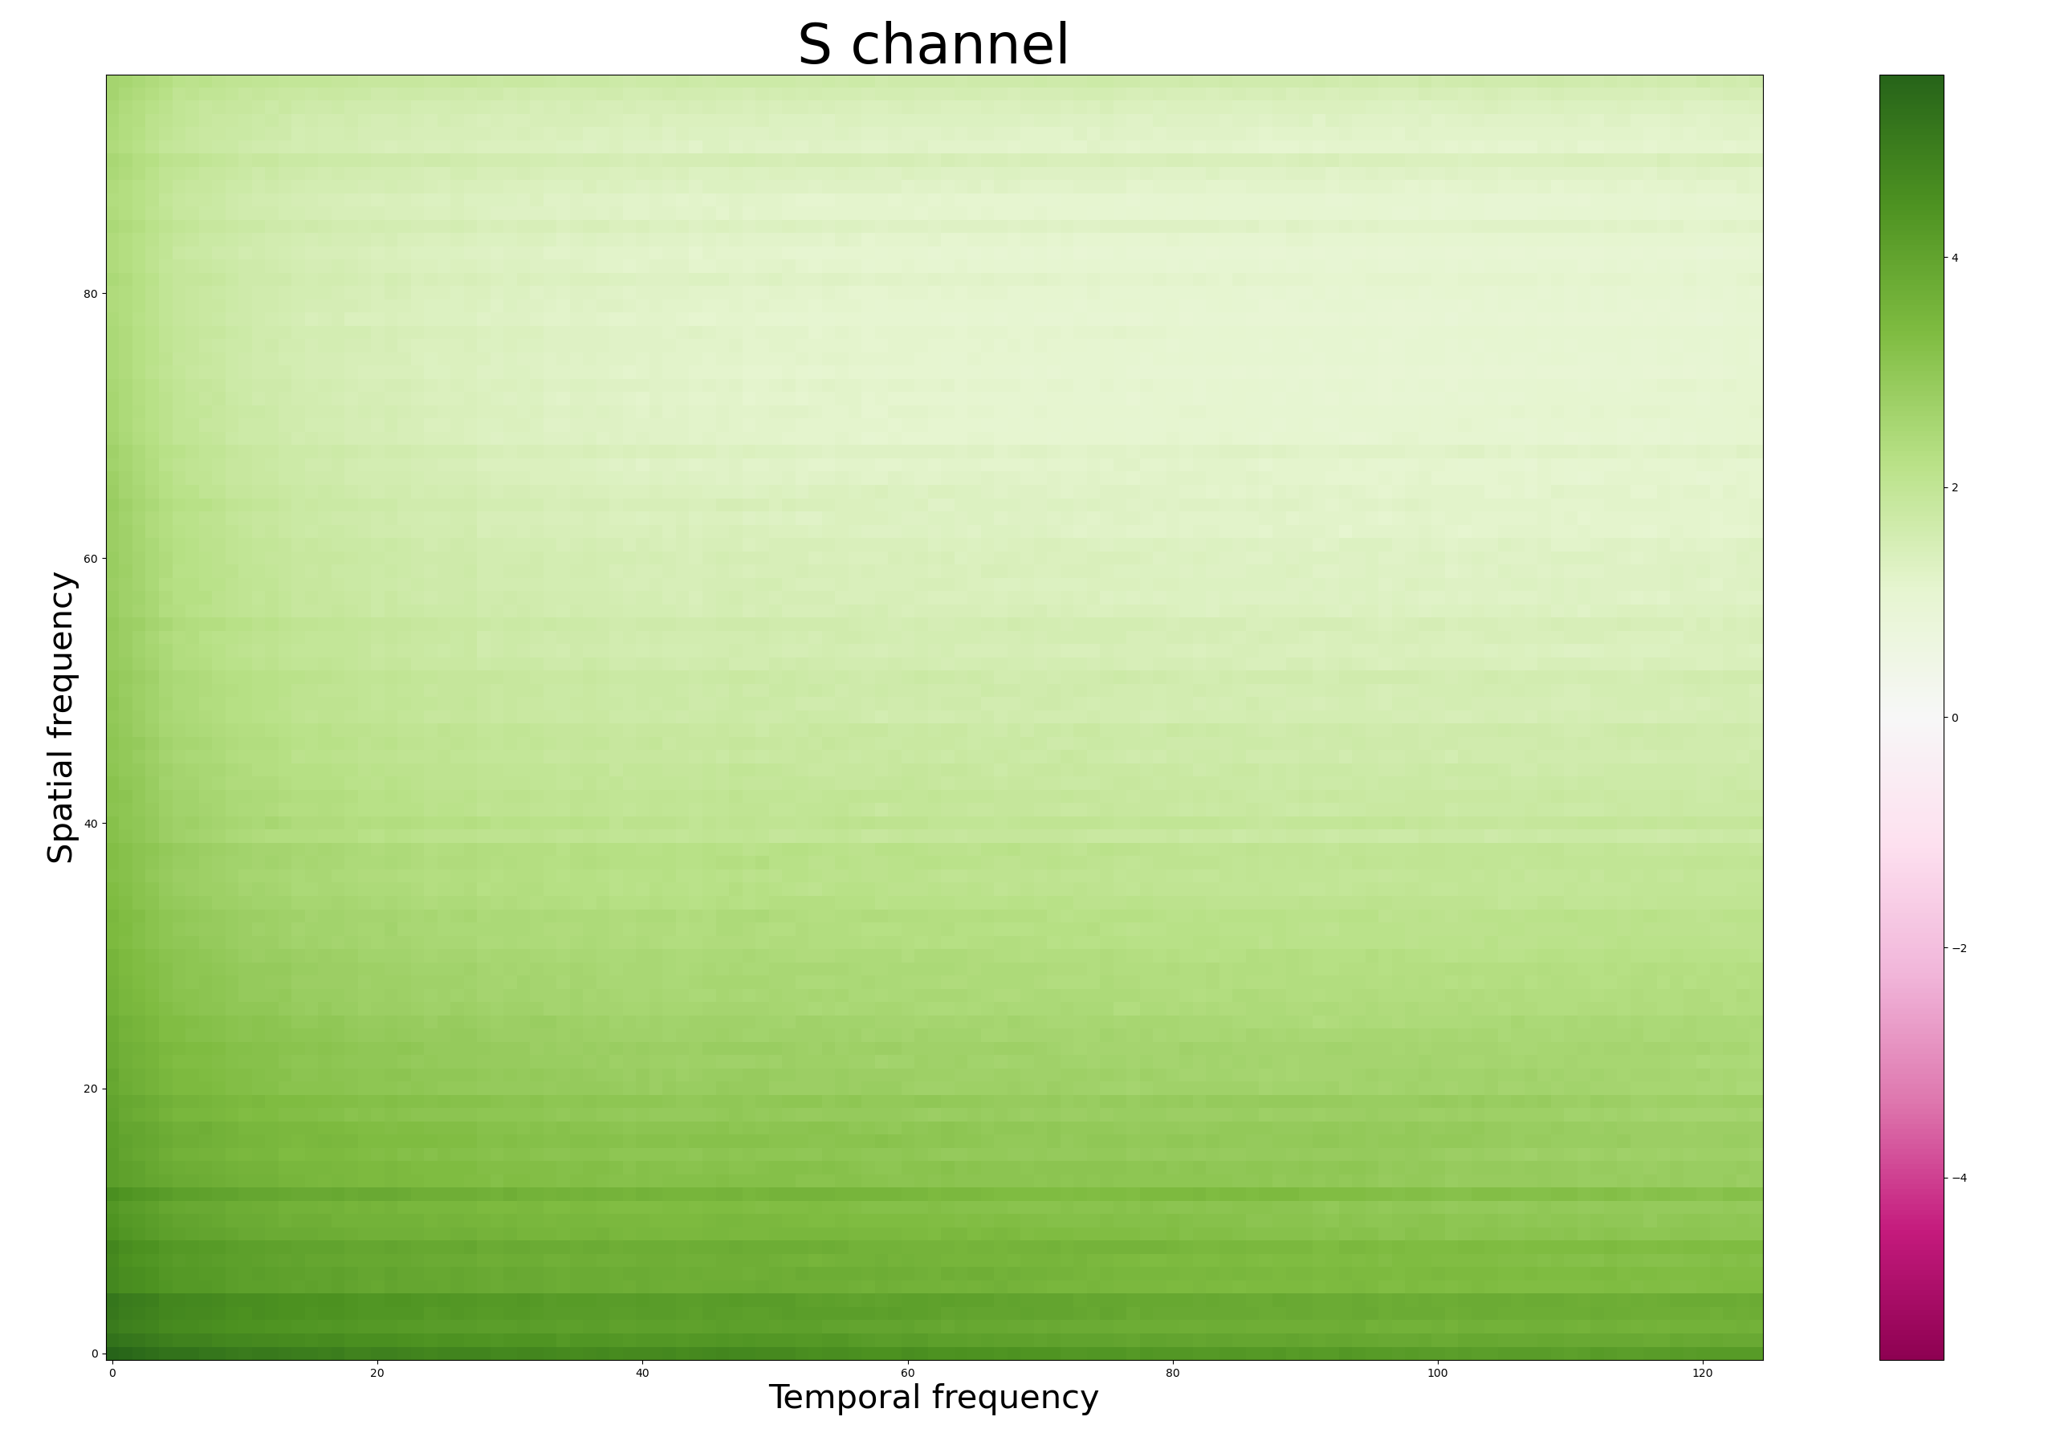
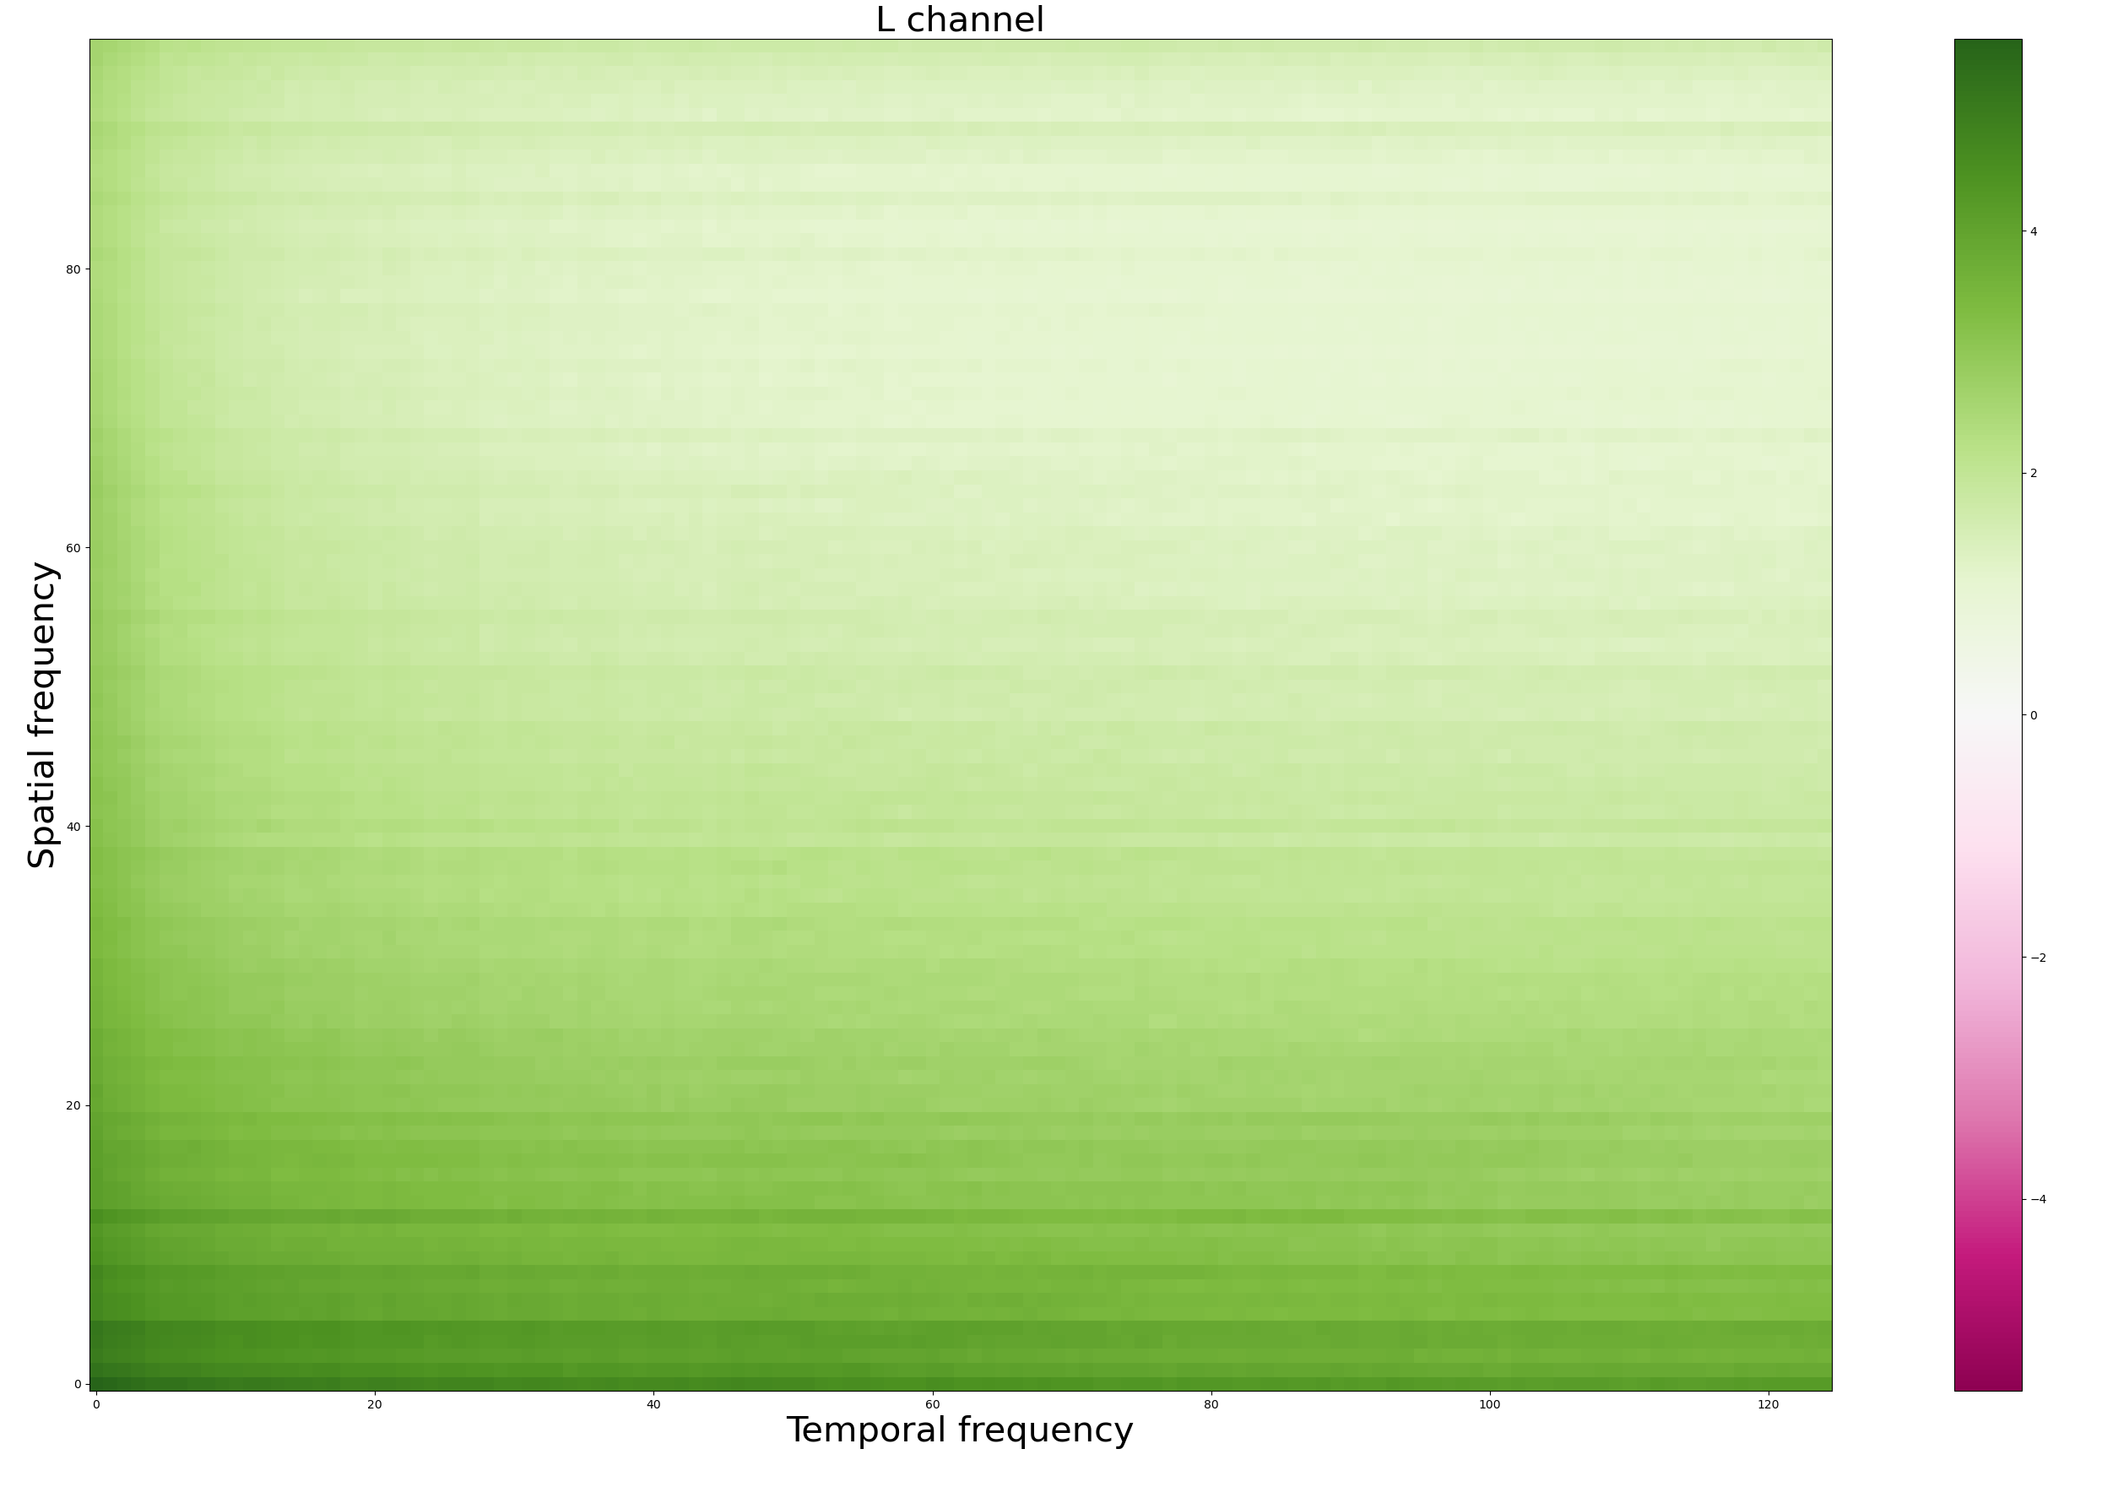
What the diagonal elements look like
Notes:
Bigger axis labels in future!!! Numbers are too small

Slide 8
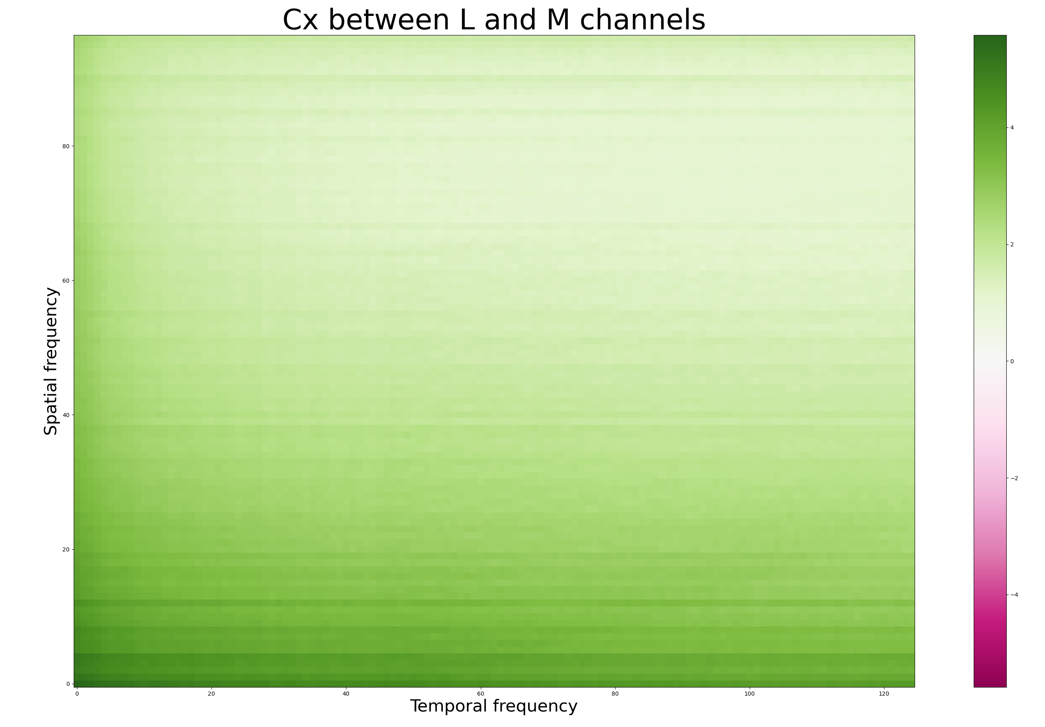
This is expected since L and M channels are very correlated

Slide 9
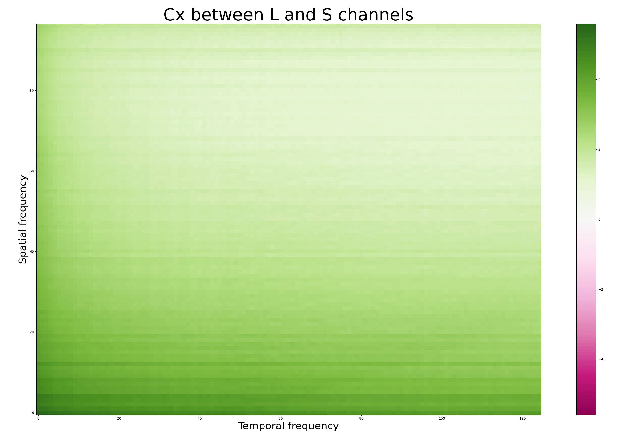
Also expected since L and S channels are also quite correlated

Slide 10
Eigen decomposition
Next step:
Compute general eigenvectors/eigenvalues for each 3x3 matrix.
First eigenvector: L + M + S (> 99.99999% of variance)
Second eigenvector: L + M – S
Third eigenvector: L - M
Notes:
John: This is not the same thing as saying 99% of the variance because it’s a generalized eigenvalue problem.

Slide 11
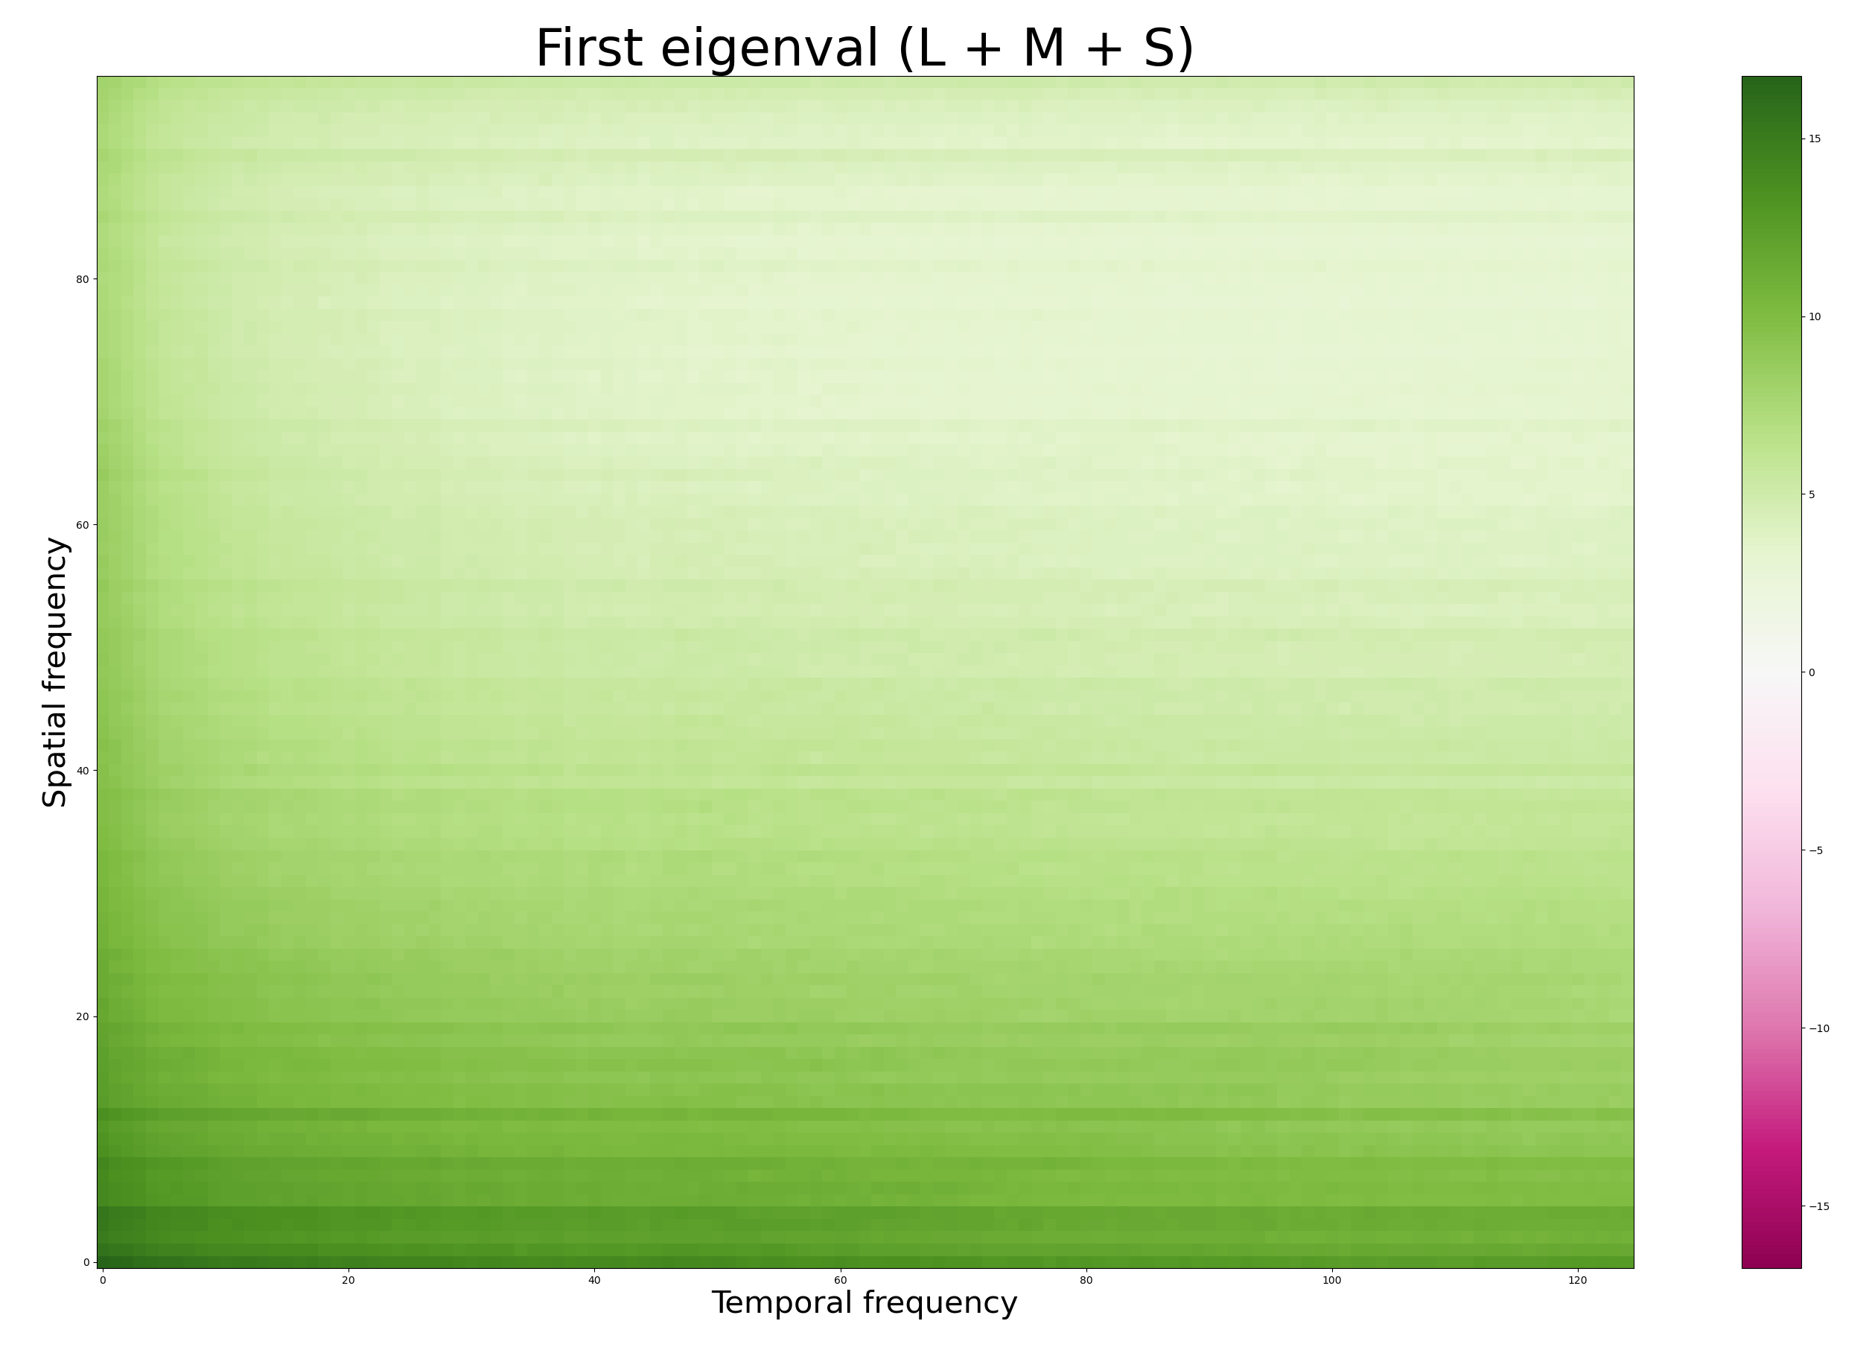
Notes:
John: Need to take the complex conjugate of one of the Fourier when I compute Cx.
Greg: Using a diverging colormap is useless here because all eigenvalues are positive.
Need to separate the eigvects better.

Slide 12
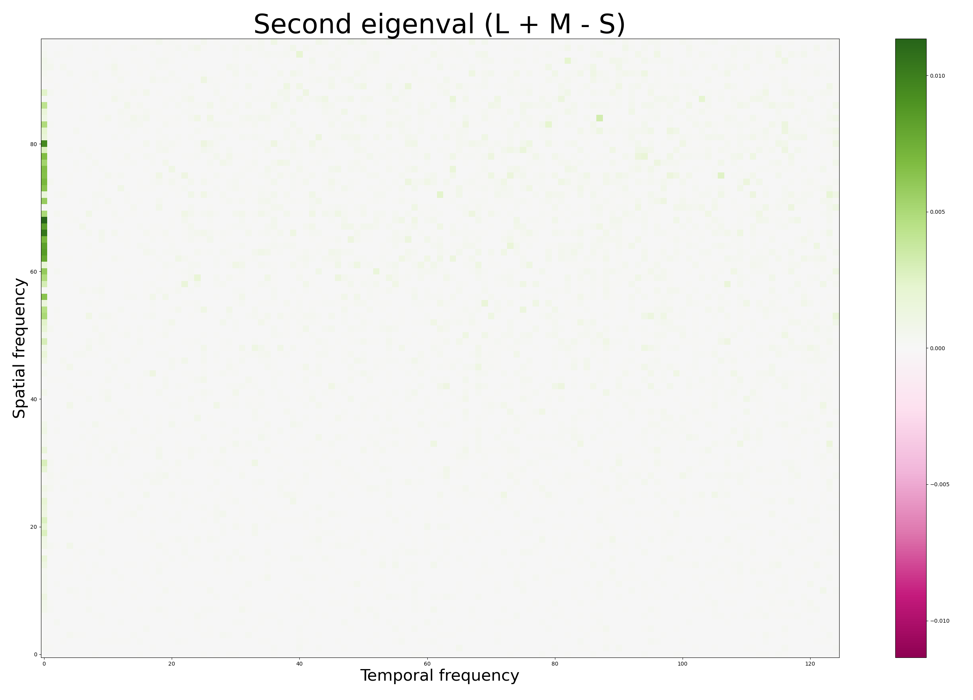

Slide 13
