Slide 1
Spatial filters with empirical Cx

Slide 2
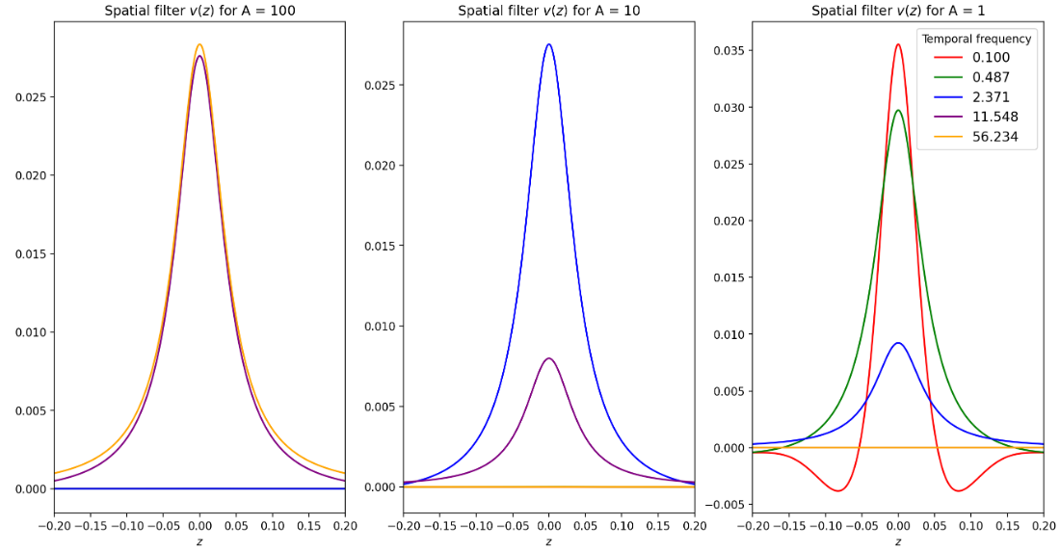
Spatial filters with theoretical Cx

Slide 3
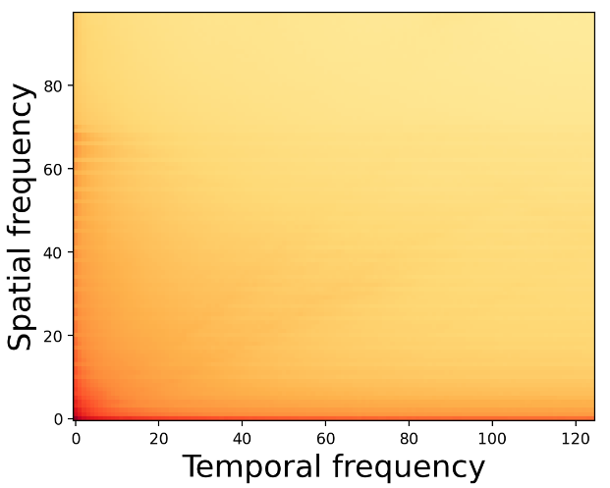
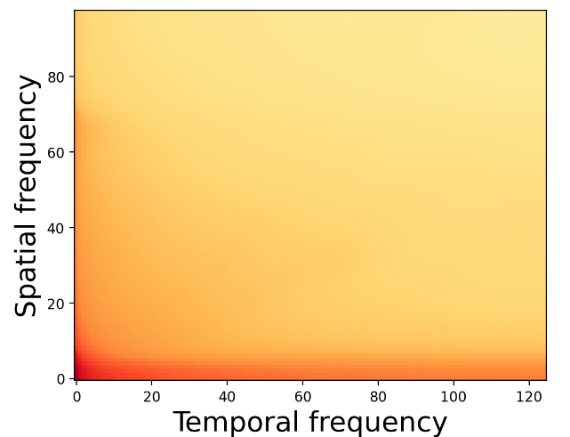
Applied gaussian filter to smooth eigenvalues
->
This smoothing is needed because assumption of radial symmetry is not perfect – more power along low x or y frequencies.
Notes:
Make this plot in 1D at specific temporal frequencies. To see how much power changes as a function of spatial frequency for each temporal frequency, before and after smoothing.

Slide 4
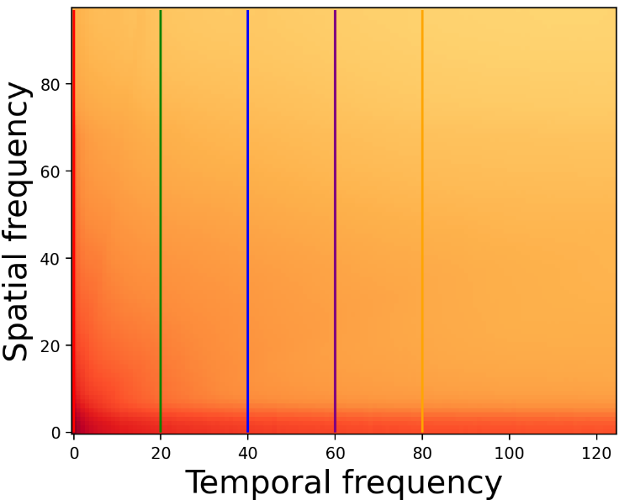
Empirical eigenvalues of Cx
First eigenvalue
Notes:
Go back and check I am solving the generalized eigenvalue problem correctly.

Slide 5
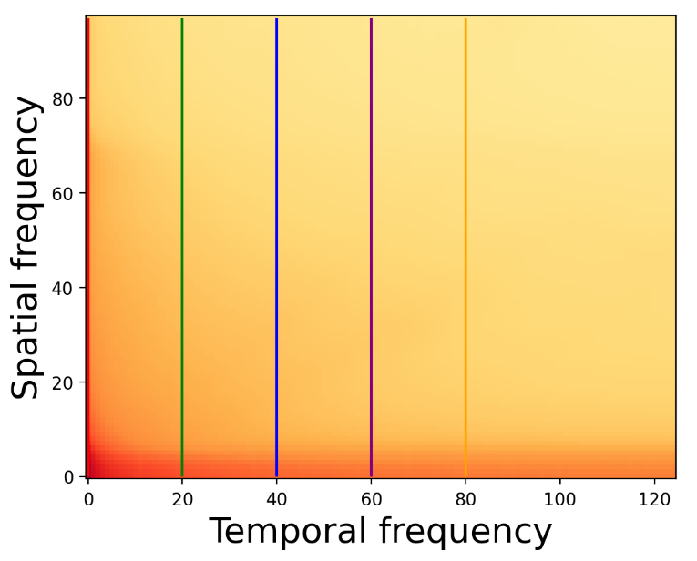
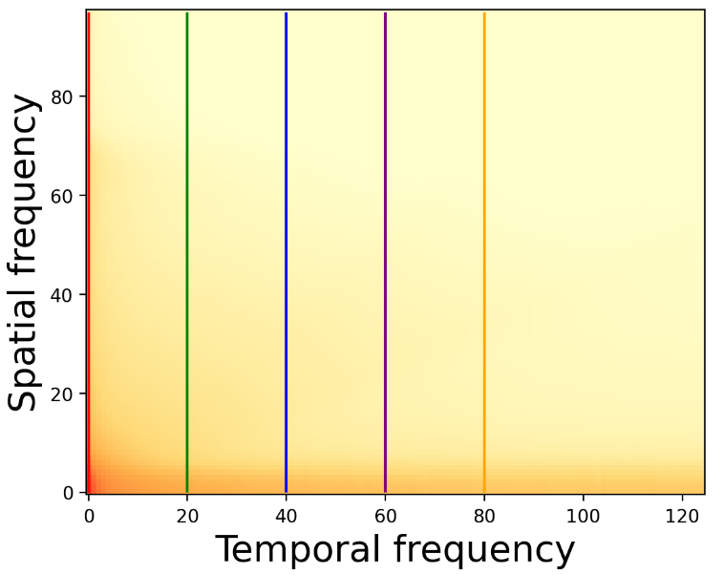
Empirical eigenvalues of Cx
Second eigenvalue
Third eigenvalue
Notes:
We want to see the difference between these pairs, not the eigenvalues themselves! Contrast is really hard to see visually.

Slide 6
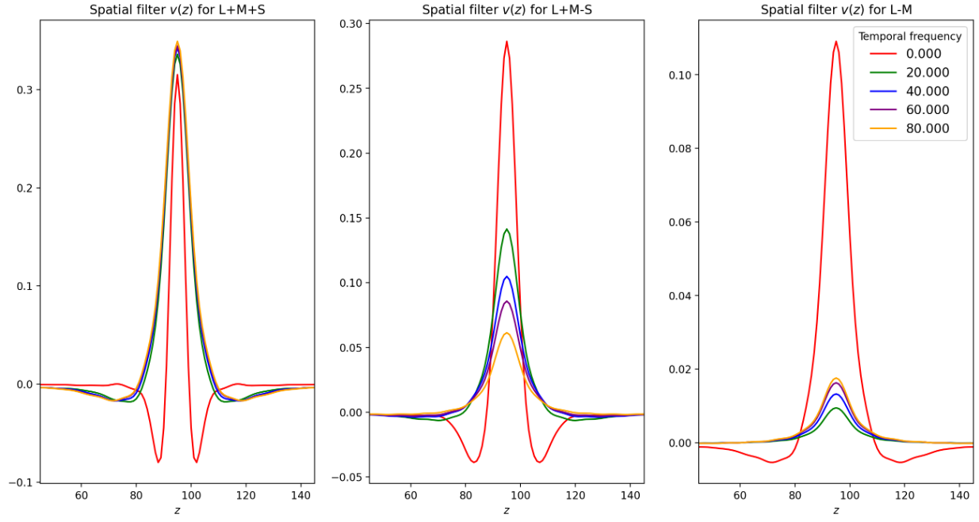
Spatial filters for three eigenchannels
I am concerned that we get different results than with theoretical Cx
Notes:
For plotting purposes, normalize within each eigenchannel. This is not what we’re going to do when we mix them back, its just for visualization purposes.

Slide 7
Observations
If we add these channels back together, we get both luminance, blue/yellow and red/green encoding at low temporal and high spatial frequencies. This somewhat aligns with the RF properties of midget cells.
At high temporal frequencies, we only get low spatial L+M+S. This aligns with the RF properties of parasol cells.
Interestingly, at low temporal frequencies, L+M+S has higher spatial frequency than L-M.

Slide 8
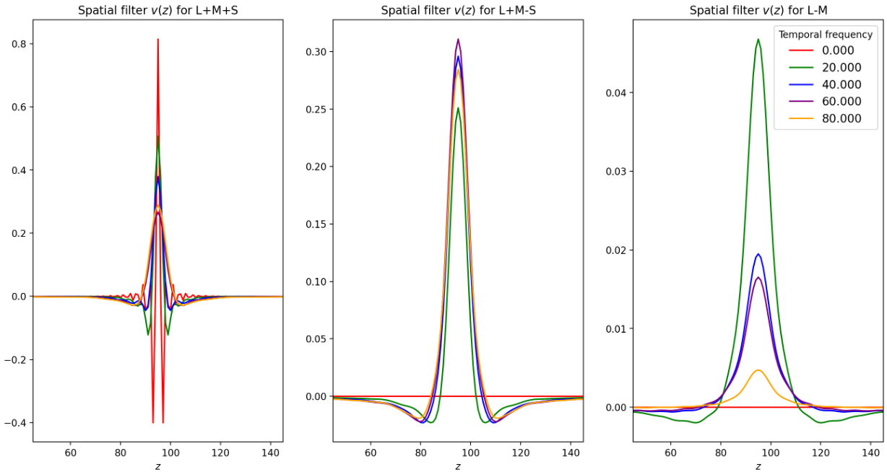
Results are not unit-invariant.
If I multiply the eigenvalues by a constant:

Slide 9
Next steps
Do the same for temporal filters
Add these eigenfilters together to get LMS filters.

