Slide 1
Advantages Linear treatment of our EC model
Guaranteed to find global minimum
Trains faster
Mathematical intuition behind our results (e.g. Jun et al., 2022)
Linear treatment in the color case will give us an intuition as to why we should, or shouldn’t, recover color-opponency from first principles.
Disadvantages
Simplifying assumptions (radial symmetry, convolutional filters, etc)
Output function is linear – no distinction between ON and OFF pathway

Slide 2
Strategy for linear filter
I’ll try to explain it to wrap my head around it

Slide 3
Orthogonal space-time filters
A key result from the theoretical section of Jun et al. (2022) is requiring RFs to not overlap in space-time is sufficient to optimize MI (under a power constraint).
However, this doesn’t mean that the same will be true for space-time LMS filters.
To solve this issue, we optimize “eigenchannels” (which we know are orthogonal), then revert them back into regular LMS space-time filters.

Slide 4
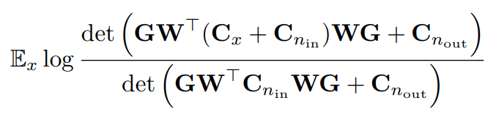

Step 1: Convert the training objective into Fourier Space
Assumptions:
- RFs are radially symmetric convolutional filters
- Infinite neurons
->
Notes:
Mistake: The right hand side is what’s inside the determinant, not the objective itself!

Slide 5
Step 2: Find generalized eigenvalues for Cx
Cx is the covariance matrix of LMS natural movies in Fourier space.
Cx has shape (time x space x color x color)
This is because 1. We assume correlation only vary as a function of (Euclidean) distance 2. because we assume radial symmetry.
For every spatial and temporal frequency, solve a generalized eigenvalue problem for the 3x3 LMS covariance matrix. This will return 3 eigenvalues, which represent the power in the L+M+S, L+M-S and L-M channels (empirical result).
Notes:
Mistake:
1. The reason why Cx is space x time is because Cx depends on time differences and spatial differences, not whats written above.

Slide 6
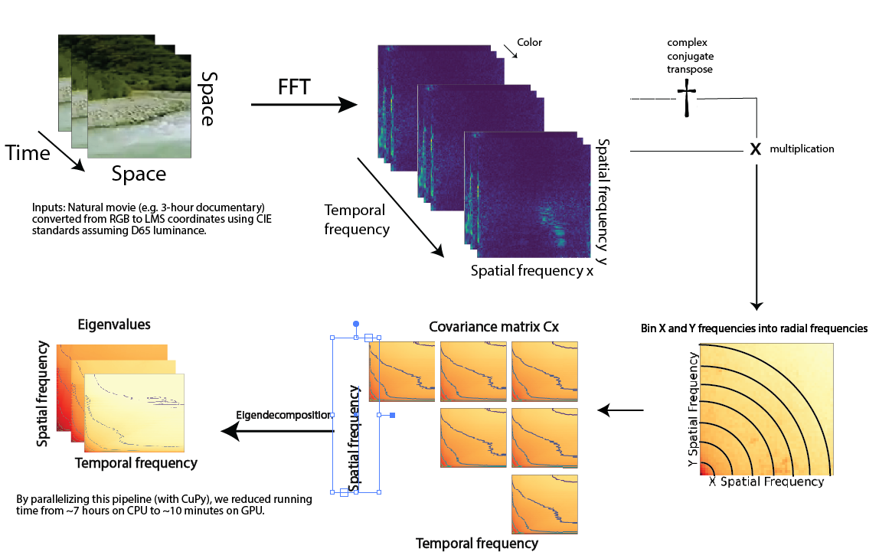
How to find eigenvalues of Cx

Slide 7
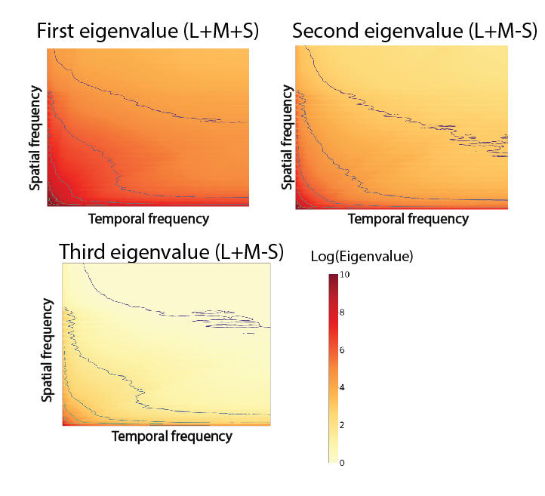
Three eigenvalues of Cx

Slide 8
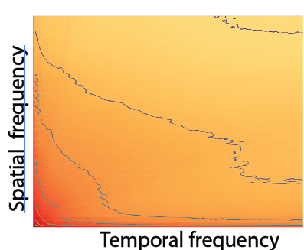


Step 3: Optimize the model to find nu (Lagrange multiplier for power constraint)
We have a closed form solution for MI, and a closed-form solution for Power.
Under the power constraint, choose a temporal (or spatial) frequency and find nu (for each eigenchannel) that maximizes mutual information.
Mutual information
Power constraint

Slide 9
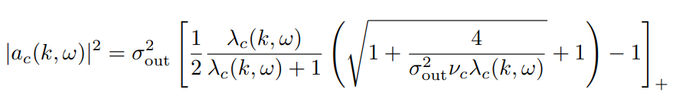
Step 4: Use nu to find optimal filters
For a temporal frequency omega, optimize the spatial filters in eigenspace:

Slide 10

Results
Assuming

Slide 11
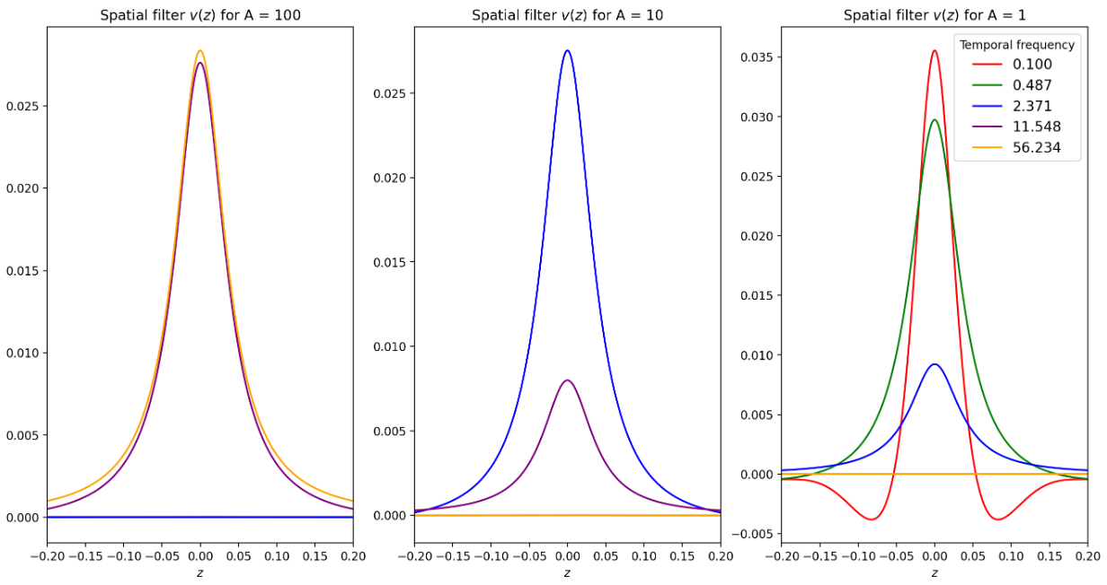
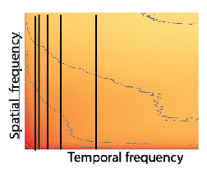
Spatial filters at different temporal frequencies
Filters at low TF have high SF, and vice-versa
Notes:
Color code the lines on the plot on the left!!! That would be it SO much easier to understand
Purple line looks red. Make sure I use the same color scheme for each plot.

Slide 12
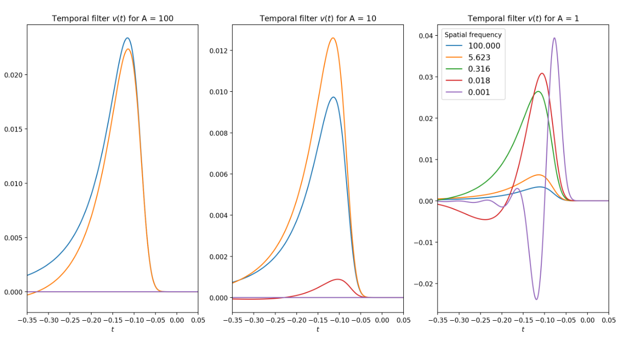
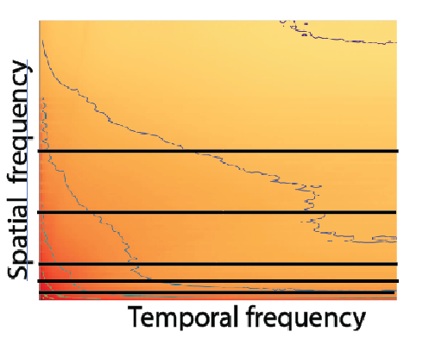
Temporal filters at different spatial frequencies
Filters at low SF have high TF, and vice-versa

Slide 13
Step 5: Go back from eigenspace to color space
“Reverse” generalized eigendecomposition to go back from eigenspace to color space.
Work in progress…
Hopefully it’ll be done very very soon (fingers crossed)

