Slide 1
Outline for today
2-color channel now gives proper mosaics
Changes/Improvements to DoG fits
Correlated noise experiment
Re-analyzing 3 channel experiment

Slide 2
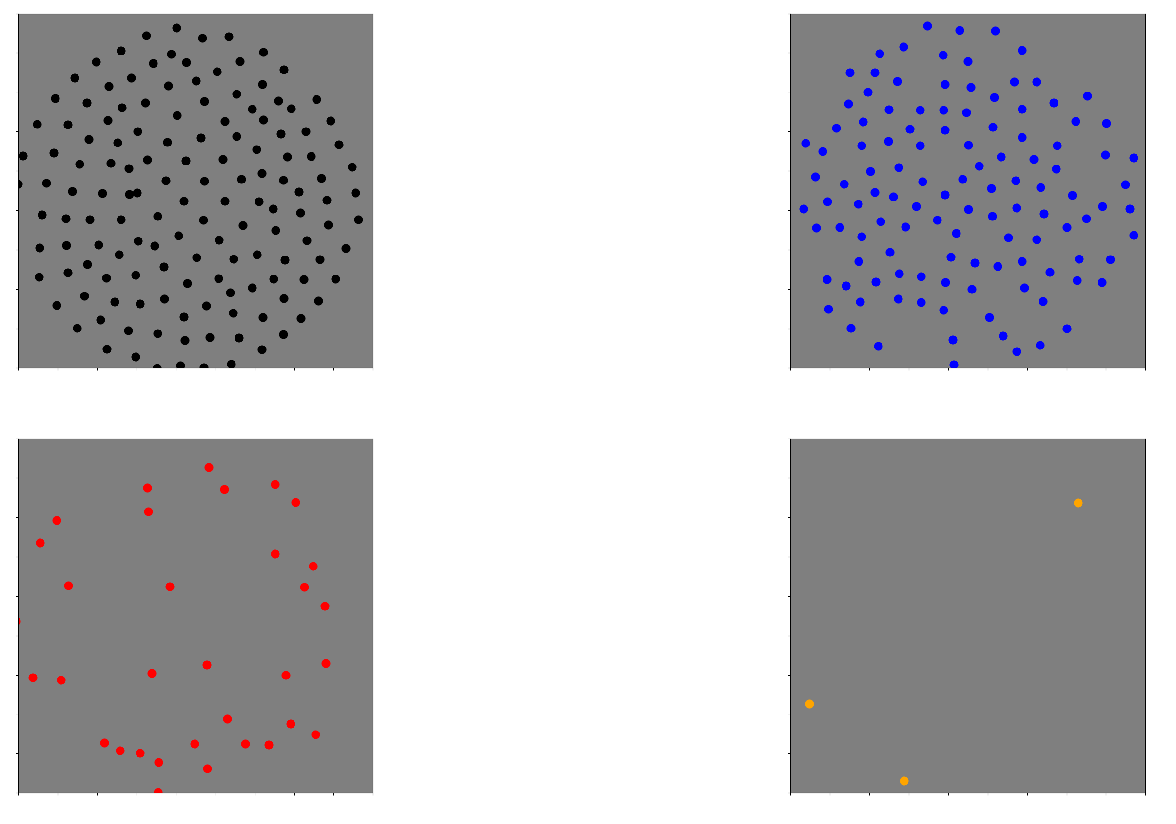
Before: 2-channel mosaics

Slide 3
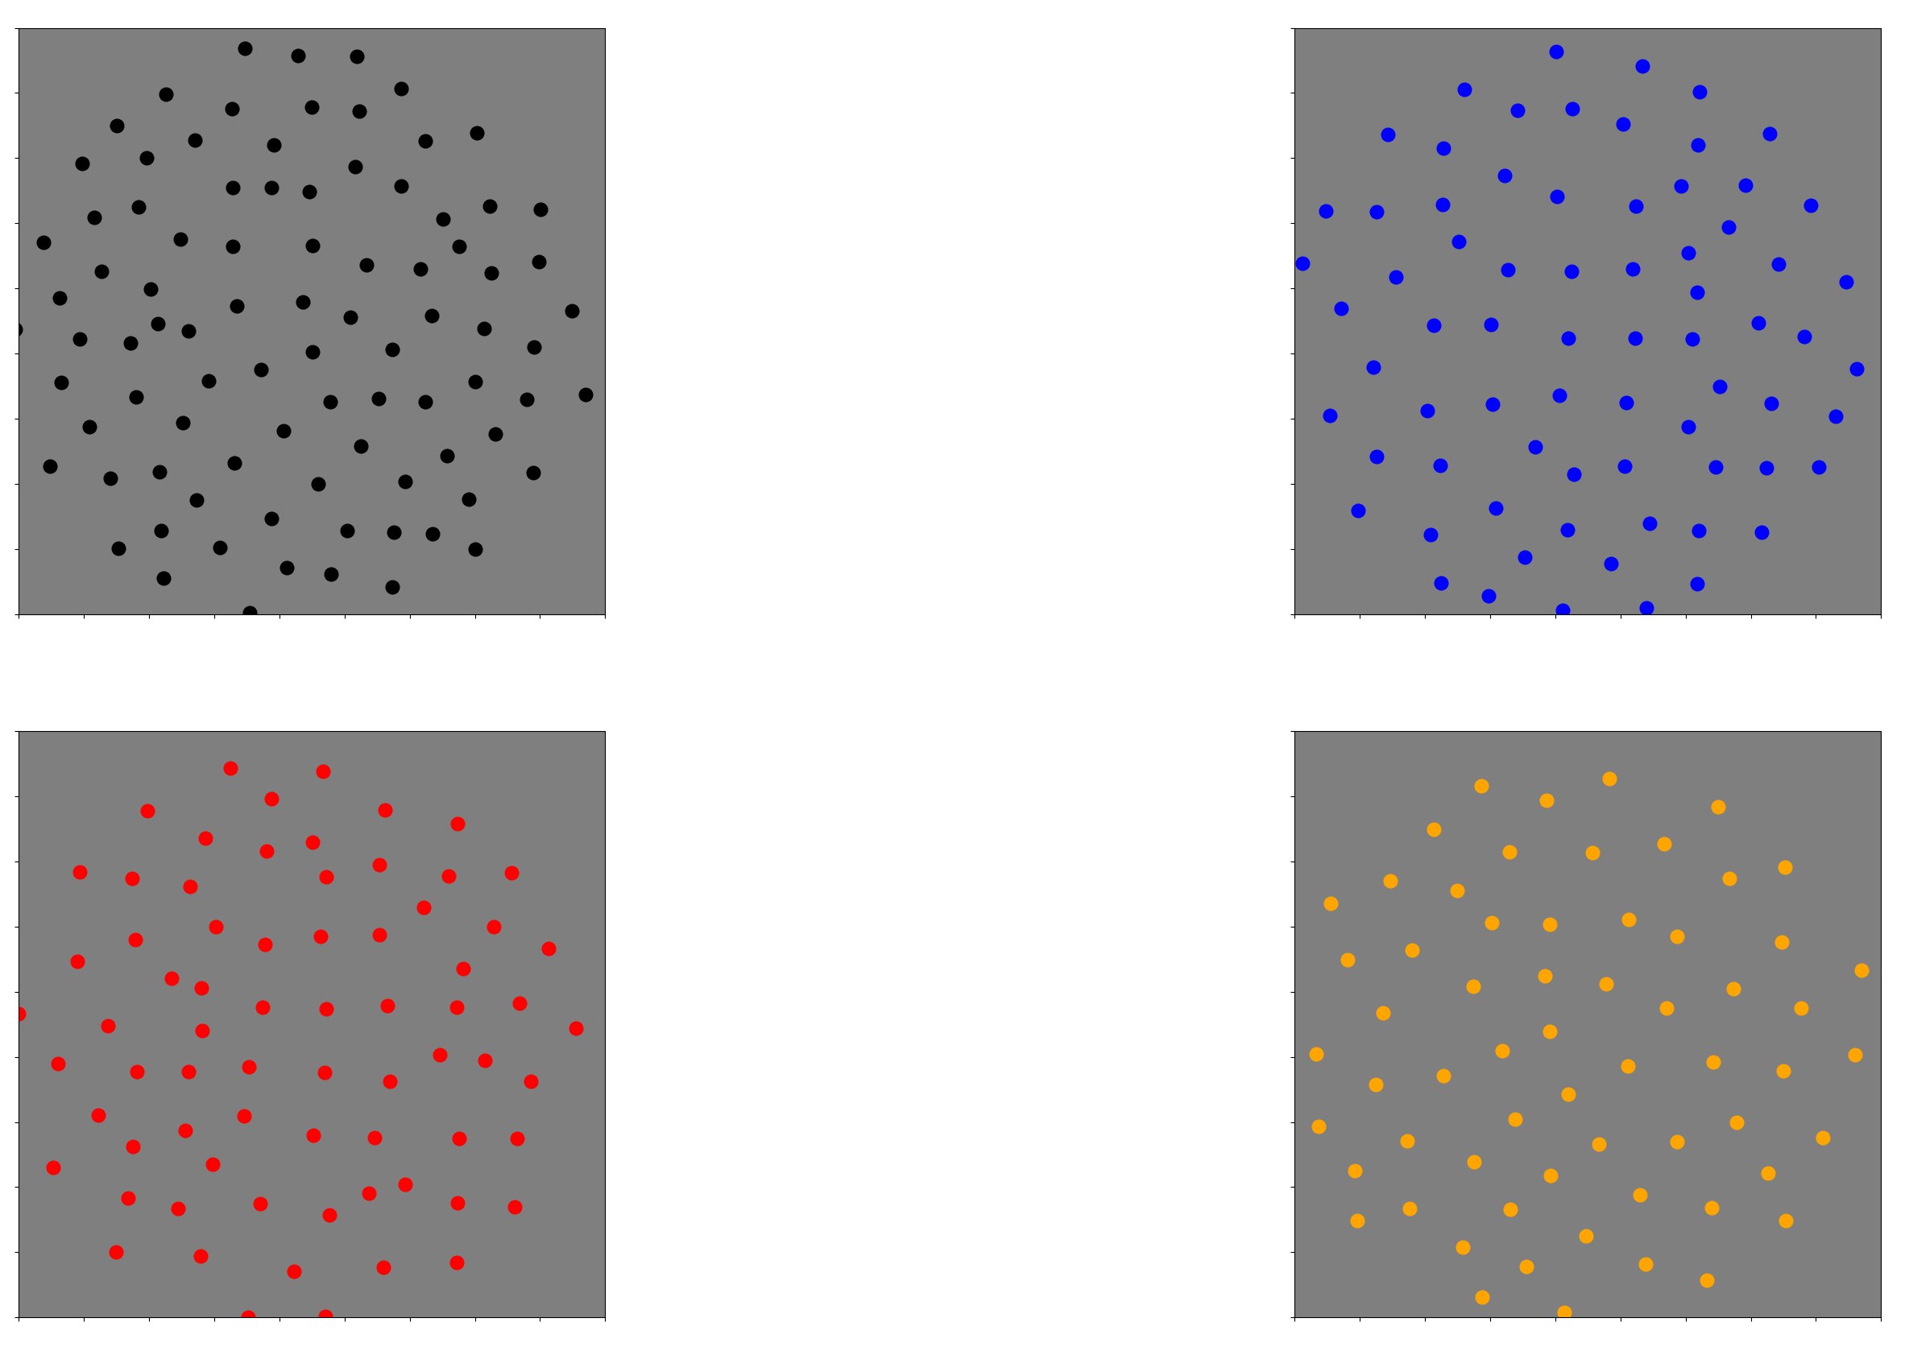
Now: 2 channel mosaics
'240301-055438'

Slide 4
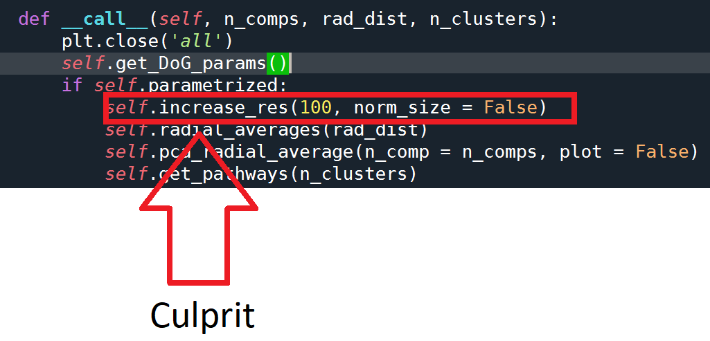
What changed?

Slide 5
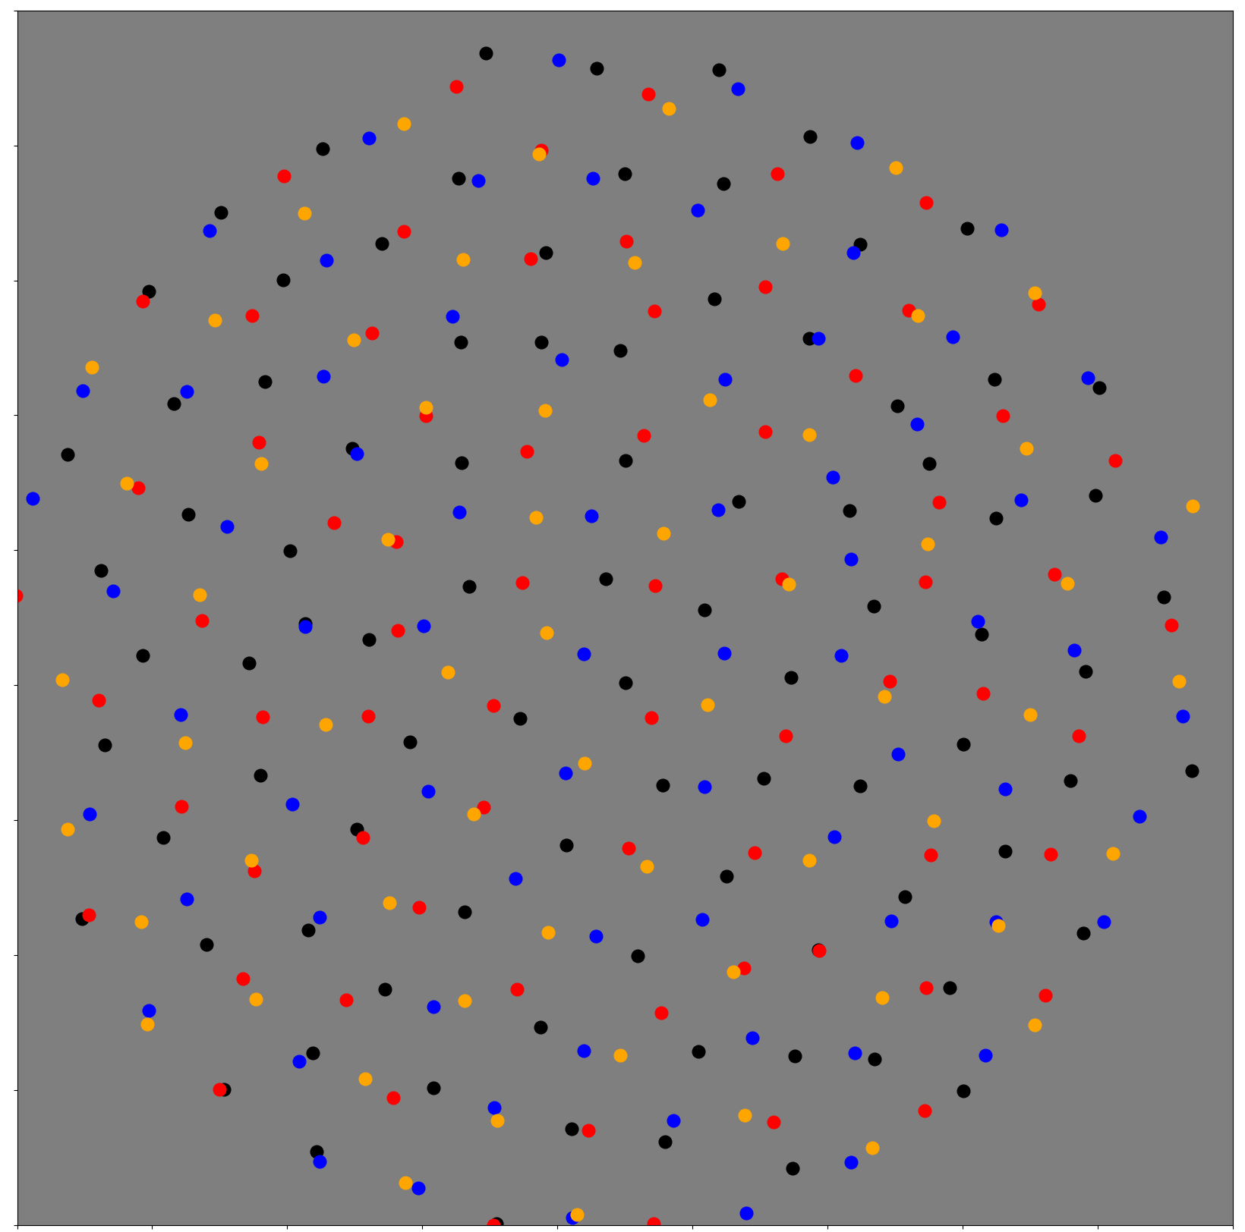

Slide 6
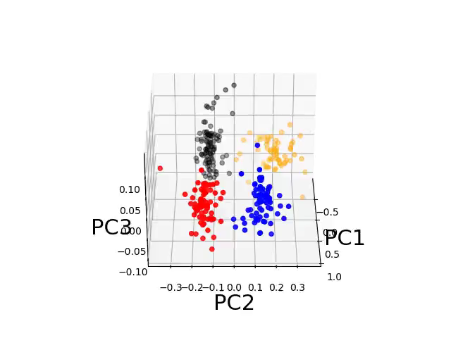

Slide 7
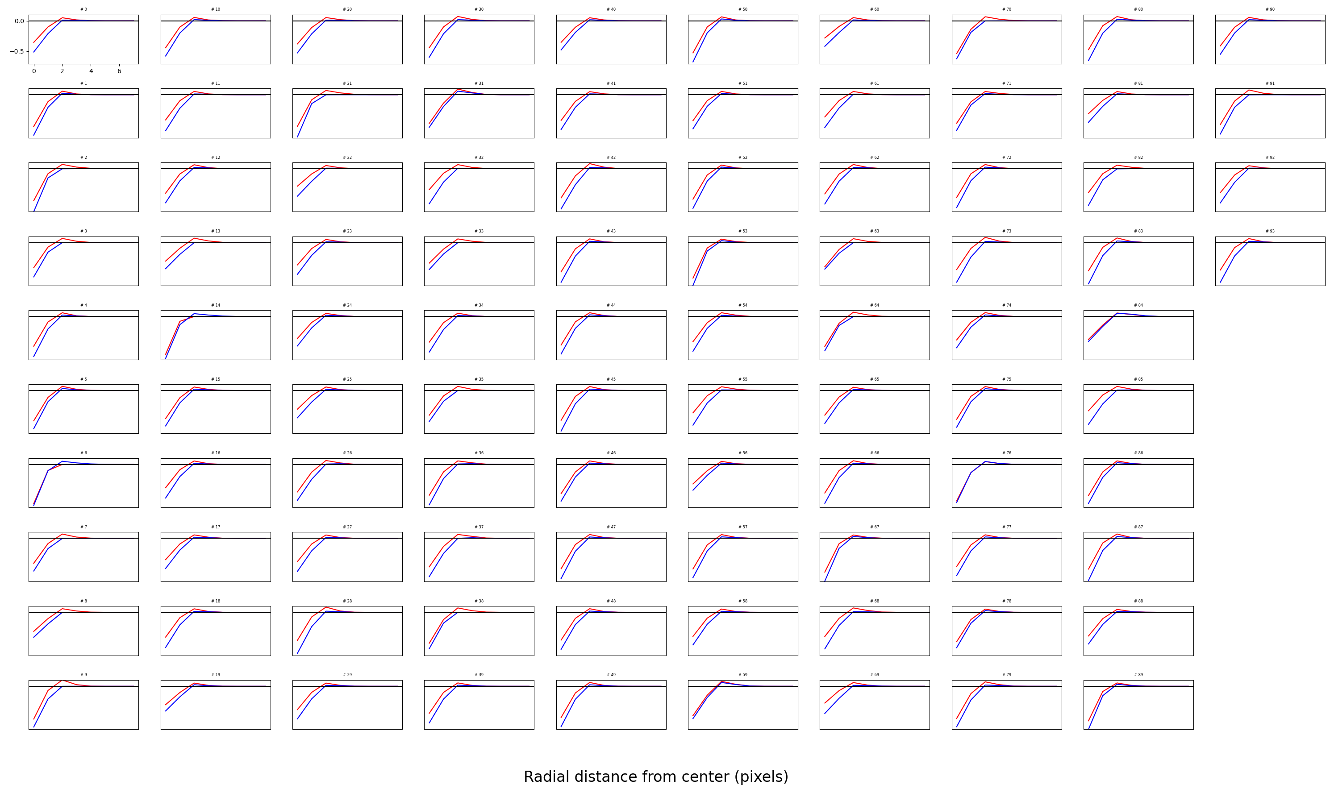
OFF parasol

Slide 8
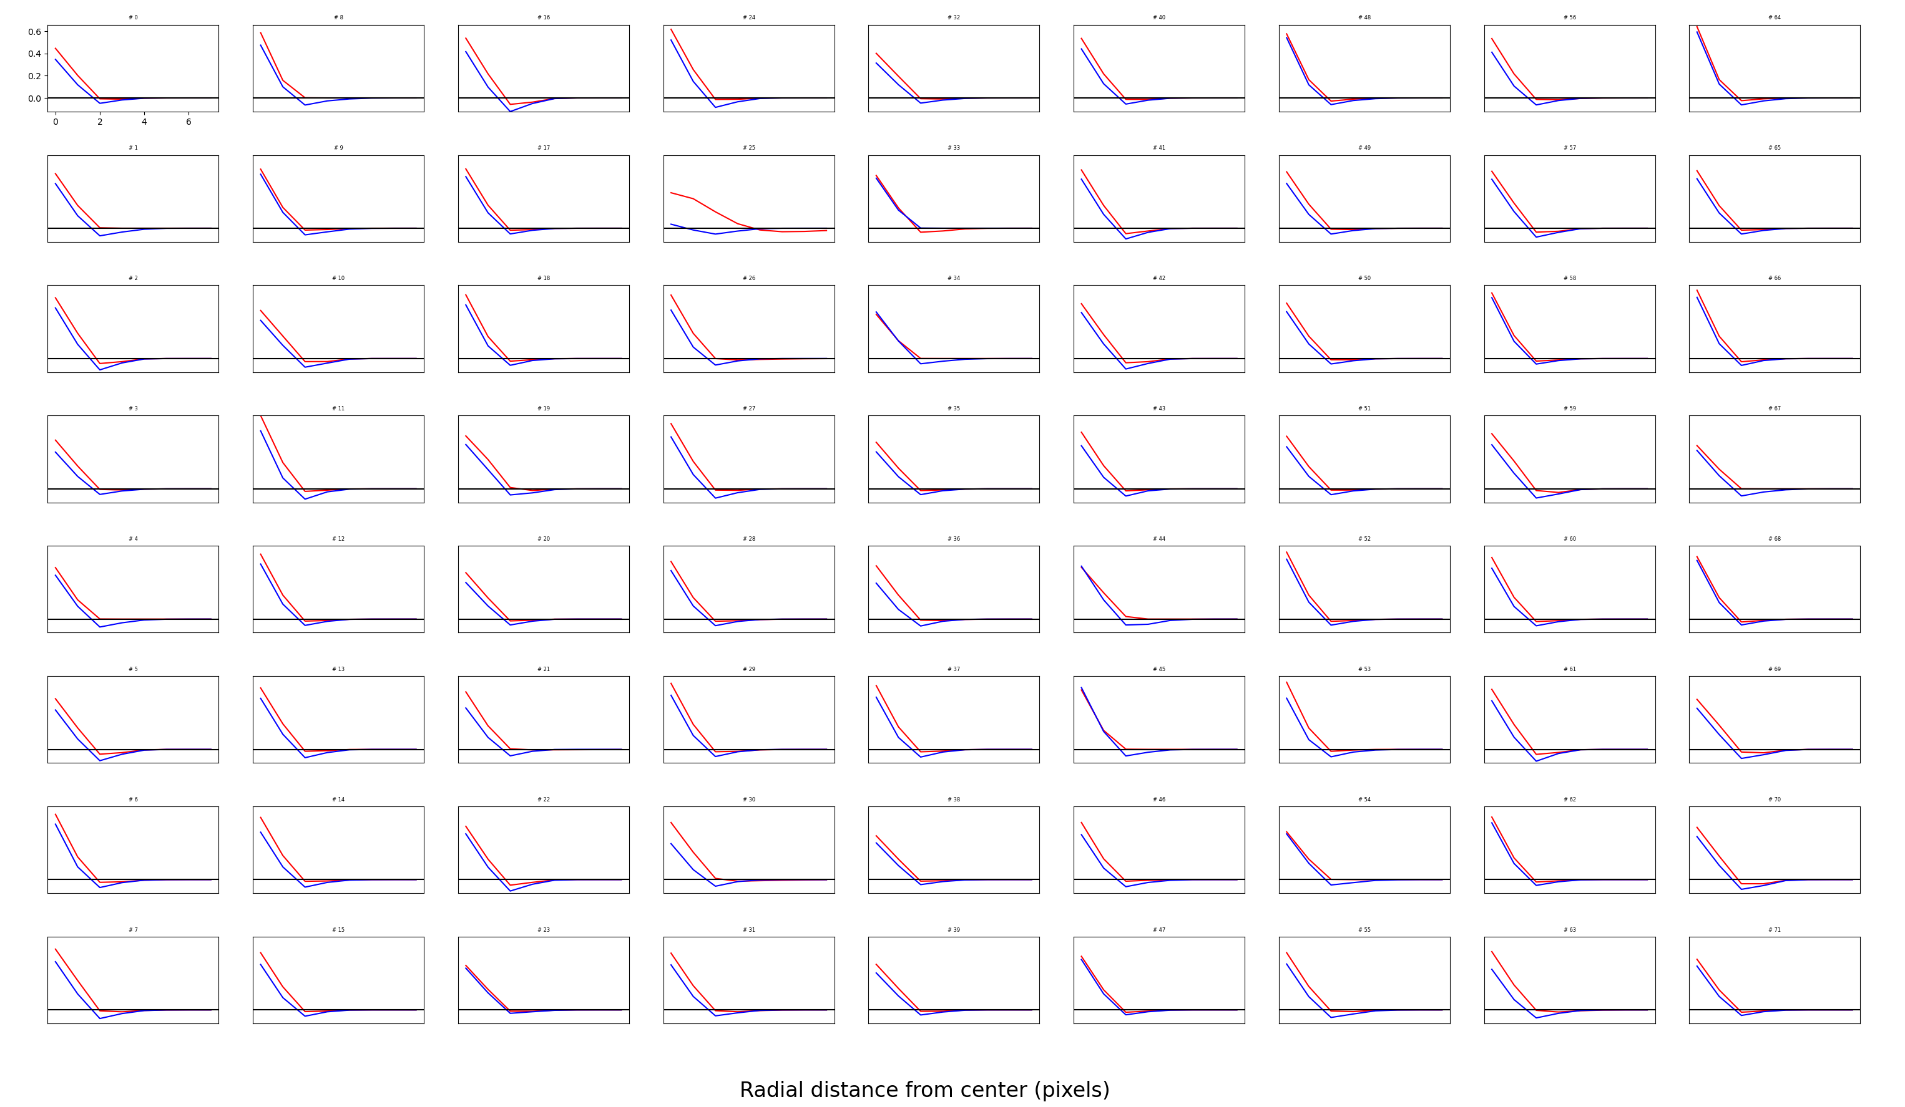
ON parasol

Slide 9
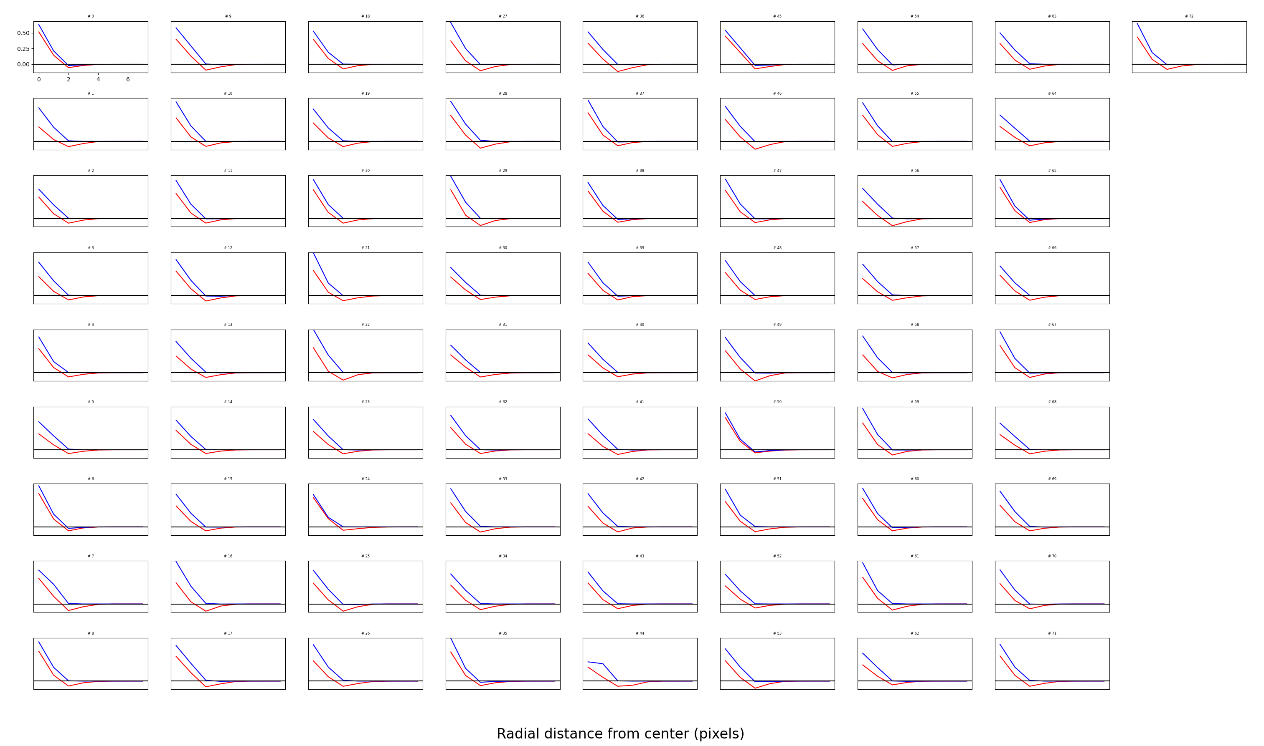
ON pathway #2

Slide 10
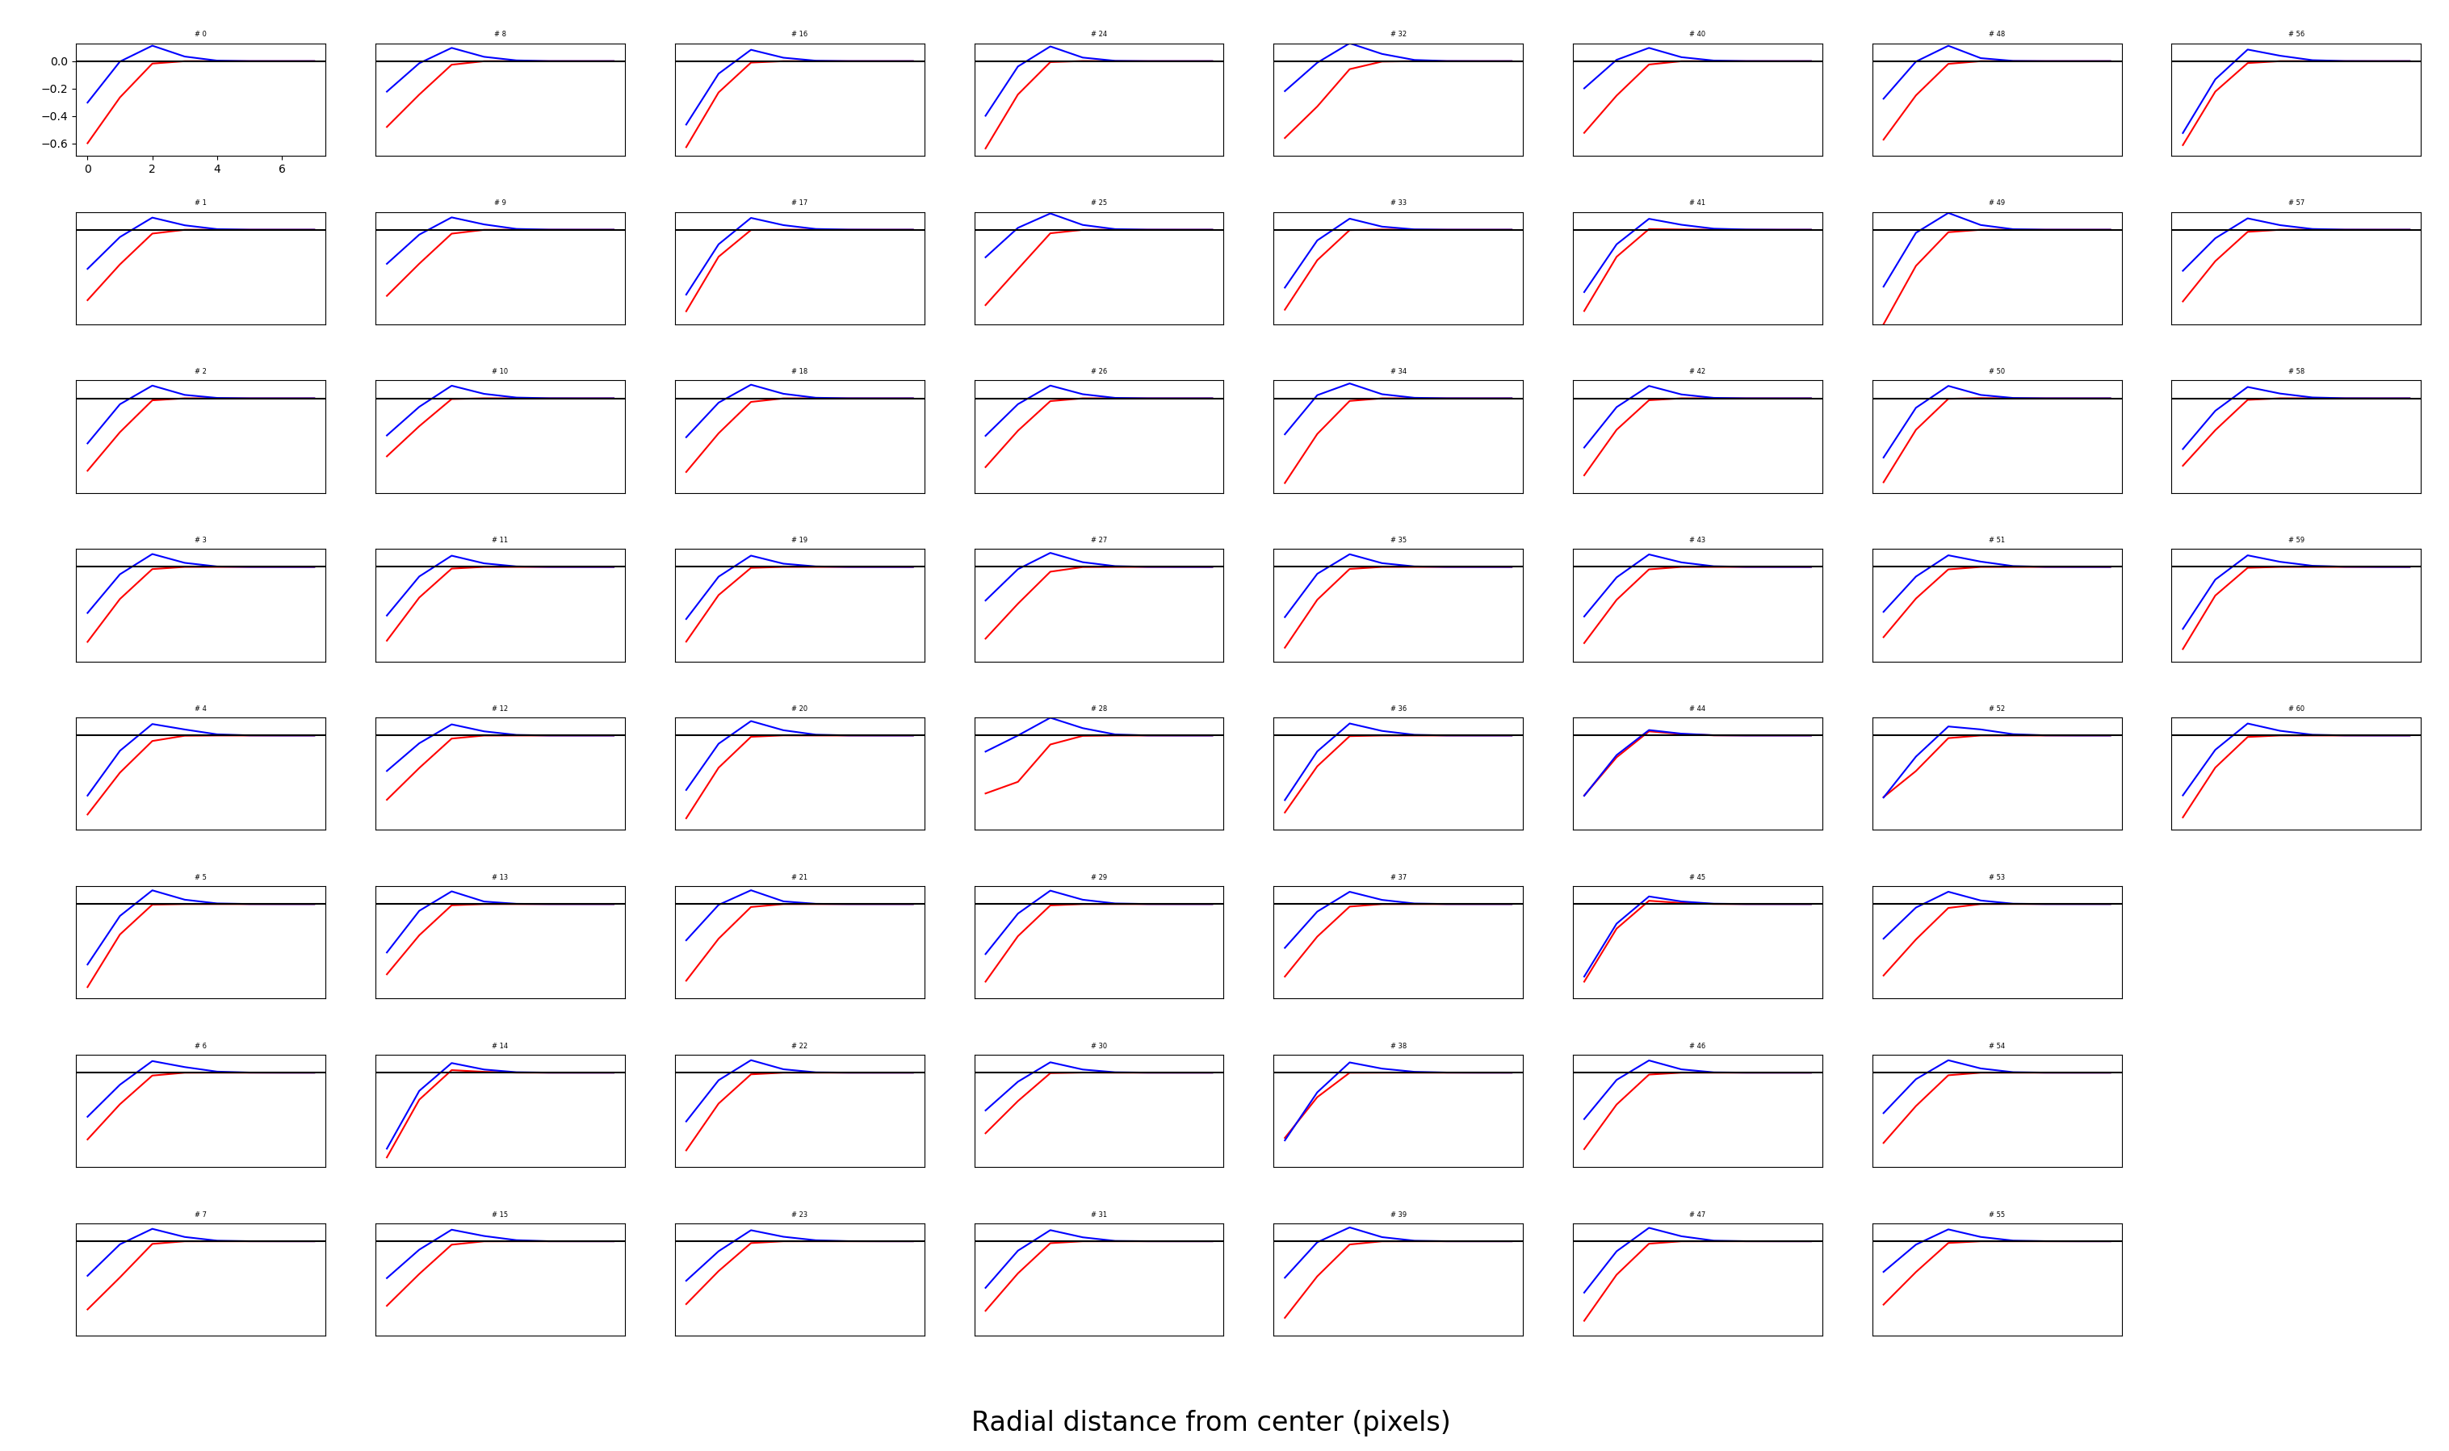
OFF pathway #2

Slide 11
Changing input and output noise
We get weak surrounds and weak color opponency: maybe we need to lower noise?
Original: Output = 3, input = 0.4
What you just saw: Output = 2, input = 0.2
What I’m about to show: Output = 1, input = 0.05.

Slide 12
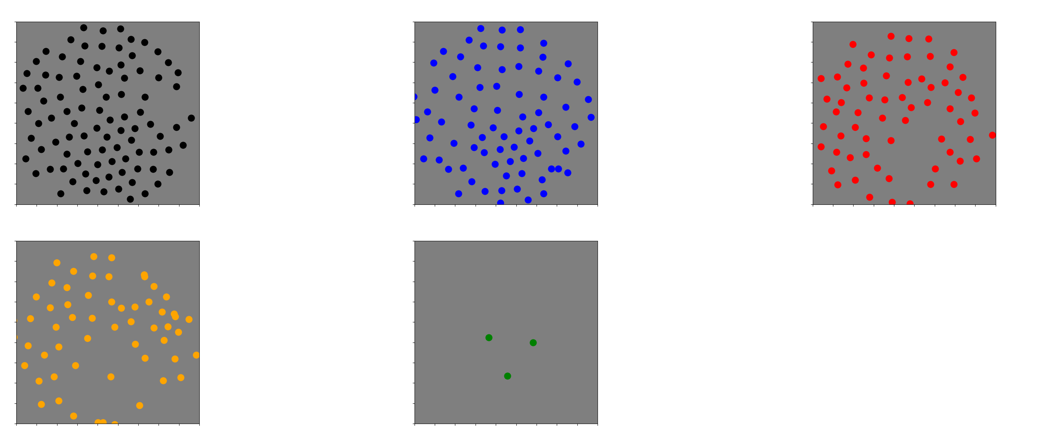

Slide 13
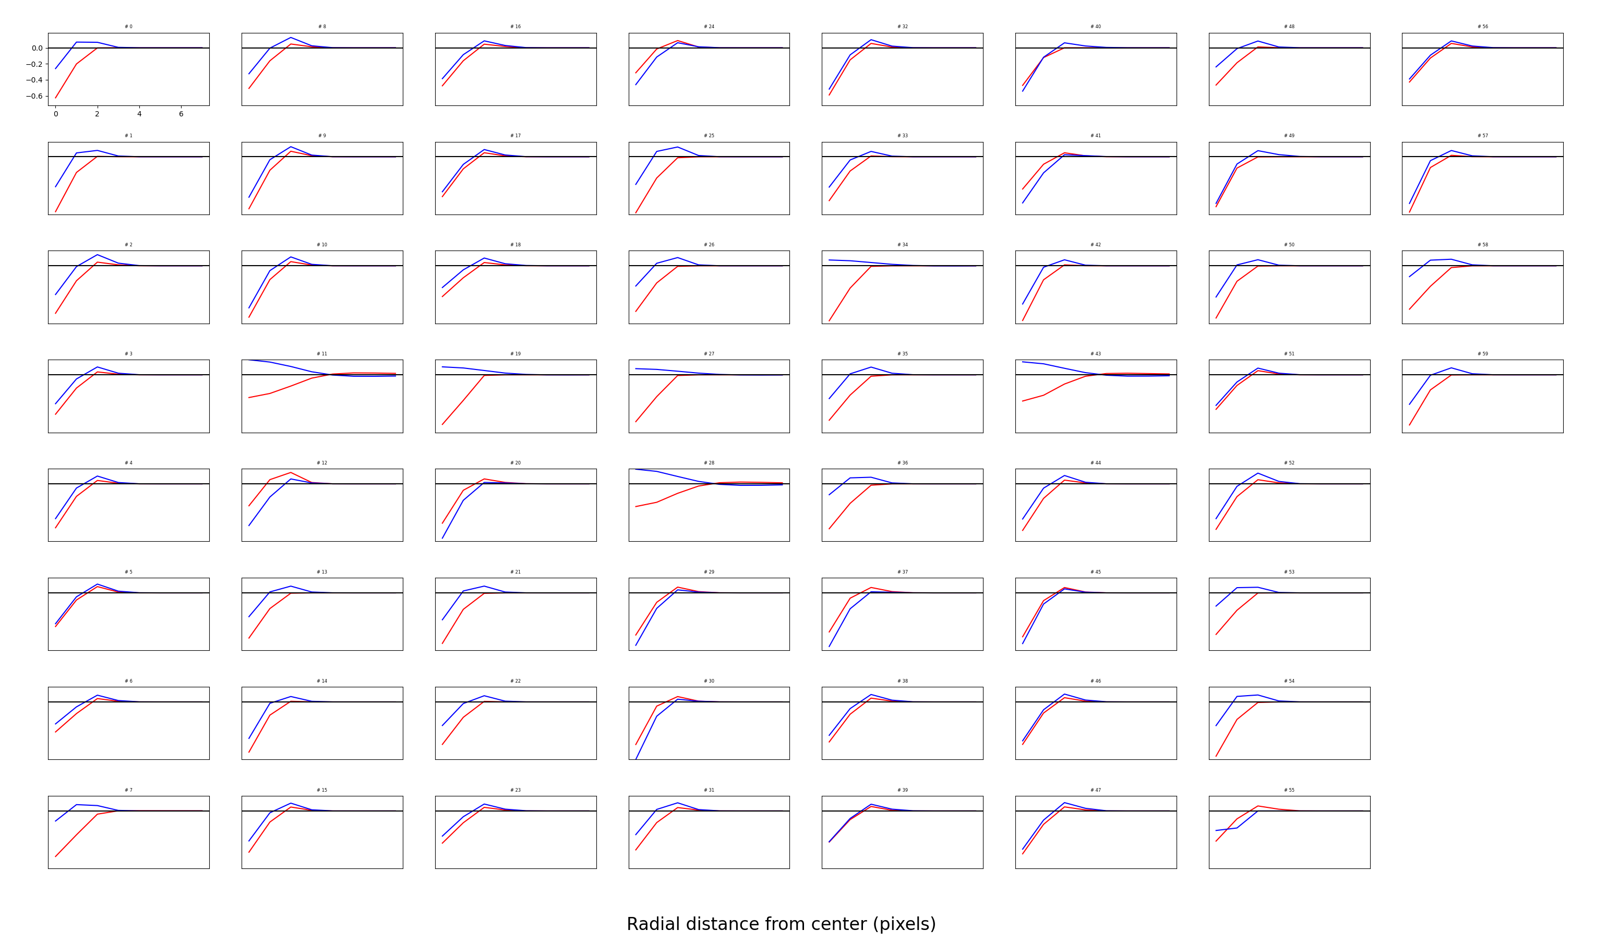
4th mosaic, quite a few opponent cells

Slide 14
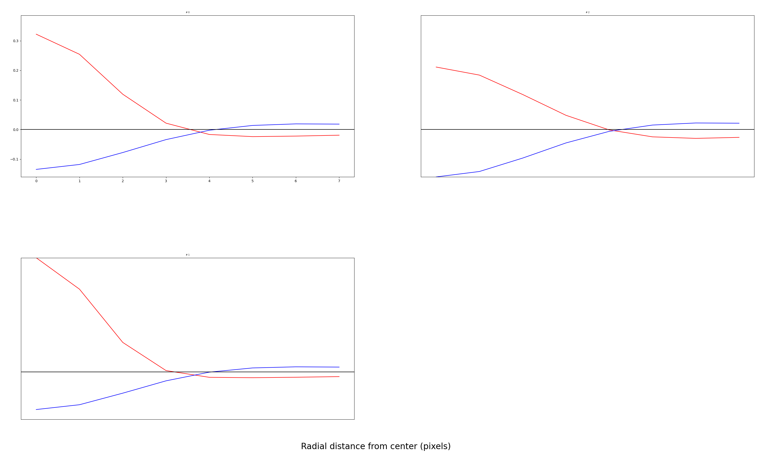
5th mosaic

Slide 15
Notes
Seems like I still need to lower noise to get more opponency
3 channels experiment still don’t make clean mosaics

Slide 16
Changes/Improvements to DoG fits

Slide 17
