Slide 2
Plan for today
Fitting DoG to RFs
Almost complete absence of –S RFs
Parametrized vs unparametrized mosaics
Does reducing LR at plateau improve mosaics

Slide 3
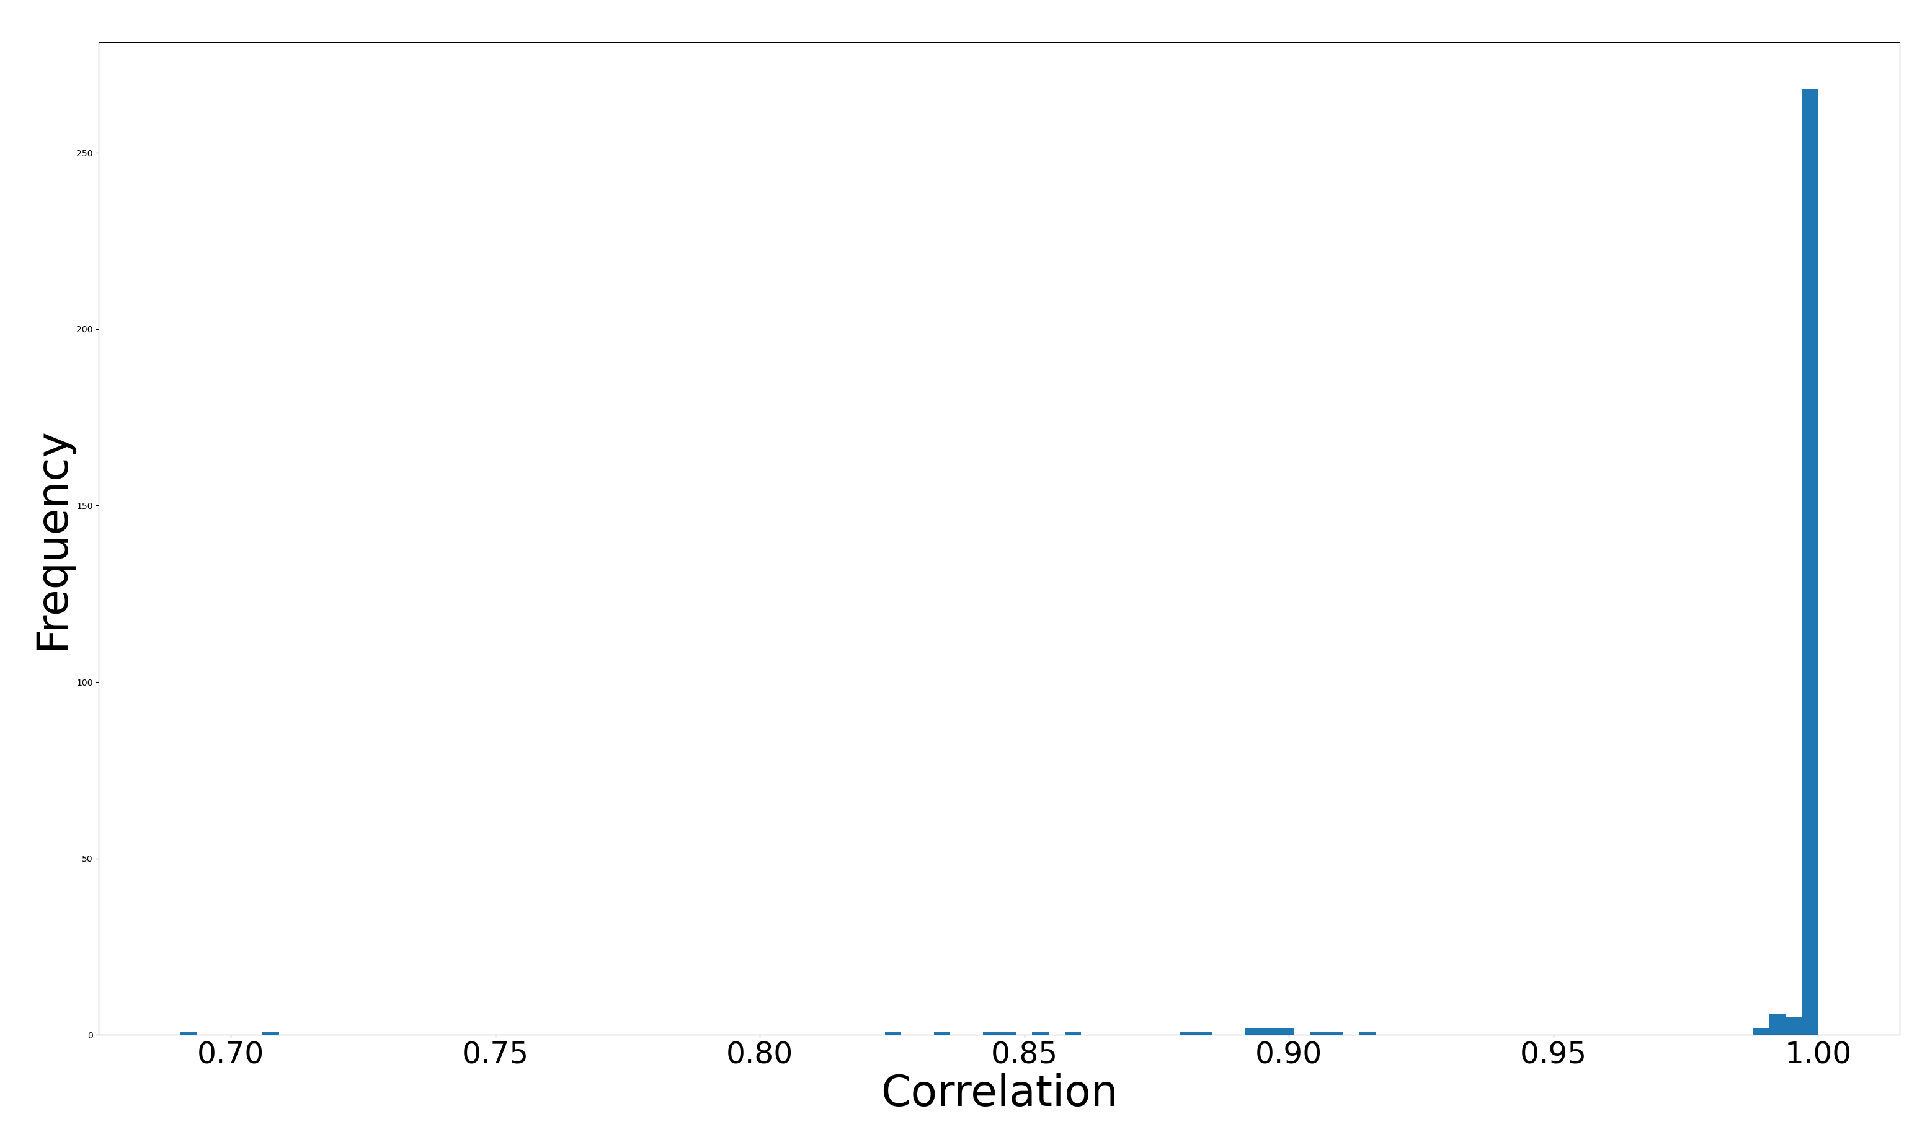
DoG fit to parametrized RFs

Slide 4
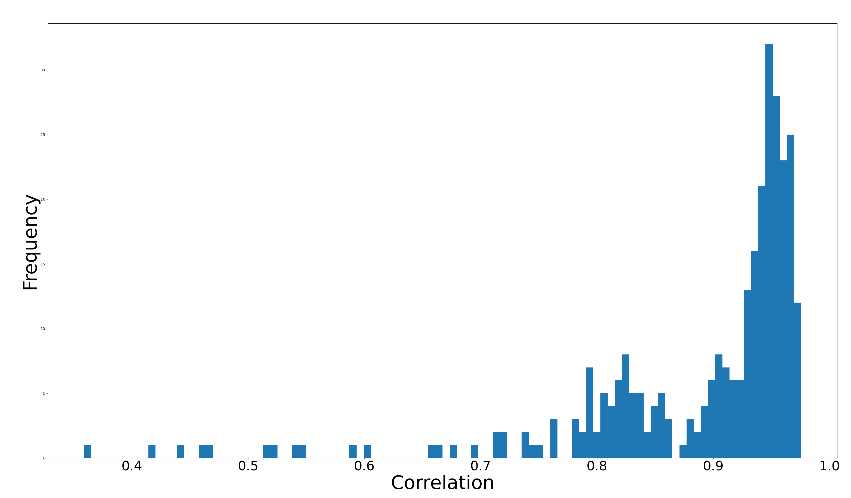
DoG fit to unparametrized RFs

Slide 5
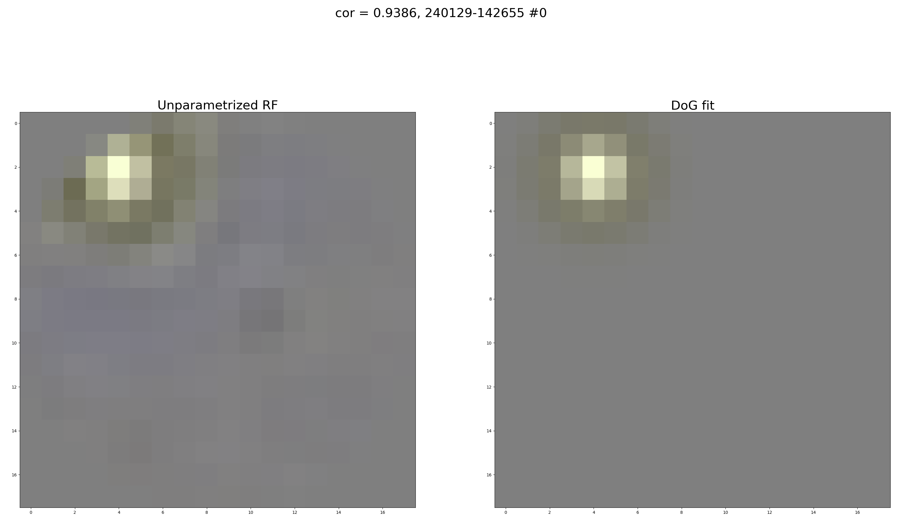

Slide 6
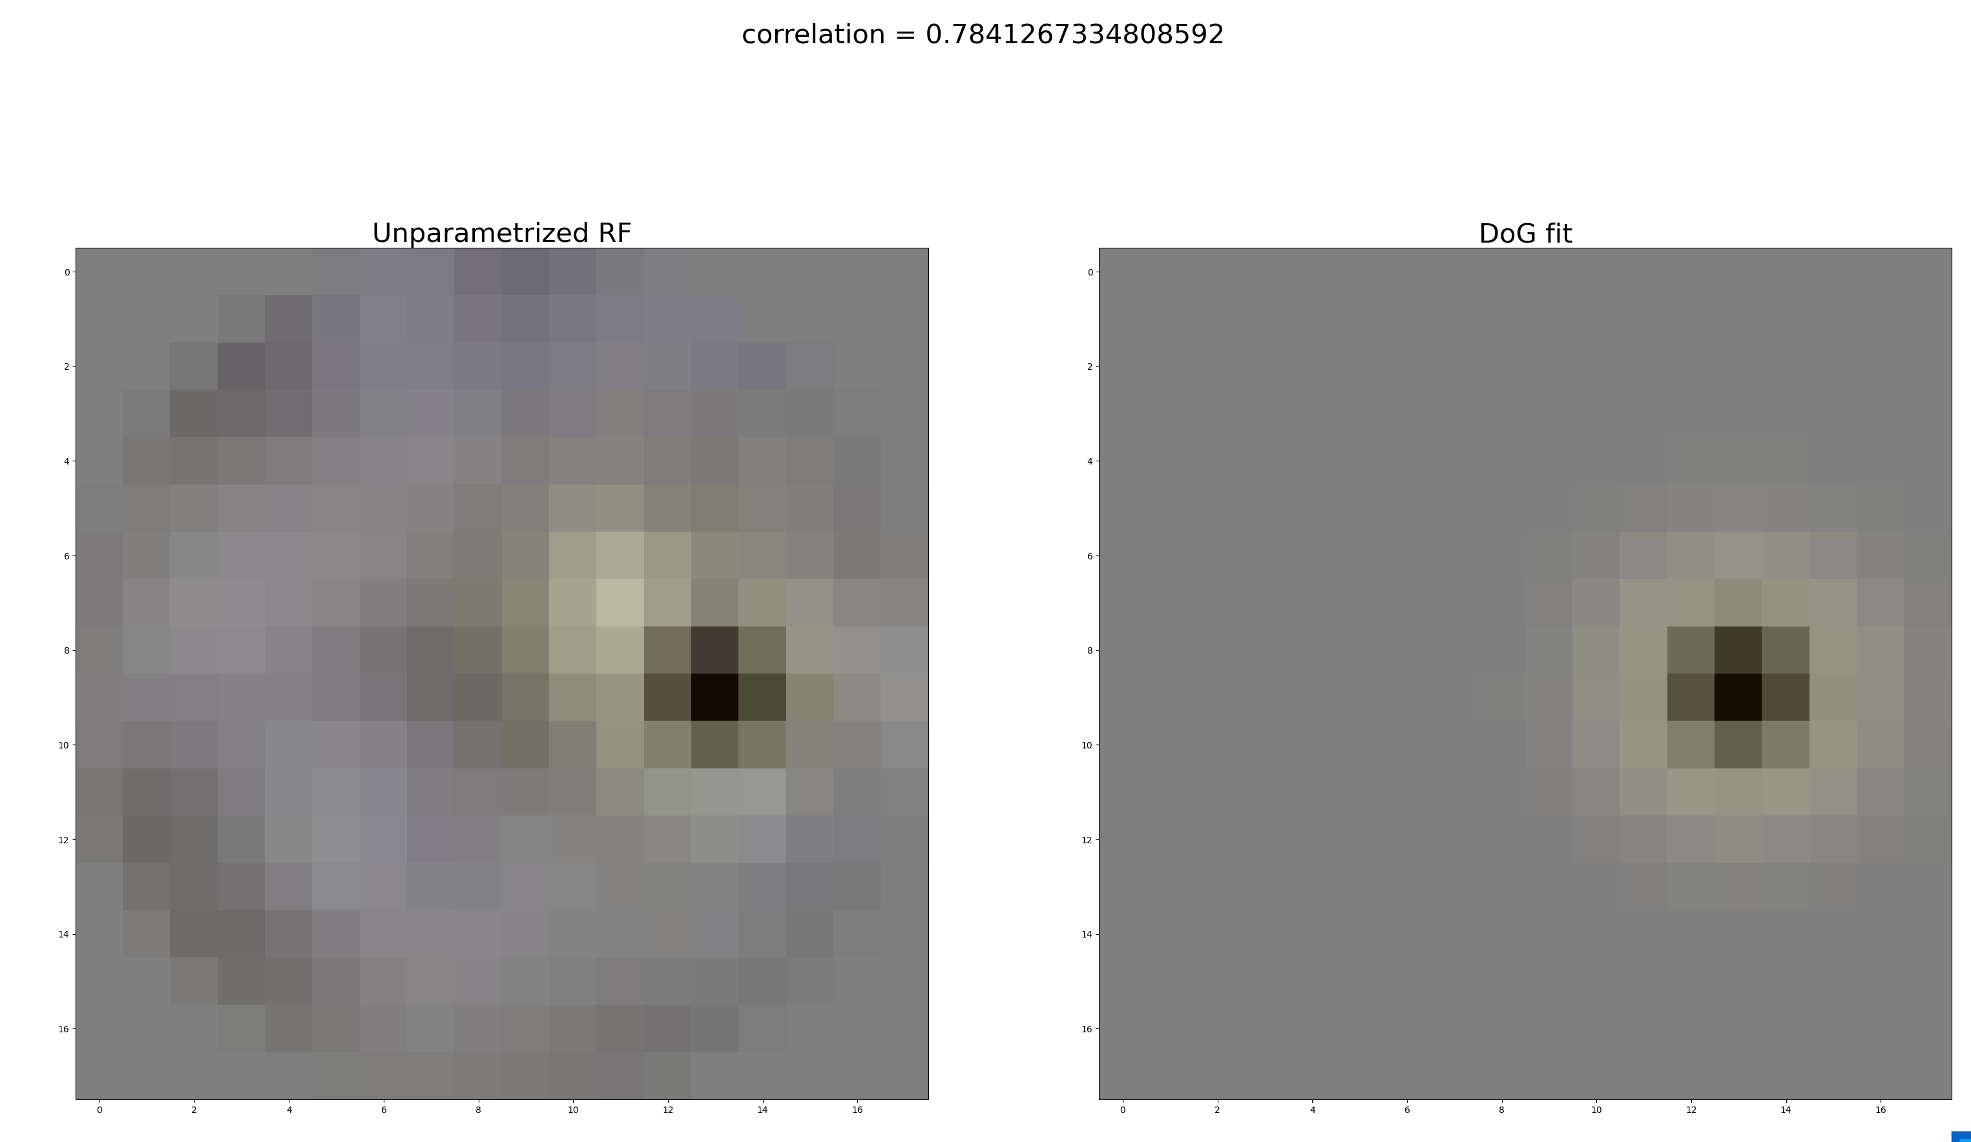

Slide 7
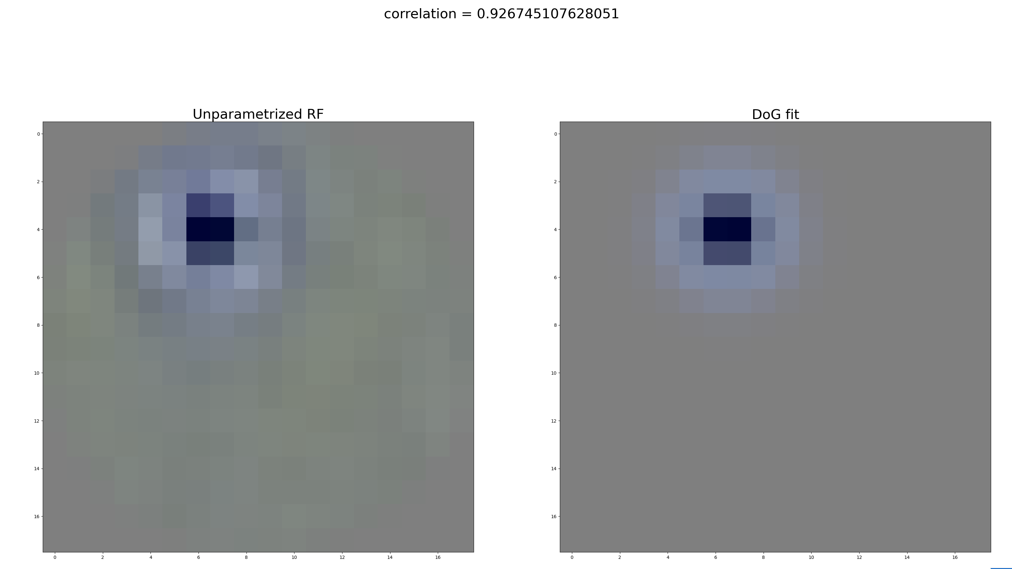

Slide 8
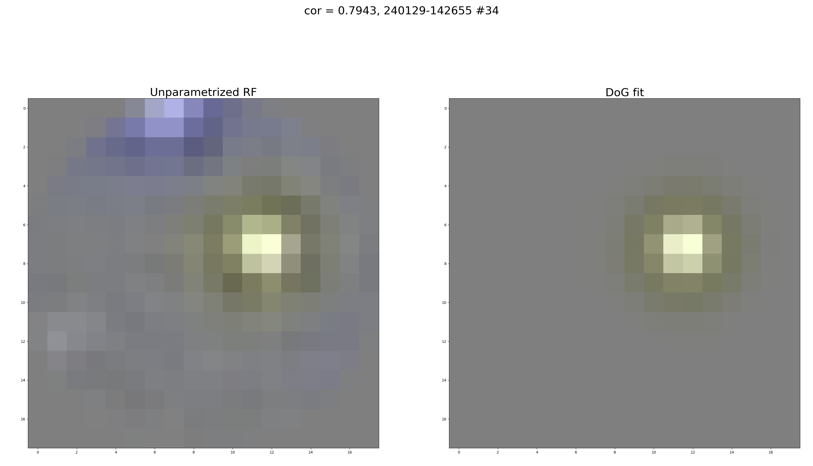

Slide 9
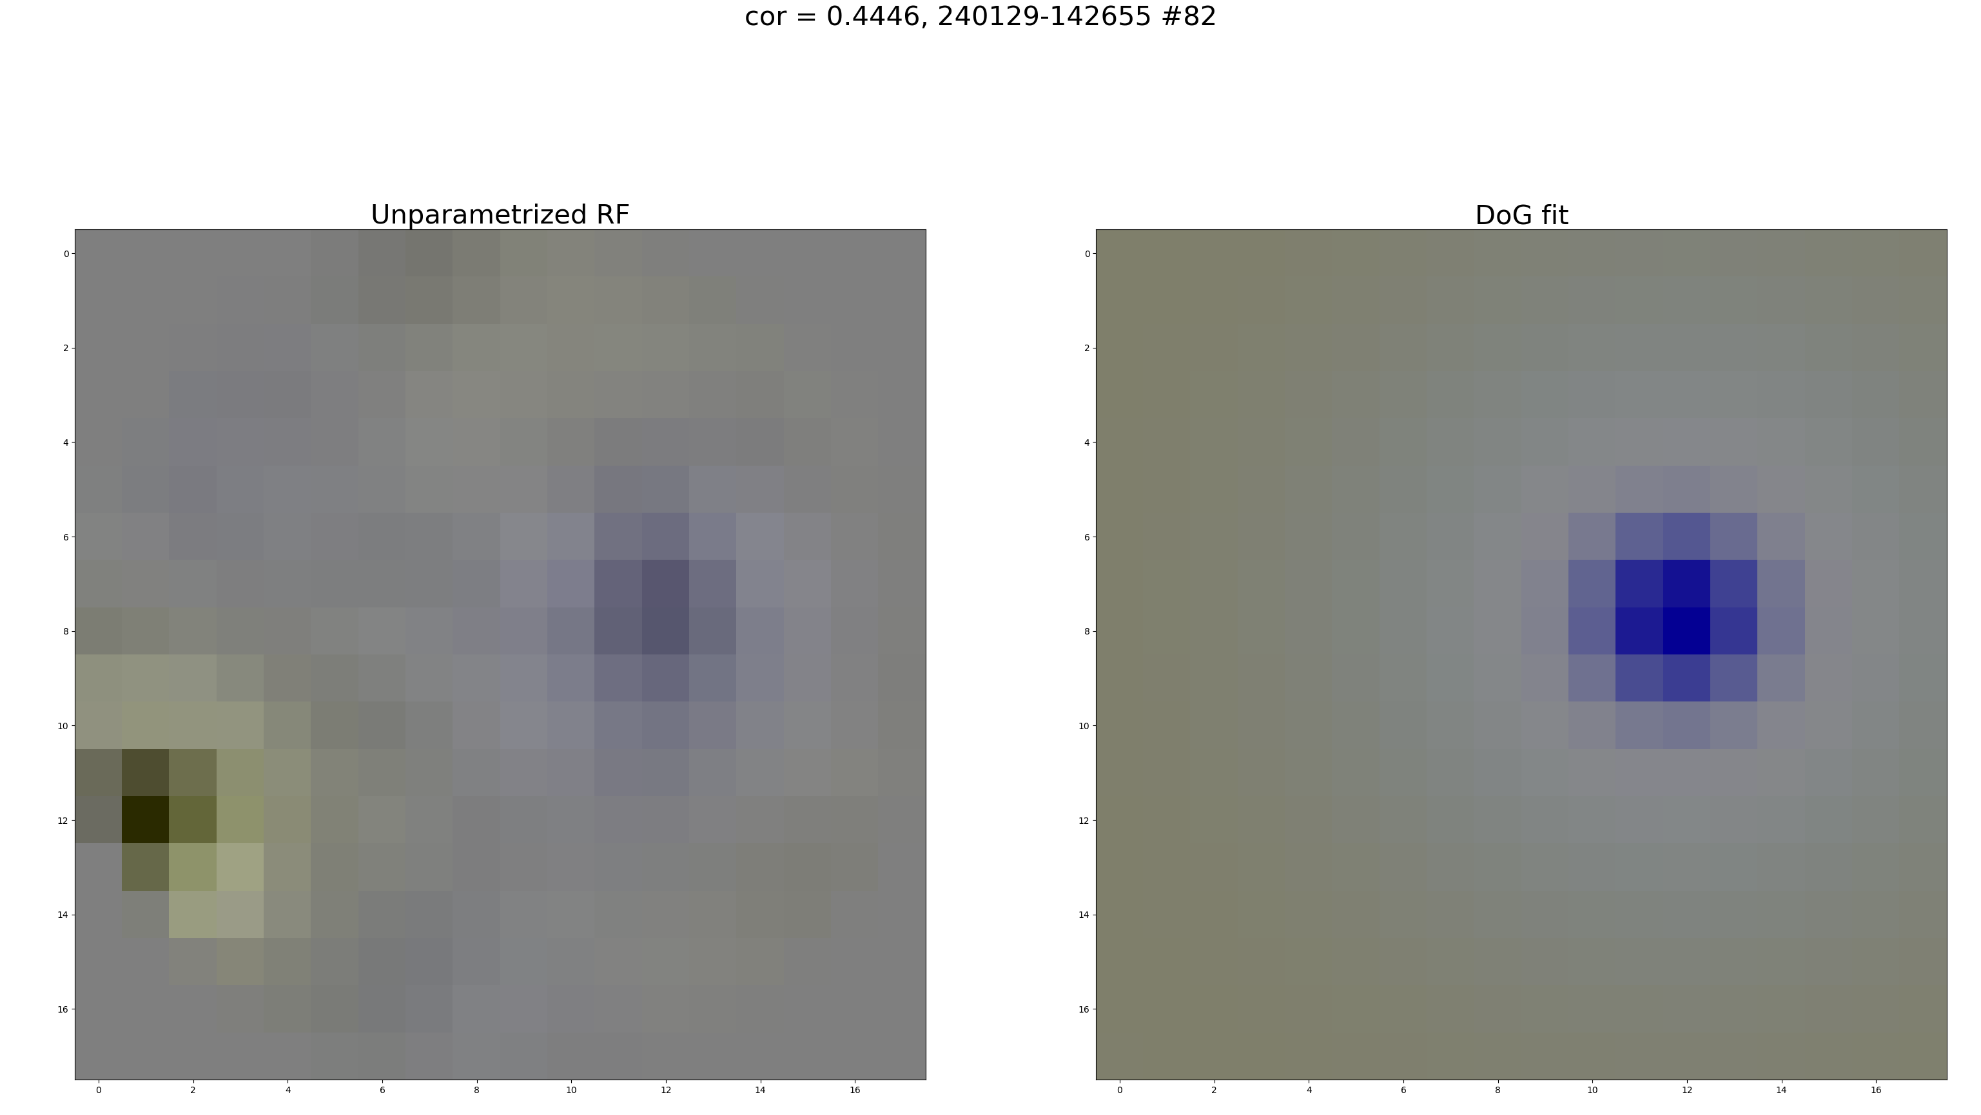

Slide 10
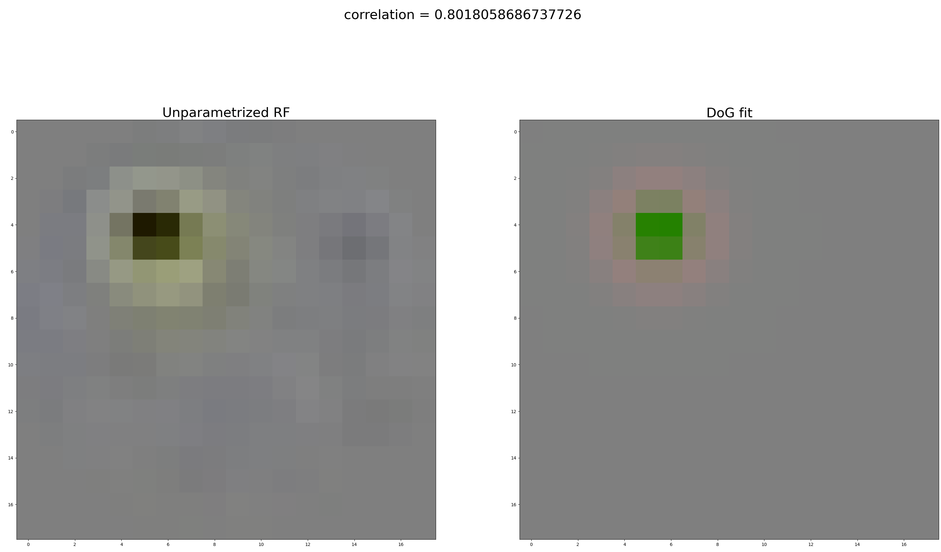

Slide 11
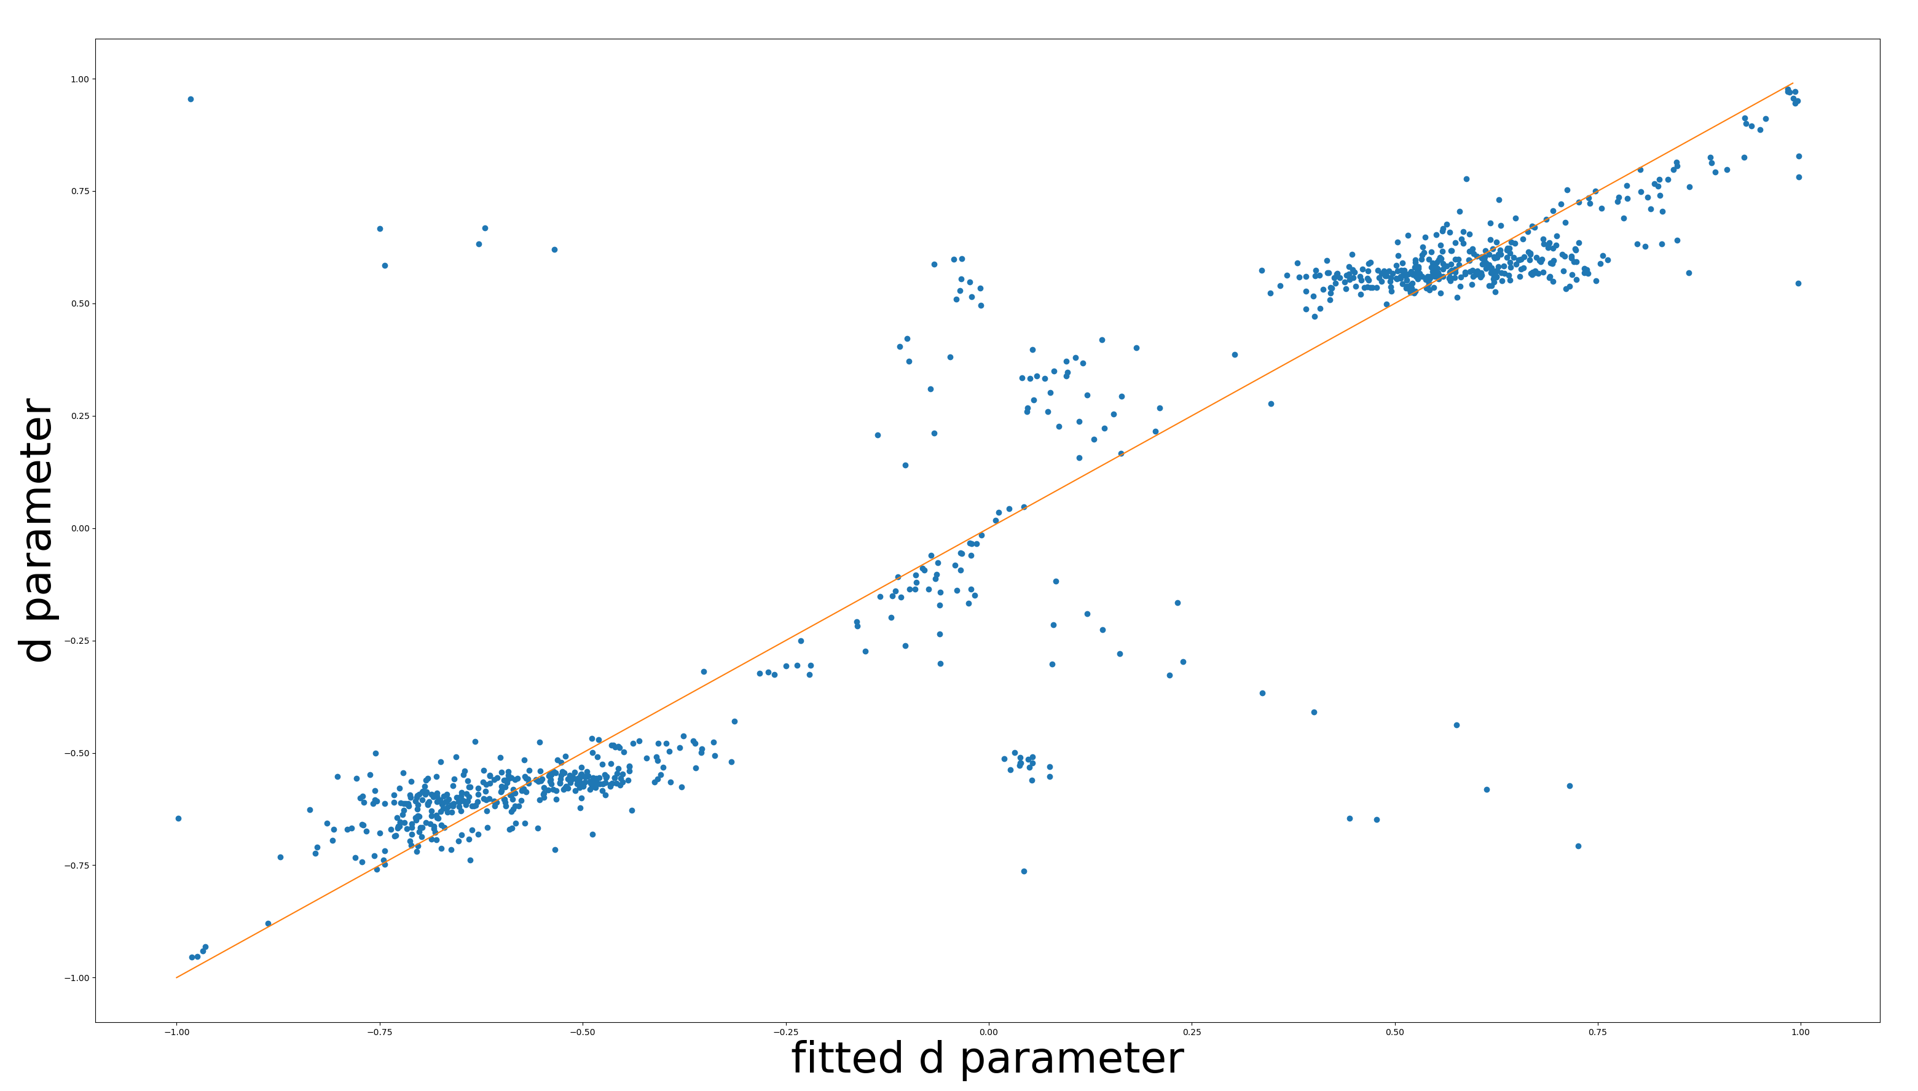

Slide 12
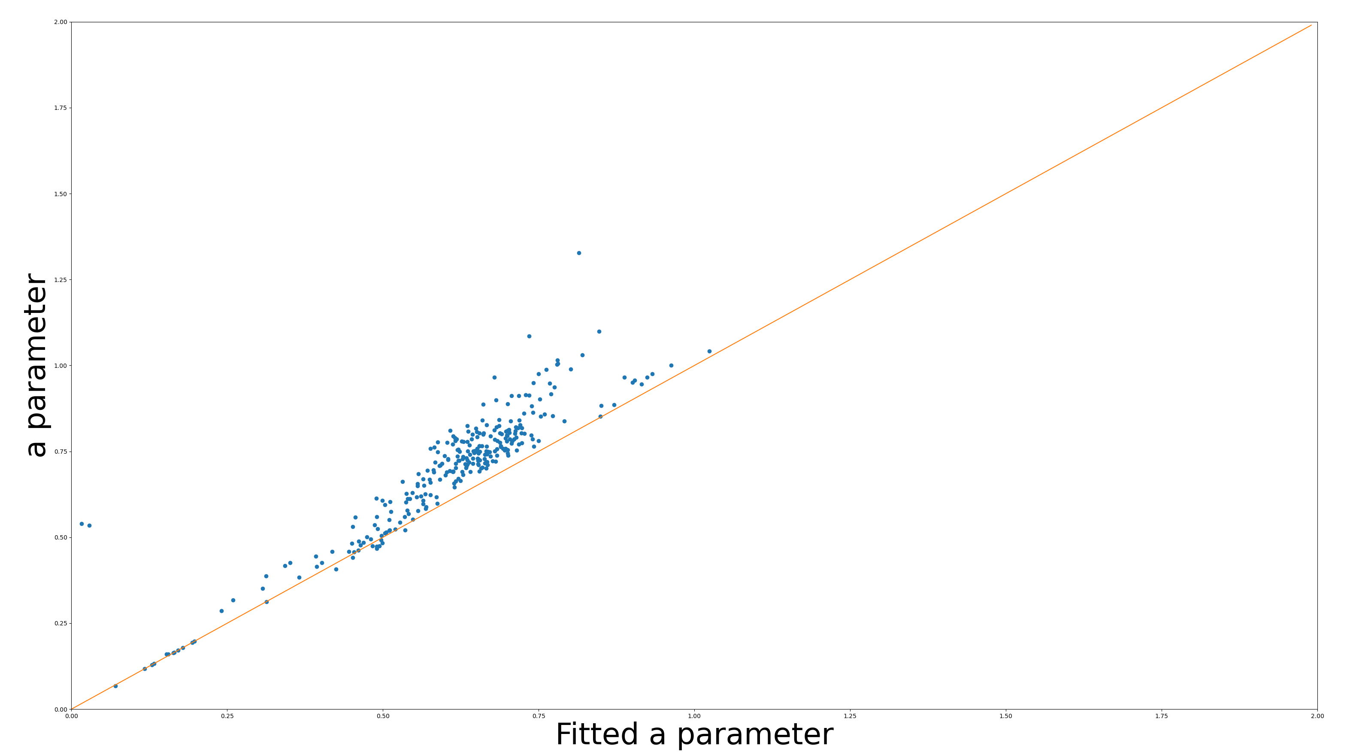
Only the most important channel

Slide 13
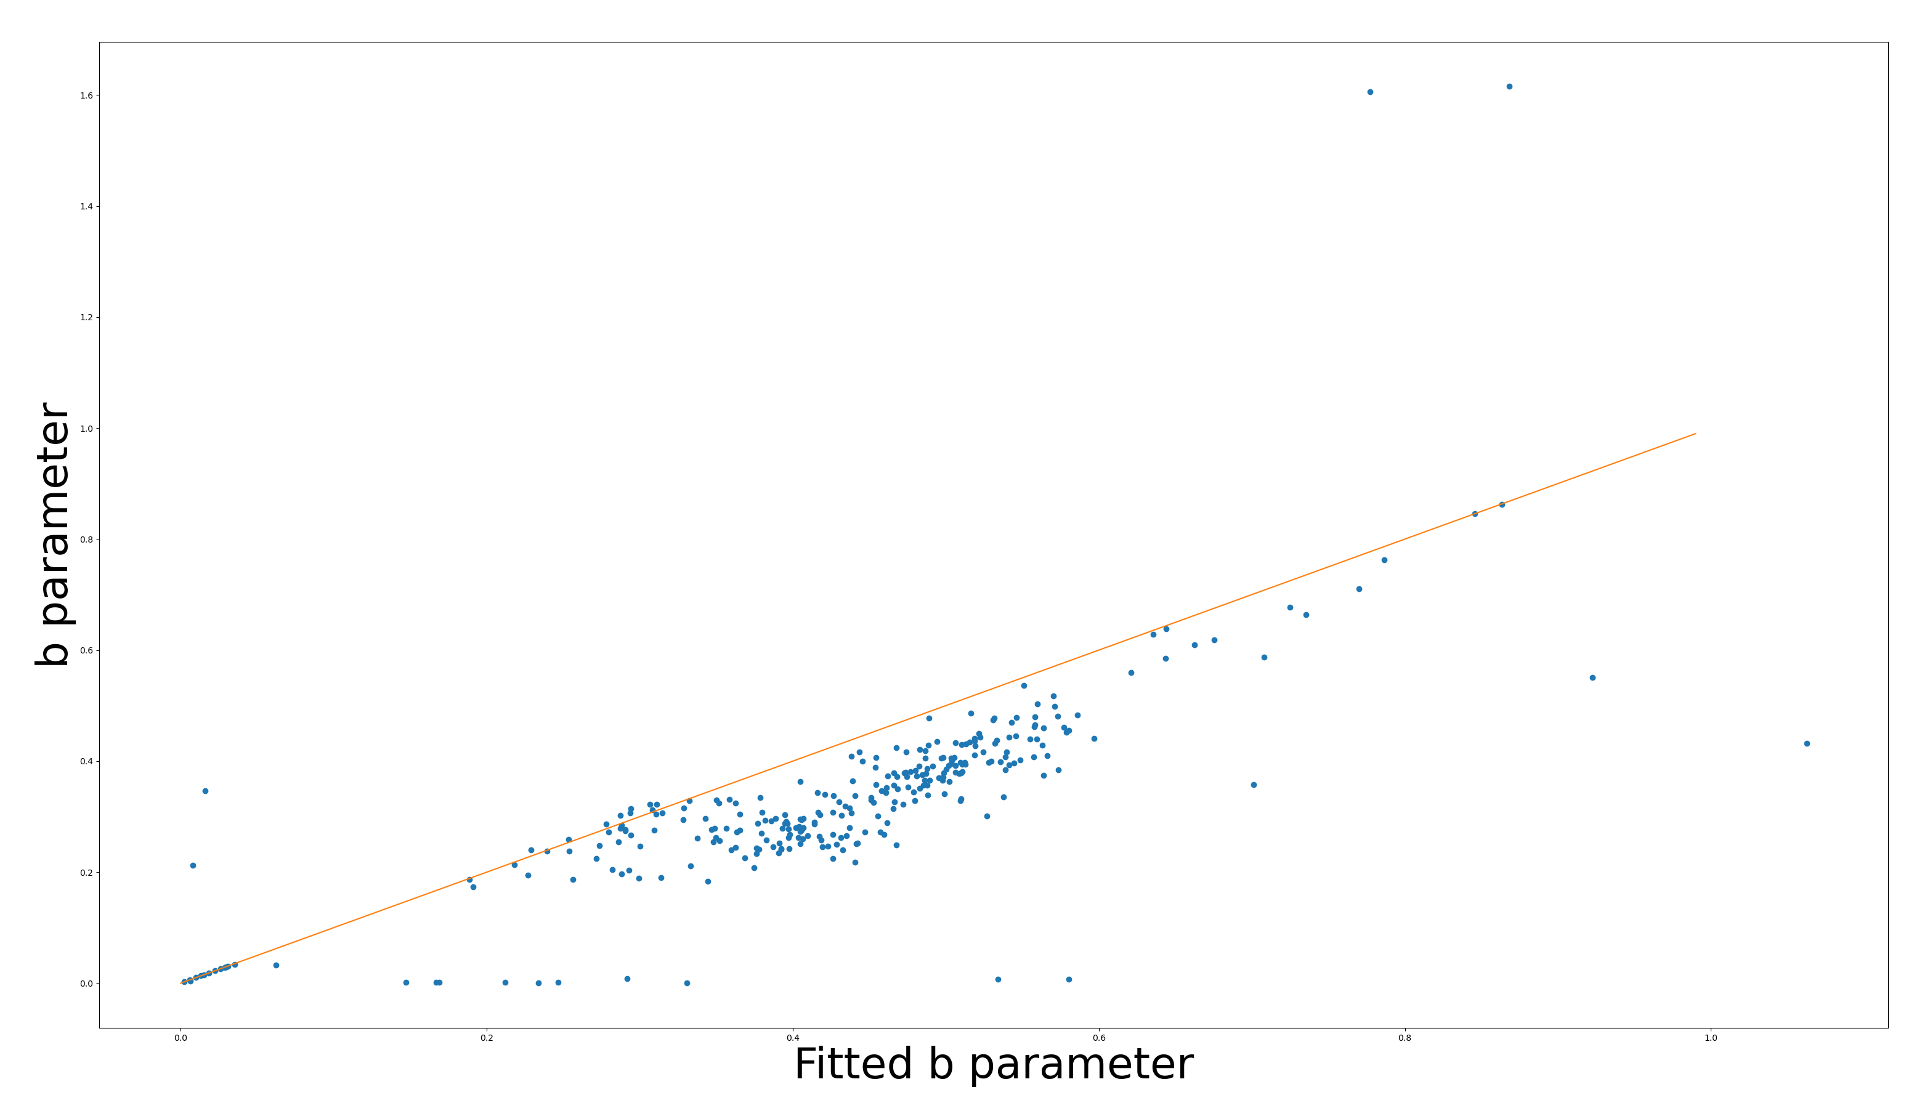
Only the most important channel

Slide 14
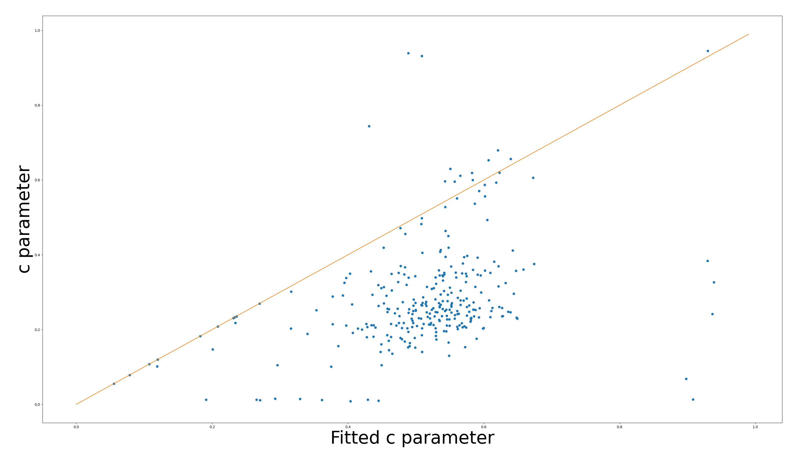
Only the most important channel

