Slide 1
Schedule for today
1. Switching L and S channels for half of the 18x18 images
2. “Boosting” +L –S images 4x fold.

Slide 2
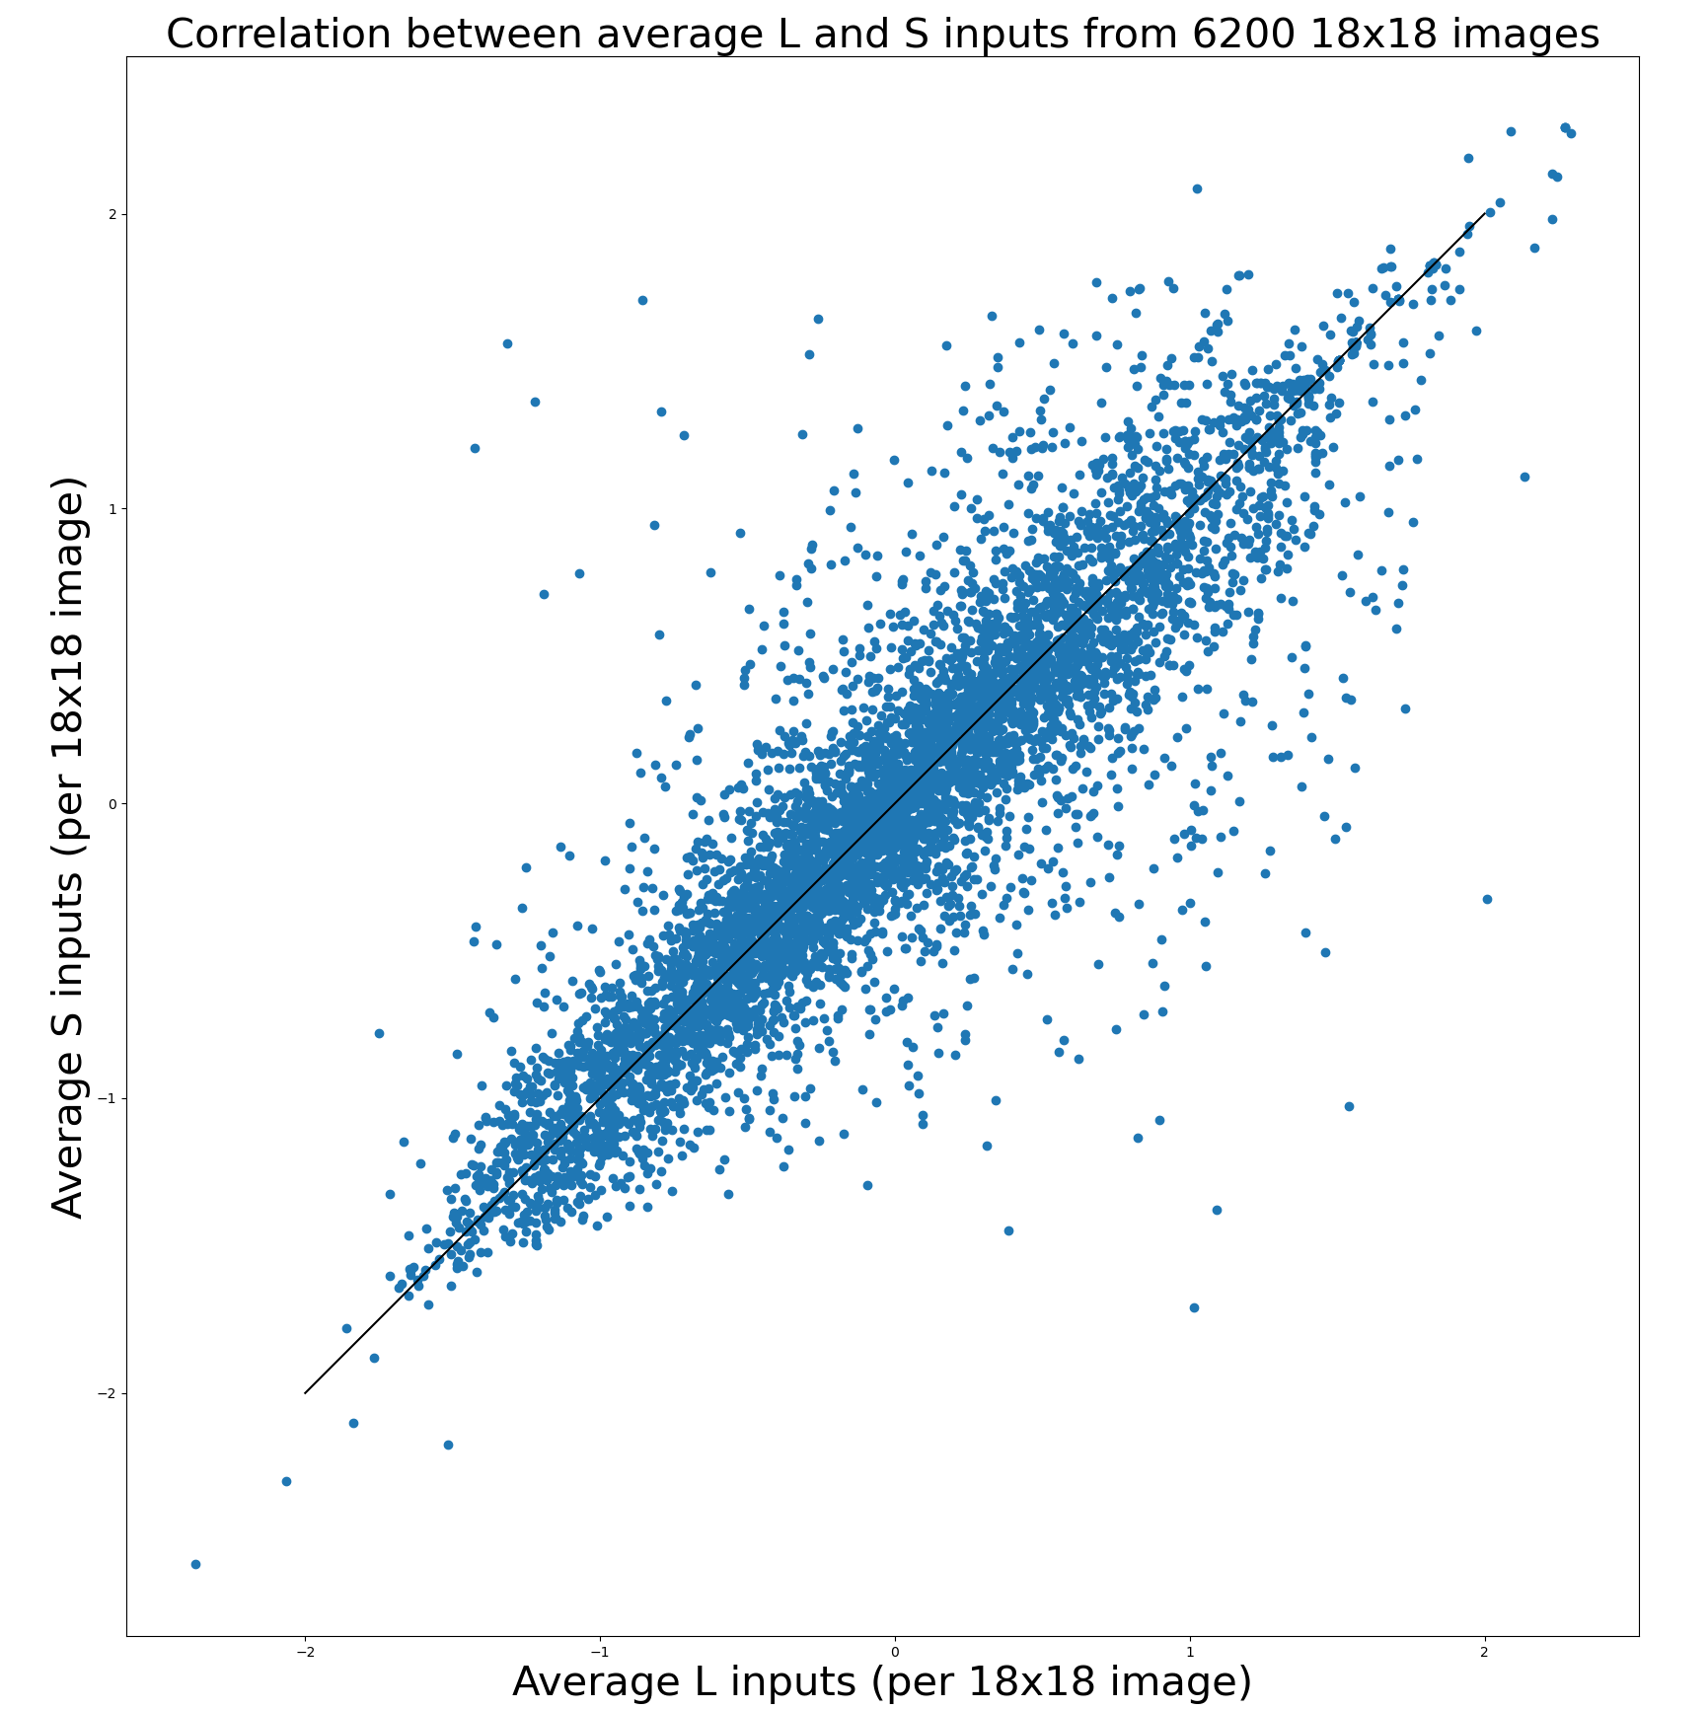
Switching L and S channels for 50% of images

Slide 3
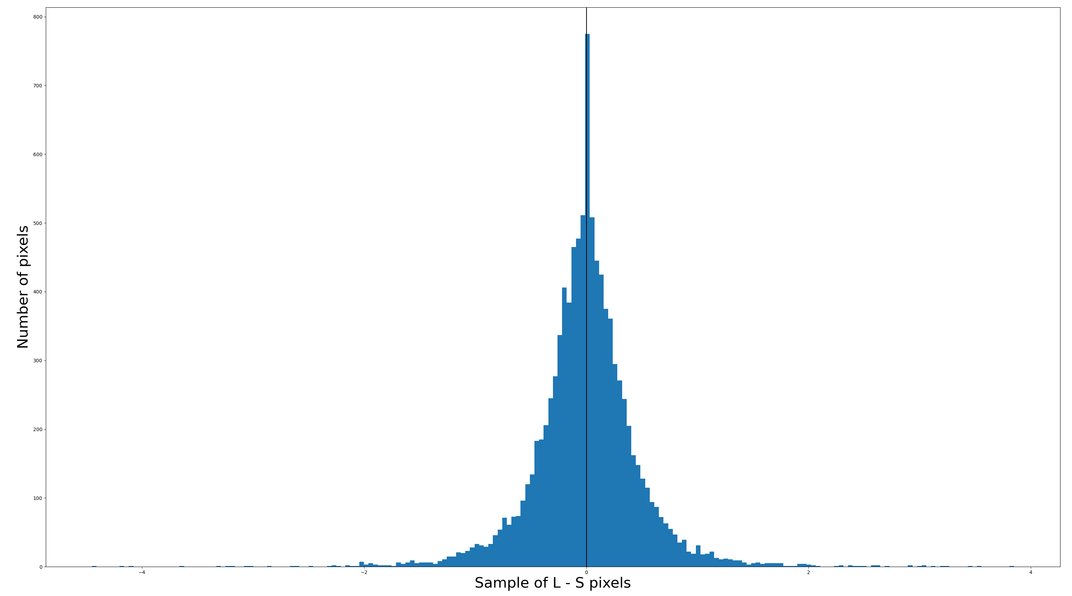
Symmetric distribution of L - S

Slide 4
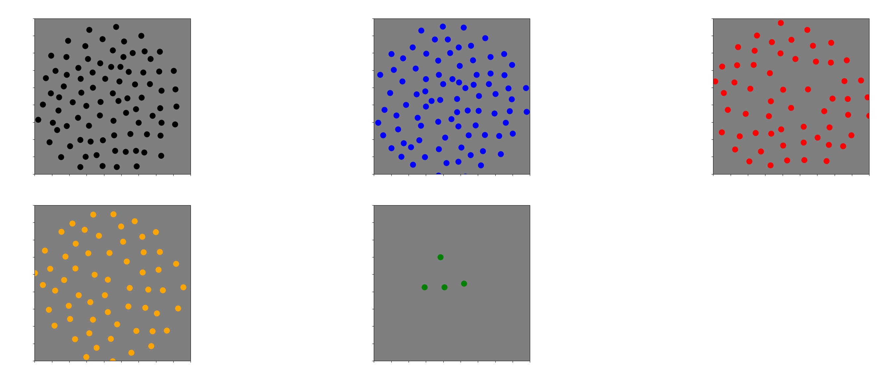
5 clusters

Slide 5
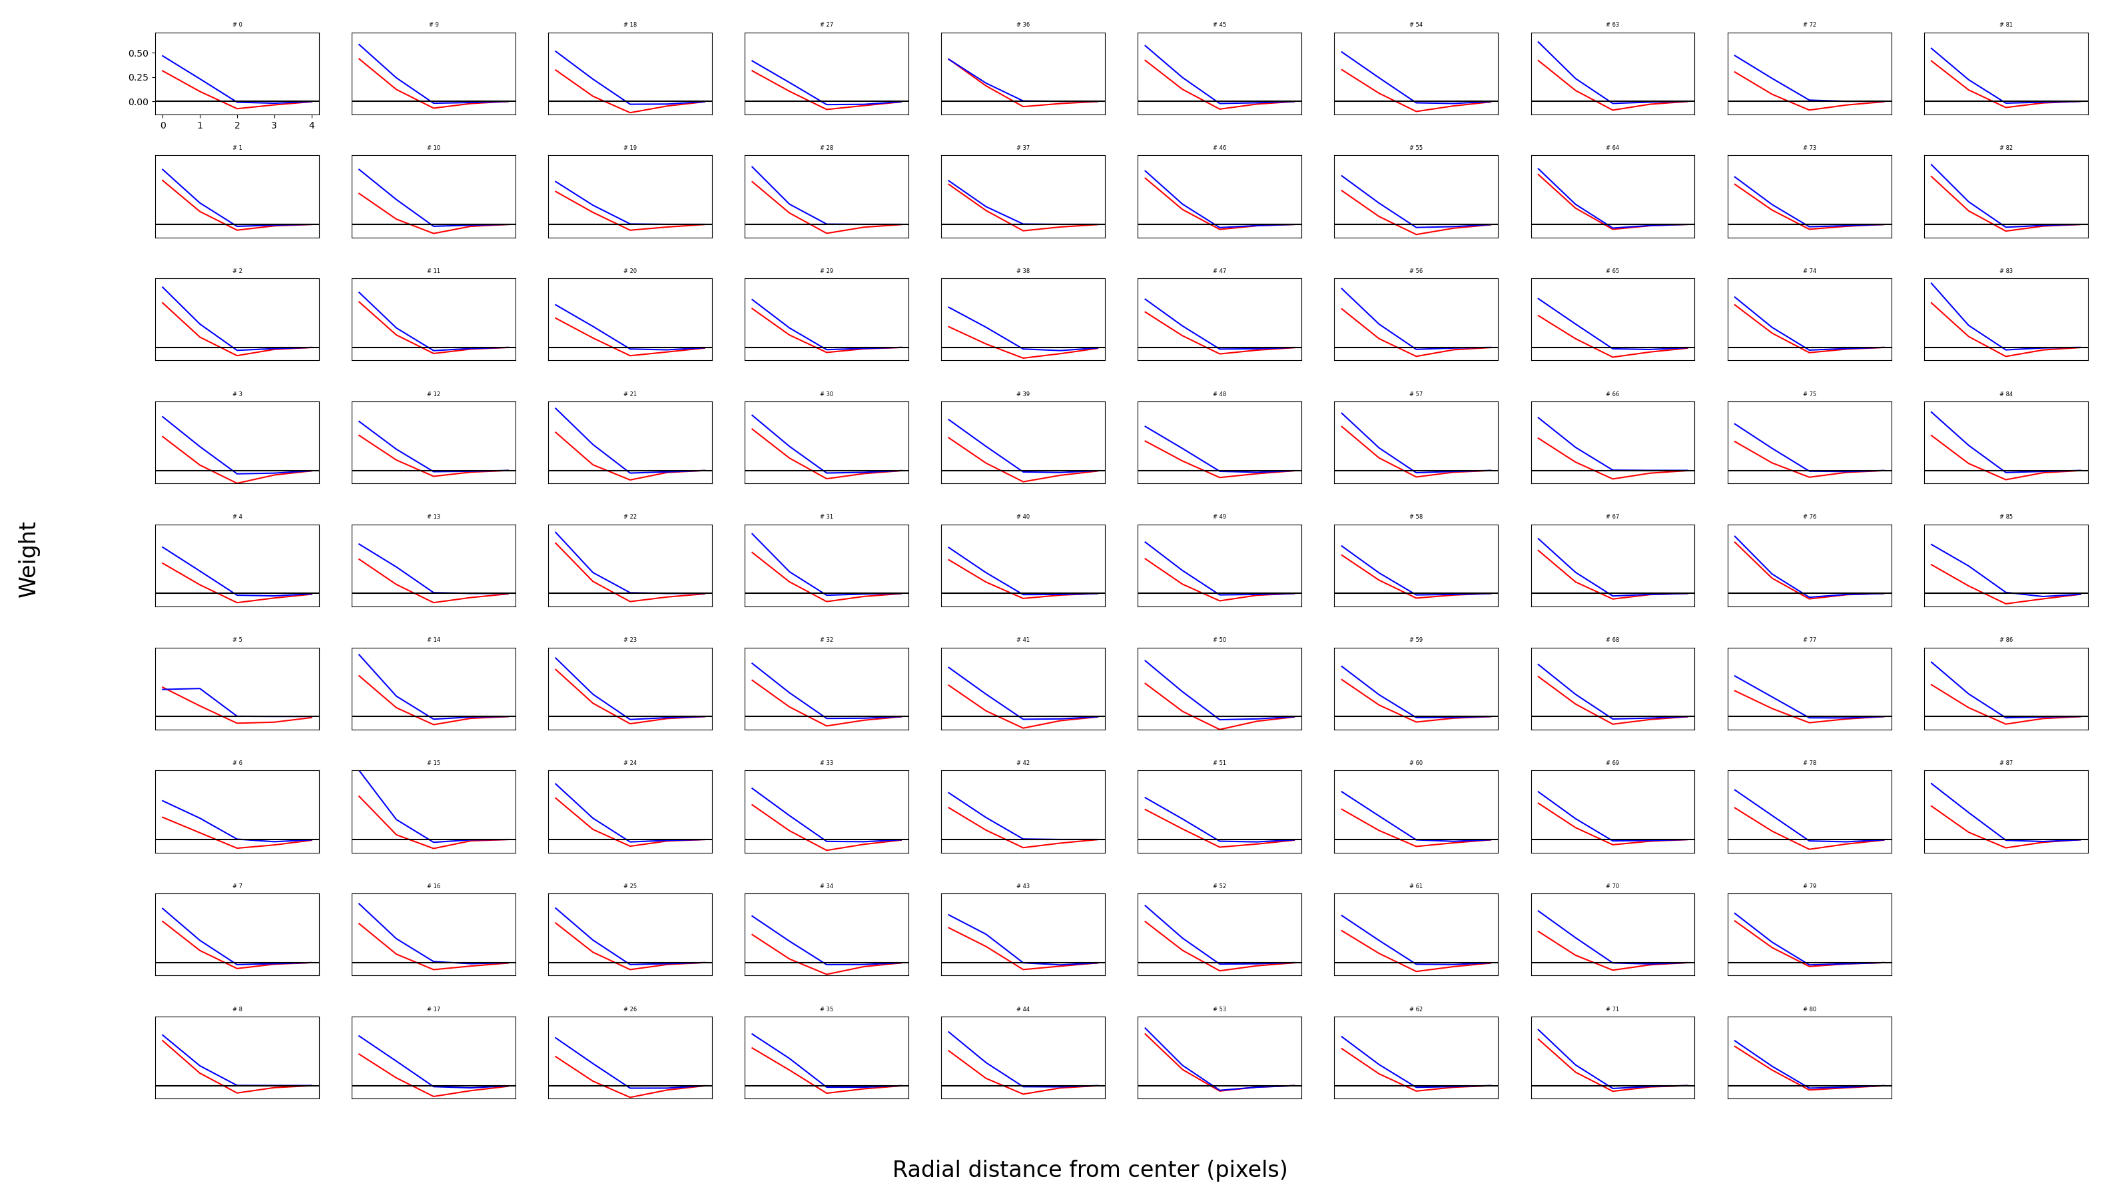
First cluster (88 neurons)

Slide 6
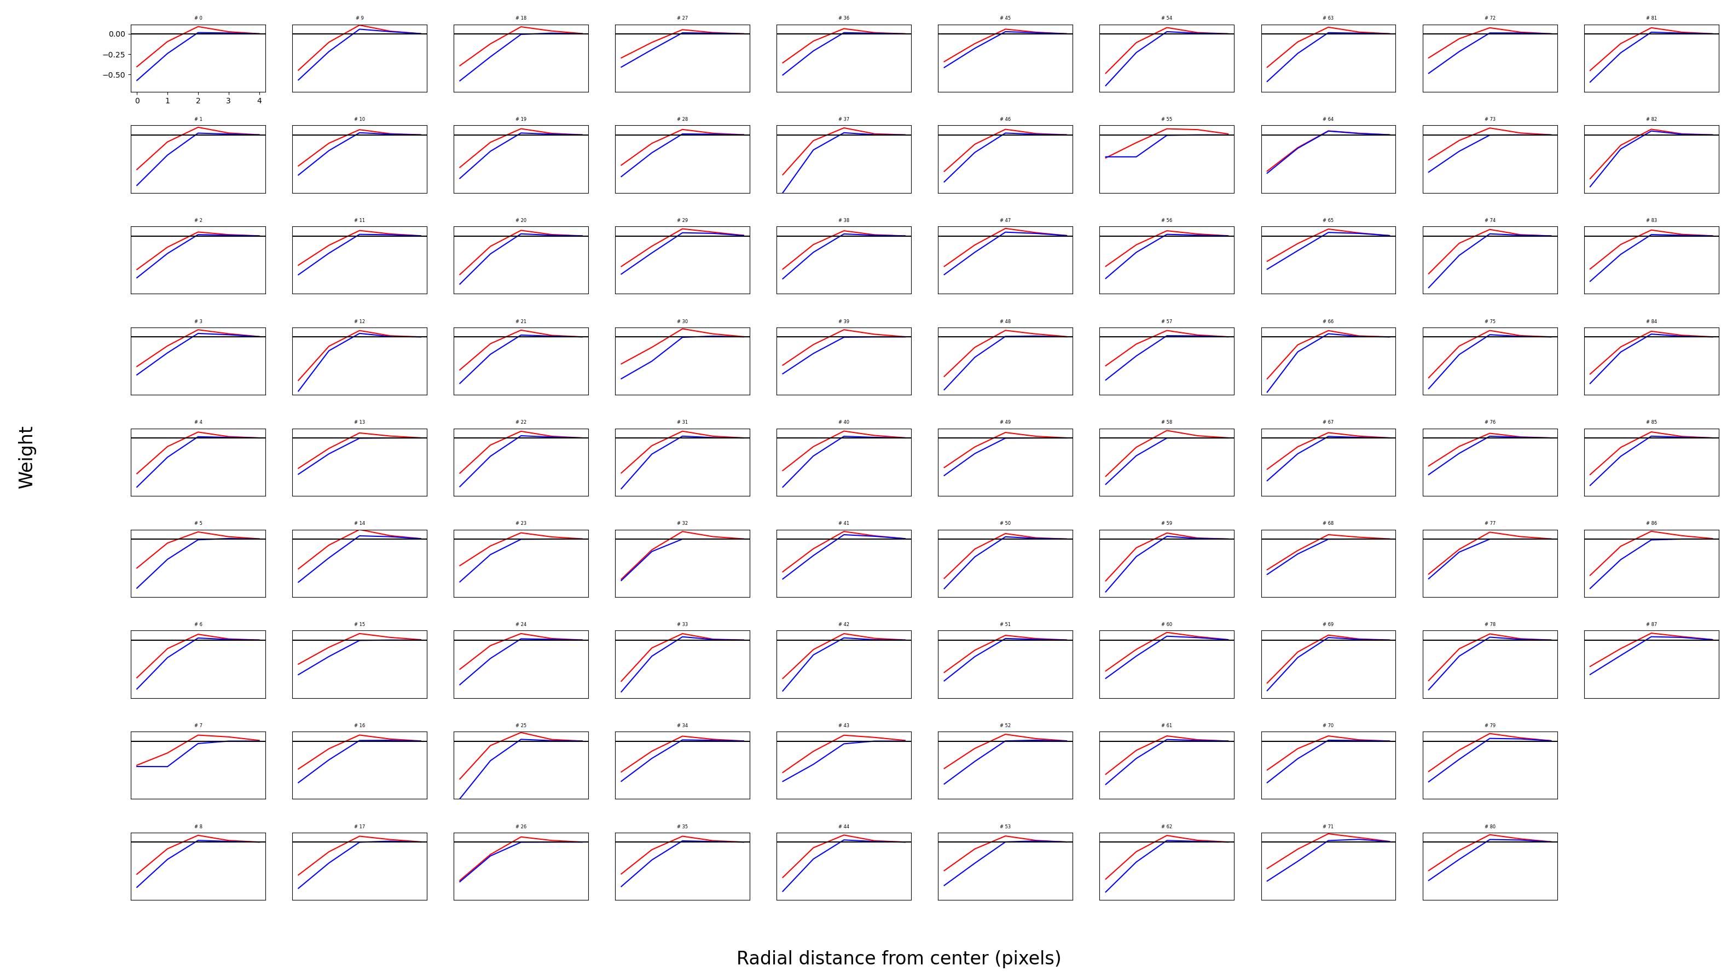
Second cluster (88 neurons)

Slide 7
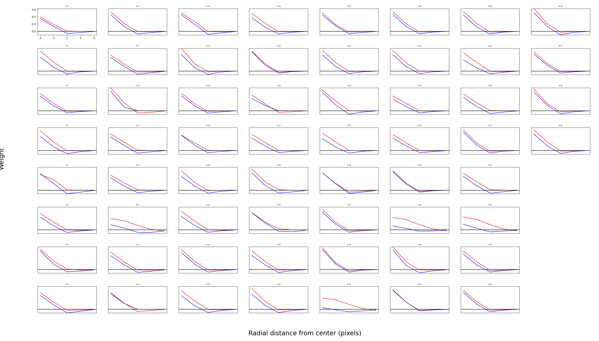
Third cluster (60 neurons)

Slide 8
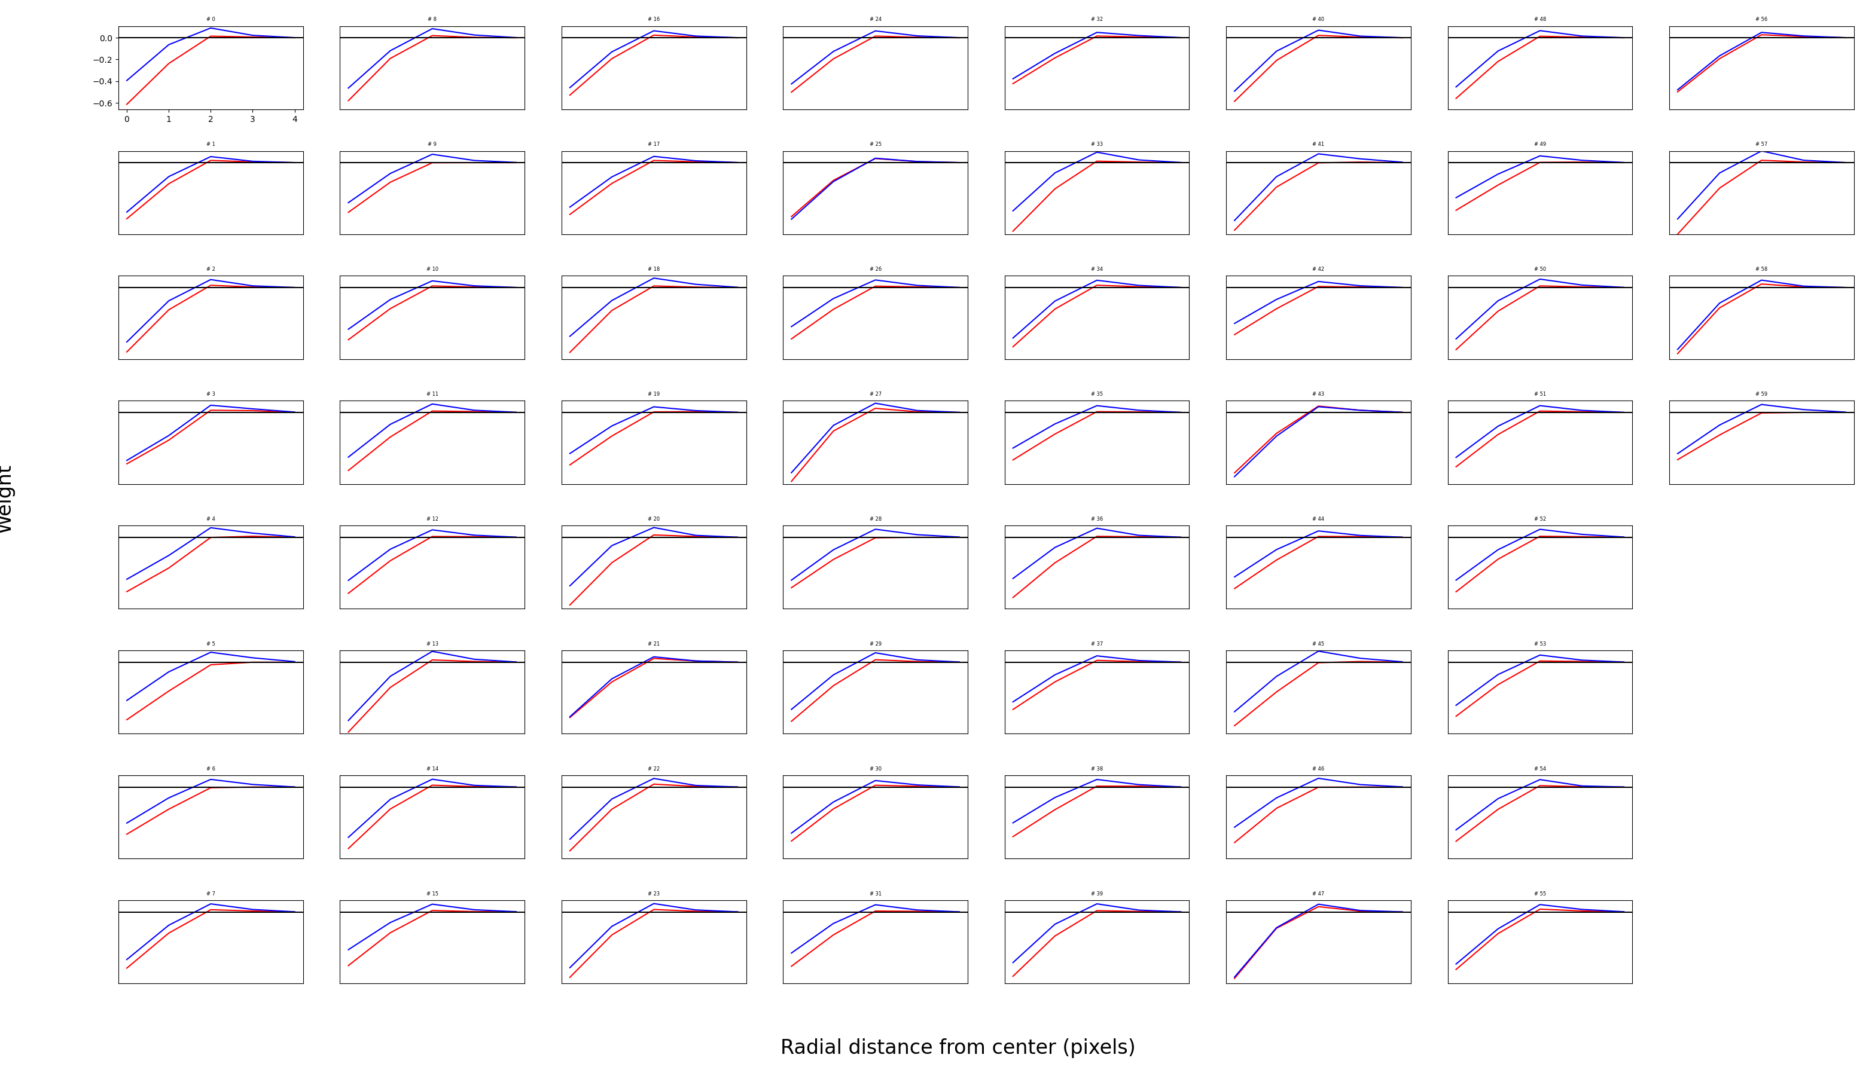
Fourth cluster (60 neurons)

Slide 9
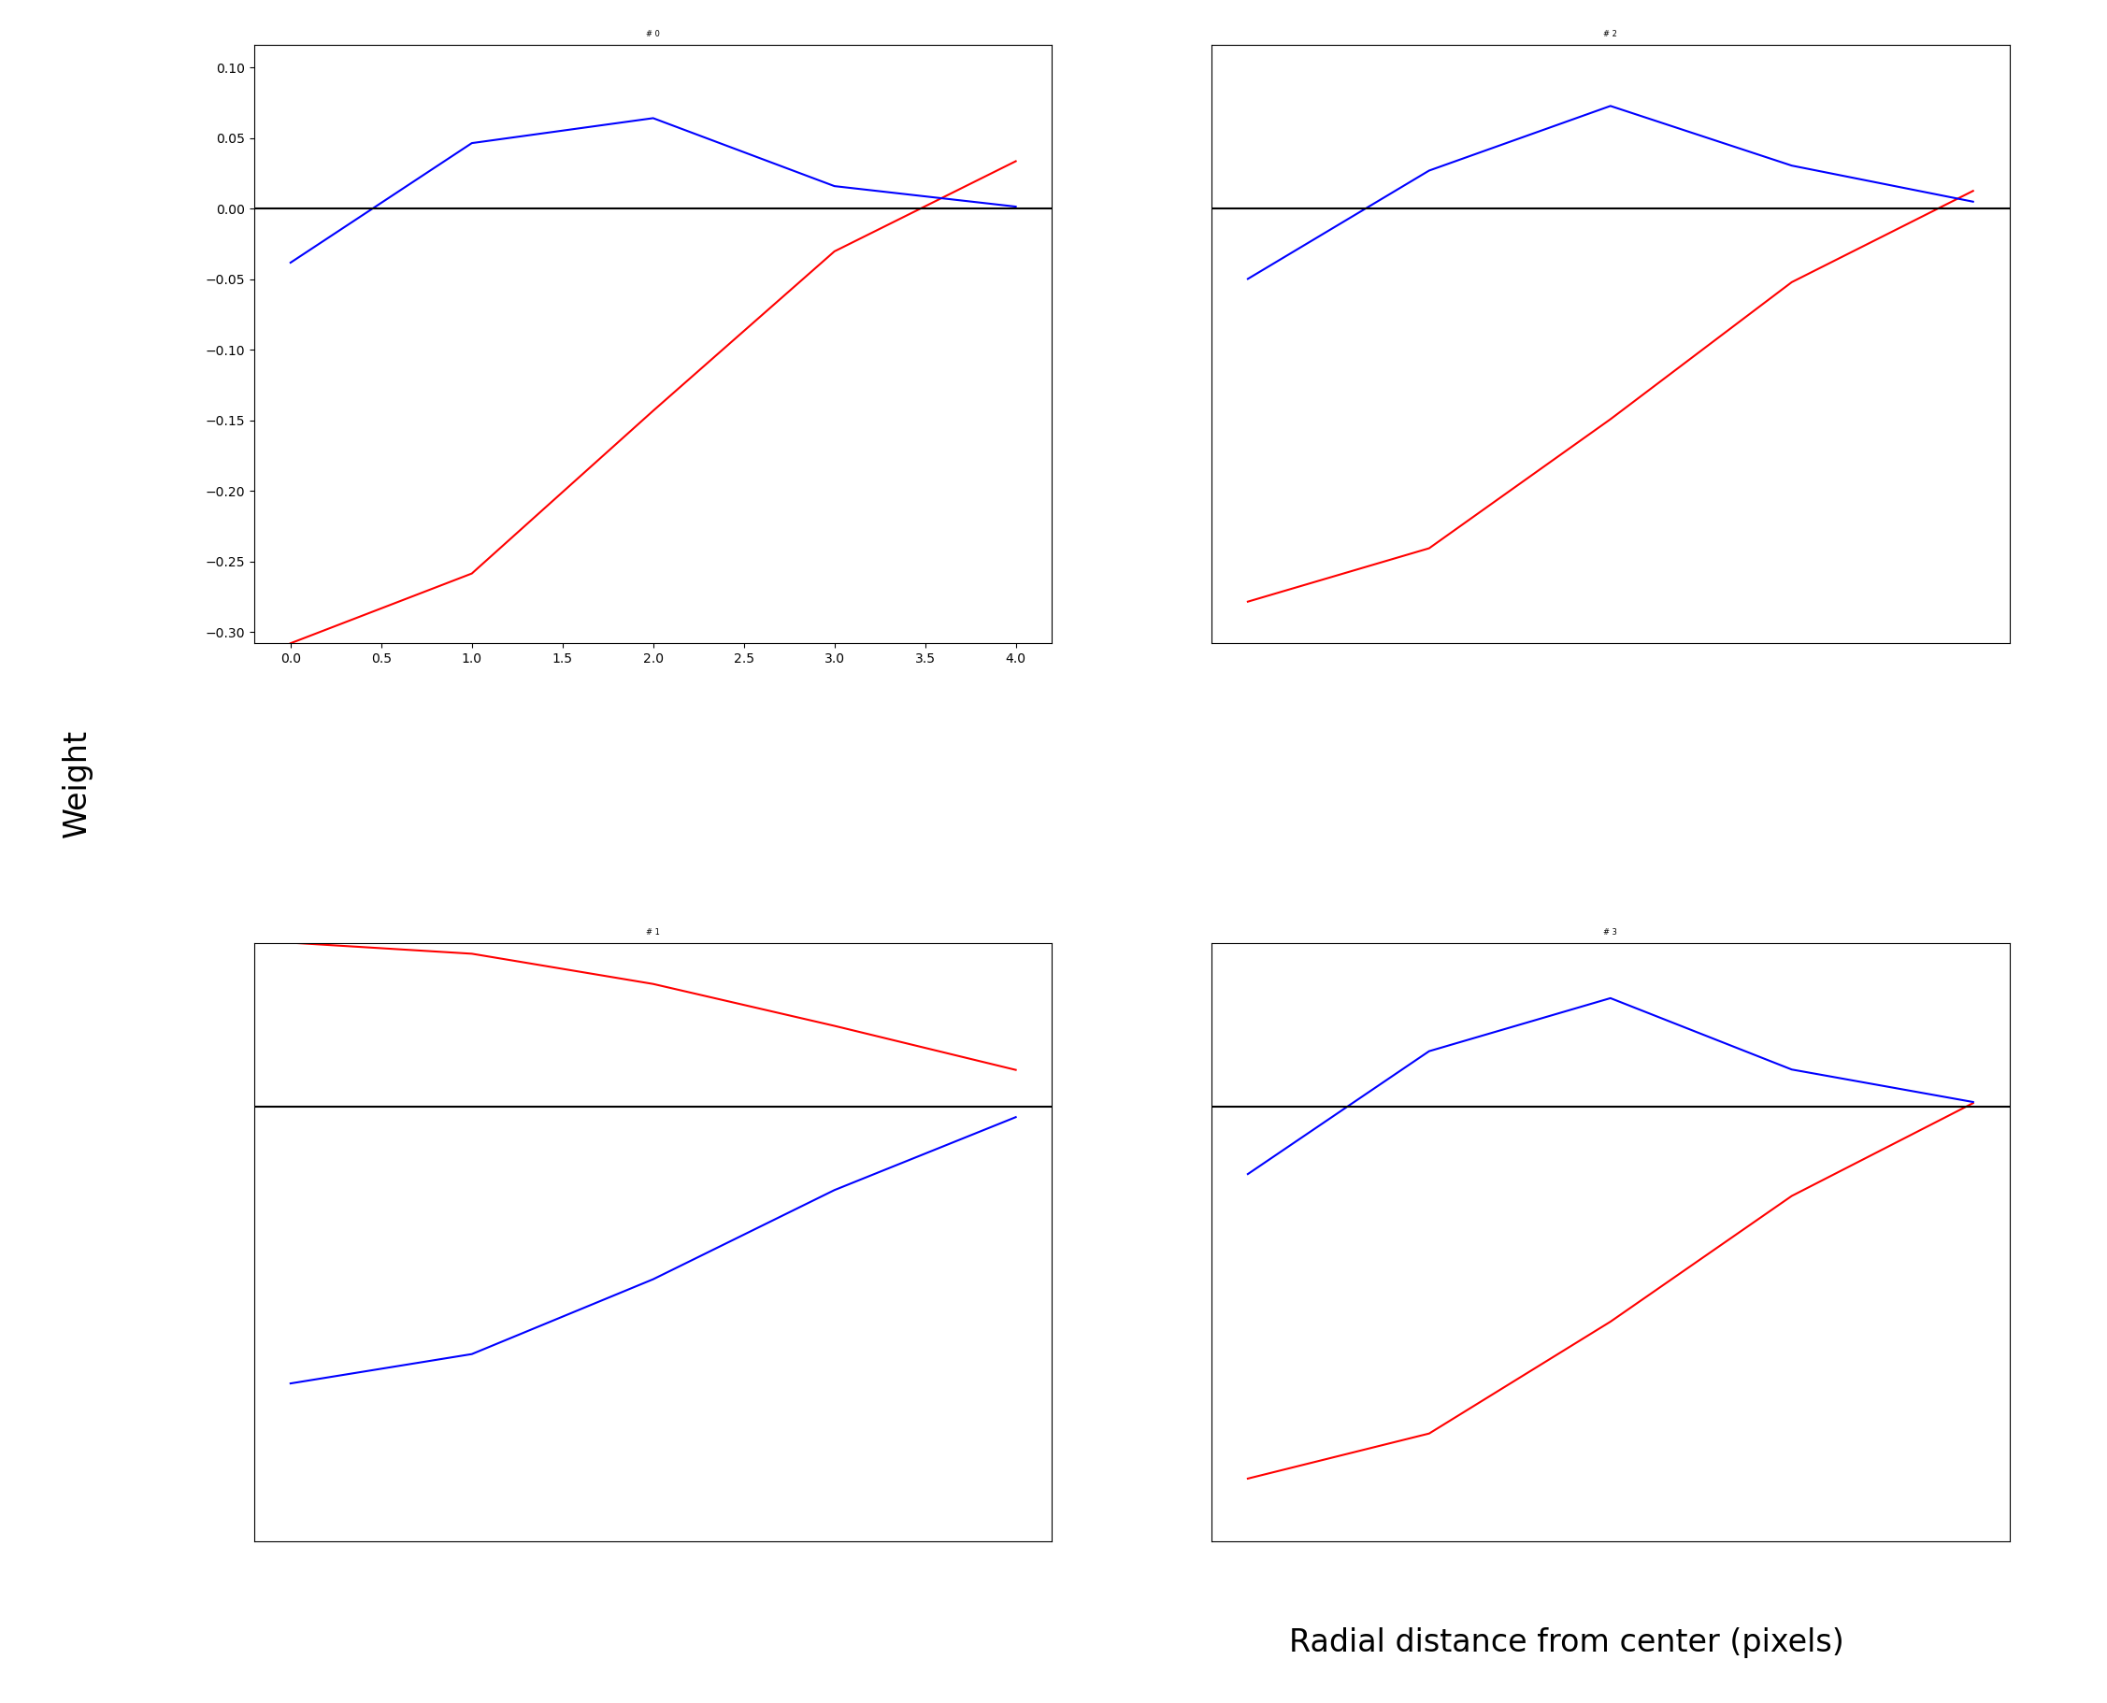
The 5th cluster is opponency

Slide 10
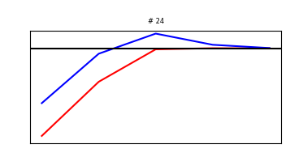
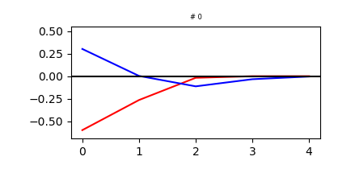
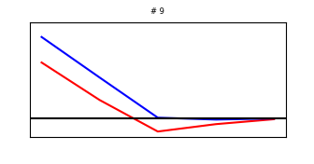
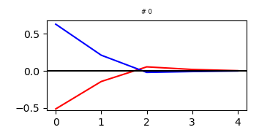
Effect of reversing weaker channel in all clusters
Manipulation
Training
This failure could be because I reversed all 4 clusters at the same time. I usually only do 2 at a time.

Slide 11
Boosting the frequency of +L –S images

Slide 12
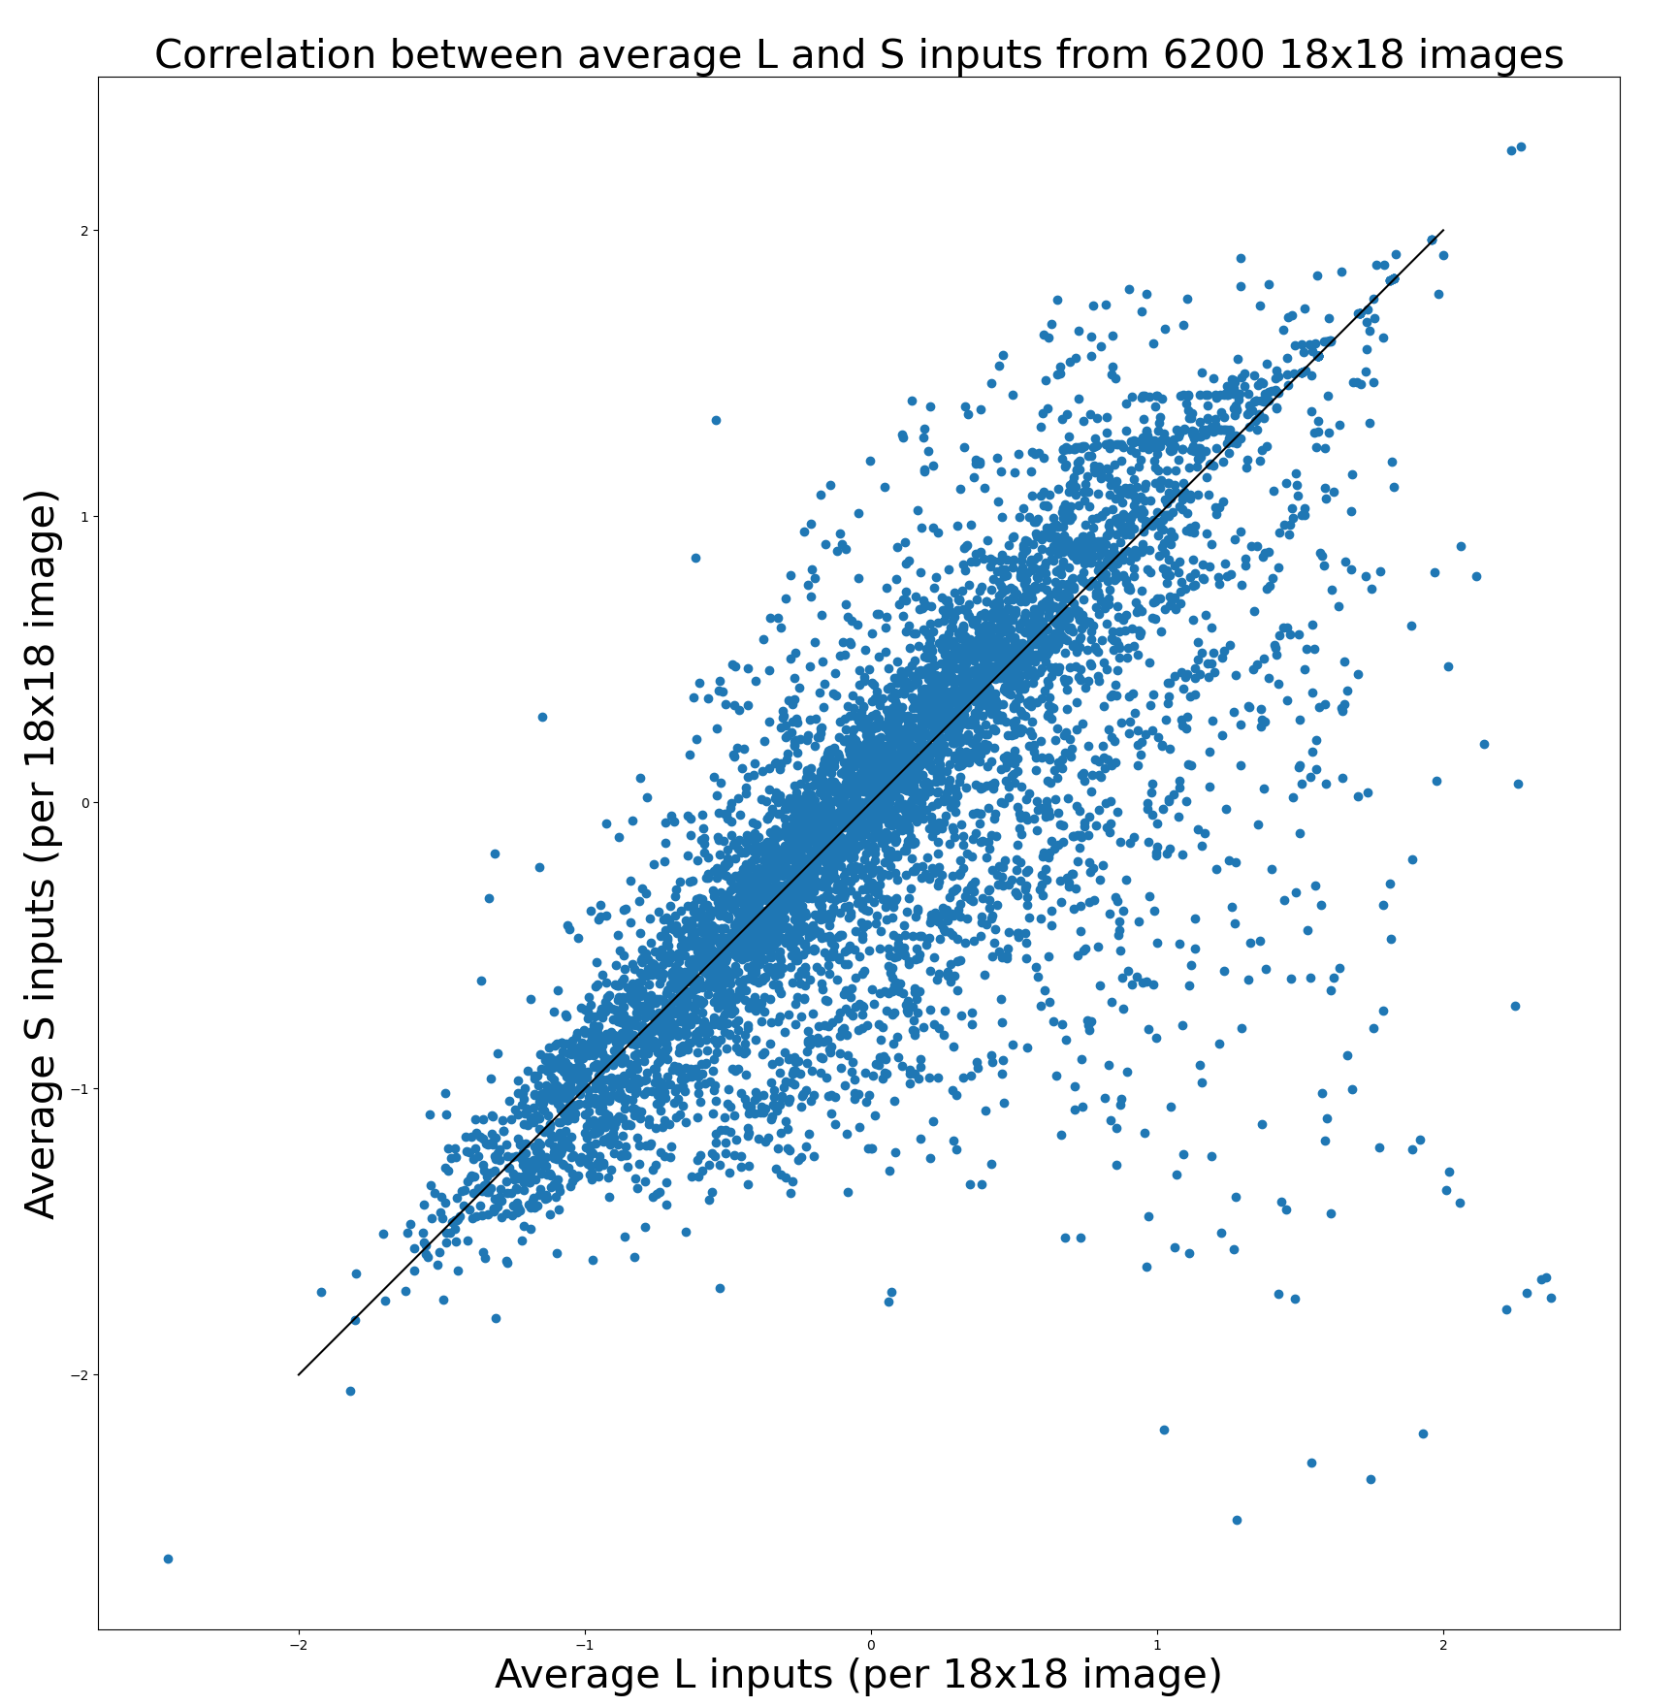
Increasing (4x) the frequency of +L –S images

Slide 13
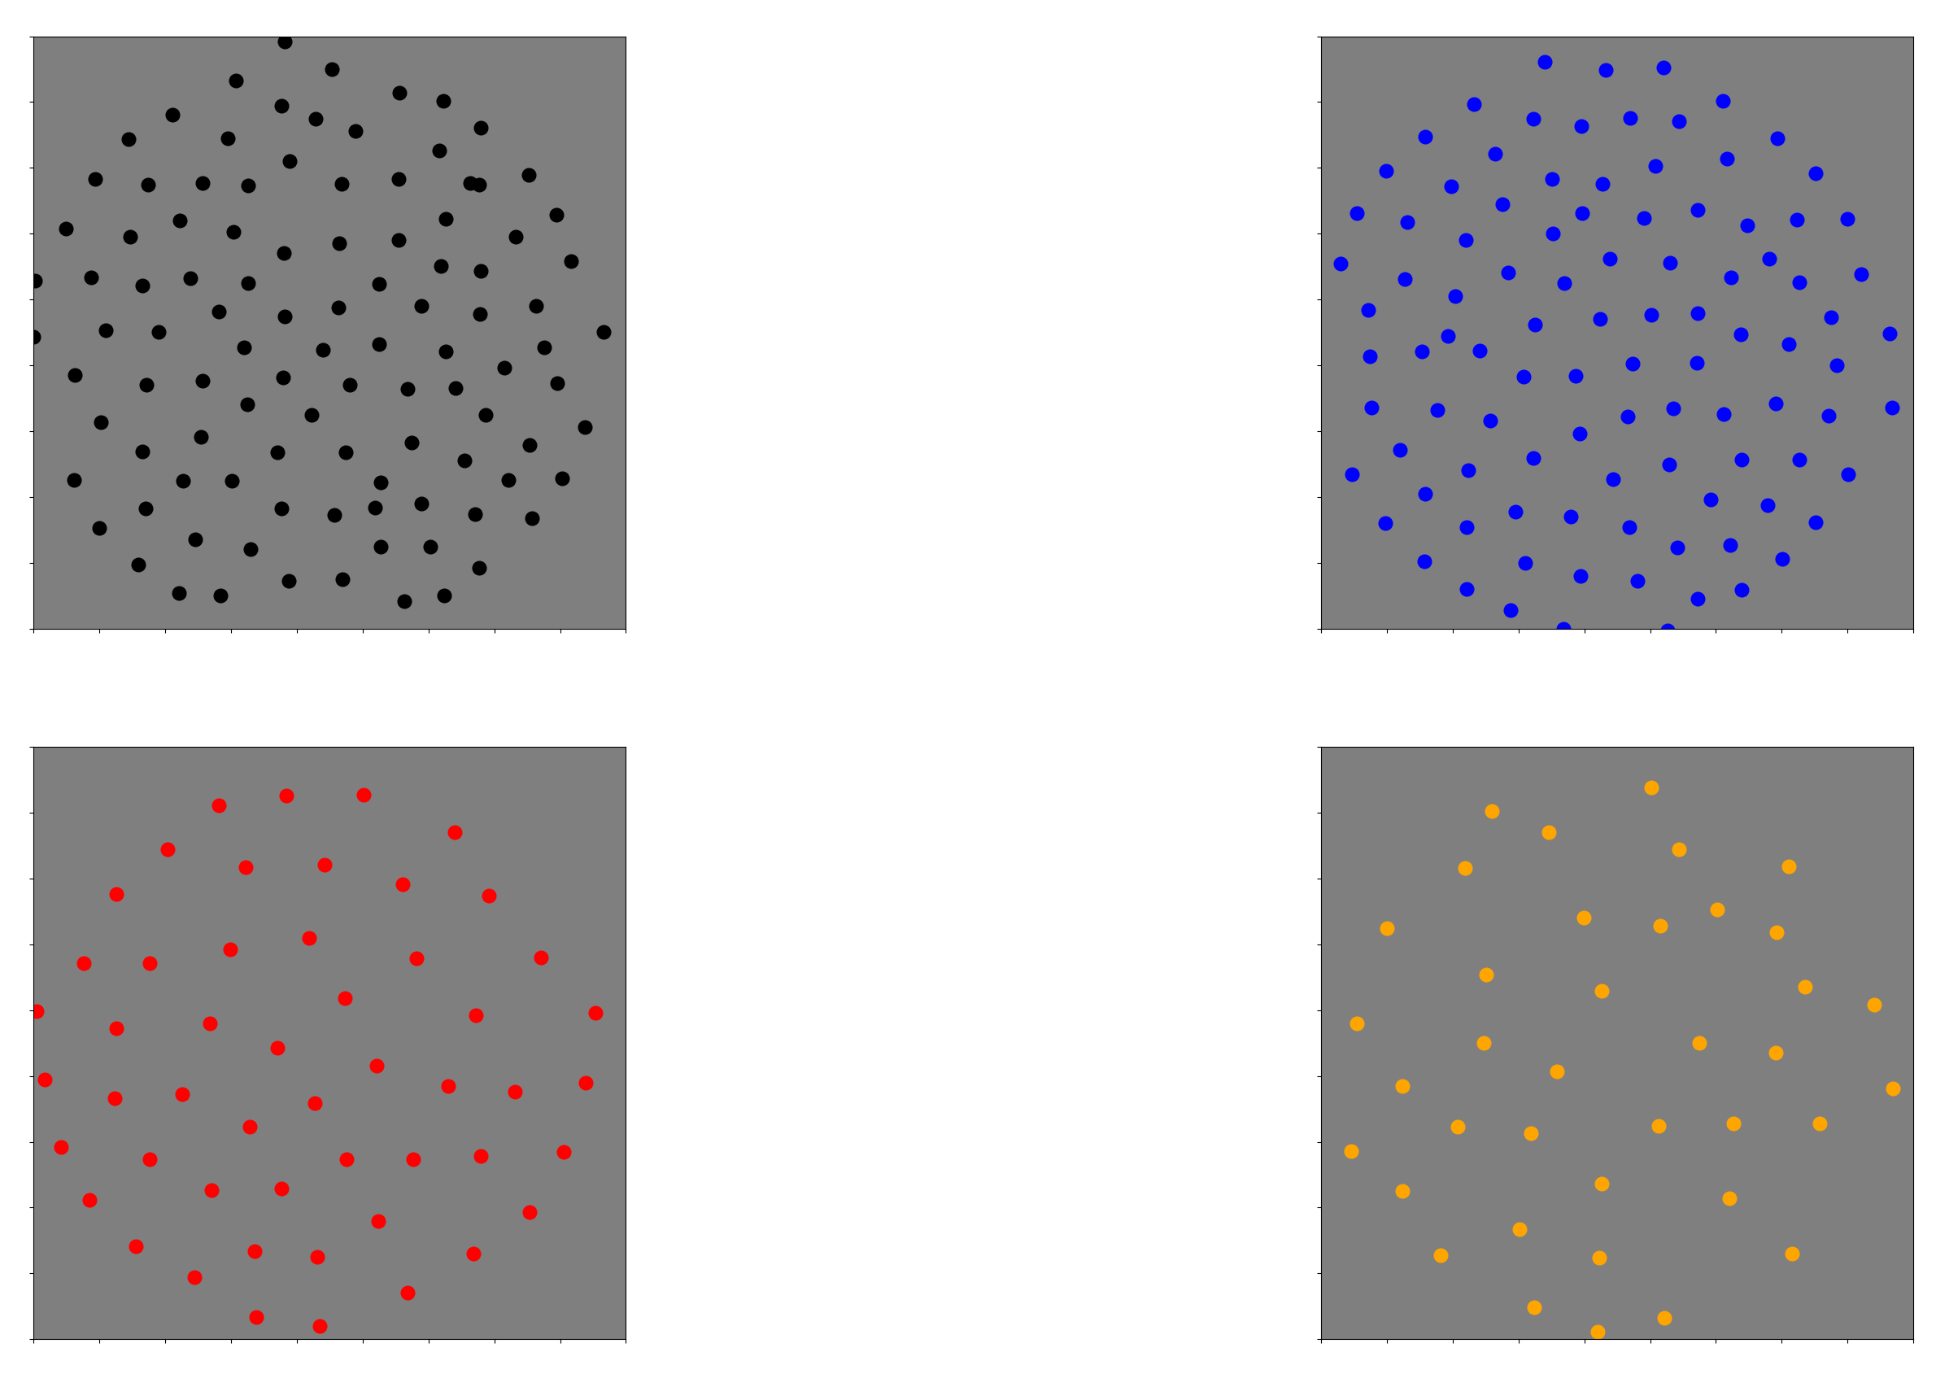

Slide 14
Number of neurons per mosaic
Original images
ON: 112
OFF: 105
L OFF: 48
S ON: 35
Removing +L -S
ON: 122
OFF: 107
L OFF: 48
S ON: 23
Increasing +L –S
ON: 107
OFF: 103
L OFF: 51
S ON: 39

