Slide 2
I&A UI Group Review 3/09

Slide 3
Goals
Add a tool(s) to allow the advanced filtration of coverage
Specifics for this iteration focus on the following parameters:
Visibility State by Category
Assignment State by Category
Measurement/Analysis State by Category
Manual Rejection State by Category

Slide 4
Current Coverage State Matrix
Combination of Options may result in an empty response for filtering, here’s why.
Matrix highlights the various state option combinations for a piece of coverage.
These will feed the filter options.
There are a couple of odd loopholes not on this martix. (Rejected && Assigned && Measured.)

Slide 5
Return Matrix
Combination of Options may result in an empty response, and that’s okay.
Allows most flexibility for future development. Complicated prevention rules may box us in.
Increase verbosity in responses to inform users that empty return is not a system error but a result of exclusive term use.
Make input-feedback loop small for rapid error recovery.

Slide 6
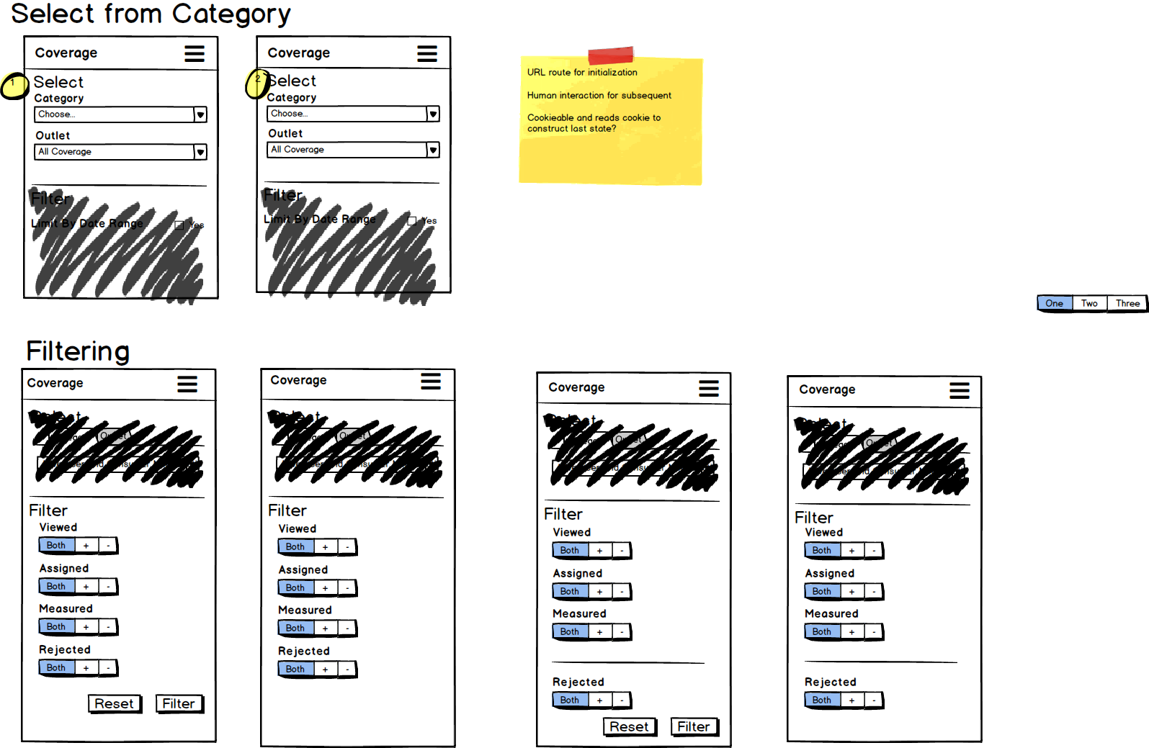
Each Filter has 3 options
Default/Both results set is “both” for all options.
Each option refines/reduces the data set from the ‘both’ option: EX: Viewed (+) & Assigned (+) will only return positives for both fields and both measured and unmeasured and rejected and non-rejected.
Version A
Results are obtained Asynchronously upon interaction
Each click on a field wipes out the current data set and replaces it with the called for data set
Version B
Results are called for by user interaction with the verb button.
Data set wiped out and replaced with results of query.
Designs
A
B

Slide 7
Sets the “Rejected” state apart
Version A
Results are obtained Asynchronously upon interaction
Each click on a field wipes out the current data set and replaces it with the called for data set
Version B
Results are called for by user interaction with the verb button.
Data set wiped out and replaced with results of query.
Designs
A
B

Slide 8
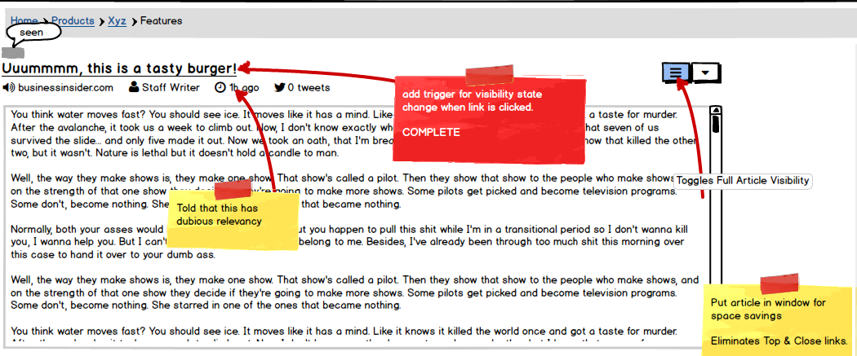
Designs: Enhancement?

Slide 9
THANK YOU
© 2014 Waggener Edstrom Communications All Rights Reserved.

