Slide 1

Python Media Player Application
By Peace

Slide 2
Group Members
Ngozi Peace
Naseli Okha
Hipolito
Youmen

Slide 3
Contents
Requirements/ Components for Media Player in Python
About Pygame module
About Tkinter module
Media Player Architecture
Screenshots of Source Code
Screenshot of the Result
Demonstraton

Slide 4
Requirements for Python Media Player
You should download and install the latest version of Python.
Python Development environment ( IDE). Using Atom as a Python editor for this project.(it is really flexible and has a great support of external packages which make it a powerful Interactive Development Environment (IDE).
Free and Open Source python programming language library for playing sounds.
Should be able to play, pause, resume and stop music as well as the ability to set the volume for the music.
Should be able to play selected music.

Slide 5
Components
File Explorer
.wav or .ogg file extension(for the music or sound)
Pygame module for controlling streamed audio
Pygame.mixer.music.load | Load a music file for playback
Pygame.mixer.music.play | Start the playback of the music
Pygame.mixer.music.pause | Temporarily stop music playback
Pygame.mixer.music.unpause | Resume paused music
Pygame.mixer.music.stop | Stop the music playback
Pygame.mixer.music.set_volume | Set the music volume

Slide 6
About Pygame Module
Pygame is a Python wrapper module for the SDL multimedia library. It contains python functions and classes that will allow you to use SDL’s support for playing audio and video output.
Does not require a GUI to use all functions.
Pygame has several commands to load and play sound files usually .wav or .ogg files.
Steps to Install Pygame
- Go to http://www.lfd.uci.edu/~gohlke/pythonlibs/#pygame and then click on the version that will work with your python version. If you have a 64-bit version of python , then download a 64-bit version of Pygame.

Slide 7
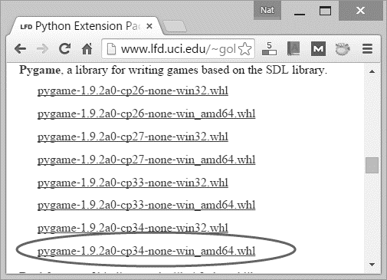
Step by Step procedure for Pygame installation

Slide 8
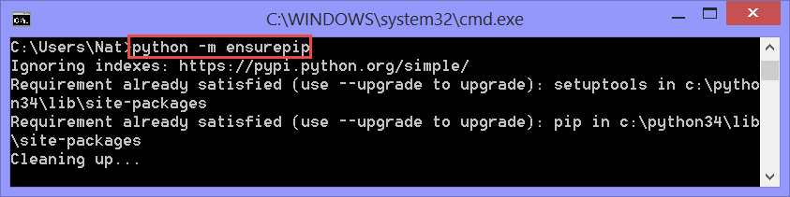
Step by Step procedure for Pygame installation
Then go to your cmd prompt and type the following:

Slide 9
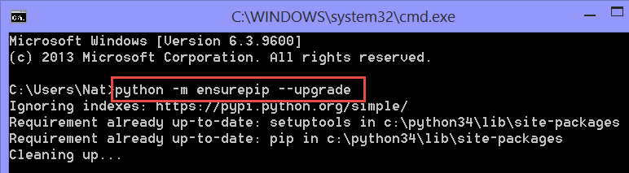
Step by Step procedure for Pygame installation
If it tells you the requirement is already satisfied, run the upgrade command:

Slide 10
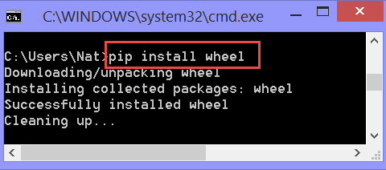
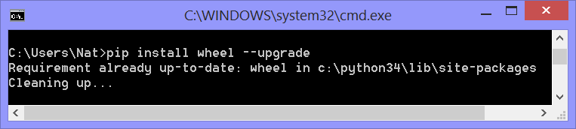
Step by Step procedure for Pygame installation
Install wheel. At the command prompt, type the following:
If it tells you the requirement is already satisfied, run the upgrade command:

Slide 11
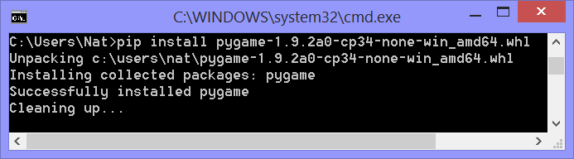
Step by Step procedure for Pygame installation
Now you are ready to install pygame at the command line by simply typing in the version you downloaded.

Slide 12
Media Player Architecture
File Explorer
Accesses the list of sounds in the folder
Pygame module
Plays the selected sounds
Music file

Slide 13
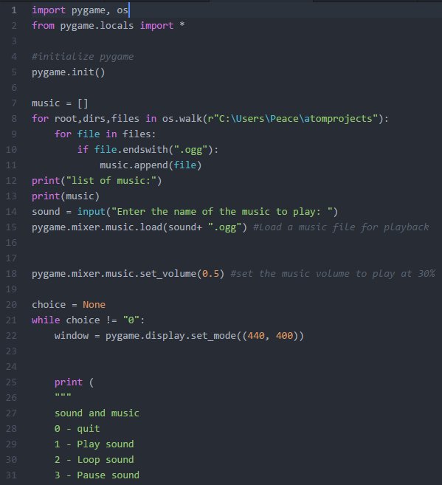
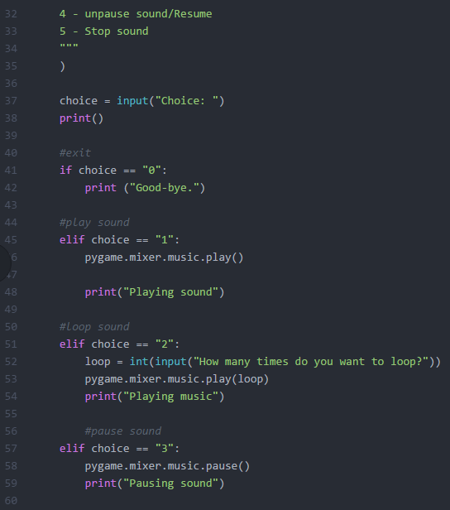
Source Code

Slide 14
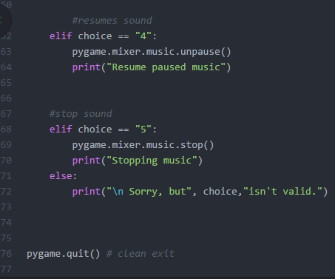
Source Code cont’d

Slide 15
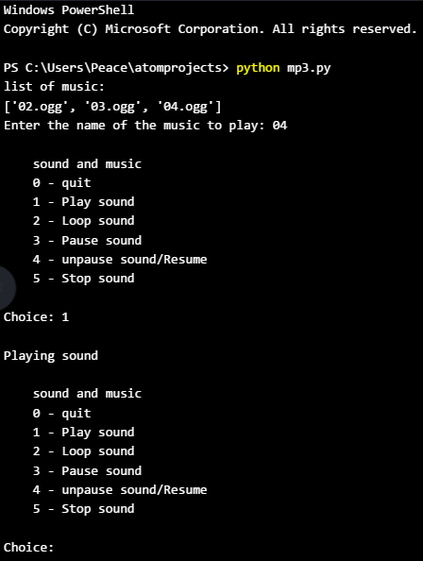
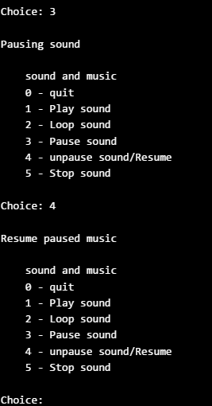
Screenshots of the Result

Slide 16
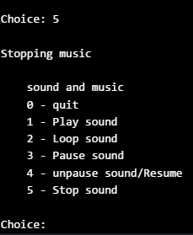
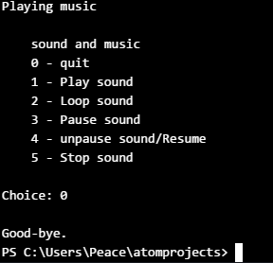
Screenshots of the Result

Slide 17
Amelioration

Slide 18
Updated Media Architecture
File Explorer
Accesses the list of sounds in the folder
tkinter module
Basic GUI for playing the music
Pygame module
Plays the selected sounds
Music file

Slide 19
Tkinter
It is module in the Python standard library which serves as an interface to Tk, a simple toolkit.
It provides us with a variety of common GUI elements – such as buttons, menus and various kinds of entry fields and display areas.

Slide 20
Pygame – music playing
Tkinker – to make the basic GUI for the media app ( user friendly)

Slide 21
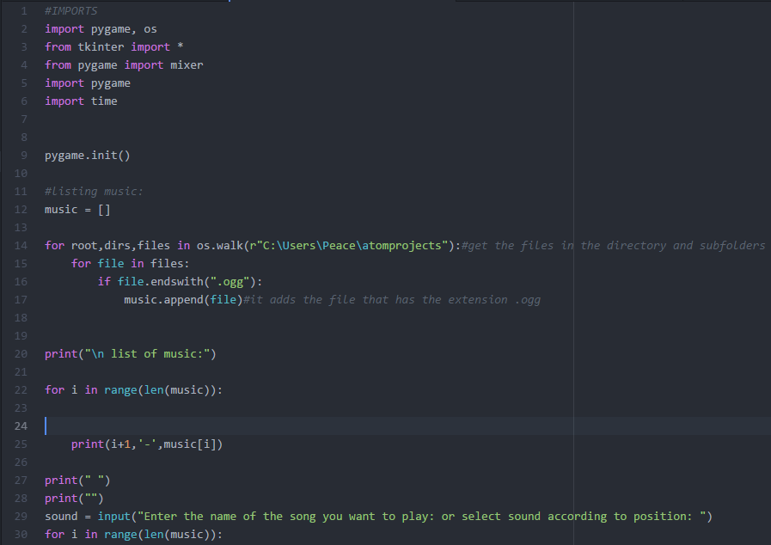
First Stage of the code

Slide 22
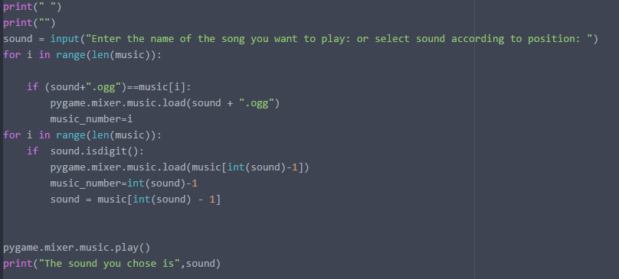
Continuation

Slide 23
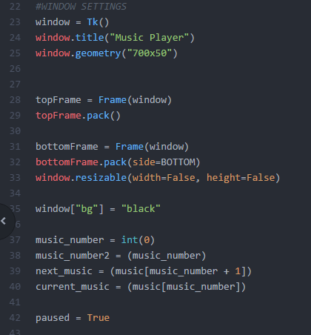
Windows settings

Slide 24
Definition

Slide 25
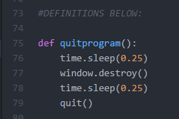
Defining the Quit Button

Slide 26
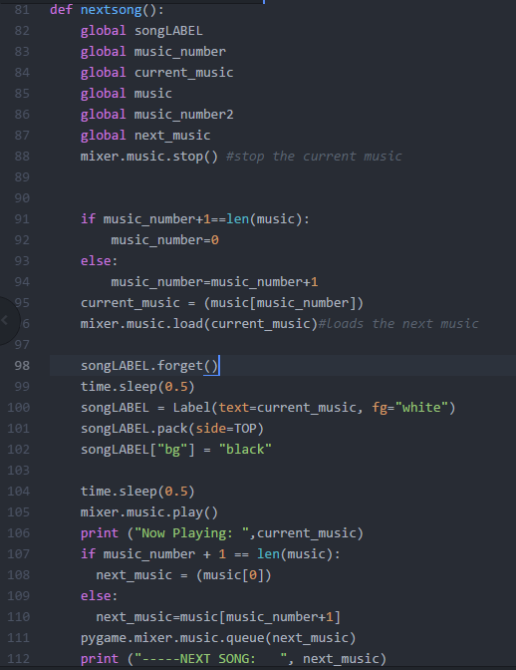
Define the Nextsong Button

Slide 27
The global keyword is the way that you tell python that a particular variable in your function is defined at the global (module-level) scope.

Slide 28
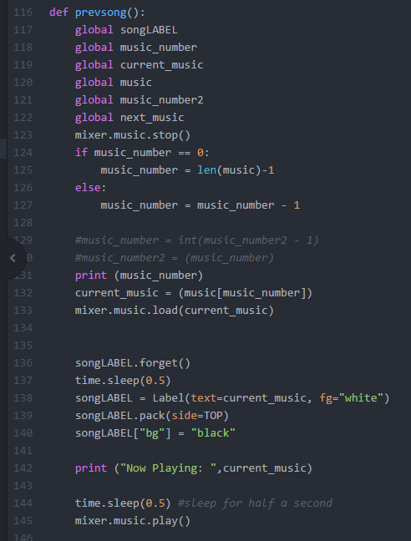
Next stage To define the PrevSong button

Slide 29
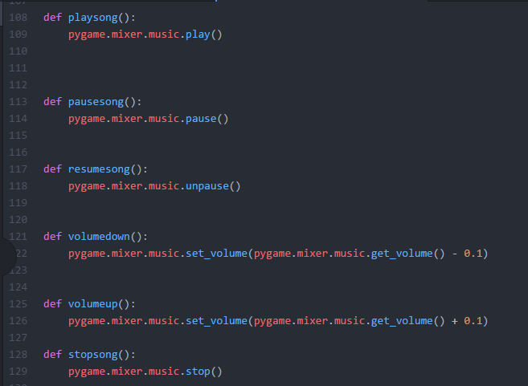
Define the pygame. Mixer.music module

Slide 30
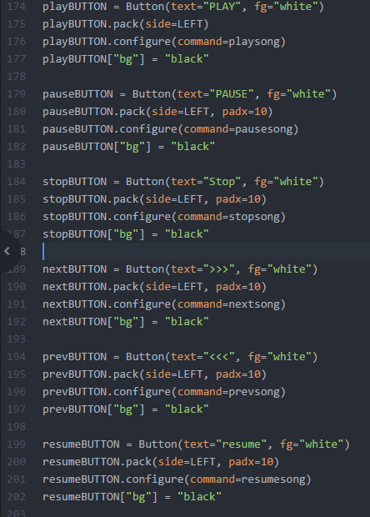
The Button Description

Slide 31
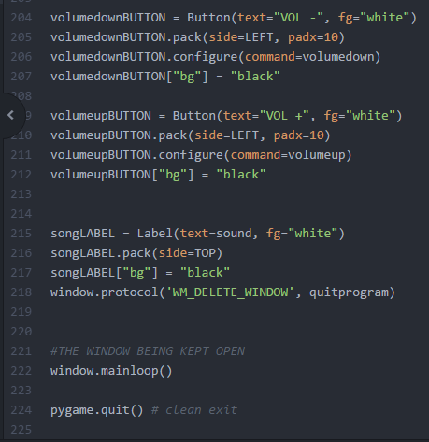
The Button Description

Slide 32
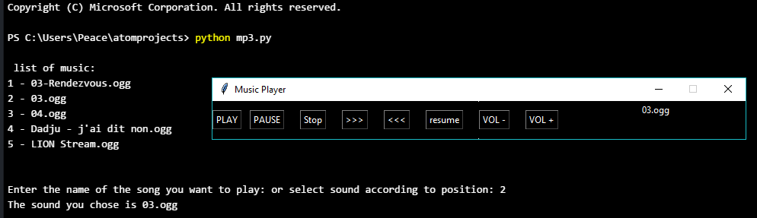
Result

Slide 33
Demonstration

