Slide 1
Logic Programming Infrastructure for Inferences on FrameNet
Peter Baumgartner
MPI Informatik, Saarbrücken
Aljoscha Burchardt
Universitaet des Saarlandes, Saarbruecken

Slide 2
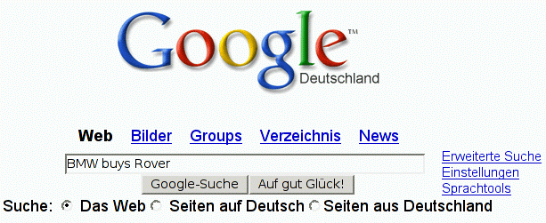
Motivation

Slide 3
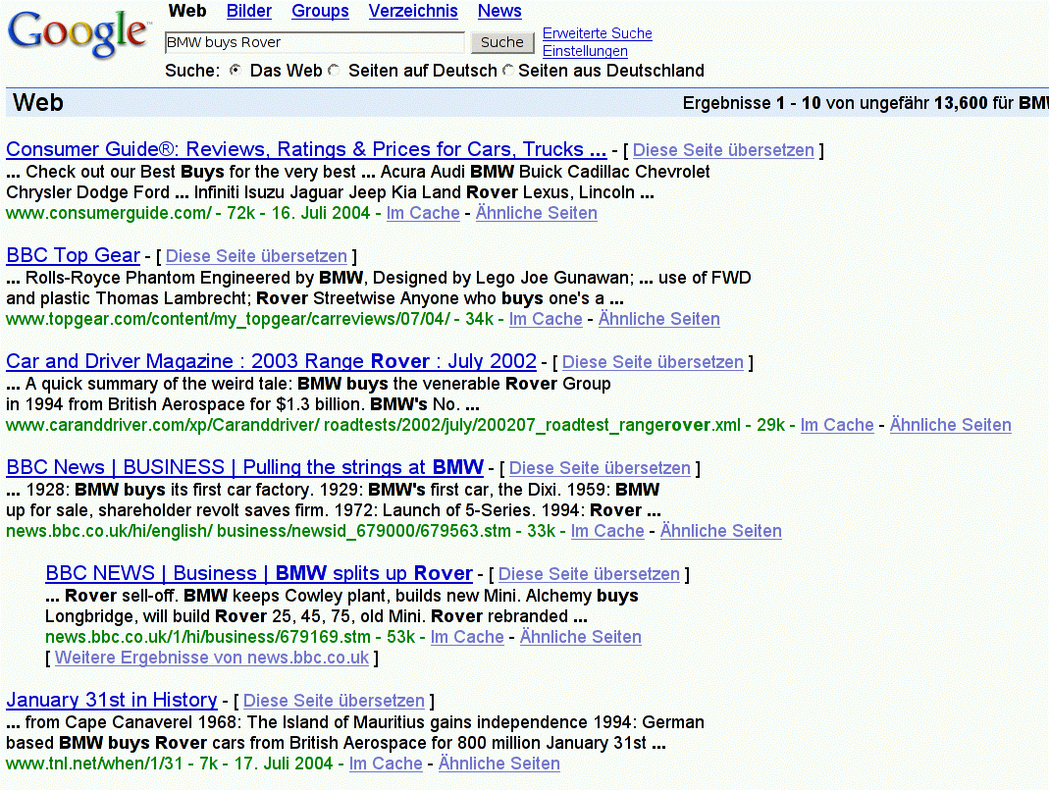
Motivation
Problem 1: Low Precision
Problem 2: Low Recall
(Miss highly relevant page
returned for search term
BMW buy Rover)

Slide 4
Approaches
- Stemming (buys – buy)
Synonyms (purchase – buy), e.g. from WordNet
Compare words on page and words of query term
Statistics based methods mostly help to improve recall
Idea of our Approach: Combination (roughly):
- Linguistic methods
state-of-the-art parsing, synonyms, feature structures,
word sense disambiguation
-> High recall
- Logic based method
Structured, frame-like representation
Reasoning with background knowledge
-> high precision
Next: knowledge representation framework

Slide 5
From Natural Language Text to Frame Representation
FrameNet
550 Frames
7000 Lex Units
Frame
Representation
Com GT
Buyer: BMW
Seller: BA
Goods: Rover
Money: unknown
Text
BMW
bought
Rover
from BA
?
Com GT
Buy
Sell
Linguistic
Method
BMW
Rover
BA
Rover
Deduction
System
Logic

Slide 6
Representing Text as Logical Facts
BMW bought Rover from BA
Assumption: linguistic method delivers:
... as a Logic Program (facts):
buy1:
buy
buyer: "BMW"
goods: "Rover"
buy(buy1).
buyer(buy1,"BMW").
goods(buy1,"Rover").
How to realize this task:
Linguistic method knows about "basic" FrameNet Frames
(those admitting linguistic realization)
Lexical units of FrameNet frames backed up by WordNet Synonym sets
Mapping of parse trees to frames can be learned
Extension: some parsers (Xerox LFG parser) deliver additional valuable
information, e.g. that BMW is a manufacturer

Slide 7
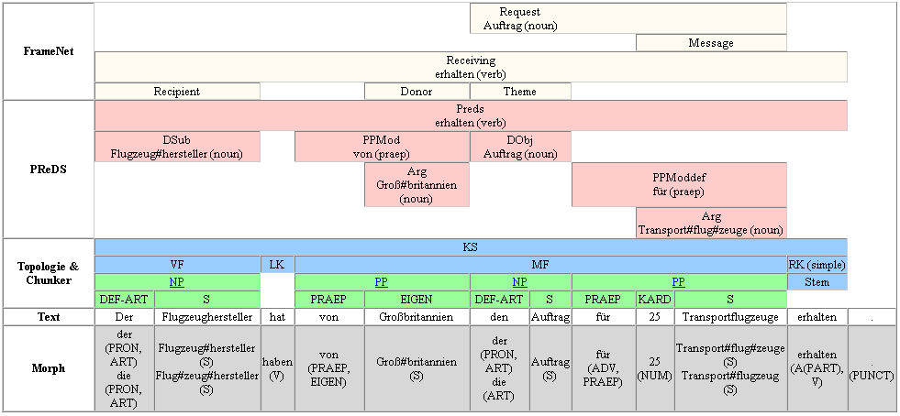
A First Application: Transfer of Role Fillers
(Slide by Gerd Fliedner)
The plane manufacturer has from Great Britain the order for 25 transport planes received.
"Challenge": Fill in the missing elements of „Request“ frame

Slide 8
Transfer of Role Fillers
The plane manufacturer has from Great Britain the order for 25 transport planes received.
Parsing gives partially filled FrameNet
frame instances of „receive“ and „request“:
receive1:
receive
target: „received“
donor: „Great Britain“
recipient: manufacturer1
theme: request1
request1:
request
target: „order“
speaker:
addressee:
message: „transport plane“
„Great Britain“
manufacturer
Transfer of role fillers done so far manually
Can be done automatically. By „model generation“

Slide 9
Computing Models with KRHyper
a. (1)
b ; c :- a. (2)
a ; d :- c. (3)
false :- a,b. (4)
- Disjunctive logic programs
- Stratified default negation
- Perfect model semantics
- Also stable models, possible models
- Serious implementation (OCaml)
e :- c, not d. (5)
a
a
a
b
c
b
c
X
X
e
{} ² (1)
{a} ² (2)
{a,b} ² (4)
X
{a,c} ² (1)-(4)
- Variant for predicate logic
- Extensions: minimal models, abduction, default negation

Slide 10
Transfer of Role Fillers
The plane manufacturer has from Great Britain the order for 25 transport planes received.
Parsing gives partially filled FrameNet
frame instances of „receive“ and „request“:
receive1:
receive
target: „received“
donor: „Great Britain“
recipient: manufacturer1
theme: request1
request1:
request
target: „order“
speaker:
addressee:
message: „transport plane“
„Great Britain“
manufacturer
Transfer of role fillers done so far manually
Can be done automatically. By „model generation“

Slide 11
Transfer of Role Fillers by Logic Programming
receive1:
receive
target: „received“
donor: „Great Britain“
recipient: manufacturer1
theme: request1
request1:
request
target: „order“
speaker:
addressee:
message: „transport plane“
„Great Britain“
Rules
Facts
speaker(Request, Donor) :-
receive(Receive),
donor(Receive, Donor),
theme(Receive, Request),
request(Request).
receive(receive1).
donor(receive1,
„Great Britain“).
theme(receive1,request1).
request(request1).

Slide 12
Translation of FrameNet Frames to Logic Programs
So far:
logical representation of analyzed text, and
impression of usefulness of logic programming approach
using hand-crafted "expensive" rules. But:
FrameNet offers useful information that can be translated
once and for all into a logic program, in a systematic way:
Inheritance among frames
"Uses" relationships (partial inheritance)
"Subframe" relationships
This way, FrameNet is equipped with a formal semantics!
Also realized in our translation: default values
Next: default values in some detail, "Uses" relationship in brief

Slide 13
Default Values
Insert default value as a role filler in absence of specific information
Example:
receive1:
receive
target: „received“
donor: „Great Britain“
recipient: manufacturer1
theme: request1
request1:
request
target: „order“
speaker:
addressee:
message: „transport plane“
„Great Britain“
Should transfer "donor" role filler only if "speaker" is not already filled:
default_request_speaker(Request, Donor) :-
receive(Receive),
donor(Receive, Donor),
theme(Receive, Request),
request(Request).

Slide 14
Default Values
Insert default value as a role filler in absence of specific information
Example:
In Stock Market context use default "share" for "goods" role of "buy":
default_buy_goods(Buy, "share") :-
'Buy is an event in a stock market context'.
Example:
Disjunctive (uncertain) information
Linguistic analysis is uncertain whether "Rover" or "Chrysler" was bought:
default_buy_goods(buy1,"Rover").
default_buy_goods(buy1,"Chrysler").
This amounts to two models, representing the uncertainty
They can be analyzed further

Slide 15
Default Values
Insert default value as a role in absence of specific information
Example:
Generic "typed" default value:
default_commerce_goods_transfer_money(_,unspecified_money).
Generic default value, general scheme:
default_F_R(_,unspecified).
where F is a Frame with role R
Note:
Apply general scheme only to basic frames, but omit FEE role.
Otherwise every frame will be filled right away, which is pointless!

Slide 16
Default Value – General Transformation
Technique:
a :- not not_a.
not_a :- not a.
has two stable models: one where a is true and one where a is false
Choice to fill with default value or not:
goods(F,R) :-
not not_goods(F,R),
buy(F),
default_buy_goods(F,R).
not_goods(F,R) :-
not goods(F,R),
buy(F),
default_buy_goods(F,R).
Case of waiving default value:
false :-
buy(F),
default_buy_goods(F,R1),
goods(F,R1),
goods(F,R2),
not equal(R1,R2).
equal(X,X).
Require at least one filler for role:
false :-
buy(F),
not some_buy_goods(F).
Role is filled:
some_buy_goods(F) :-
buy(F),
goods(F,R).

Slide 17
The "Uses" Relation
Pragmatics: offer different perspectives on Frames
buy1:
commerce_goods_transfer
buyer: "BMW"
seller: "BA"
goods: "Rover"
money: unspecified_money
Uses
buy1:
buy
buyer: "BMW"
goods: "Rover"
buy1:
sell
seller:"BA"
goods: "Rover"
Technically: partial inheritance

Slide 18
The "Uses" Relation – Partial Inheritance
"Upwards" inheritance:
buy1:
commerce_goods_transfer
buyer: "BMW"
seller: "BA"
goods: "Rover"
money: unspecified_money
Uses
buy1:
buy
buyer: "BMW"
goods: "Rover"
buy1:
sell
seller:"BA"
goods: "Rover"
- Create instance of "used" frame
ransfer role fillers of "using" frame
Use default values for extra roles of "used" frame

Slide 19
The "Uses" Relation – Partial Inheritance
"Upwards" inheritance – slightly different scenario:
buy1:
commerce_goods_transfer
buyer: "BMW"
seller: unspecified
goods: "Rover"
money: unspecified_money
Uses
buy1:
buy
buyer: "BMW"
goods: "Rover"
sell
seller:
goods:
- Create instance of "used" frame
transfer role fillers of "using" frame
Use default values for extra roles of "used" frame

Slide 20
The "Uses" Relation – Partial Inheritance
"Downwards " inheritance:
cgt1:
commerce_goods_transfer
buyer: "BMW"
seller: "BA"
goods: unspecified
money: unspecified_money
Uses
cgt1:
buy
buyer: "BMW"
goods: unspecified
cgt1:
sell
seller: "BA"
goods: unspecified
- Create instances of "using" frames
Transfer role fillers of "used" frame
Note: "money" role is not inherited
Rules accomplishing partial inheritance can be derived automatically!

Slide 21
Query Evaluation
Text
BMW
bought
Rover
from BA
FrameNet
Com GT
Buy
Sell
Linguistic
Method
BMW
Rover
BA
Rover
L. Pr.
KRHyper
M₂
M₁
Answer
buy(buy1).
buyer(buy1,"BMW").
:
KRHyper
M₃
M₄
Query:
"Who bought Rover?"

Slide 22
Query Evaluation - Technical
Who bought Rover from whom?
As a conjunctive query:
Q: solution(Buyer,Seller) :-
commerce_goods_transfer(E),
buyer(E,Buyer),
goods(E,"Rover"),
seller(E,Seller).
Assume models of text M₁,...,M_{n} already computed
Different Reasoning Tasks
Credulous: exists M_{i} such that M_{i} [ {Q} ² solution(B,S) ?
(for some B and S)
Skeptical: for all M_{i} , does M_{i} [ {Q} ² solution(B,S) hold?
(for some B and S)
Both can be solved by inspecting models of M_{i} [ {Q}

Slide 23
Next Step: RTE Challenge
Recognizing Text Entailment Challenge
Bar Ilan University, Israel, November 2004
Compare natural language processing systems for IR, QA, ...
on a common test set
"Textual entailment problem":
  Given: a text snippet "text"
  Given: a text snippet "hypothesis"
  Question: Does "text" entail "hypothesis"?
300 sample pairs available now as a test set, total 1000
Test goes beyond word sense disambiguation and beyond named entity recognition. Need "semantic" processing
Challenge is considered as difficult by its creators
Our approach:
  compute models of "text" and "hypothesis"
  compare models using further background knowledge

Slide 24
RTE Challenge - Examples
Text | Hypothesis | Status
Doug Lawrence bought the impressionist oil landscape by J. Ottis Adams in the mid-1970s at a Fort Wayne antiques dealer | Doug Lawrence sold the impressionist oil landscape by J. Ottis Adams | False
Eyeing the huge market potential, currently led by Google, Yahoo took over search company Overture Services Inc last year | Yahoo bought Overture. | True
The market value of u.s. overseas assets exceeds their book value. | The market value of u.s. overseas assets equals their book value. | False
Crude oil for April delivery traded at $37.80 a barrel, down 28 cents | Crude oil prices rose to $37.80 per barrel | False
Guerrillas killed a peasant in the city of Flores | Guerrillas killed a civilian | True
Clinton's new book is not big seller here | Clinton's book is a big seller | False

Slide 25
Conclusions
Summary
Propose model computation paradigm for "semantical" processing of natural language text
Target application: information retrieval from templates, question answering
Builds on readily developed FrameNet ontology
Lots of Open Ends
Implementation (Master's thesis, in progress)
Practical evaluation, in particular RTE challenge
Negation, Anaphora resolution
Background knowledge: combination with ontologies like SUMO
Relevance of proposed framework for Semantic Web

