Slide 1
The Model Evolution Calculus
Peter Baumgartner, MPI Saarbruecken and U Koblenz
Cesare Tinelli, U Iowa

Slide 2
Background
Recent research in propositional satisfiability (SAT) has been very successful.
An effective method for SAT was pioneered by Davis, Putman, Logemann, and Loveland (DPLL).
The best modern SAT solvers (MiniSat, zChaff, Berkmin,…) are based on DPLL.

Slide 3

The DPLL Procedure: Main Idea
assert: p = T

Slide 4

The DPLL Procedure: Main Idea
assert: p = T
assert: q = F

Slide 5

The DPLL Procedure: Main Idea
assert: p = T
assert: q = F
guess: r = T

Slide 6
The DPLL Procedure: Main Idea
assert: p = T
assert: q = F
guess: r = T
contradiction!

Slide 7

The DPLL Procedure: Main Idea
assert: p = T
assert: q = F
guess: r = F
satisfiable!

Slide 8
Correctness of DPLL method
Prop. A formula ϕ is satisfiable iff
there is a sequence of guesses
such that DPLL(ϕ) = ∅

Slide 9
Research Questions
Can we lift DPLL to the first-order level?
Can we combine successful SAT techniques (unit propagation, backjumping, learning,…) with successful first-order techniques (unification, subsumption, ...)?

Slide 10
Previous Work
Instance based methods
- (O)SHL [Plaisted],
- Disconnection method [Billon], [Letz, Stenz],
- Hyper Tableaux Next Generation [Baumgartner],
- Primal/Dual approach [Hooker et al],
- Ganzinger-Korovin method
First-Order DPLL [Baumgartner]
- proper lifting of split rule

Slide 11
This Work
The Model Evolution Calculus
≈
First-Order DPLL
+ DPLL’s simplification rules
+ Universal variables
The calculus is a direct lifting of the whole DPLL to the first-order level.

Slide 12
Overview
The DPLL method as a sequent-style calculus
A model generation view of DPLL
The Model Evolution calculus as a lifting of the DPLL calculus
Properties of the ME calculus
Further Work

Slide 13
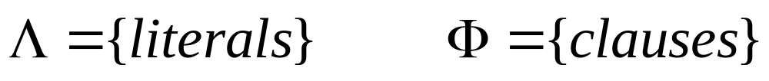

The DPLL Calculus
Context
(asserted literals)

Slide 14
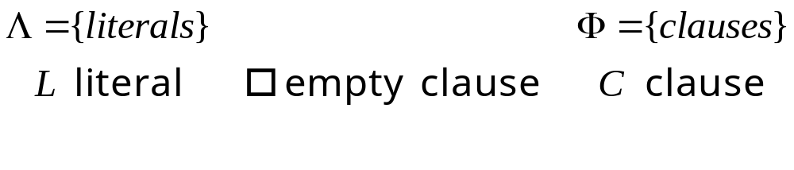

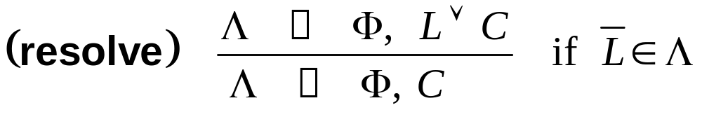
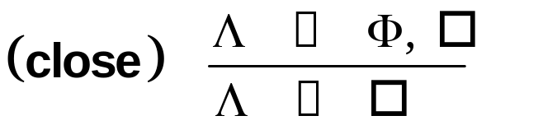
The DPLL Calculus

Slide 15
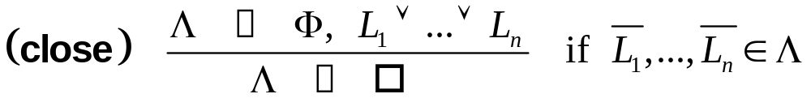
The DPLL Calculus

Slide 16
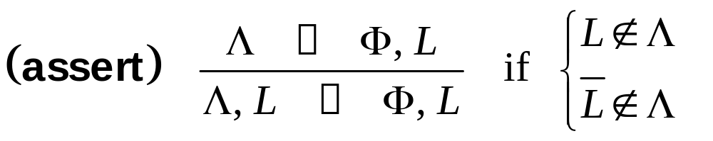
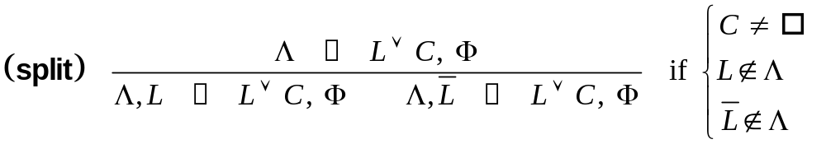
The DPLL Calculus (cont.)

Slide 17
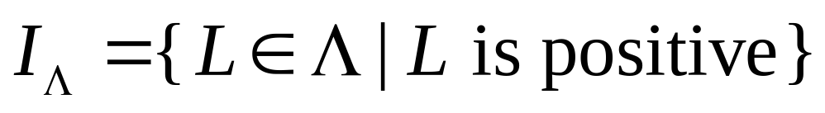
The DPLL Calculus: Key Insight
Λ can be seen as a finite representation
of a Herbrand interpretation:
If I_{Λ} does not satisfy Φ,
“repair” it by adding literals to Λ

Slide 18
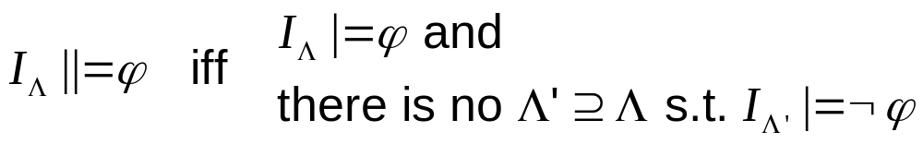
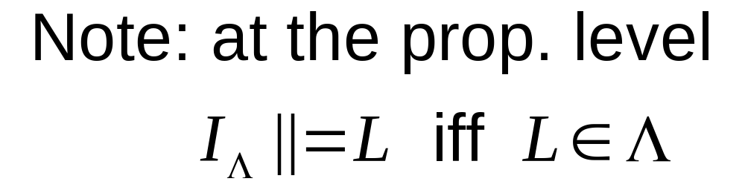
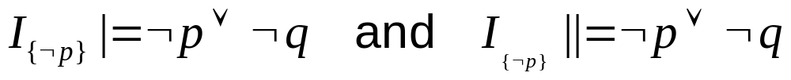
Some Notation
permanently satisfies
Examples:

Slide 19
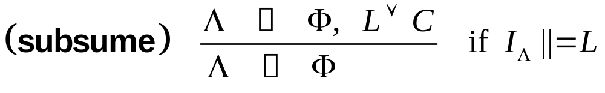
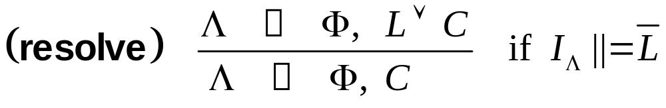
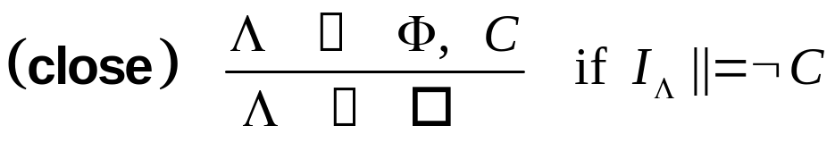
The DPLL Calculus Revisited:
A Model Evolution View

Slide 20
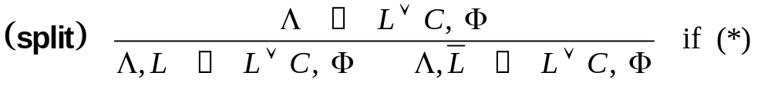
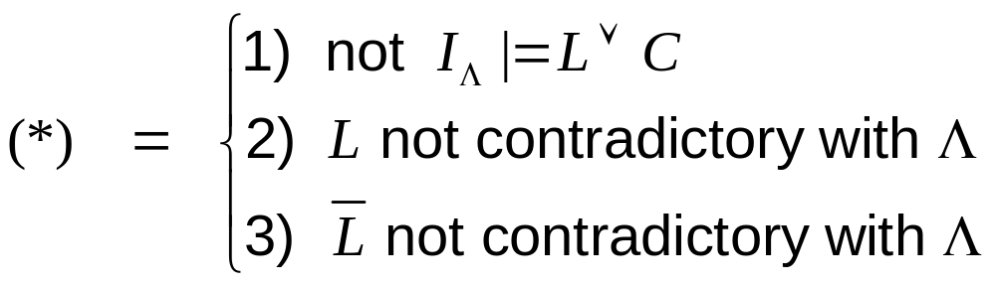
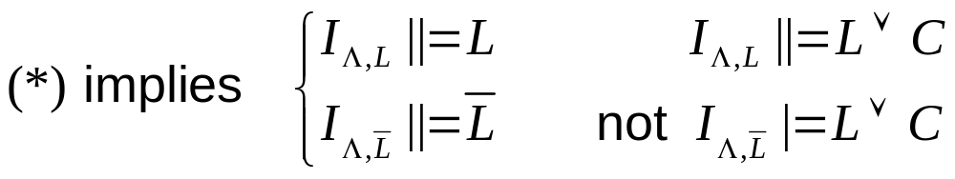
The DPLL Calculus Revisited:
A Model Evolution View
Note:

Slide 21
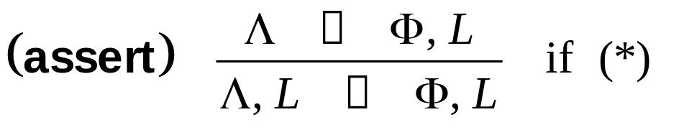
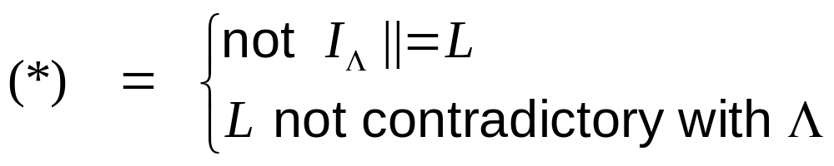
The DPLL Calculus Revisited:
A Model Evolution View

Slide 22
Lifting DPLL to First Order Logic
Main questions:
How to use contexts to represent a FOL Herbrand interpretation
What is a contradictory context
How to check |=
How to check ||=
How to repair an interpretation

Slide 23
First-order Contexts
Sets Λ of parametric literals L(u,v,..) and
universal literals L(x,y,…)
parameters (u,v, …) and variables (x,y,…) both stand for ground terms
(roughly) a parametric literal L in Λ denotes all of its ground instances, unless ¬L’∈Λ for some instance L’ of L
a universal literal denotes all of its ground instances, unconditionally

Slide 24
First-order Contexts: Examples
Λ = { p(u,v) }
p(u,v)
Λ produces every instance of p(u,v)

Slide 25
First-order Contexts: Examples
Λ = {p(u,v), ¬p(u,u)}
p(u,v)
¬p(u,u)
Λ produces every instance of p(u,v) except the instances of p(u,u)
Λ produces every instance of ¬p(u,u)

Slide 26
First-order Contexts: Examples
Λ = {p(u,v), ¬p(u,u), p(f(u),f(u))}
p(u,v)
¬p(u,u)
p(f(u),f(u))

Slide 27
First-order Contexts: Examples
OK
Λ = {¬p(f(u),v), p(u,g(v))}
¬p(f(u),v)
p(u,g(v))
p(f(u),g(v))

Slide 28
First-order Contexts: Examples
OK
Λ = {¬p(f(u),v), p(u,g(v)), p(b,g(v)) }
¬p(f(u),v)
p(u,g(v))
p(b,g(v))

Slide 29
First-order Contexts: Examples
Λ = {¬p(u,v), p(u,v)}
Not OK!
Contradictory
¬p(u,v)
p(u,v)

Slide 30
First-order Contexts: Examples
Λ = {p(u,v), ¬p(x,x)}
p(u,v)
¬p(x,x)
Λ produces every instance of ¬p(x,x) with no possible exceptions

Slide 31
First-order Contexts: Examples
Λ = {p(u,v), ¬p(x,x), p(f(u),f(u)}
Not OK!
Contradictory
p(u,v)
¬p(x,x)
p(f(u),f(u))

Slide 32
Initial Context
Λ = {¬v}
¬v
Lambda produces no positive literals
We’ll consider only extensions of {¬v}

Slide 33
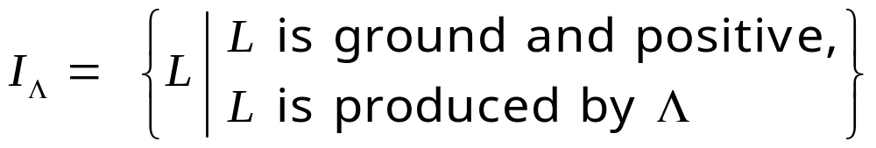
Contexts and Interpretations
Let Λ be a non-contradictory context with parametric literals and universal literals
Λ denotes a Herbrand interpretation:

Slide 34
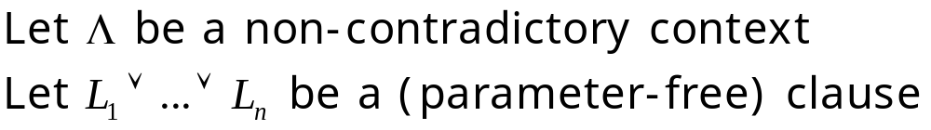
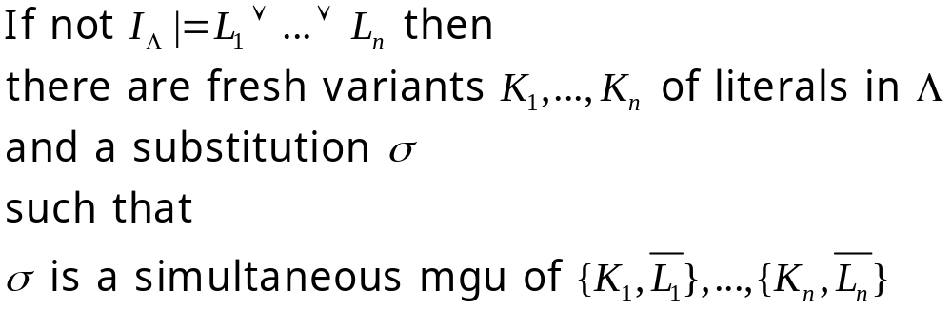
Checking |=
σ is called a context unifier (of the clause against Λ)

Slide 35
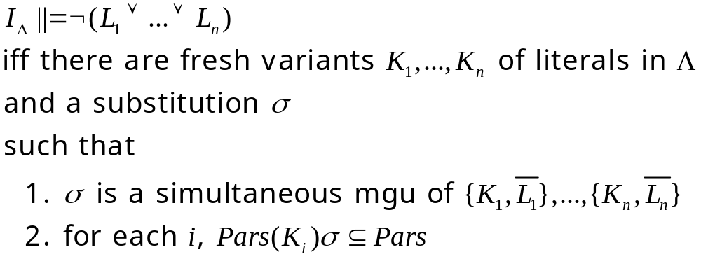
Checking ||=
Example
I_{{¬p(u,v)}} ||= ¬(p(x,y) ∨ p(x,x))
equivalently, match
{p(x,y), p(x,x)} against {p($,$)}

Slide 36
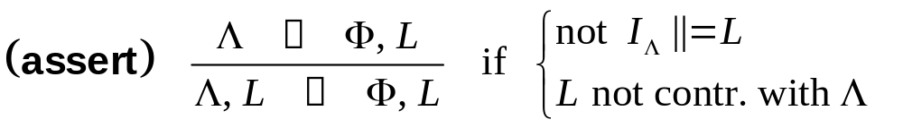
The Model Evolution Calculus:
Semantical View
Exactly the same as in DPLL!

Slide 37
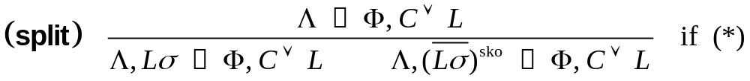
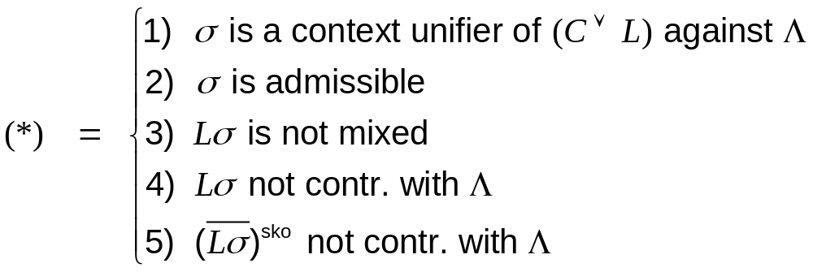
The Model Evolution Calculus:
Semantical View
No Longer

Slide 38
The Split Rule: Example
First, identify falsified clause instance:
Now, split with
abs(x)≥u | ¬abs(c)≥u
Clauses: x≥y ∨ y≥x
abs(x)≥0
¬(x≥y) ∨ ¬(y≥z) ∨ (x≥z)
σ
context
unifier
Context: abs(x)≥0 v≥u ¬v
¬(abs(x)≥0) ∨ ¬(0≥u) ∨ (abs(x)≥u)
Permanenly
falsified
remainder
σ admissible context unifier

Slide 39
Example
abs(u)≥a  abs(x)≥a, ...
assert
abs(x)≥a, abs(u)≥a  abs(x)≥a, ...
compact
abs(x)≥a  abs(x)≥a, ...
subsume
abs(x)≥a  ¬abs(f(x))≥a ∨ p(x), ...
resolve
abs(x)≥a  p(x), ...

Slide 40
Further Notions
Derivation tree
Exhausted/closed branch
Derivation/refutation
Limit tree
Fair limit tree/derivation

Slide 41
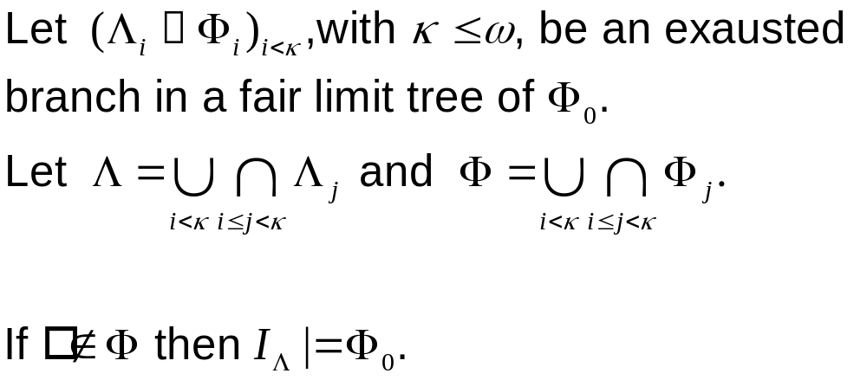
Main Results: Completeness

Slide 42
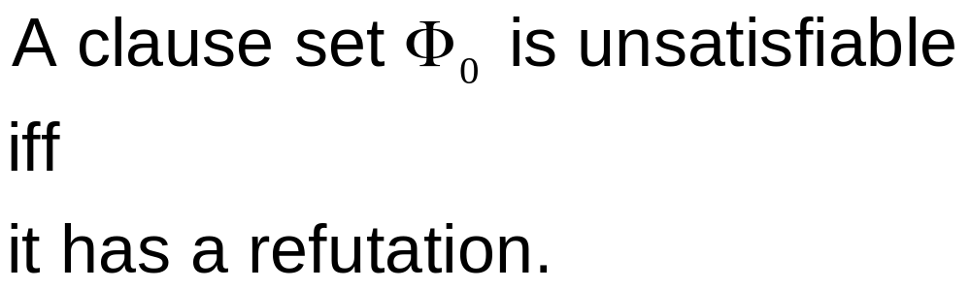
Main Results: Soundness and Completeness

Slide 43
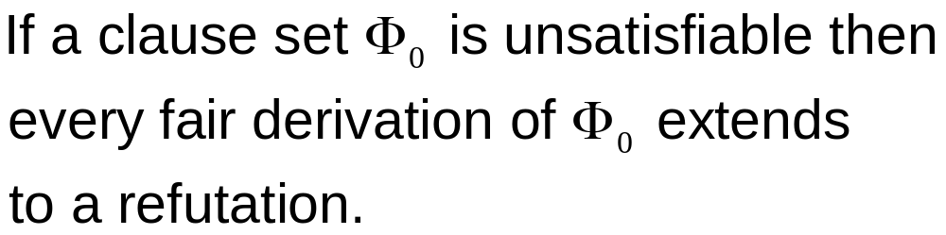
Main Results: Proof Convergence

Slide 44
Making ME Efficient
Well-known DPLL improvements:
Literal selection strategies
Model Elimination:
can exploit don’t care nondeterminism
for remainer literal to split on
Learning (lemma generation)
not trivial – future work
Intelligent backtracking (backjumping)

Slide 45


Backjumping

Slide 46
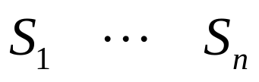
Backjumping
L not used to close
left subtree

Slide 47
Conclusions
Full lifting of DPLL achieved
Properties of DPLL preserved
  sound and complete
  proof convergent
  simplification rules
  model generation paradigm
  (no Commit rule as in FDPLL)
Abstract framework
  Wide range for fair strategies
  Semantically justified redundancy criteria

Slide 48
Further Work
Implement the calculus! (in progress)
Lift DPLL optimizations (backjumping, lemma generation, …)
Add equality
Study decidable fragments
Add nonmonotonic features
Build-in theories
...

