Slide 1
The Model Evolution Calculus with Built-in Theories
Peter Baumgartner
MPI Informatik, Saarbrücken
www.mpi-sb.mpg.de/~baumgart/

Slide 2
Problem
The Model Evolution Calculus is a sound and refutationally complete calculus for first-order clause logic
Can we extend it with built-in theory handling?
That is, „plug in“ an (efficient) reasoner for a special domain
Examples for interesting theories
  Equality
  Real arithmetic
  Theories axiomatized by logic programs
Can existing theory reasoners be plugged in (to Darwin)?
  Equality: Waldmeister
  Real arithmetic: quantifier elimination
  Logic programs: logic program interpreter

Slide 3
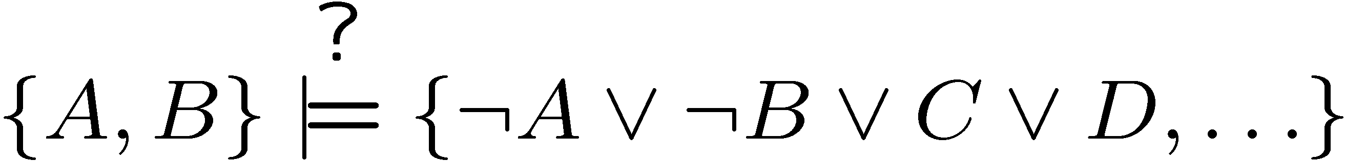
Model Evolution – Idea (1)
DPLL: Davis-Putnam-Logemann-Loveland Procedure (1960-63)
Basis of some of the SAT solvers (Chaff, …)
Input: Propositional clause set
Output: Model or „unsatisfiable”
A
:A
Algorithm components:
- Simplification
- Split
- Backtracking
B
:B
C
:C
No, split on C

Slide 4
Model Evolution – Idea (2)
¼ First Order DPLL [Joint Work with Cesare Tinelli]
Input: First-order clause set
Output: Model or „unsatisfiable”
if termination
 
: 
Procedure components:
- Simplification
- Split
- Backtracking
:


:
No, split on 

Slide 5

Calculus
Sequent Style Calculus
Simplified Calculus (for the purpose of talk)
  No simplification inference rules to modify Φ
  No simplification inference rules to modify Λ
  No „universal“ variables, only „parametric“ ones
Current Clause Set:
Initally: input clauses
Context: A set of literals
(same as branch on previous slide)
Initially: { :v }

Slide 6
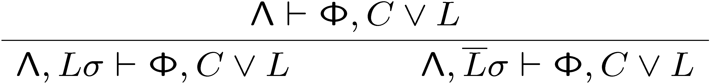
Derivation Rules (1)
Split
if
(1) σ is a context unifier of C Ç L against Λ
(2) neither Lσ nor : Lσ is contraditory with Λ
- σ is a context unifier: σ is a most general simultaneous unifier of the
clause literals and context literals with opposite sign (pairwise)
- Lσ is contradictory with Λ : Λ contains a variant of :Lσ
Context:    
σ = { ! ! ! ! }
Clause: : Ç : 
Clause σ: : Ç : 
: is admissible for Split
contradictory
not contradictory

Slide 7
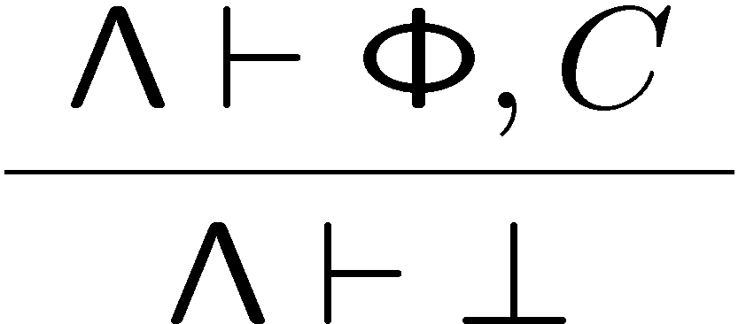
Derivation Rules (2)
Close
if (1) Φ ≠ ; or C ≠ ?
(2) there is a context unifier σ of C against Λ
such that each literal of Cσ is contraditory with Λ
- σ is a context unifier: σ is a most general simultaneous unifier of the
clause literals and context literals with opposite sign (pairwise)
- Lσ is contradictory with Λ : Λ contains a variant of :Lσ
Context:    
σ = { ! ! ! }
Clause: : Ç : 
Clause σ: : Ç : 
Close is applicable
contradictory
contradictory

Slide 8
Model Evolution – Further Ingredients
Derivation
  Start with sequent : ` „Input Clause Set“
  Apply Split and Close derivation rules (gives tree over sequents)
Refutation: Every branch ends in sequent of the form Λ ` ?
Fairness
  Consider a derivation with limit context Λ₁ = _{i>0} Λ_{i}
  Close is not applicable to any Λ_{i}
  Roughly: if some ground instance Cγ of an input clause is falsified by Λ_{i}
  then there is a j>i such that Λ_{j} satisfies Cγ
  (this can always be achieved by applying the split rule)
Completeness
  Assume a fair derivation with limit context
  Show that Λ₁ constitutes a model for the input clause set

Slide 9
Theories – Basic Definitions
A Theory T is a consistent set of sentences
Consider here universal theories
(no existential quantifier in prenex normal form)
Def: Clause set Φ is T-unsatisfiable iff
Φ [ T is unsatisfiable
Def: Let K be a set of literals and L be a literal
K ²_{T} L
iff K [ T ² L
iff for every structure A and every valuation v:
A,v ² K [ T implies A,v ² L
Examples
{    } ²_{E}  holds
 {    } ²_{E}  does not hold

Slide 10
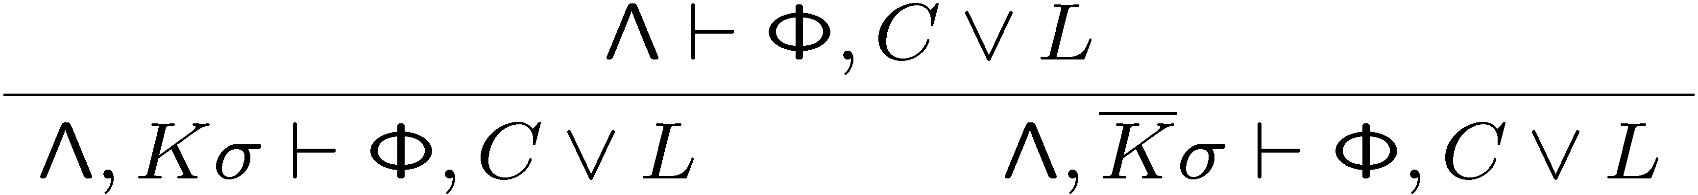
ME(T) – Derivation Rules (1)
T -Split
if
(1) σ is a T -context unifier of C Ç L against Λ with key set K [ { L }
(2) K 2 :K
(3) neither Kσ nor :Kσ is T -contraditory with Λ
σ is a T -context unifier of clause L₁ Ç … Ç L_{ν}
iff there are sets K₁,…,K_{n} of variants of literals from Λ s.th. K_{i}σ ²_{T} :L_{i}σ
Each set K_{i} [ { L_{i} } is called a key set
Key set:
{    : }
Context:    
Clause: : 
σ = { ! ! ! }
T -Split on :

Slide 11
ME(T) – Derivation Rules (1)
T -Split
if
(1) σ is a T -context unifier of C Ç L against Λ with key set K [ { L }
(2) K 2 :K
(3) neither Kσ nor :Kσ is T -contraditory with Λ
Kσ is T –contradictory with Λ
iff there is a set K of variants of literals from Λ s.th. K ²_{T} :K_{i}σ
Example for T –contradictory:
Context:    
K = {    }
Kσ: : 

Slide 12
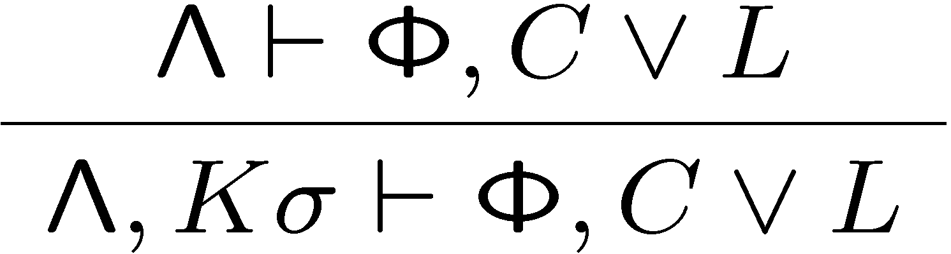
ME(T) – Derivation Rules (2)
T -Repair
if
(1) σ is a T -context unifier of C Ç L against Λ with key set K [ { L }
(2) K 2 :K
(3) Kσ is not T –contradictory with Λ, but
:Kσ is T -contraditory with Λ
(4) Λ does not contain a variant of Kσ
- T –Repair is the one-armed, disjoint variant of T –Split
- T –Repair is not applicable if T is the „empty“ theory
Context: :      
Clause: : 
T -Repair with :

Slide 13
ME(T) – Derivation Rules (3)
T -Close
if (1) Φ ≠ ; or C ≠ ?
(2) there is a T -context unifier σ of C against Λ
such that each literal of Cσ is T -contraditory with Λ
Note: Condition (2) must be decidable!

Slide 14
Interpretation Associated to a Context
Crucial to understand the working of the calculus
Basis of the completeness proof
Basis of feasible instantiation with theory reasoners
E.g. Waldmeister for the theory of equality

Slide 15
Interpretation Associated to a Context
Literal set K T –produces a literal L in Λ
Literal set K: { K₁ … K_{n} }
No literals L_{i} 2 Λ
such that
K_{i} ¶ :L_{i} & K_{i}γ
Instances: { K₁γ … K_{n} γ }
„K_{i} produces K_{i}γ in Λ“
Theory Reasoning: { K₁γ … K_{n} γ } ²_{T} L
Interpretation Associated to Λ
A ground atom A is assigned true in Λ via K
iff some set K of variants of literals from Λ T –produces A

Slide 16
Interpretation Associated to a Context
Context Λ T –produces a literal L
Literal set K (as above): K₁ … K_{n}
Instances: K₁γ … K_{n} γ
No literals L_{i} 2 Λ
such that
K_{i} ¶ :L_{i} & K_{i}γ
Theory Reasoning: K₁γ … K_{n} γ ²_{T} L
Examples
{   : } does not E-produce 
   => P(f(a)) is assigned false in associated E-interpretation
{   : } E-produces  and :
=> P(f(a)) is assigned true in associated E-interpretation

Slide 17
ME(T) Calculus – Theory Reasoner R_{T}
A lifting lemma cannot be proven „once and for all“,
replace it by admissibility condition of theory reasoner R_{T}
Theory reasoner R_{T}
  Input: a context Λ and a clause C = L₁ Ç … Ç L_{n}
  Output: a n+1 -tuple (K₁,…,K_{n},σ) or undefined
  where K_{i} is a set of variants of literals from Λ and σ is a substitution
R_{T} is sound iff K_{i}σ ²_{T} :L_{i}σ (i.e. σ is a T –context unifier)
R_{T} is complete iff the following holds:
For every ground instance Cγ and all sets K₁,...,K_{n} (as above):
If Cγ is assigned false in Λ via K₁,...,K_{n}
then R_{T}(Λ,C) = (K₁,…,K_{n},σ) for some substitution σ & γ
R_{T} is admissible iff it is sound and complete

Slide 18
Consequences and Properties
Associated interpretation should be total: easy, context contains :v
Associated interpretation should be a T –interpretation
Need further restrictions on allowed theories to guarantee this:
  Non-negative theories: ²_{T} 9 (A₁ Æ … Æ A_{n})
  T = { :A } is not allowed
  Theory must be ground convex:
  ²_{T} B ! A₁ Ç … Ç A_{n} implies ²_{T} B ! A_{i} for some i
  (B conjunction of ground atoms, A ground atom)
  T = { A Ç B } is not allowed
Property
If limit context Λ₁ assigns false to a (ground) clause Cγ via K₁,…,K_{n}
then
there is an i such that for all j > i Λ_{j} assigns false to Cγ via K₁,…,K_{n}
Completeness
Fairness + admissible theory reasoner will detect this situation eventually and invalidate it

Slide 19
Equality and Waldmeister
Problem
Waldmeister is a theorem prover for unit clauses
{ _{n} : }
How to match it to contexts and arbitrary clauses?
: Ç … Ç : Ç _{m+1}_{m+1}Ç … Ç _{n}_{n}
Context Problem
Λ = {   : : : }
Clause :
Waldmeister has to discover instances 
Solution (?)
Convert context to equivalent set of atoms
E.g. for signature {  } obtain
Λ = {      }
Resulting set can be infinite in case of non-linear literals!

Slide 20
Equality and Waldmeister
Problem
Waldmeister is a theorem prover for unit clauses
{ _{n} : }
How to match it to contexts and arbitrary clauses
: Ç … Ç : Ç _{m+1}_{m+1}Ç … Ç _{n}_{n}
Arbitrary Clauses Problem
From definition of associated interpretation it follows:
Context Λ falsifies a positive literal A
iff some negative literal :B 2 Λ produces :A in Λ
Consequently:
Can resolve away positive clause literals against context literals
Leaves only rest clause (: Ç … Ç :σ

Slide 21
Equality and Waldmeister
Problem
Waldmeister is a theorem prover for unit clauses
{ _{n} : }
How to match it to contexts and arbitrary clauses
: Ç … Ç : Ç _{m+1}_{m+1}Ç … Ç _{n}_{n}
Arbitrary Clauses Problem
How to treat rest clause (: Ç … Ç :σ ?
Solution
Code it as a negative unit clause (due to Thomas Hillenbrand):
:(_{m}
_{m}
Can easily query Waldmeister with many clauses simultaneously
Thus have transformation for Waldmeister now
But Waldmeister still has to be modifed to compute „all“ solutions!

Slide 22
Conclusion
Presented simplified calculus, without universal variables
e.g. \forall x P(x,u)
  Universal variables crucial for performance
    calculus instantiates to postive hyper-resolution for Horn case
    One call to Waldmeister for unit theories
  Should work out without greater difficulties
Is this all feasible?
Difference to Ganzinger/Korovin Calculus wrt.\ theory reasoning
  Works for arbitrary universal non-negative convex theories
  Does not need a term ordering
  But using term orderings might be advantageous…

