Slide 1
Combining Description Logic, Autoepistemic Logic and Logic Programming
Peter Baumgartner
Max-Planck-Institute for Computer Science, Saarbrücken

Slide 2
Contents
Application – from CoLi Saarbruecken
Representing „semantics“ of Web documents Question answering system (eventually)
Knowledge representation language
Description logic
Rule language
Autoepistemic operator
System
(1) Disjunctive logic programs
Stratified negation by failure
KRHyper
(2) Autoepistemic DPLL

Slide 3
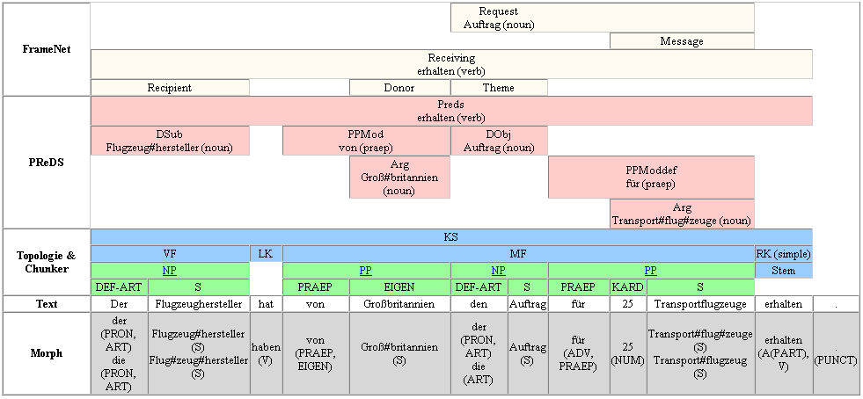
CoLi SB – Shallow Parsing
(Slide by Gerd Fliedner)
The plane manufacturer has from Great Britain the order for 25 transport planes received.
Challenge: Fill in missing elements of „Request“ frame

Slide 4
Fill in Missing Elements of „request“ frame
The plane manufacturer has from Great Britain the order for 25 transport planes received.
Shallow parsing gives partially filled (predefined) FrameNet
frame instances of „receive“ and „request“:
receive1:
receive
target: „received“
donor: „Great Britain“
recipient: manufacturer1
theme: request1
request1:
request
target: „order“
speaker:
addressee:
message: „transport plane“
„Great Britain“
manufacturer
Transfer of role fillers done so far manually
Automatically? With „logic“? By „model generation“?

Slide 5
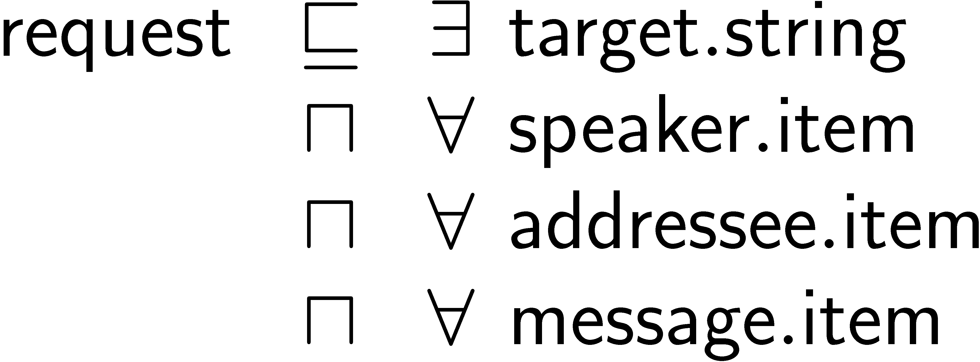
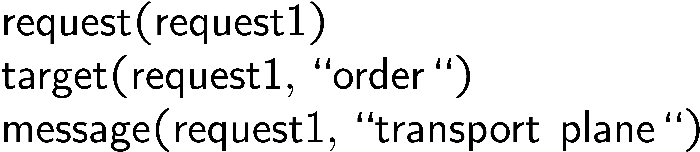
Description Logics Representation of Frames
request1:
request
target:
speaker:
addressee:
message:
„order“
„transport plane“
TBox – Conceptual Knowledge
ABox - Assertions
Rest of this talk:
How to solve these problems
Can feed this to recent Description Logic systems (FaCT, Racer)
Problems, not solvable with standard DL constructs:
Transfer of role fillers
request v 9 target.string better viewed as an integrity constraint

Slide 6
Transferring Role Fillers using Rules
receive1:
receive
target: „received“
donor: „Great Britain“
recipient: manufacturer1
theme: request1
Problem:
Unconditional transfer of role fillers
Better have only rules supplying default values
Solution: use autoepistemic constructs
request1:
request
target: „order“
speaker:
addressee:
message: „transport plane“
„Great Britain“
Rule Box
ABox
speaker(Request, Donor) :-
receive(Receive),
donor(Receive, Donor),
theme(Receive, Request),
request(Request).
receive(receive1)
donor(receive1,
„Great Britain“)
theme(receive1,request1)
request(request1)

Slide 7
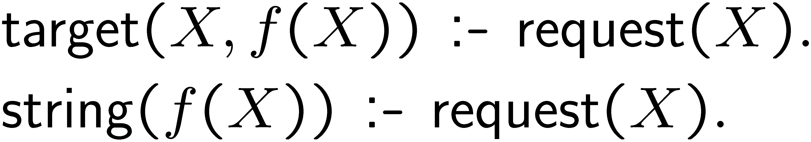
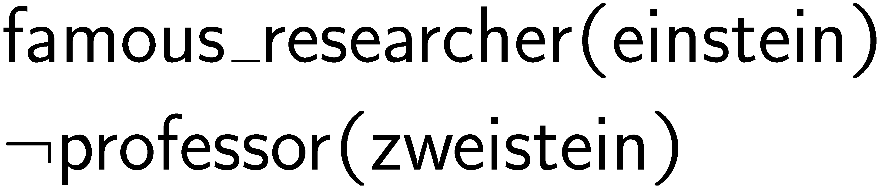
Combining Description Logics with Rules
Theory Reasoning Approach, e.g. AL-Log
Foreground reasoner: rule language
Background reasoner: description logic language
Interface: concepts as unary predicates in rule body
Advantage:
Can use both TBox and
rule part for predicate
definitions
Transformational Approach, e.g. by Horrocks et al
+ Rules and facts (ABox)
Useful:
- to realize default role
fillers, e.g. for „speaker“
- to formulate integrity
constraints
Epistemic Description Logics, ALCK [Donini et al]

Slide 8
Autoepistemic Logic at Work
“Reports that say that something hasn't happened are always
interesting to me, because as we know, there are known knowns,
there are things we know we know.
We also know there are known unknowns; that is to say we
know there are some things we do not know.
But there are also unknown unknowns –
the ones we don't know we don't know.”
Donald Rumsfeld,
'Foot in Mouth' awardee of 'Plain English Campaign'

Slide 9

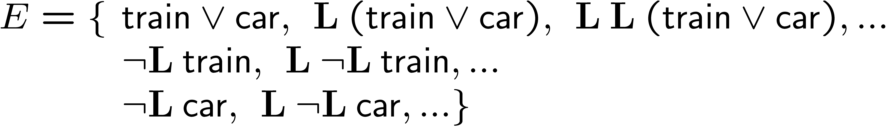
Autoepistemic Logic [Moore 85]
Models the beliefs/knowledge of a perfect rational agent with full
introspection
Given: (Propositional) language including unary operator L
T – set of formulas (initial knowledge)
Cn - consequence operator, treat LÁ as an atom
A set of formulas E is a stable expansion of T iff it satisfies:
Examples

Slide 10

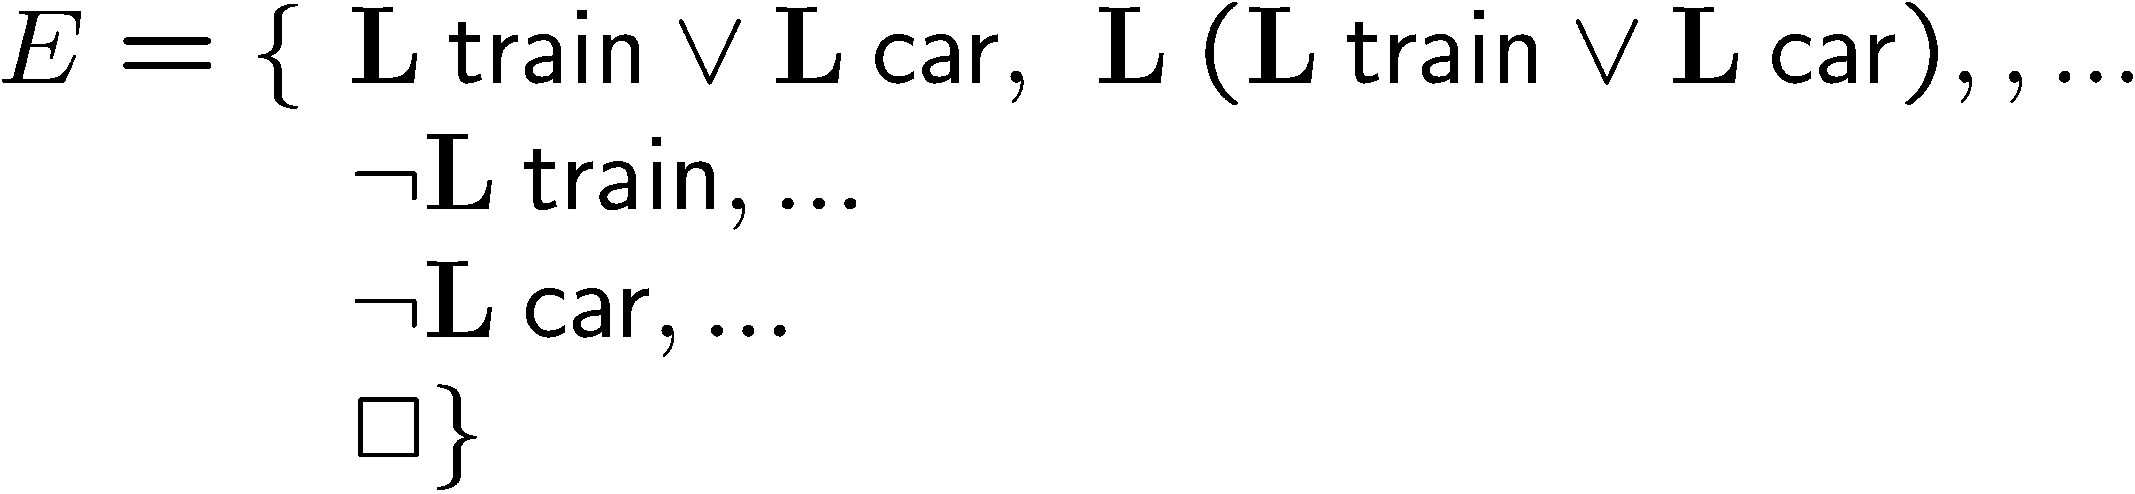
Autoepistemic Logic [Moore 85]
Models the beliefs/knowledge of a perfect rational agent with full
introspection
Given: (Propositional) language including unary operator L
T – set of formulas (initial knowledge)
Cn - consequence operator, treat LÁ as an atom
A set of formulas E is a stable expansion of T iff it satisfies:
Examples
Consistent stable expansions need not exist

Slide 11
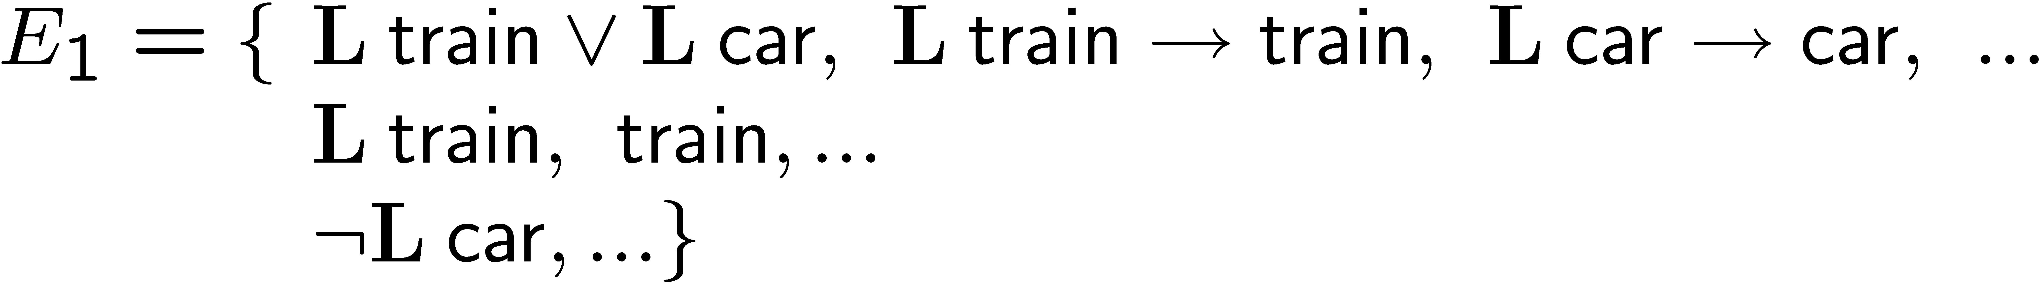
Autoepistemic Logic [Moore 85]
Models the beliefs/knowledge of a perfect rational agent with full
introspection
Given: (Propositional) language including unary operator L
T – set of formulas (initial knowledge)
Cn - consequence operator, treat LÁ as an atom
„Select“ operator
useful for abduction
A set of formulas E is a stable expansion of T iff it satisfies:
Examples
Consistent stable expansions need not be unique

Slide 12
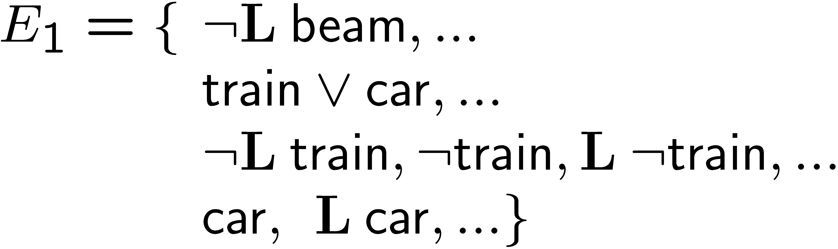
Autoepistemic Logic [Moore 85]
Models the beliefs/knowledge of a perfect rational agent with full
introspection
Given: (Propositional) language including unary operator L
T – set of formulas (initial knowledge)
Cn - consequence operator, treat LÁ as an atom
Instance: beam ! L beam
Equivalent: : L beam ! : beam
A set of formulas E is a stable expansion of T iff it satisfies:
Examples
Correspondence to stable models via translation not A  : L A

Slide 13
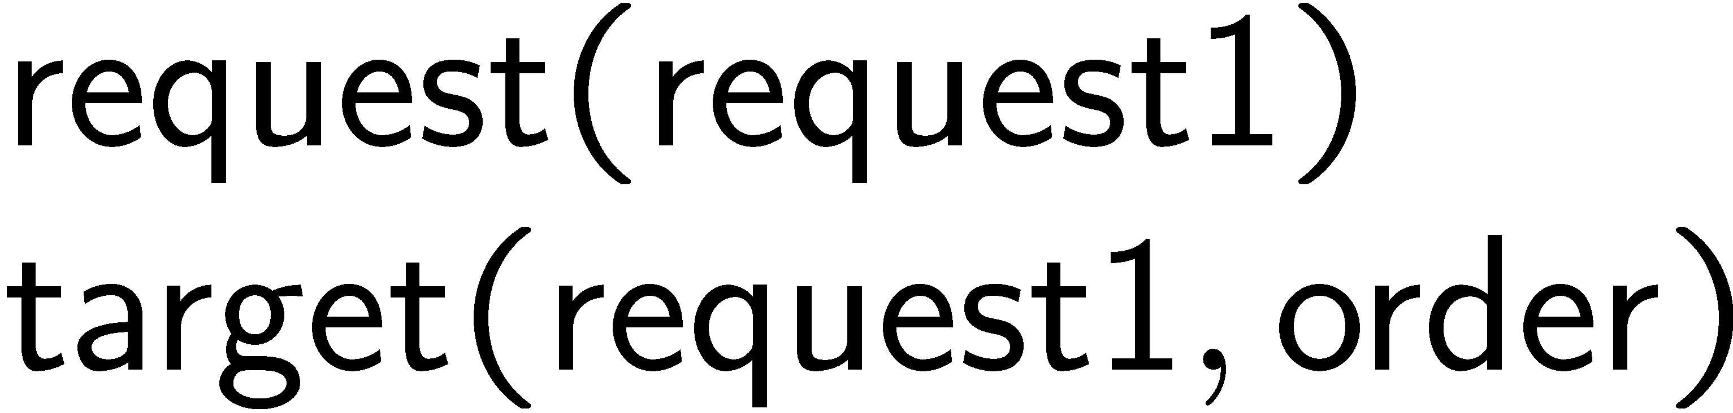
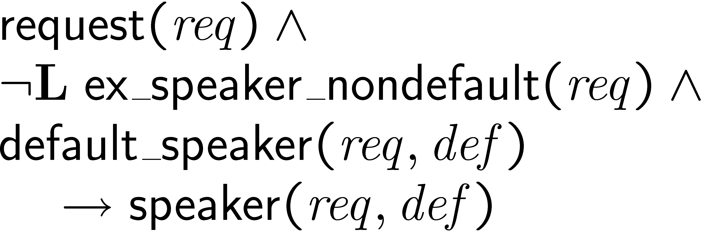

Putting Things Together
ABox
RBox
TBox
User Language
System input language:
AEL clauses
as is
as is
First-Order AEL!

Slide 14
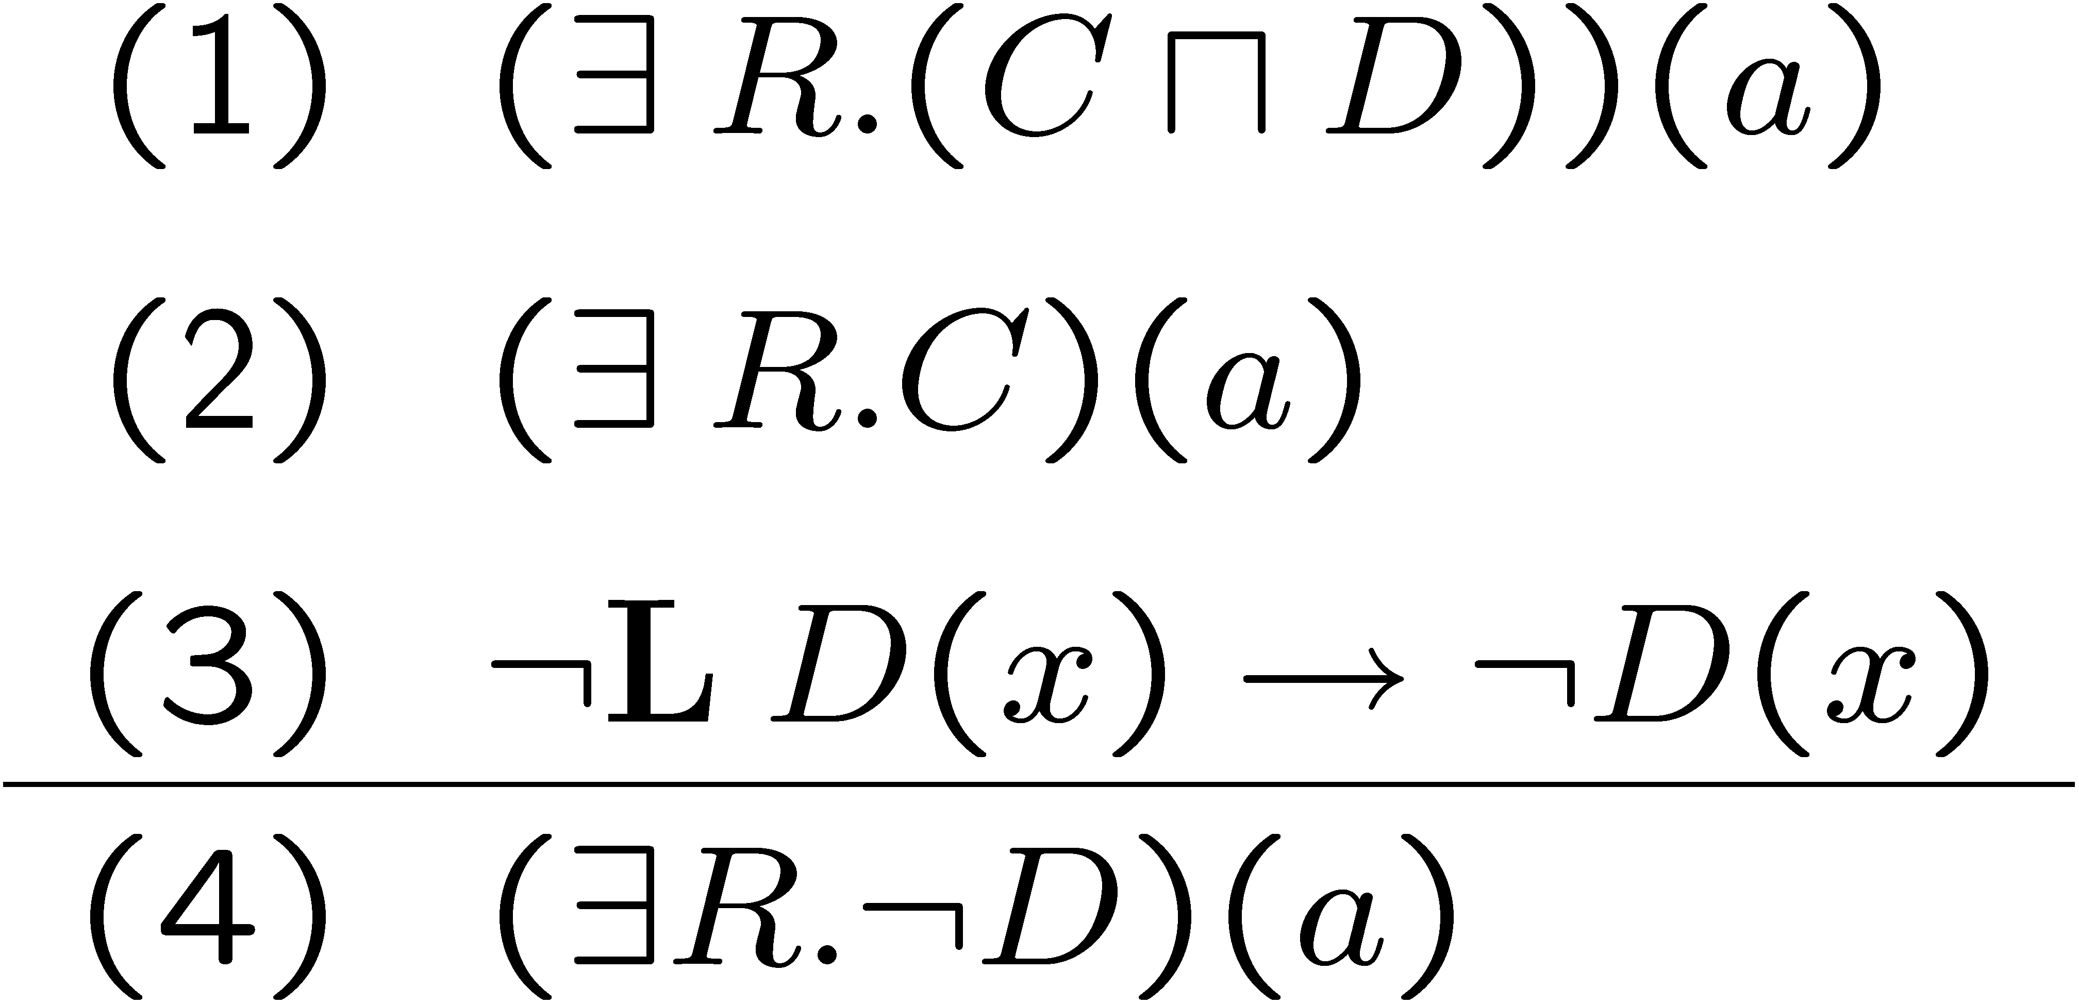
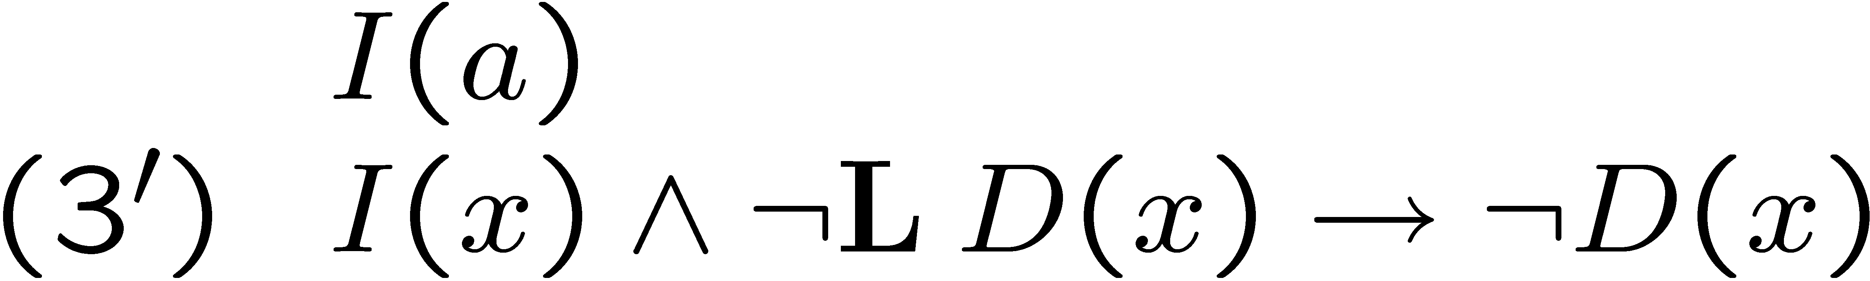
Skolemization causes Problems [Baader, Hollunder 95]
D
R
a
C
(1) implies (2)
But from (1) and (3), (4) does not follow
So, consequences depend from syntax!
Solution
Apply rules to known objects only,
those explicitly mentioned:

Slide 15
Translating Autoepistemic Rules
Per rule translation (trivial):
l(d(X)) :- l(c(X), i(X).
Per literal translation:
Really need A ! L A !
Existence of minimal/stable model: Σ^{p}₁
Existence of stable expansion: Σ^{p}₂
Don‘t hope for polynomial size translation!
Guess L A - :L A:
l(c(X)) ; not_l(c(x)) :- i(X).
false :- l(c(X)), not_l(c(x)).
If A 2 E then :L A 2 E:
false :- l(c(X)), \+ c(x).
If A 2 E then L A 2 E :
Stronger Axiom A ! L A:
l(c(X)) :- c(x).
The resulting program is stratified; can apply KRHyper
Theorem (?): minimal models = consistent stable expansions
Generalizes Theorem [Przcymusinski] (uses not A  : L A):
stable models = consistent stable expansions

Slide 16
A DPLL-like Procedure for Autoepistemic Logic
(1) p Ç q
(2) p ! Lp
(3) q ! Lq

Lp
:Lp
Counterexample
confirm

Counterexample
Lq
:Lq
Lq
:Lq
:p
p
:p
p
:q
ce
q
:p
p
confirm
:q
q
:q
q
:q
q
:p
p
:p
p
:q
q
:q
q
*
(1)
*
(1)
*
(3)
*
(3)
*
(1)
*
(2)
*
(2)
*
(1)
*
(3)
*
(2)
*
(2)
Start „ordinary“ cuts as given by positive L-literals along branch
Runs in polynomial space, 2EXP time

Slide 17
Conclusions
Scientific Interest
Basic research: combination DL with rule languages
Application: is the approach feasible to solve the computer linguist‘s tasks (appropriateness, efficiency)
Lots of Open Ends
Decidability? Specifically: termination with bottom-up evaluation guaranteed?
Seems so, if no recursion in TBox and function-free clauses
Soundness and completeness then, wrt. Kripke semantics
Transitive roles
Implementation halfway done
Practical evaluation: formalize and solve tasks from linguistics
Include abduction (for resolving anaphora)
First-order representation and computation of models

