Slide 1
Automated Deduction Techniques for
Knowledge Representation Applications
Peter Baumgartner
Max-Planck-Institute for Informatics

Slide 2
The Big Picture
Knowledge Base
Reasoning
Tasks
- TBox: (Un)satisfiability,Subsumption
- ABox: Instance, Retrieve
- General entailment tasks
Theorem provers for:
- Classical FO (ME: Darwin)
FO with Default Negation
(Hyper Tableaux: KRHyper)
Ontologies
- OWL DL
(Tambis, Wine, Galen)
First-Order
(SUMO/MILO, OpenCyc)
FrameNet
Rules (SWRL)
Data (ABox)
Robust Reasoning Services?
Issues: undecidable logic, model computation, equality, size
Approach: transformation of KB tailored to exploit prover features

Slide 3
Contents
Transforming the knowledge base for reasoning
  Transformation of OWL to clause logic: about equality
  Treating equality
  Blocking
Theorem proving
  KRHyper model generation prover
  Experimental evaluation
Rules: an application for reasoning on FrameNet

Slide 4
Transformation of OWL to Clause Logic
We use the WonderWeb OWL API to get FO Syntax first
Then apply standard clause normalform trafo (except for "blocking")
Equality comes in, e.g., for
  nominals ("oneOf")
  cardinality restrictions
-> Need an (efficient) way to treat equality
W
h
i
t
e
L
o
i
r
e
v
8
m
a
d
e
F
r
o
m
G
r
a
p
e
S
a
u
v
i
g
n
o
n
t
C
h
e
n
i
n
t
P
i
n
o
t
:
W
h
i
t
e
L
o
i
r
e
(
x
)
^
m
a
d
e
F
r
o
m
G
r
a
p
e
(
x
y
)
)
,
y
=
S
a
u
v
i
g
n
o
n
_
y
=
C
h
e
n
i
n
_
y
=
P
i
n
o
t
C
a
t
i
o
n
v
·
4
h
a
s
C
h
a
r
g
e
C
a
t
i
o
n
(
x
)
^
h
a
s
C
h
a
r
g
e
(
x
x
1
)
^
¢
¢
¢
^
h
a
s
C
h
a
r
g
e
(
x
x
5
)
)
,
,
x
1
=
x
2
_
x
1
=
x
3
_
¢
¢
¢
_
x
4
=
x
5

Slide 5
Equality
Option1: use equality axioms
But substitution axioms - cumbersome
Option 2: use a (resolution) prover with built-in equality
But how to extract a model from a failed resolution proof?
We focus on systems for model generation
Option 3: Transform equality away a la Brand's transformation
Problem: Brand's Transformation is not "efficient enough"
Solution: Use a suitable, modified Brand transformation
x
=
y
)
f
(
x
)
=
f
(
y
)

Slide 6
Brand's Transformation Revisited
Extension of Brand's Method: UNA for constants (optional)
A
d
d
:
(
a
=
b
)
f
o
r
a
l
l
d
i
f
f
e
r
e
n
t
c
o
n
s
t
a
n
t
s
a
a
n
d
b
Modified Flattening
G
i
v
e
n
:
P
(
f
(
x
)
)
Ã
f
(
g
(
a
)
)
=
h
(
a
x
)
,
B
r
a
n
d
:
P
(
z
1
)
Ã
f
(
z
2
)
=
z
3
h
(
z
4
x
)
=
z
3
,
,
,
f
(
x
)
=
z
1
g
(
z
4
)
=
z
2
a
=
z
4
,
,
O
u
r
t
r
a
f
o
:
P
(
f
(
x
)
)
Ã
f
(
z
1
)
=
h
(
a
x
)
g
(
a
)
=
z
1
,
,
A clause is flatt iff all proper subterms are constants or variables
Our Transformation
- modified flattening
- add equivalence relation axioms for =
- add predicate substitution axioms
P
(
y
)
Ã
P
(
x
)
x
=
y
,
It works much better in practice!

Slide 7
Blocking
Problem: Termination in case of satisfiable input
Specifically: cyclic definitions in TBox
Example from Tambis KB:
Solution: Learn from blocking technique from description logics
"Re-use" previously introduced individual to satisfy exist-quantifier
Here: encode search for model with finite domain in clause logic:
Issue: Make it work fast: don't be too ambitious on speculating
TBox
9
h
a
s
A
u
t
h
o
r
A
u
t
h
o
r
e
d
C
h
a
p
t
e
r
C
o
l
l
e
c
t
i
o
n
B
o
o
k
9
h
a
s
P
a
r
t
C
(
P
(
A
(
)
)
)
P
(
A
(
)
)
Try this first
a
a
^
a
=
a
a
C
(
a
)
^
d
o
m
(
a
)
a
C
(
P
(
A
(
a
)
)
)
^
d
o
m
(
P
(
A
(
a
)
)
)

Slide 8
KRHyper
Semantics
  Classical predicate logic (refutational complete)
  Stable models of normal programs (with transformation)
  Possible models for disjunctive programs (with transformation)
Efficient Implementation (in Ocaml):
Transitive closure of 16.000 facts -> 217.000 facts:
  KRHyper: 17 sec, 63 Mb
  Otter (pos. hyperres) 37 min, 124 Mb
  Compiling SATCHMO: 2:14 h, 271 Mb
smodels: - -
User manual
Proof tree output

Slide 9
Computing Models with KRHyper
a. (1)
b ; c :- a. (2)
a ; d :- c. (3)
false :- a,b. (4)
- Disjunctive logic programs
- Stratified default negation
e :- c, not d. (5)
a
a
a
b
c
b
c
X
X
e
{} ² (1)
{a} ² (2)
{a,b} ² (4)
X
{a,c} ² (1)-(4)
- Variant for predicate logic
- Extensions: minimal models, abduction, default negation

Slide 10
Experimental Evaluation
OWL Test Cases
S
y
s
t
e
m
C
o
n
s
i
s
t
e
n
t
(
5
6
)
I
n
c
o
n
s
i
s
t
e
n
t
(
7
2
)
E
n
t
a
i
l
m
e
n
t
(
1
1
1
)
K
R
H
y
p
e
r
w
i
t
h
b
l
o
c
k
i
n
g
8
6
%
8
9
%
9
3
%
K
R
H
y
p
e
r
w
/
o
b
l
o
c
k
i
n
g
7
9
%
9
4
%
9
3
%
F
a
c
t
4
2
%
8
5
%
7
%
H
o
o
l
e
t
7
8
%
9
4
%
7
2
%
F
O
W
L
5
3
%
4
%
3
2
%
P
e
l
l
e
t
9
6
%
9
8
%
8
6
%
E
u
l
e
r
0
%
9
8
%
1
0
0
%
O
W
L
P
5
0
%
2
6
%
5
3
%
C
e
r
e
b
r
a
9
0
%
5
9
%
6
1
%
S
u
r
n
i
a
-
0
%
1
3
%
C
o
n
s
V
I
S
o
r
7
7
%
6
5
%
-

Slide 11
Realistically Sized Ontologies
Tambis
  About chemical structures, functions, processes, etc within a cell
  345 concepts,107 roles
  KRHyper: 2 sec per subsumption test
Wine
  Wine and food ontology, from the OWL test suite
  346 concepts, 16 roles, 150 GCIs, ABox
  KRHyper: 80 sec / 3 sec per negative / positive subsumption test
Galen Common Reference Model
  Medical teminology ontology
  big: 24.000 concepts, 913.000 relations, 400 GCIs, transitivity
  KRHyper: 5 sec per subsumption test
OpenCyc
  480.000 (simple) rules. Darwin: 60 sec for satisfiability

Slide 12
Rules
Adding logic programming style rules is currently discussed in the Semantic Web context (SWRL and many others)
Example:
Cannot be expressed in description logics
Adding rules to the input language is trivial in approaches that transform ontologies to clause logic
Problem: can simulate Role-Value maps, leading to undecidability
Rationale of doing it nethertheless:
  Better have only a semi-decision procedure than nothing
  In many cases have termination nethertheless (with blocking)
  Really useful in some applications
H
o
m
e
W
o
r
k
e
r
(
x
)
Ã
w
o
r
k
(
x
y
)
^
l
i
v
e
(
x
z
)
^
l
o
c
(
y
w
)
^
l
o
c
(
z
w
)
,
,
,
,

Slide 13
From Natural Language Text To Frame Representation
FrameNet
550 Frames
7000 Lex Units
Frame
Representation
Com GT
Buyer: BMW
Seller: BA
Goods: Rover
Money: unknown
Text
BMW
bought
Rover
from BA
Com GT
Buy
Sell
Linguistic
Method
BMW
Rover
BA
Rover
Deduction
System
Logic
Work in Colaboration with Computer Linguistics Department (Prof. Pinkal)

Slide 14
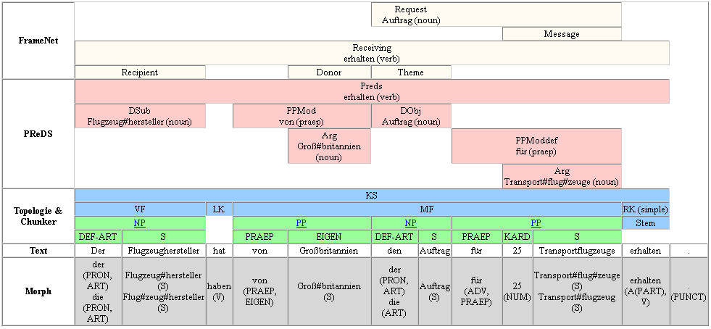
Transfer of Role Fillers
(Slide by Gerd Fliedner)
The plane manufacturer has from Great Britain the order for 25 transport planes received.
Task: Fill in the missing elements of „Request“ frame

Slide 15
Transfer of Role Fillers
The plane manufacturer has from Great Britain the order for 25 transport planes received.
Parsing gives partially filled FrameNet
frame instances of „receive“ and „request“:
receive1:
receive
target: „received“
donor: „Great Britain“
recipient: manufacturer1
theme: request1
request1:
request
target: „order“
speaker:
addressee:
message: „transport plane“
„Great Britain“
manufacturer
Transfer of role fillers done so far manually
Can be done automatically. By „model generation“

Slide 16
Transfer of Role Fillers by Rules
receive1:
receive
target: „received“
donor: „Great Britain“
recipient: manufacturer1
theme: request1
request1:
request
target: „order“
speaker:
addressee:
message: „transport plane“
„Great Britain“
Rules
Facts
speaker(Request, Donor) :-
receive(Receive),
donor(Receive, Donor),
theme(Receive, Request),
request(Request).
receive(receive1).
donor(receive1,
„Great Britain“).
theme(receive1,request1).
request(request1).

Slide 17
Exploiting Nonmonotonic Negation: Default Values
Insert default value as a role filler in absence of specific information
receive1:
receive
target: „received“
donor: „Great Britain“
recipient: manufacturer1
theme: request1
request1:
request
target: „order“
speaker:
addressee:
message: „transport plane“
„Great Britain“
Should transfer "donor" role filler only if "speaker" is not already filled:
default_request_speaker(Request, Donor) :-
receive(Receive),
donor(Receive, Donor),
theme(Receive, Request),
request(Request).

Slide 18
Default Values
Insert default value as a role filler in absence of specific information
Example:
In Stock Market context use default "share" for "goods" role of "buy":
default_buy_goods(Buy, "share") :-
'Buy is an event in a stock market context'.
Example:
Disjunctive (uncertain) information
Linguistic analysis is uncertain whether "Rover" or "Chrysler" was bought:
default_buy_goods(buy1,"Rover").
default_buy_goods(buy1,"Chrysler").
This amounts to two models, representing the uncertainty
They can be analyzed further

Slide 19
Default Value – General Transformation
Technique:
a :- not not_a.
not_a :- not a.
has two stable models: one where a is true and one where a is false
Choice to fill with default value or not:
goods(F,R) :-
not not_goods(F,R),
buy(F),
default_buy_goods(F,R).
not_goods(F,R) :-
not goods(F,R),
buy(F),
default_buy_goods(F,R).
Case of waiving default value:
false :-
buy(F),
default_buy_goods(F,R1),
goods(F,R1),
goods(F,R2),
not equal(R1,R2).
equal(X,X).
Require at least one filler for role:
false :-
buy(F),
not some_buy_goods(F).
Role is filled:
some_buy_goods(F) :-
buy(F),
goods(F,R).

Slide 20
Conclusions
Objective: "robust" reasoning support beyond description logics
Method
  FO theorem prover, specifically model generation paradigm
  Tailor translation to capitalize on prover features
  Exploit nonmonotonic features (for KB with FO semantics!)
Practice
  Experimental evaluation on OWL test suite "promising"
  Need more experiments with e.g. OpenCyc and FrameNet

