Slide 1
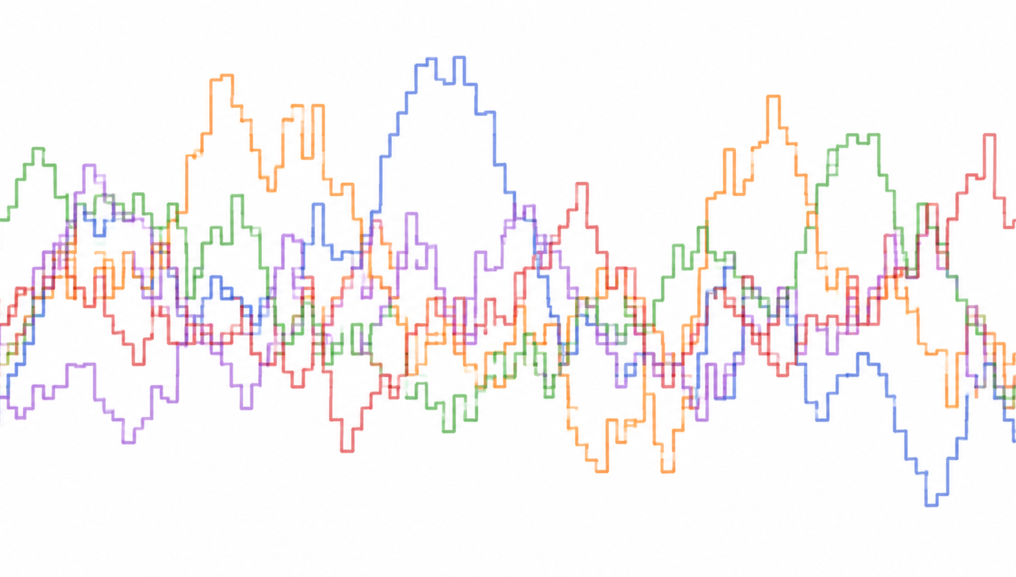
Gillespie Simulation
From deterministic ODEs to stochastic reaction events
A tutorial for stochastic chemical kinetics and biological switching
TA: Wenqin Zhou
01

Slide 2
What we will solve today
Why stochastic simulation is needed, how SSA works, and how to code it
Workflow
Open questions
1
Background
3
5
from reaction table to complete trajectory
for you to explore on your own
Why are ODEs not enough?
2
Principle
4
Bio case
propensity, waiting time, reaction selection
SinI-SinR stochastic cell fate switch
02
Notes:
用这一页先告诉听众：Gillespie不是一个新的ODE求解器，而是用来生成随机反应轨迹的算法。

Slide 3
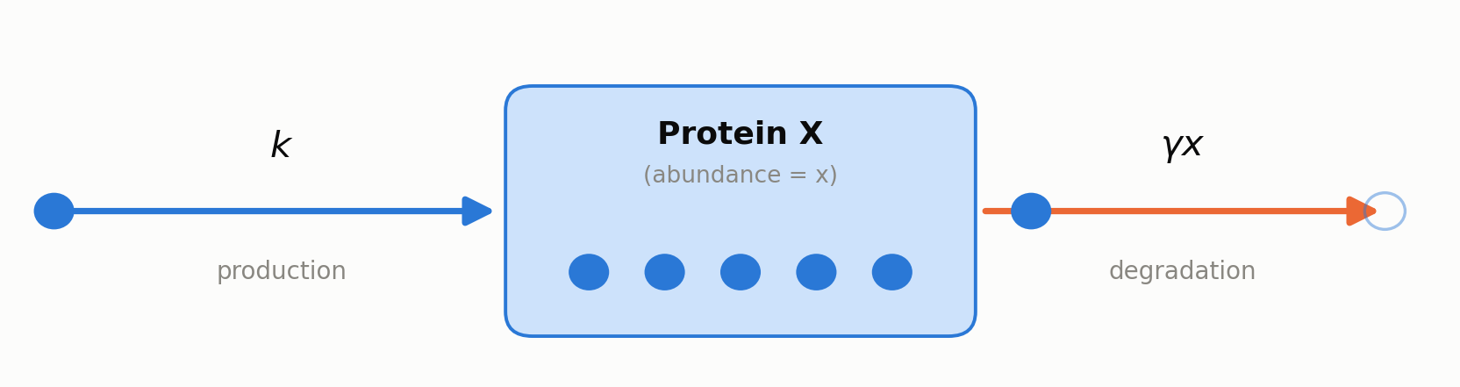
Interactive module 1: birth-death process
use the minimal model to build intuition for stochastic trajectories
Model
∅ --k--> X X --γX--> ∅
Open the ‘interactive module 1’ notebook, run the codes, and try sliders
Hands-on question:
1. Why do identical parameters generate different single-cell trajectories?
2. What will happen if you increase the number of cells simulated?
3. How is it different from deterministic ODEs?
k: synthesis rate
γ: degradation rate
Tmax: simulation length
n_reps: how many cells
06

Slide 4
Background: cellular reactions are not continuous fluids
especially for low-copy molecules, switches, pulses, and state transitions
Deterministic ODE
Stochastic reality
dx/dt = synthesis − degradation
reaction events happen one by one
describes the mean trend; the same initial condition usually gives the same curve.
each cell experiences a different molecular event history; the same initial condition does not necessarily give the same curve.
03

Slide 5
Why Gillespie?
SSA directly simulates the time and identity of discrete reaction events
Low copy number
mRNA、TF、plasmid、rare state species
Noisy noise
the noisy nature of biological world
Pulse timing
focus on waiting time / residence time, not only the mean
...
more is waiting you guys to explore!
ODE gives one average; SSA gives trajectories + distributions.
04

Slide 6
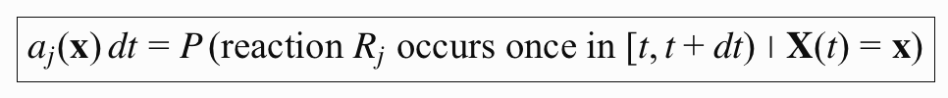
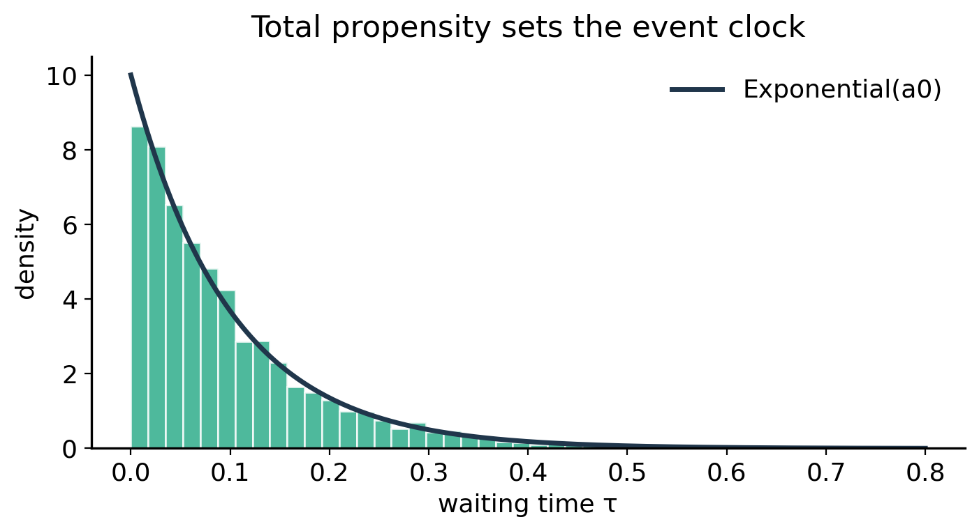
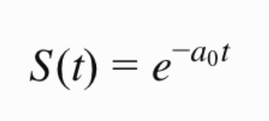
Core principle: the next reaction is determined by two random numbers
The first number decides how long we’ll wait until next event happens.
events: 1, 2, 3, ..., j
a_{j}(x) = propensity of reaction j
a₀(x) = Σ_{j} a_{j}(x)
r₁ ~ U(0,1), τ = −ln(r₁)/a₀
Intuition
larger a₀ means a faster event clock.
05

Slide 7
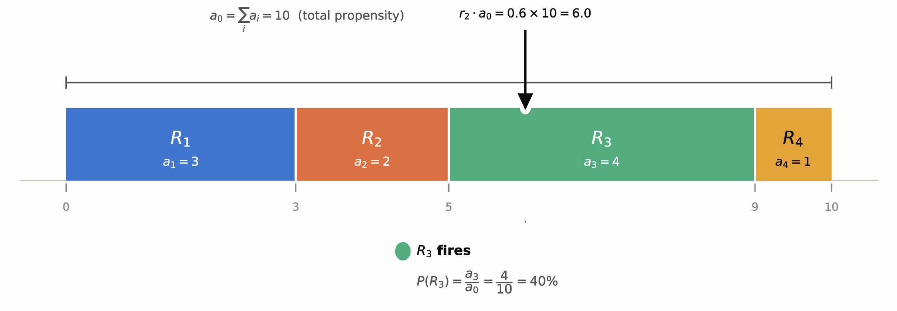
Core principle: the next reaction is determined by two random numbers
The second number decides which event will happen next.
events: 1, 2, 3, ..., j
r2 ~ U(0,1), choose μ such that Σ_{{j<μ}} a_{j} < r₂a₀ ≤ Σ_{{j≤μ}} a_{j}
Intuition
each a_j/a₀ is the probability that the next event is reaction j.
05

Slide 8
Formal workflow
each step is a reproducible algorithmic operation
1
Write reactions
2
Define propensities
3
Draw waiting time
4
Select reaction
5
Update state
list every possible event
a_j(x) = rate of reaction j in the current state
τ ~ Exponential(a₀)
roulette wheel: P(j)=a_j/a₀
x ← x + ν_j, t ← t + τ
Repeat until t reaches the desired final time, or until no reaction can occur (a₀ = 0).
07

Slide 9
Detailed example: one mRNA species
walk through the full algorithm with the simplest model
1
Write reactions
3
Draw waiting time
∅ --k_m--> M M --γ_m m--> ∅
a₁ = 5
a₂ = 0.2 × 20 = 4
a₀ = a₁ + a₂ = 9
m = current mRNA molecule count
τ = −ln(0.37)/9 = 0.11 min
2
Define propensities
Reaction
Propensity
State update
4
Select reaction
transcription: ∅→M
a₁ = k_m
m ← m + 1
r₂a₀ = 5.67
degradation: M→∅
a₂ = γ_m m
m ← m − 1
Since 5 < 5.67 ≤ 9, choose reaction 2: degradation.
r₂a₀ = 5.67
suppose current m = 20, k_m = 5 min⁻¹, γ_m = 0.2 min⁻¹
0
5
9
draw r₁ = 0.37, r₂ = 0.63
Reaction 1: birth
length = a₁
Reaction 2: death
length = a₂
5
Update state
t ← t + 0.11, m ← 19
08

Slide 10
Reusable Gillespie code skeleton
any reaction network fits into the same framework
def gillespie(x0, propensities, updates, tmax):
t, x = 0.0, x0.copy()
T, X = [t], [x.copy()]
while t < tmax:
a = np.array([f(x) for f in propensities])
a0 = a.sum()
if a0 <= 0: break
tau = -np.log(np.random.rand()) / a0
mu = np.searchsorted(np.cumsum(a), np.random.rand()*a0)
t += tau
x += updates[mu]
T.append(t); X.append(x.copy())
return np.array(T), np.array(X)
What changes between models?
state vector x
propensity functions a_j(x)
state-change vectors ν_j
parameter values and stop time
Core idea: the algorithm stays the same; biology enters through reaction lists and propensities.
11

Slide 11
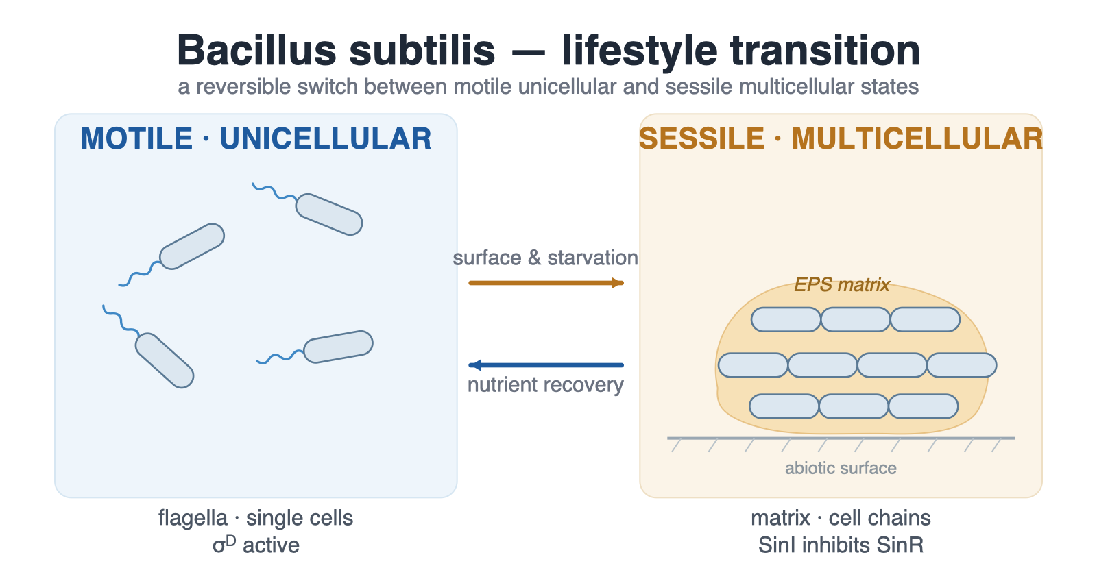
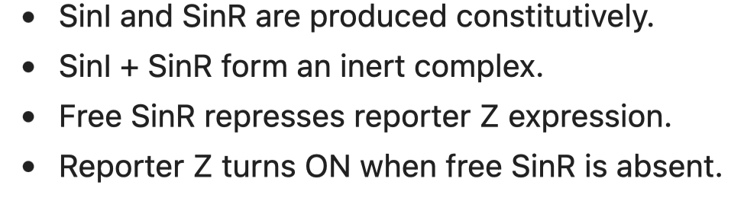
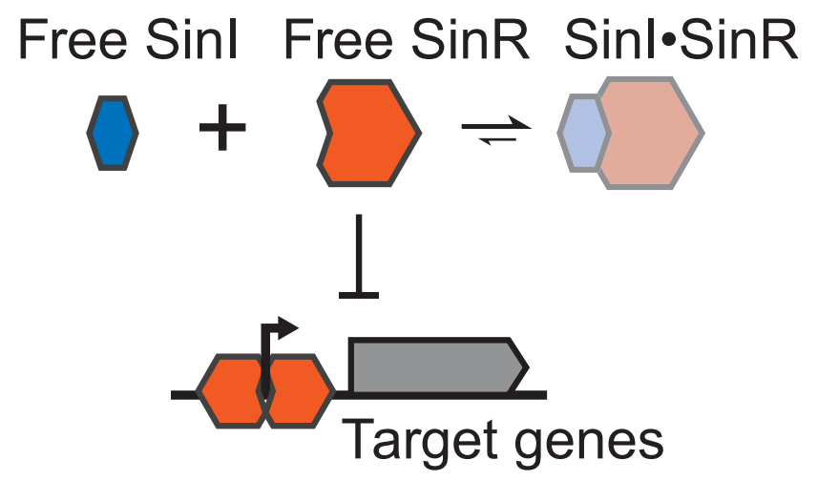
Biological case: stochastic antagonism drives a cell fate switch
Lord et al., Science 2019: SinI-SinR competition in Bacillus subtilis
Key biological motif
Important conceptual point
This is not classical deterministic bistability. The deterministic model has a single stable steady state; stochastic competition creates long-lived apparent states and pulses.
Use Gillespie simulation to generate the single-cell event histories. Try it with your agents first and then check the following slides.
13

Slide 12
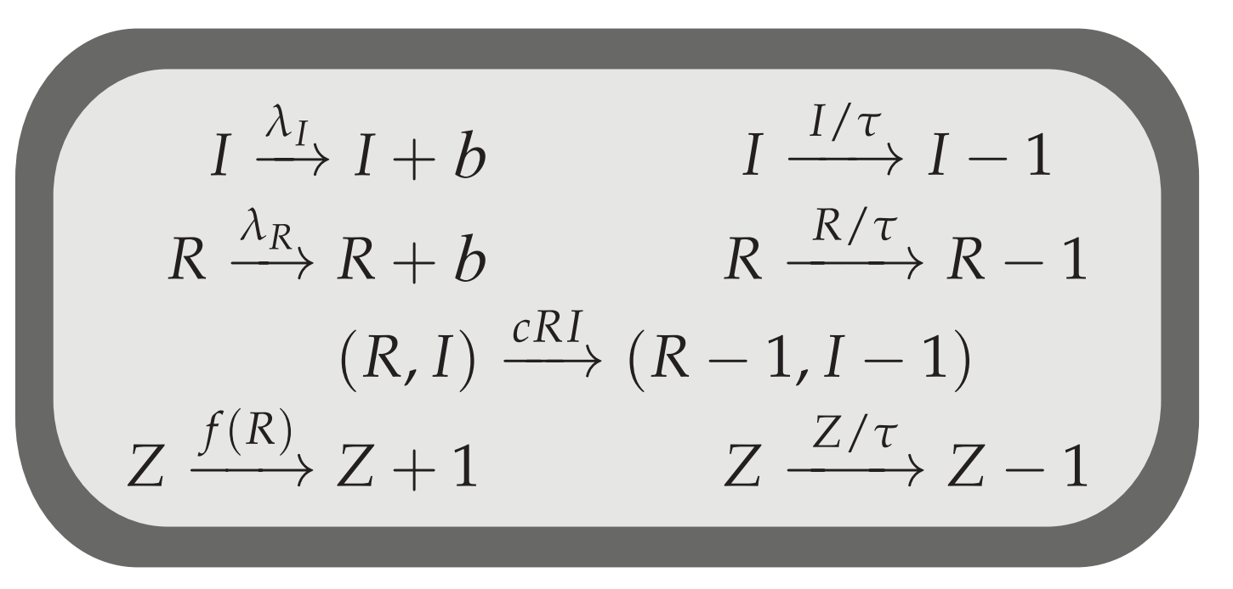
Translate the SinI-SinR motif into reactions
The biological model becomes a reaction table
∅ → I ∅ → R I + R → C
I → ∅ R → ∅ Z → ∅ ∅ → Z if R = 0
Propensities
a₁=λ_I, a₂=λ_R, a₃=c·I·R
a₄=I/τ, a₅=R/τ,
a₆=Z/τ,
a₇=fR(R), where fR is high when R=0
14

Slide 13
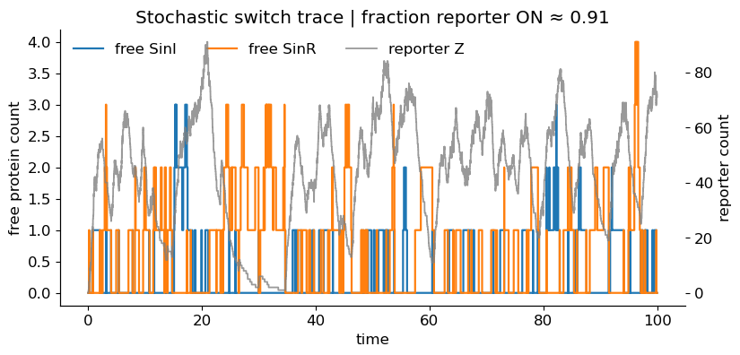
Interactive module 2: simulate the stochastic switch
Open the notebook ‘interactive module 2’
Tune λI/λR and watch state occupancy and pulse timing change
Things to test live
1. Increase λI/λR: what happens to fraction of reporter ON?
2. Increase complexation rate c: what happens to free species?
3. Increase reporter decay: what happens to the pulses?
15

Slide 14
Practical notes: when SSA is powerful, and when it is expensive
Gillespie is exact for well-mixed Markov reaction networks
Good for
low-copy stochastic kinetics, switching, pulses, fate probabilities
more exact
more approximate
Exact SSA
Assumes
well-mixed system, Markov reactions, known propensities
Tau-leaping
Can be slow when
reaction rates are huge or many events occur per second
Alternatives
tau-leaping, Langevin approximation, hybrid stochastic-deterministic models
ODE
17

Slide 15
Take-home messages
1
Gillespie simulation samples exact stochastic reaction trajectories.
2
Propensity determines both when the next event happens and which event it is.
3
For biological switches, the distribution of histories can be the mechanism. Noise sometimes is not a bad thing.
Open questions: what else in the biological world needs noise? Maybe you can build a model of that using Gillespie simulation.
18

