Slide 1
Workflow BIEN WCSP intersection check
all_bien_occurrences_4column.rm.na.csv
level3.shp
bien_WCSP_intersection.R
BIEN_in_WCSP_regions.RData
analyse.R
Synonyms?

Slide 2
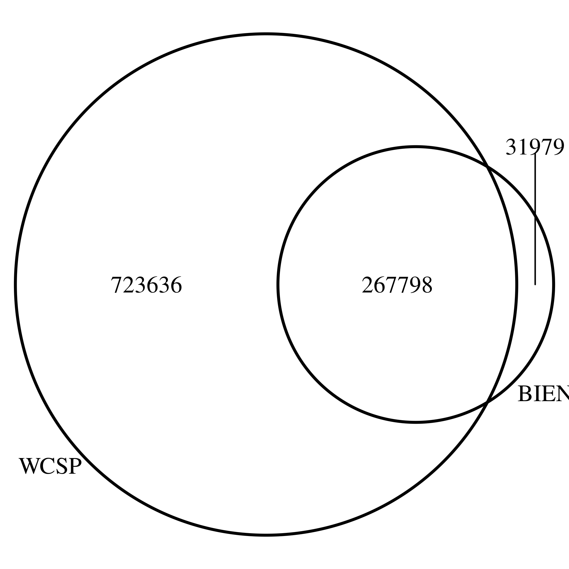
Summary stats
11% of names in BIEN do not match any names in WCSP (31 979)
  Seems to be mostly moss and lichen (non-vascular)
Of the ones that are in the WCSP:
  74% accepted / 26% non-accepted
How to match?
  Names from genus+species → compare
  If name is accepted: good, if not: change to accepted name.
  does not work - there is cases where the accepted name depends on the variety, but we don`t have this information from BIEN right now → start new download getting infraspecific information

Slide 3
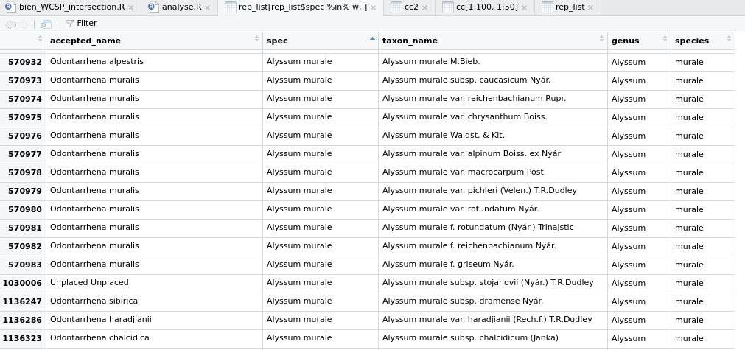
Matching
> # How many species that are classified as synonym & occur in BIEN are affected?
> table(temp>1)
FALSE TRUE
57674 10909
> table(temp>1)/length(temp)
FALSE TRUE
0.8409373 0.1590627

Slide 4
More downloads from BIEN
Columns to add:
scrubbed_taxon_name_no_author
scrubbed_author
Adjust BIEN_occurrence_species()

Slide 5
intersection
BIEN name in WCSP?
no
yes
Synonym not listed in WCSP?
Accepted?
yes
no
yes
no
Synonym?
Belongs to taxon not included in WCSP
→ addition to WCSP
Yes → change to accepted name
No:change to accepted name anyways?

Slide 6
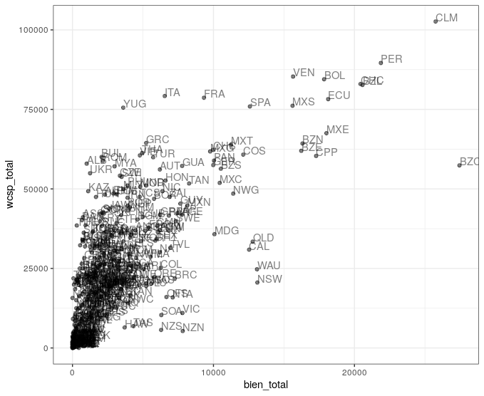
Maps based on uncorrected species names
Total species count in each WCSP region for BIEN and WCSP

Slide 7
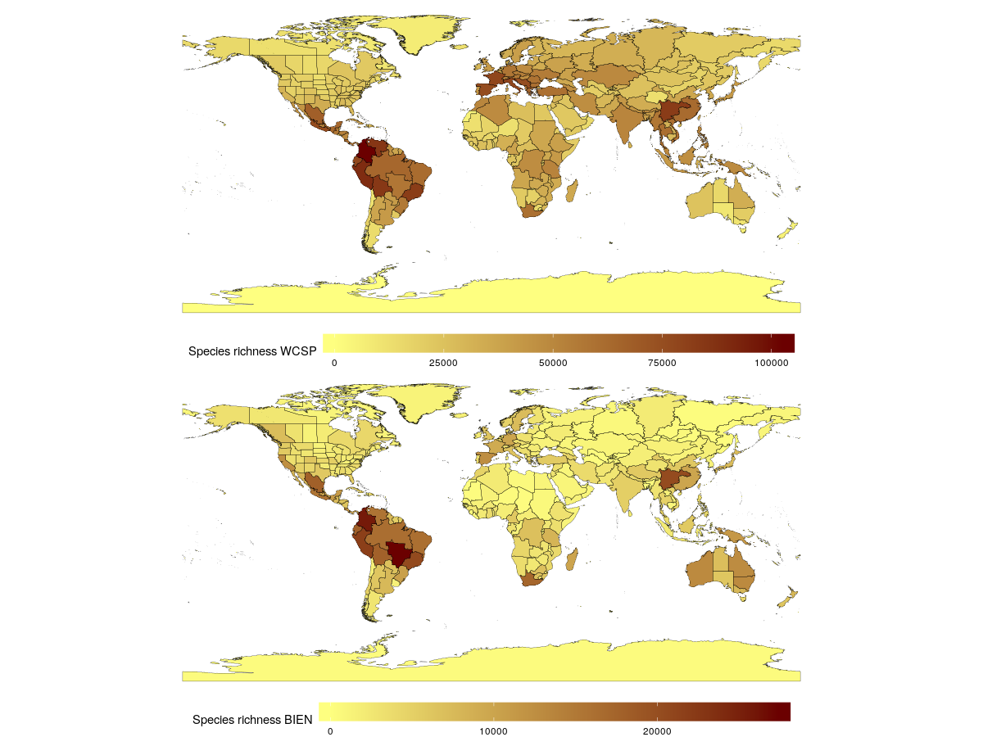
Species richness for WCSP and BIEN

Slide 8
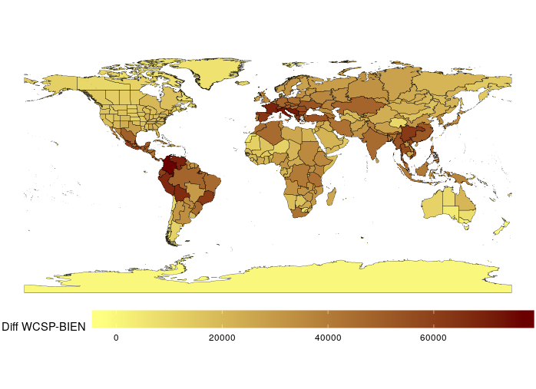
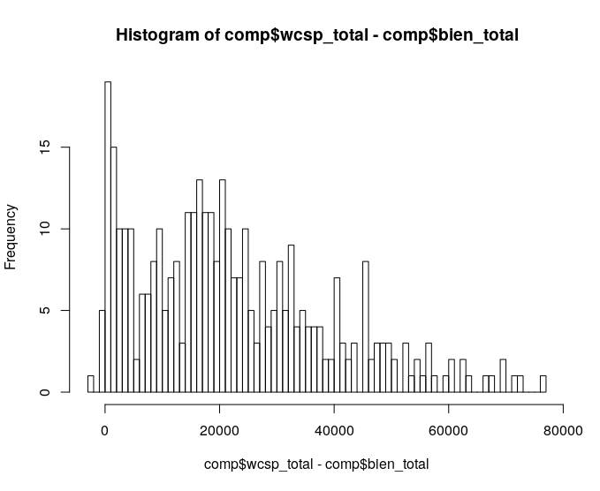
→ 6 regions with less WCSP than BIEN species in it

Slide 9
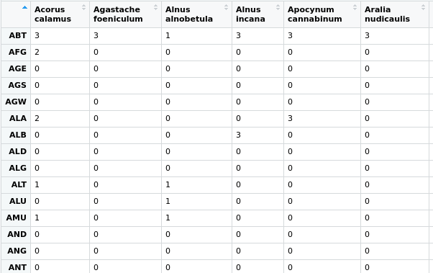
Matrix coding for each species and region:
0=not at all, 1=only in WCSP, 2=only in BIEN, 3=both

Slide 10
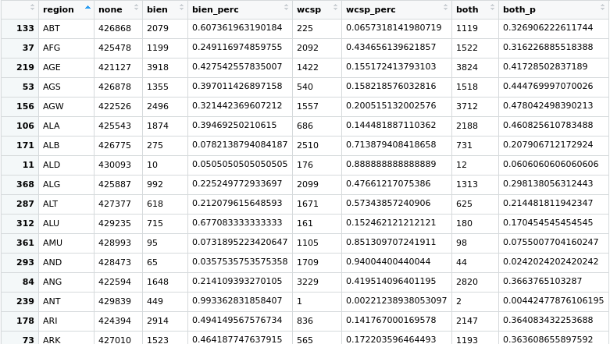
Summary table of matrix: bien: species in bien wcsp: species in wcsp both: species occurring in both + percentages for each region

Slide 11
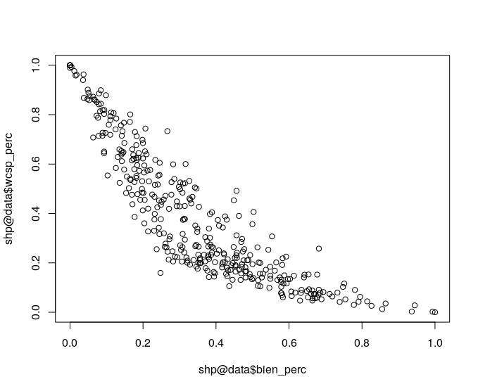
Percent WCSP and BIEN species only per region

Slide 12
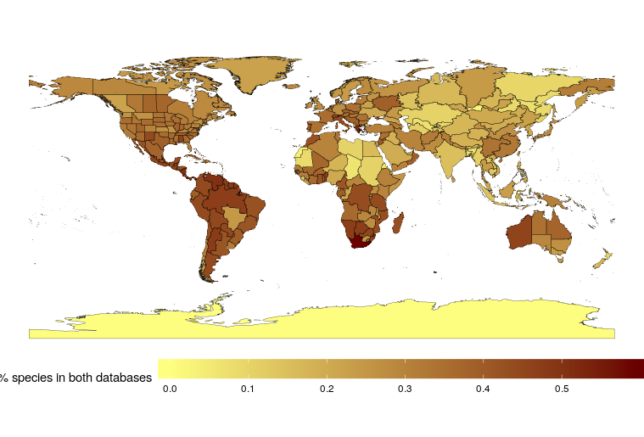
Smart way to display differences?
Too much emphasis on the difference in total numbers

