Slide 1


Business Case: Prediction of Charged Off Loans
Lending Club
Applicant: Pedro Martinez

Slide 2
The Problem and Solution Proposal
Objective: design a model that predicts Charged Off Loans using LC’s database
Solution Structure
Exploratory Data Analysis
Analysis and data cleaning (missing values, “o.h.e.” on categorical variables)
Feature Selection (Forward Selection, Gradient Boosted Weights and Regularization)
Model Training
three models: Logistic Regression, Gradient Boosting, K-Nearest Neighbors
GridSearch for HyperParameters and Cross Validation for overfitting analysis
Performance analysis: Confusion Matrices and ROC Curves
Model Testing
Performance analysis: Confusion Matrices and ROC Curve

Slide 3
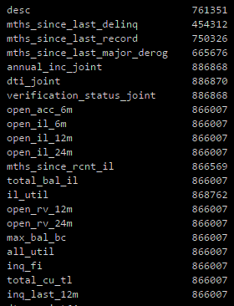
Dataset
Train set: 887379 observations by 74 variables
Test set: 759338 observations by 72 variables
Columns with more than half of observations with missing values:

Slide 4
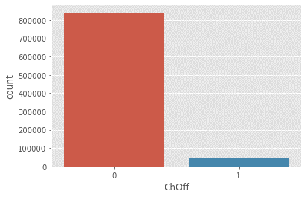
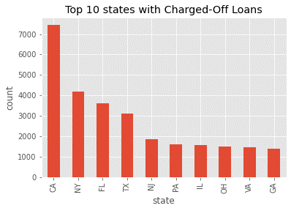
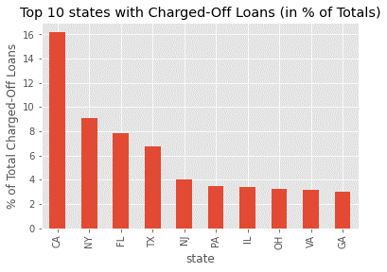
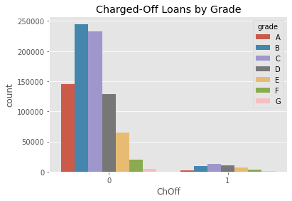
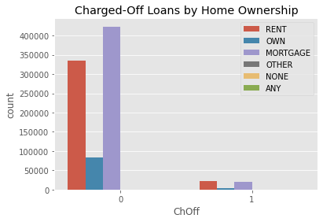
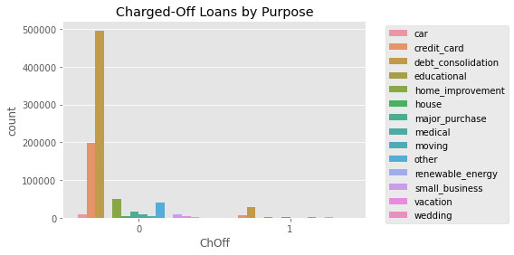
Exploratory Data Analysis
Number of Non Charged-Off vs Charged-Off Loans

Slide 5
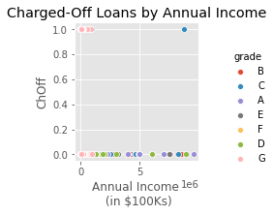
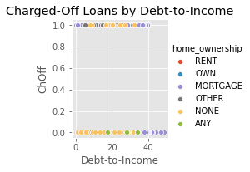
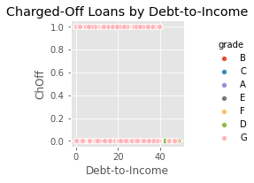
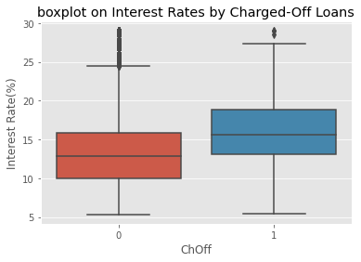
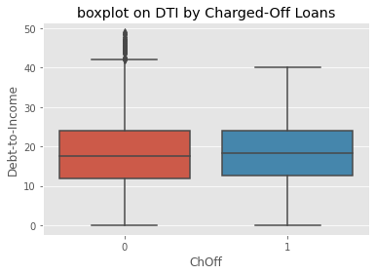
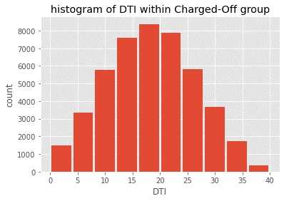
Exploratory Data Analysis (2)

Slide 6
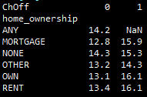
Exploratory Data Analysis (conclusion)
Average Loan Rate for Charged-Off borrowers may show common higher cost:
In summary, a preliminary analysis shows no noticeable common characteristics among Charged-Off Loan borrowers compared to others.
Avg Loan Rate per Home Ownership
(for Charged-Off and none’s)

Slide 7
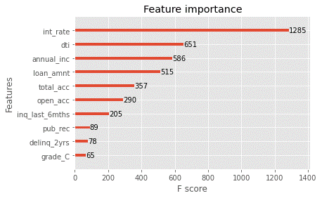
Feature Selection
Several selection techniques were performed
Regularization (for Logistic Regression): loan amount, interest rate, annual income, Debe-to-Income, delinquencies in the last 2 years, inquiries last 6 months, employment length, number of derogatory public records, number of open credit lines in the borrower's credit file.
Gradient Boosted Weights (for Gradient Boosting):

Slide 8
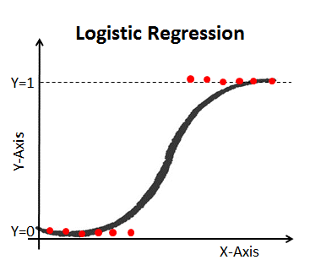
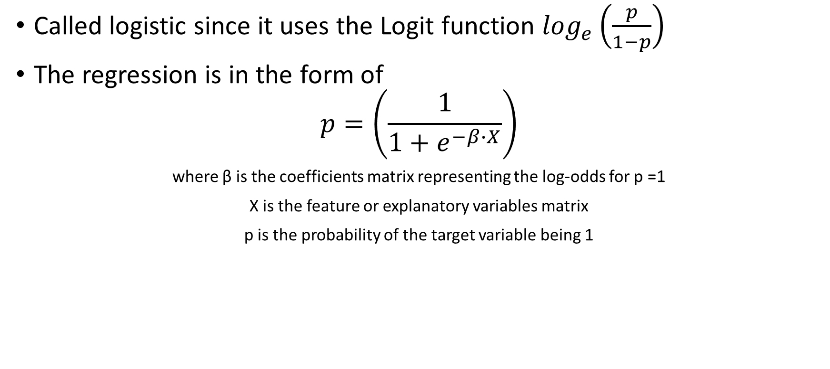
Logistic Regression
Called logistic since it uses the Logit function $\log_{e}\left(\frac{p}{1−p}\right)$
The regression is in the form of
$$p=\left(\frac{1}{1+e^{−β∙X}}\right)$$
where β is the coefficients matrix representing the log-odds for p =1
X is the feature or explanatory variables matrix
p is the probability of the target variable being 1

Slide 9
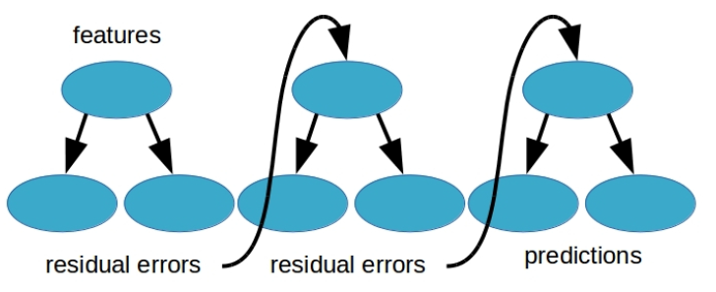
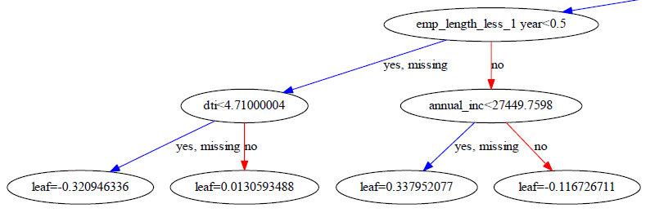
Gradient Boosting
A gradient boosting tress is an ensemble learning technique which predicts in the form of an ensemble of decision trees where the results of the each base-learner are combined to generate the final estimate.
XGBoost Plot from Charged-Off Model:

Slide 10
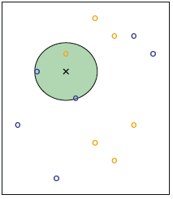
K-Nearest Neighbor
Given a defined ‘number of neighbors’ (K), for every pair combination of features (e.g. X₁ and X₂), this model analyzes for each random observation the K-nearest points and identifies their class to then estimate the very class of it based on the distribution of their neighbors (i.e. conditional probability).
example of 3-nearest neighbors
3-nearest neighbors
Class 1
(e.g. Charged-Off loan)
random
observation
X₂
Class 2
(e.g. Non Charged-Off loan)
X₁

Slide 11
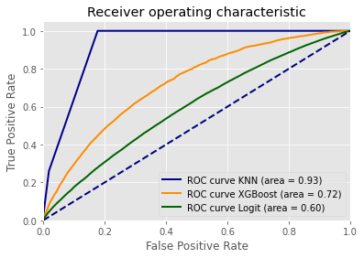
Model Training and Performance Comparison

Slide 12
Confusion Matrix
 | Predicted Negative | Predicted Positive
Actual Negative | TRUE NEGATIVE | FALSE POSITIVE
Actual Positive | FALSE NEGATIVE | TRUE POSITIVE
 | Predicted Negative | Predicted Positive
Actual Negative | 1 - α | α
Actual Positive | β | 1 - β

Slide 13
Results – Train set
Regularized Logistic Regression | Predicted No Charged-Off | Predicted Charged-Off
Actual No Charged-Off | 841,201 | 143
Actual Charged-Off | 45,935 | 71
Gradian Boosting | Predicted No Charged-Off | Predicted Charged-Off
Actual No Charged-Off | 840,904 | 440
Actual Charged-Off | 45,773 | 233
K-Nearest Neighbors | Predicted No Charged-Off | Predicted Charged-Off
Actual No Charged-Off | 840,323 | 1,021
Actual Charged-Off | 44,218 | 1,788

Slide 14
Results – Test set
Regularized Logistic Regression | Predicted No Charged-Off | Predicted Charged-Off
Actual No Charged-Off | 715,350 | 14
Actual Charged-Off | 43,618 | 0
Gradian Boosting | Predicted No Charged-Off | Predicted Charged-Off
Actual No Charged-Off | 715,054 | 310
Actual Charged-Off | 43,587 | 31
K-Nearest Neighbors | Predicted No Charged-Off | Predicted Charged-Off
Actual No Charged-Off | 713,791 | 1,573
Actual Charged-Off | 43,520 | 98

Slide 15

Classification Report
Precision: $\frac{\text{TP}}{\text{(}\text{TP}\text{ + }\text{FP}\text{)}}$
Recall: $\frac{\text{TP}}{\text{(}\text{TP}\text{ + }\text{FN}\text{)}}$
F1score: $\text{2}\text{∙}\frac{\text{precision}\text{ ∙ }\text{recall}}{\text{(}\text{precision}\text{ + }\text{recall}\text{)}}$
High precision: Predicted most of Non-Charged Off Loans correctly
High recall: Not many actual Charged Off Loans predicted as Non-Charged Off

Slide 16
Classification Report: Train and Test sets
conclusion 1: in terms of Accuracy, KNN model performs better in the Train set
conclusion 2: in terms of Accuracy, Regularized Logistic Regression model performs better in the Test set

Slide 17
Further Improvement
Feature Engineering:
Standardization
Normalization
log-changes
Outlier Analysis
Other Classifying Models

Slide 18
Business Case: Prediction of Charged Off Loans
Lending Club
Applicant: Pedro Martinez

