Slide 1
Influence of success-driven and reputation-based migration in the evolution of cooperation
The friendly prisoners
Byungsoo Kim, Basile Maret

Slide 2
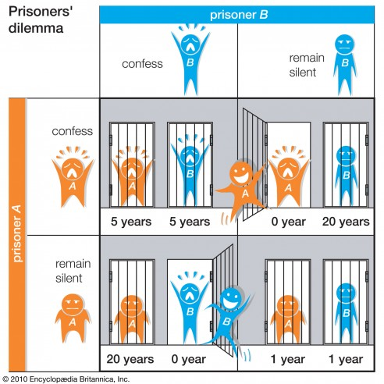
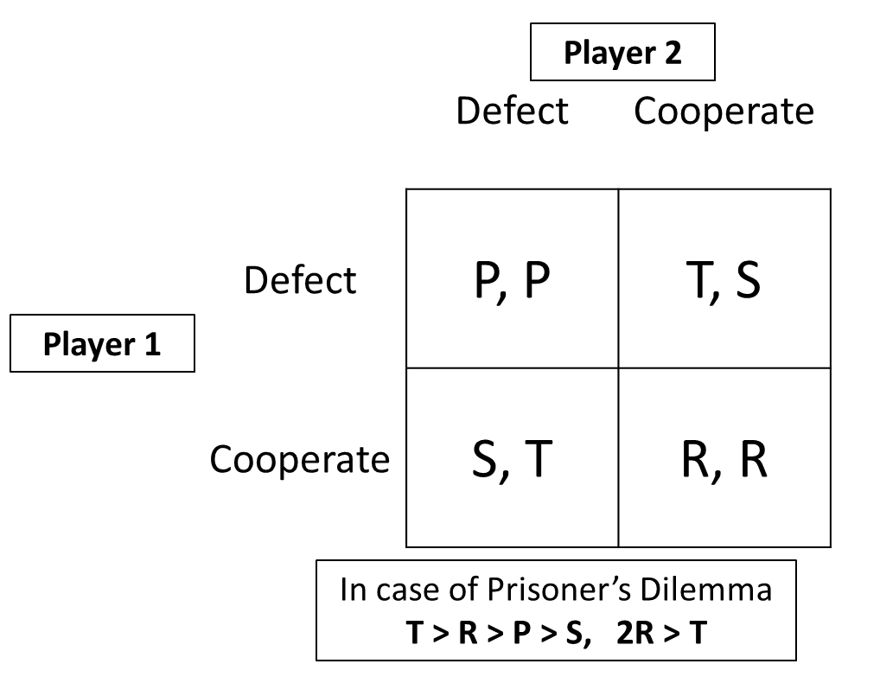
Prisoner’s Dilemma Game

Slide 3
Spatial PD Game
 | C | D
C | R R | S T
D | T S | P P
 | Cooperator
Cooperator | Cooperator | Defector
 | Cooperator
R=1
R=1
T=1.2, R=1, P=0.1, S=0
S=0
T=1.2
(2,2)’s Overall Payoff 3R+1S=3

Slide 4
Evolution of Cooperation
Strategy Imitation
Success-Driven Migration
Reputation-Based Migration
Our Model
Combination of above models

Slide 5
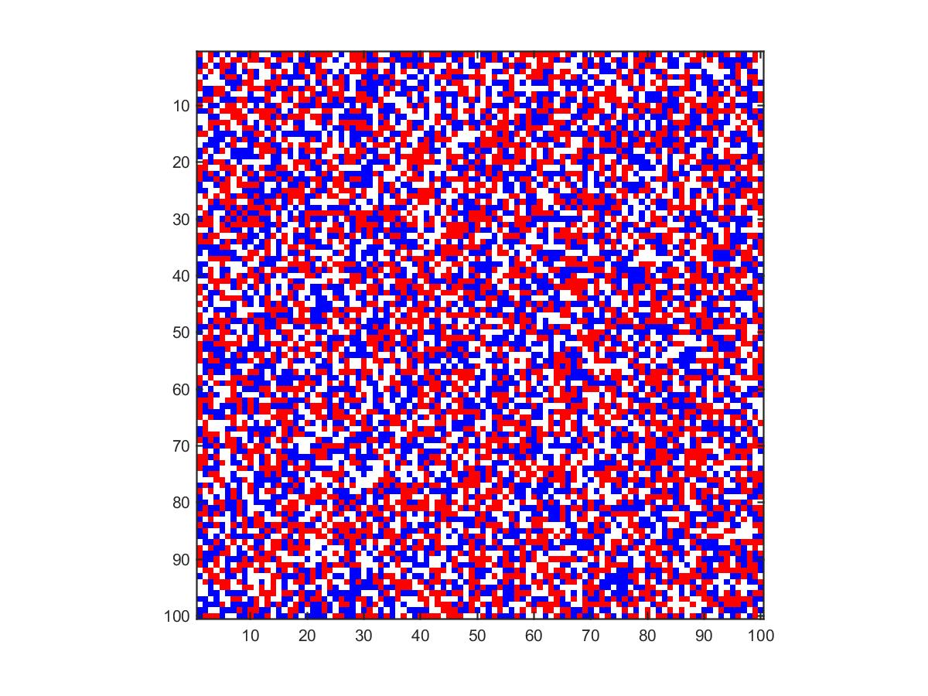

Initial State
Population Density $ρ 0.7 (L 100)$
Fraction of Cooperators $ρ_{c} 0.5$
Payoff Matrix [T, R, P, S] = [1.2 1 0 0]

Slide 6
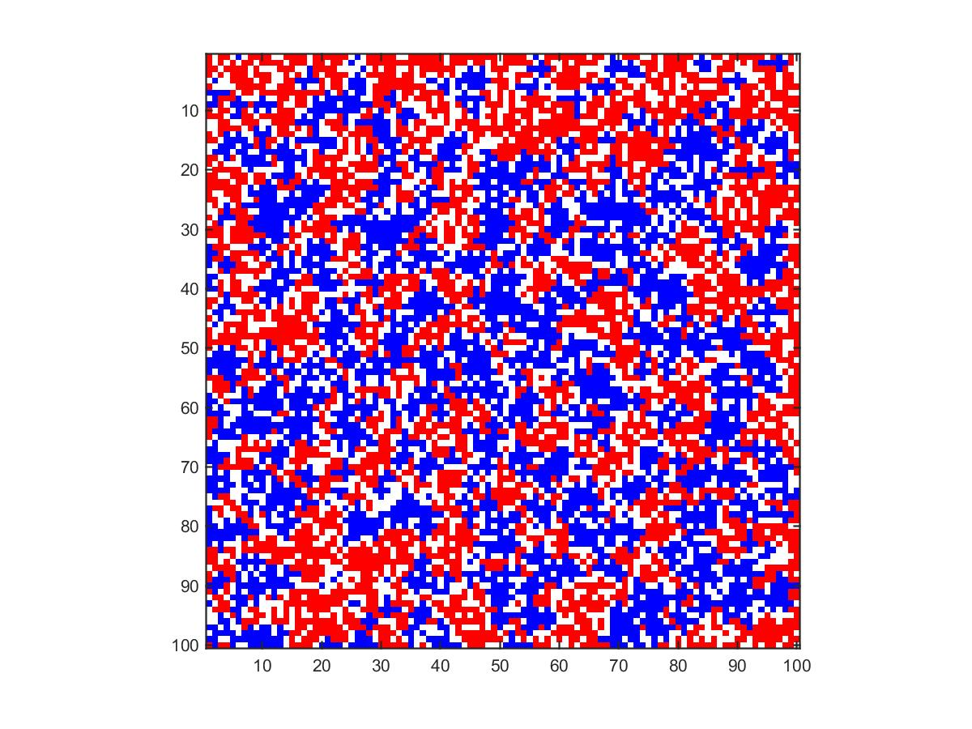

Strategy Imitation
Compare with Neighbors’ payoff, change their strategy
Iter. 100, $ρ_{c}=0.51$

Slide 7
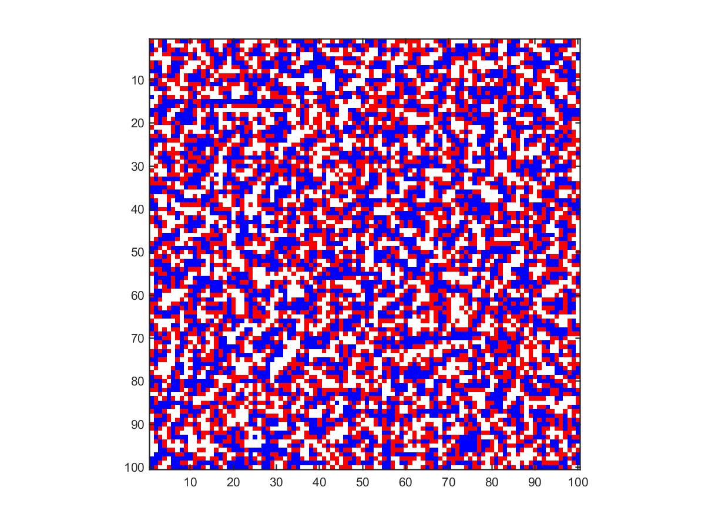

Success-Driven Migration
Migrate to the best candidate site
Iter. 100, $ρ_{c}=0.5$

Slide 8
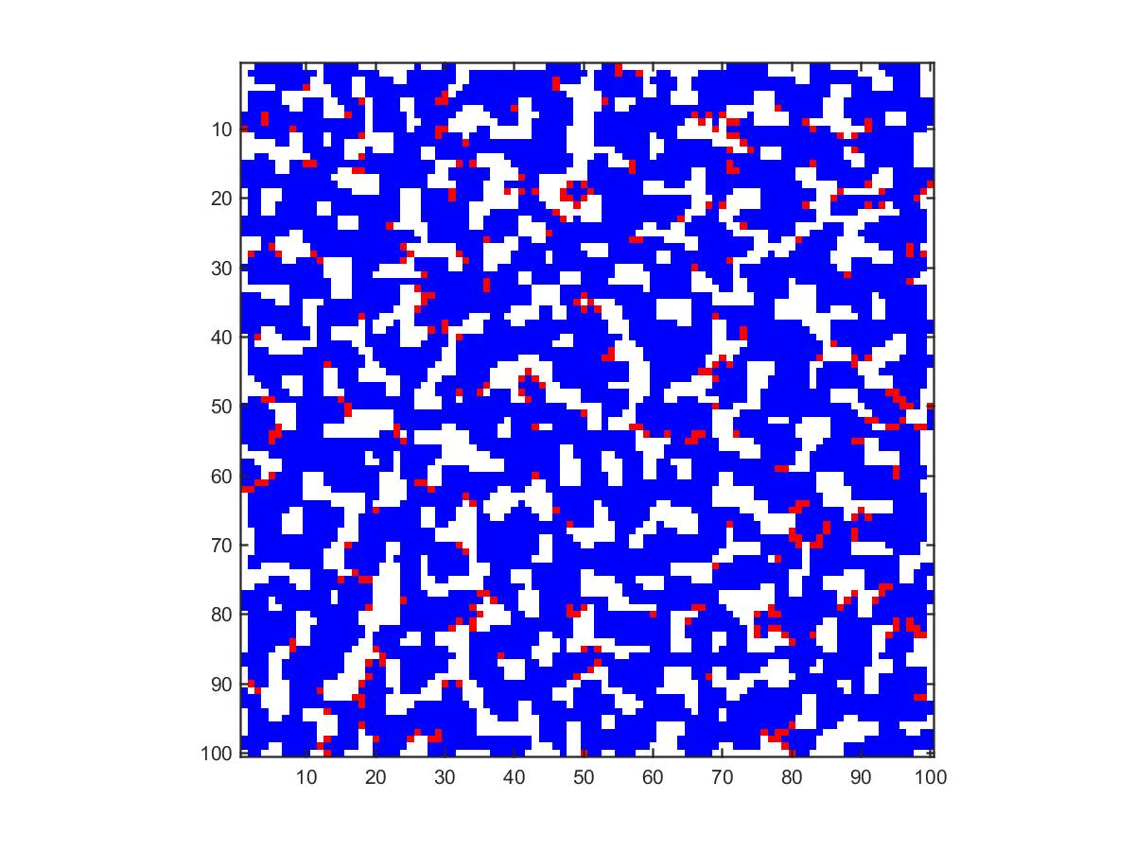

Success-Driven Migration + Imitation
Migrate and Imitate
Iter. 100, $ρ_{c}=0.95$

Slide 9

Reputation-Based Migration
Migrate to a random place with the probability based on the reputation
$$R_{i}\left(t\right)=αR_{i}\left(t−1\right)+S_{i}(t)$$
$R$: Reputation, $i$: Individual, $t$: Time, $α$: Decaying rate (memory effect)
$S$: 1 if cooperate, 0 otherwise
$$P_{i}=\frac{R_{i}^{γ}}{\sum_{l∈ℵ}{R_{l}^{γ}}}$$
$P$: Probability of individual’s leaving, $γ$: Mobility sensitivity
$ℵ$: Neighbors and itself

Slide 10
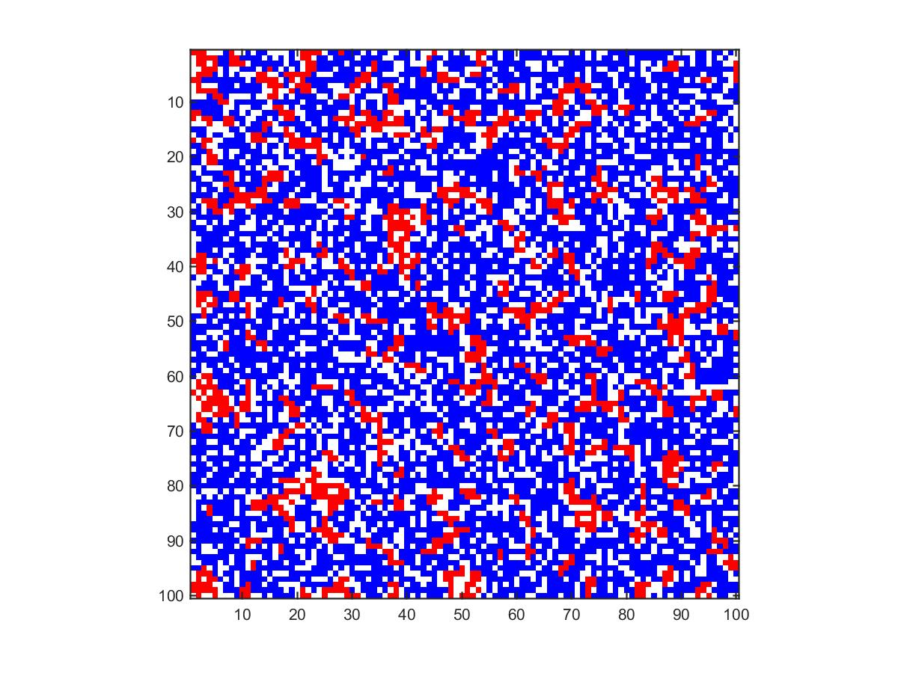

Reputation-Based Migration + Imitation
Migrate to a random place with the probability based on the reputation
Iter. 100, $ρ_{c}=0.9$1

Slide 11
Our Model
Improve overall payoff
Strategy Imitation
Where to go
Success-Driven Migration
Whether migrate or not
Reputation-Based Migration

Slide 12
Convergence

Slide 13
Cooperator Ratios

Slide 14
Patterns

Slide 15
Discussion

Slide 16
Thanks for your attention
Any question?

