Slide 1
INFLUENCE OF SUCCESS-DRIVEN AND REPUTATION-BASED MIGRATION IN THE EVOLUTION OF COOPERATION
The friendly prisoners
Byungsoo Kim, Basile Maret

Slide 2
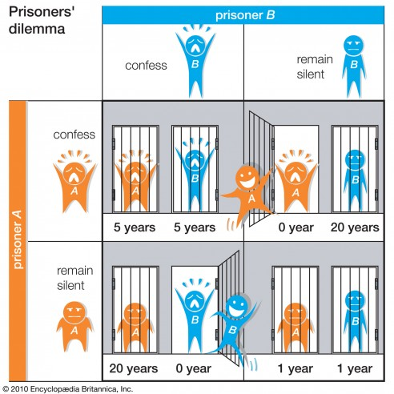
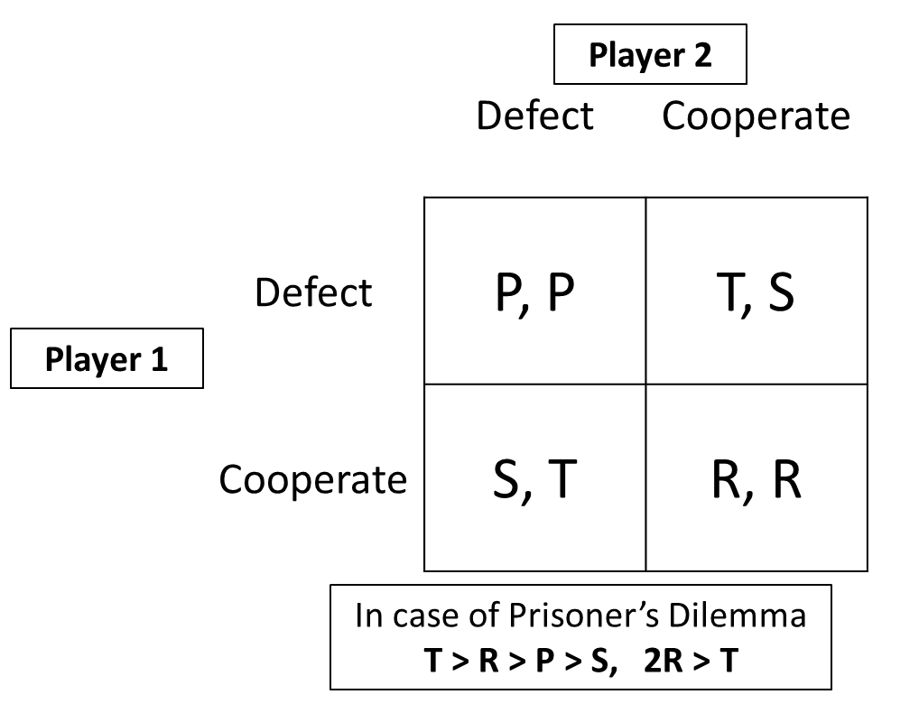
Prisoner’s Dilemma Game

Slide 3
Spatial PD Game
 | C | D
C | R R | S T
D | T S | P P
 | Cooperator
Cooperator | Cooperator | Defector
 | Cooperator
R=1
R=1
T=1.2, R=1, P=0.1, S=0
S=0
T=1.2
(2,2)’s Overall Payoff 3R+1S=3

Slide 4
Evolution of Cooperation
Strategy Imitation
Success-Driven Migration
Reputation-Based Migration
Our Model
Combination of above models

Slide 5
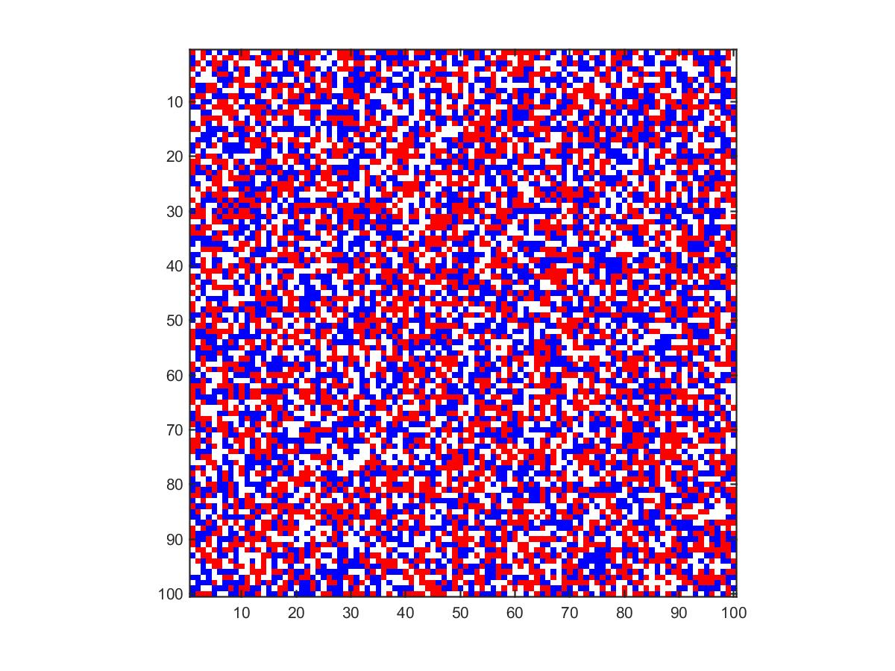

Initial State

Slide 6
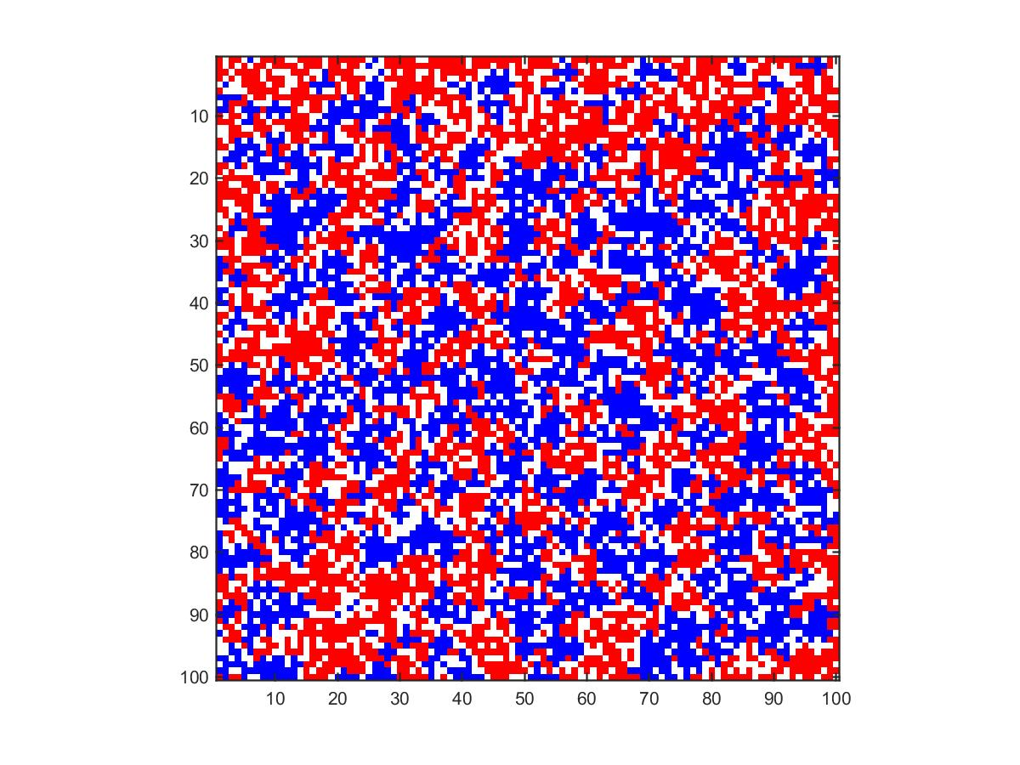

Strategy Imitation
Compare with Neighbors’ payoff, change their strategy

Slide 7
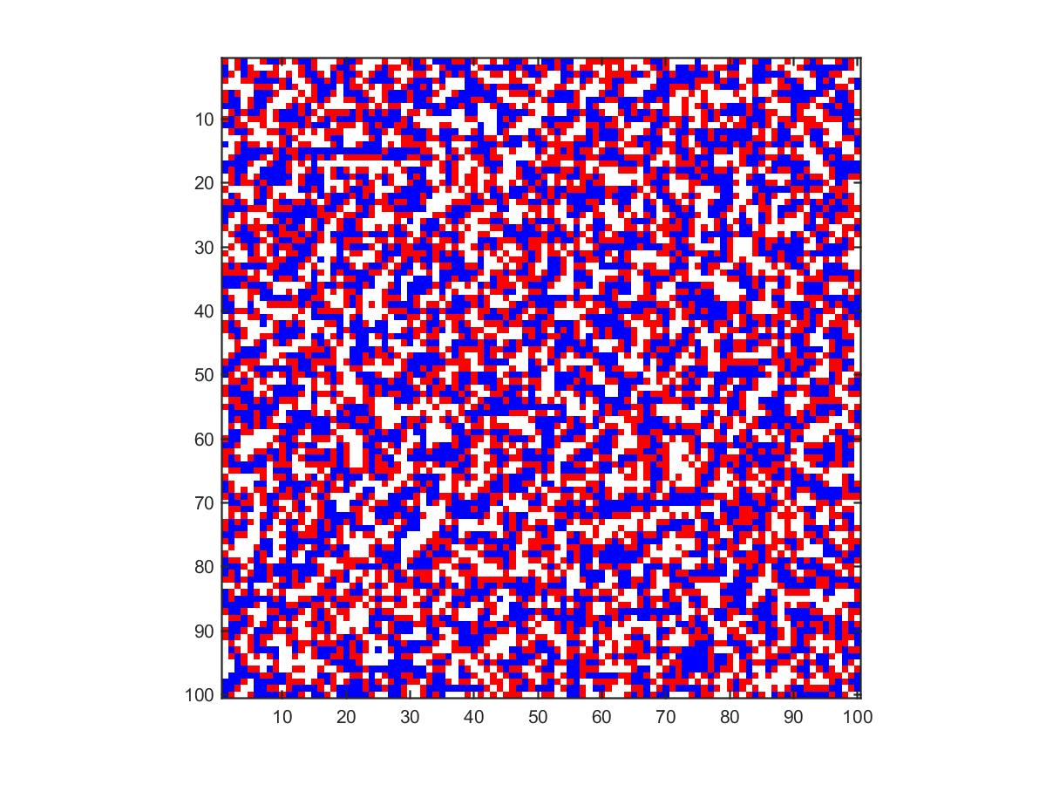

Success-Driven Migration
Migrate to the best candidate site

Slide 8
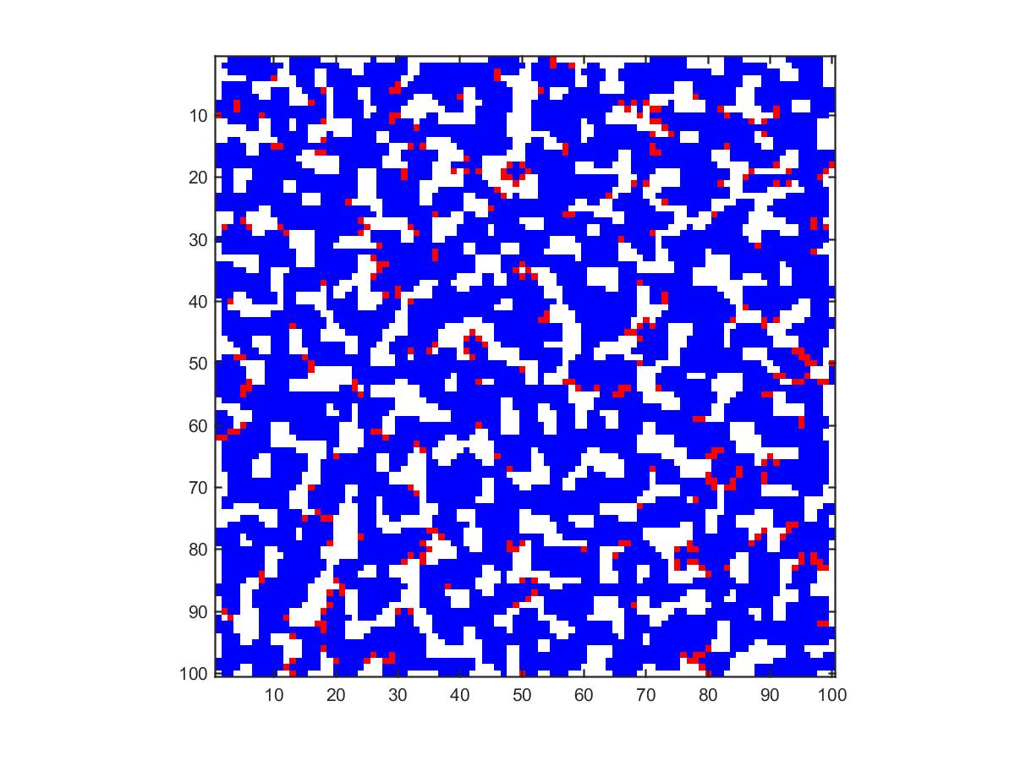

Success-Driven Migration + Imitation
Migrate and Imitate

Slide 9

Reputation-Based Migration
Migrate to a random place with the probability based on the reputation

Slide 10
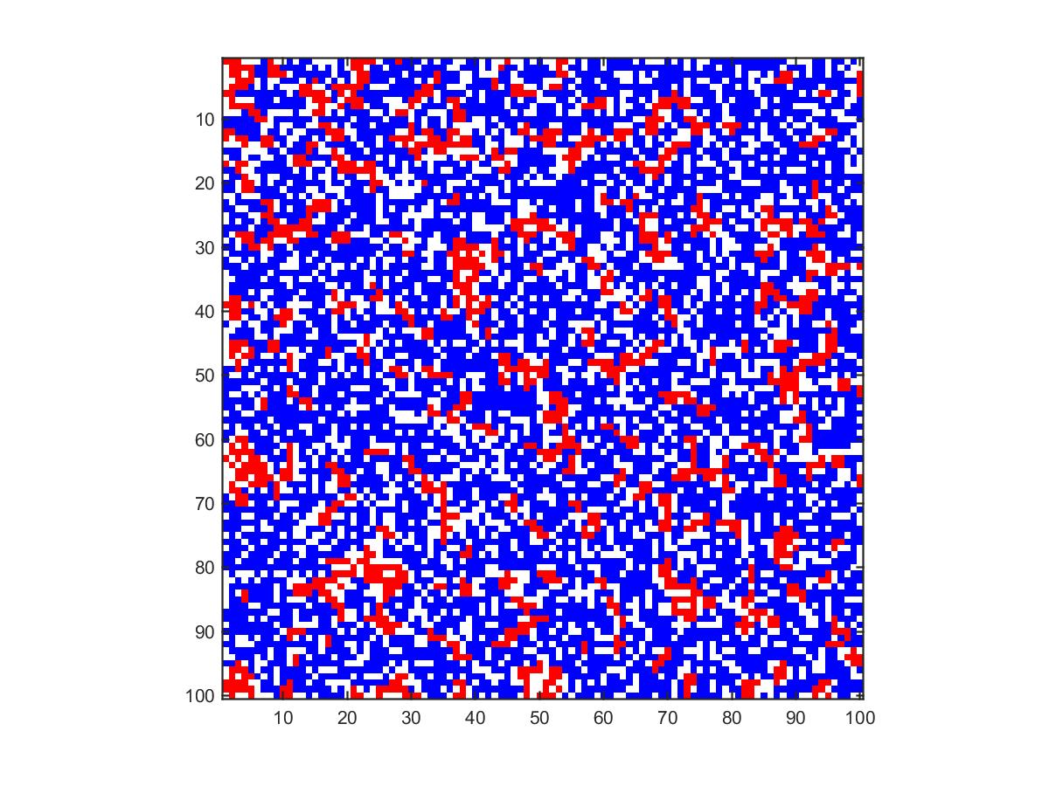

Reputation-Based Migration + Imitation
Migrate to a random place with the probability based on the reputation

Slide 11
Our Model
Improve overall payoff
Strategy Imitation
Where to go
Success-Driven Migration
Whether migrate or not
Reputation-Based Migration

Slide 12
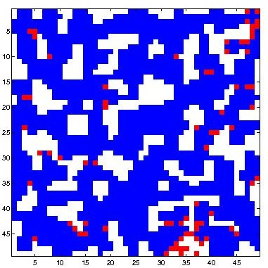
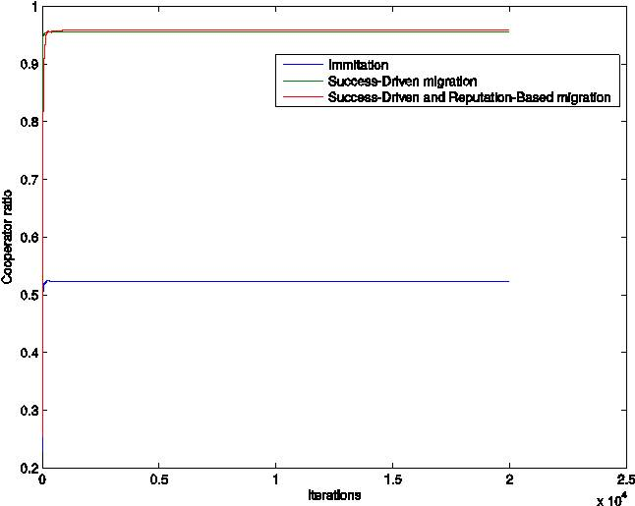

Convergence
Success-Driven after 1000 iterations
TODO : here should be the plot convergence-20000.eps
Convergence of the different models
Success-Driven after 3000 iterations

Slide 13
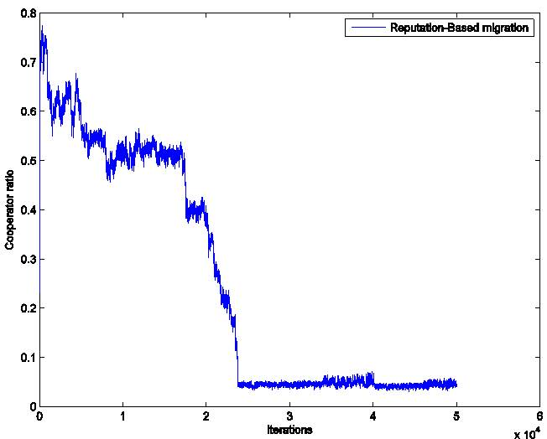
Convergence
TODO : here should be the plot convergence-50000-2.eps
Cooperator ratio after 50000 iterations for α=0.5, ɣ=500

Slide 14
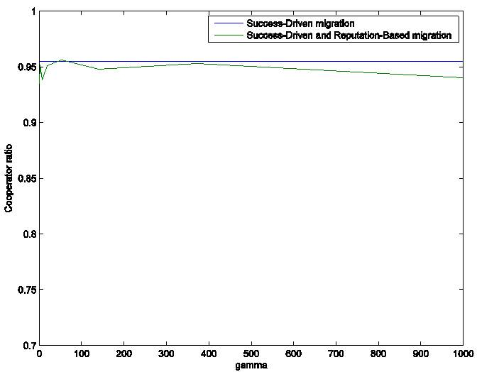
Cooperator Ratios
TODO : here should be the plot alpha05.eps
Cooperator ratio after 5000 iterations for α=0.5

Slide 15
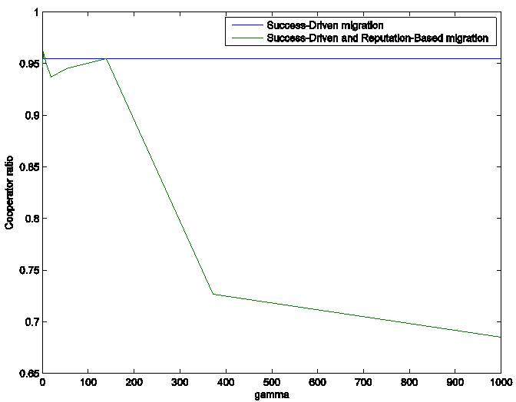
Cooperator Ratios
TODO : here should be the plot alpha095.eps
Cooperator ratio after 5000 iterations for α=0.95

Slide 16
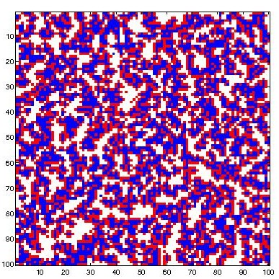
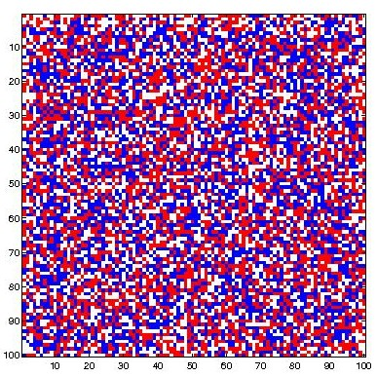
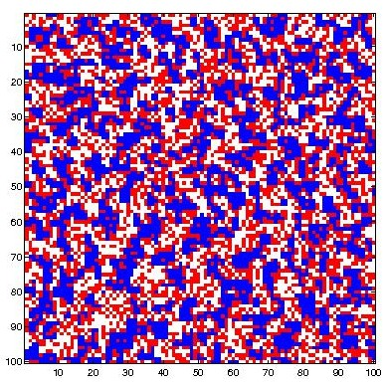
Patterns without imitation
Success-Driven migration
Reputation-Based migration
Success-Driven and Reputation-Based migration

Slide 17
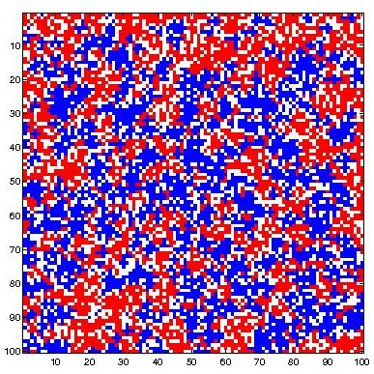
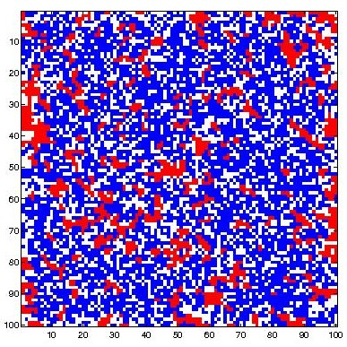
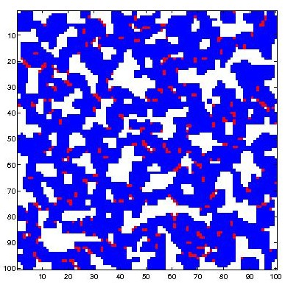
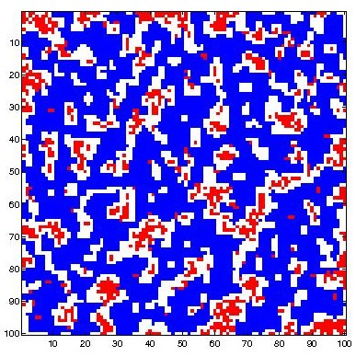
Patterns with imitation
Imitation only
Reputation-Based migration
Success-Driven migration
Success-Driven and Reputation-Based migration

Slide 18
Thanks for your attention
Any question?

