Slide 1
Influence of success-driven and reputation-based migration in the evolution of cooperation
The friendly prisoners
Byungsoo Kim, Basile Maret

Slide 2
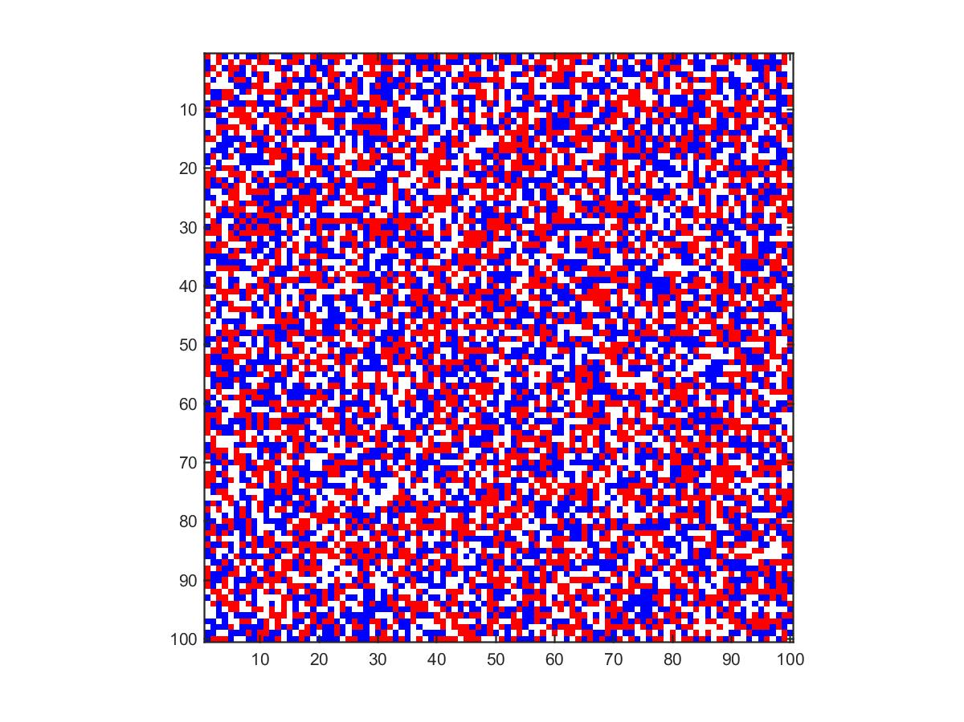
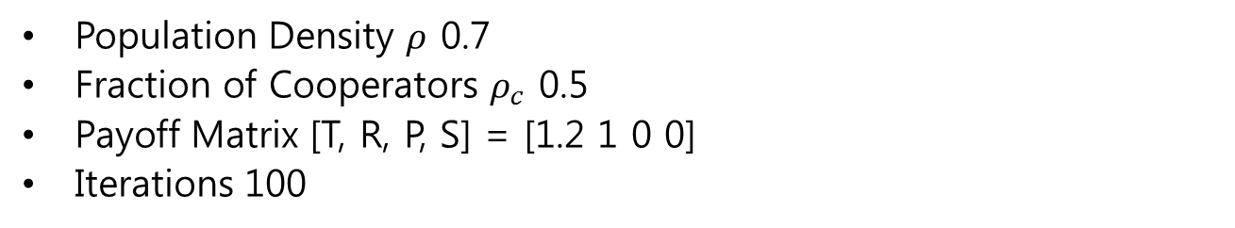
Initial State
Population Density $ρ$ 0.7
Fraction of Cooperators $ρ_{c}$ 0.5
Payoff Matrix [T, R, P, S] = [1.2 1 0 0]
Iterations 100

Slide 3
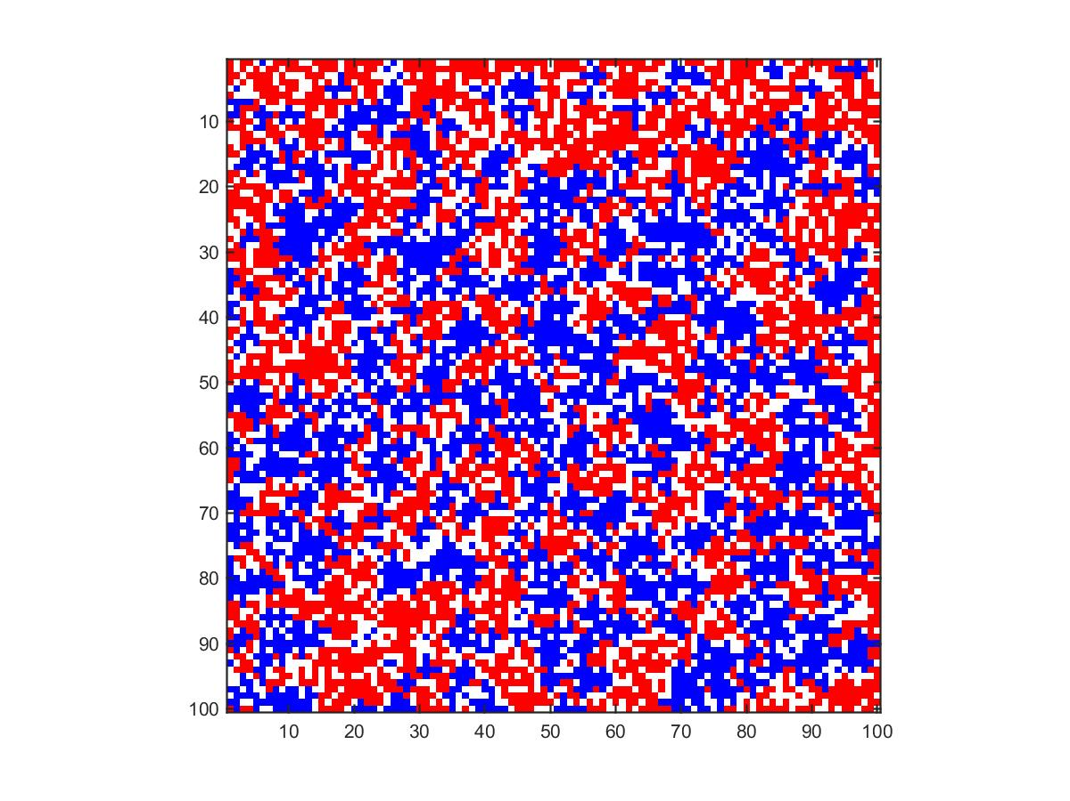

1. Imitation Only
$$ρ_{c}=0.50514$$

Slide 4
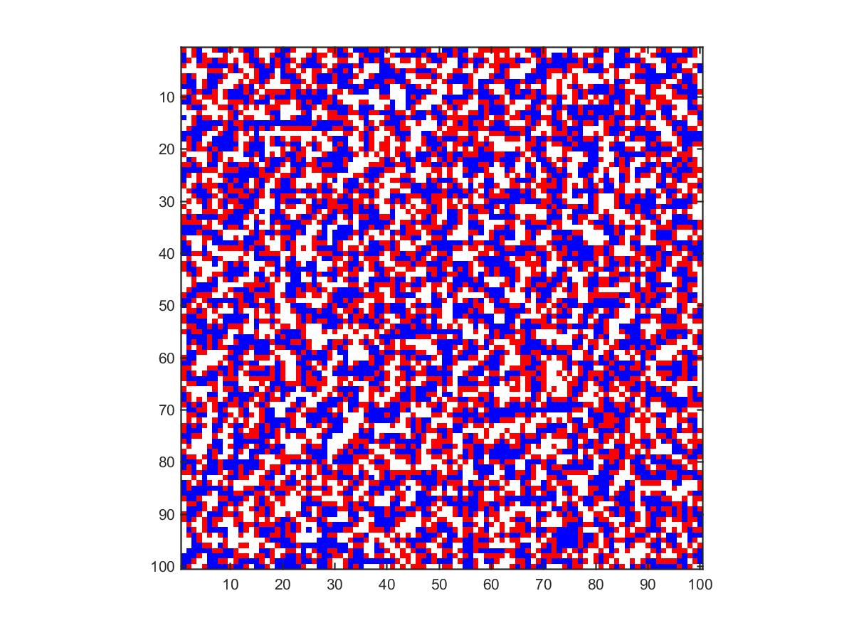

2. Success-Driven Migration Only
$$ρ_{c}=0.5$$

Slide 5
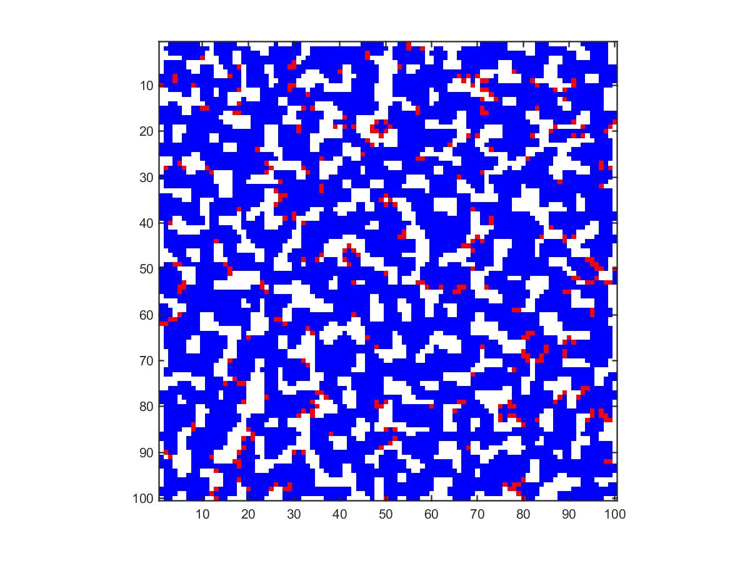

3. Success-Driven Migration + Imitation
$$ρ_{c}=0.95286$$

Slide 6
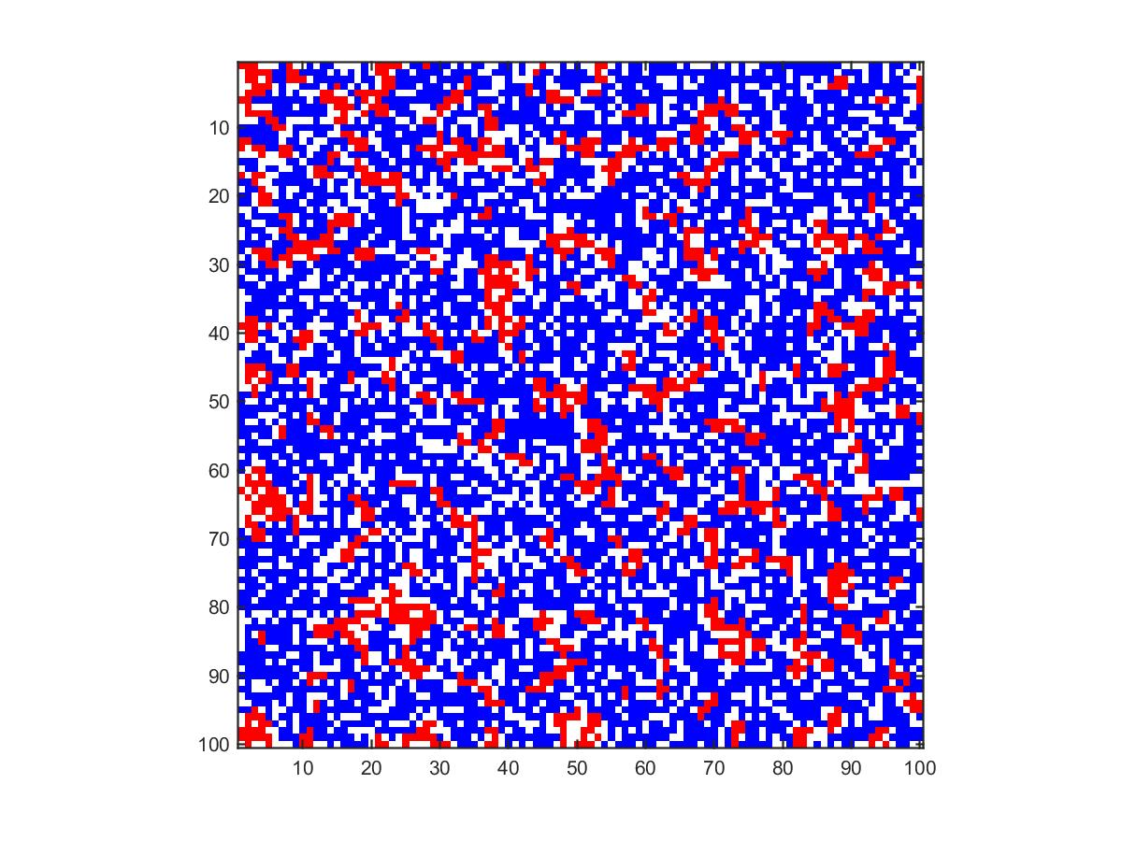

4. Reputation Based Migration + Imitation
$$ρ_{c}=0.91243$$

Slide 7
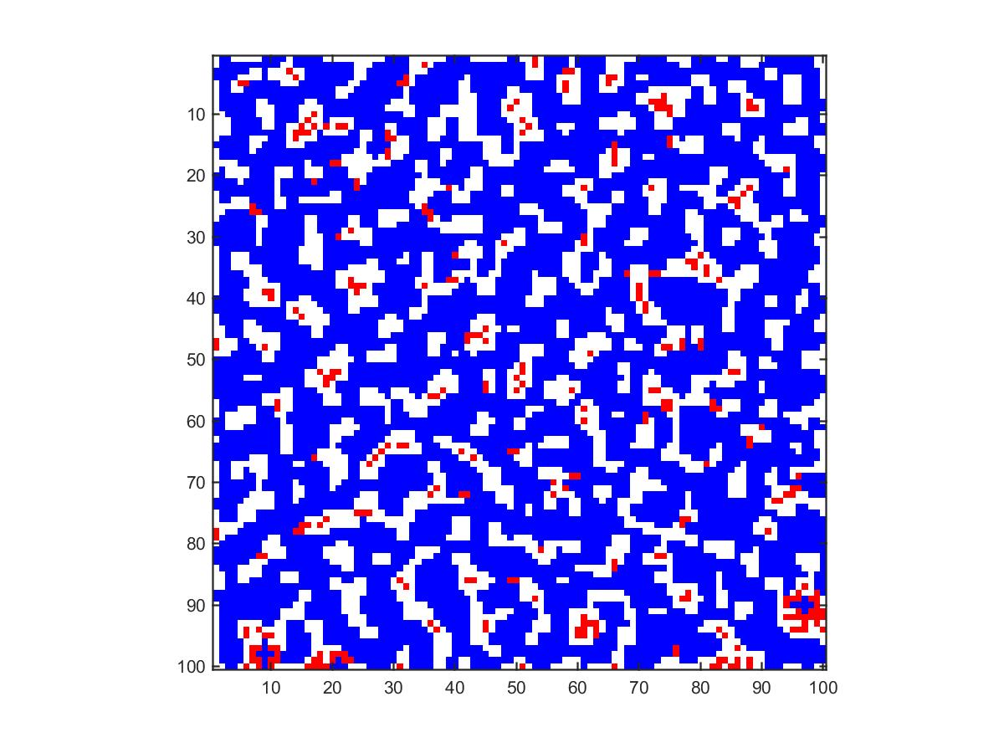

5. Success-Driven & Reputation Based Migration + Imitation
$$ρ_{c}=0.68986$$

Slide 8



Imitation
Success Mig.
Success Mig. + Imitation
Reputation + Imitation
All

Slide 9
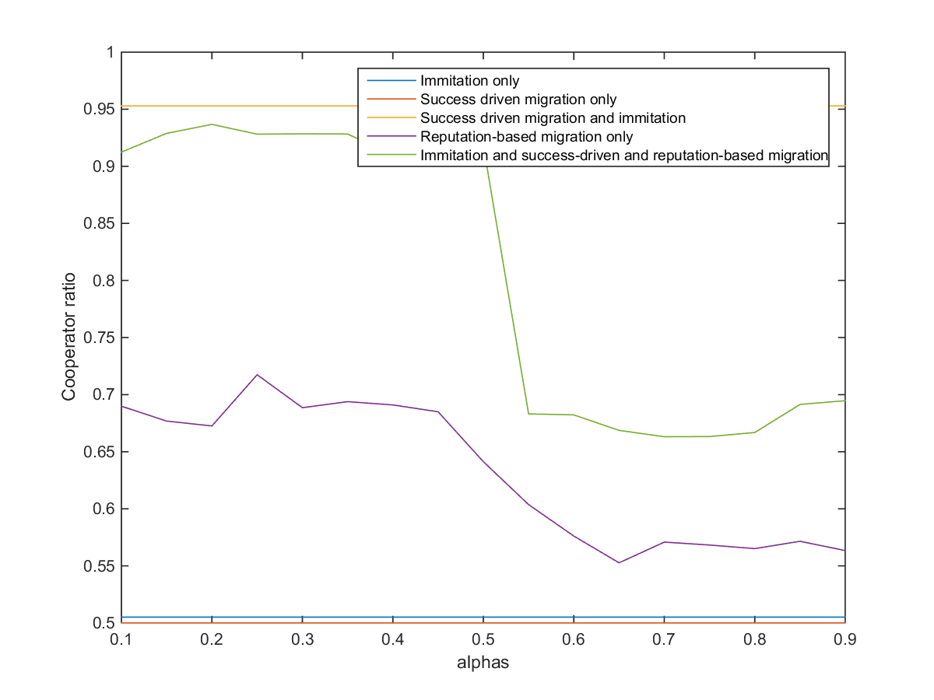

Alphas [0.1:0.05:0.9]
$$γ=1000$$

Slide 10

Gammas [1-1000,logscale]
$$α=0.95$$

