Slide 1
Ottimizzazione Riga Dataset: 3
Analisi alfain e pitch e re2is e ma2is e aratio e beta1 e beta2 e w1 e w2 e rte e tmaxu e tmaxl e tmovxu e tmovxl e tucp2 e tucp3 e sucp3 e tucp5 e sucp5 e tlcp5 e slcp5

Slide 2
Parametri PPO
n_epochs = 10
gamma = 0.99
gae_lambda = 0.95
clip_range = 0.2
ent_coef = 0.01
vf_coef = 0.5
max_grad_norm = 0.5
verbose = 1

Slide 3
Punto di partenza simulazione con LR = 3e-05
N steps = 200
Episode Length = 20
Batch size = 64
CSI Originale = 0.04053
DOF attivi modificati:
DOF_ALFAIN da 21.76 a 21.760
DOF_PITCH da 0.08149008314 a 0.081
DOF_RE2IS da 187020.0 a 187020.000
DOF_MA2IS da 0.53577 a 0.536
DOF_ARATIO da 1.320926 a 1.321
DOF_BETA1 da 29.784542 a 29.785
DOF_BETA2 da -64.40948 a -64.409
DOF_W1 da 0.5884277 a 0.588
DOF_W2 da 0.07281494 a 0.073
DOF_RTE da 0.001241217 a 0.001
DOF_TMAXU da 0.01478943 a 0.015
DOF_TMAXL da 0.003737946 a 0.004
DOF_TMOVXU da 0.04723816 a 0.047
DOF_TMOVXL da -0.101828 a -0.102
DOF_TUCP2 da 0.3106763 a 0.311
DOF_TUCP3 da 0.8328845 a 0.833
DOF_SUCP3 da 0.09361572 a 0.094
DOF_TUCP5 da 0.4981995 a 0.498
DOF_SUCP5 da 0.5915985 a 0.592
DOF_TLCP5 da 0.4858276 a 0.486
DOF_SLCP5 da 0.5182648 a 0.518
CSI profilo modificato = None
Limiti operativi (DOF Bounds):
DOF_ALFAIN = [20.0, 30.0]
DOF_PITCH = [0.04560844344, 0.1489434866]
DOF_RE2IS = [50820.0, 256750.0]
DOF_MA2IS = [0.40001, 0.89993]
DOF_ARATIO = [0.950024, 1.399712]
DOF_BETA1 = [-9.54361, 39.858401]
DOF_BETA2 = [-79.62194, -50.804227]
DOF_W1 = [0.0002319336, 0.7997925]
DOF_W2 = [5.340576e-05, 0.9997559]
DOF_RTE = [0.0007000397, 0.001999911]
DOF_TMAXU = [0.004015076, 0.02998889]
DOF_TMAXL = [0.002500534, 0.01999947]
DOF_TMOVXU = [-0.1499146, 0.1999332]
DOF_TMOVXL = [-0.1499893, 0.1999012]
DOF_TUCP2 = [0.280032, 0.4799954]
DOF_TUCP3 = [0.6000522, 0.9799333]
DOF_SUCP3 = [0.08003296, 0.1999982]
DOF_TUCP5 = [0.2500381, 0.7499733]
DOF_SUCP5 = [0.5000038, 0.7499638]
DOF_TLCP5 = [0.3500168, 0.5499741]
DOF_SLCP5 = [0.5000095, 0.7499924]

Slide 4
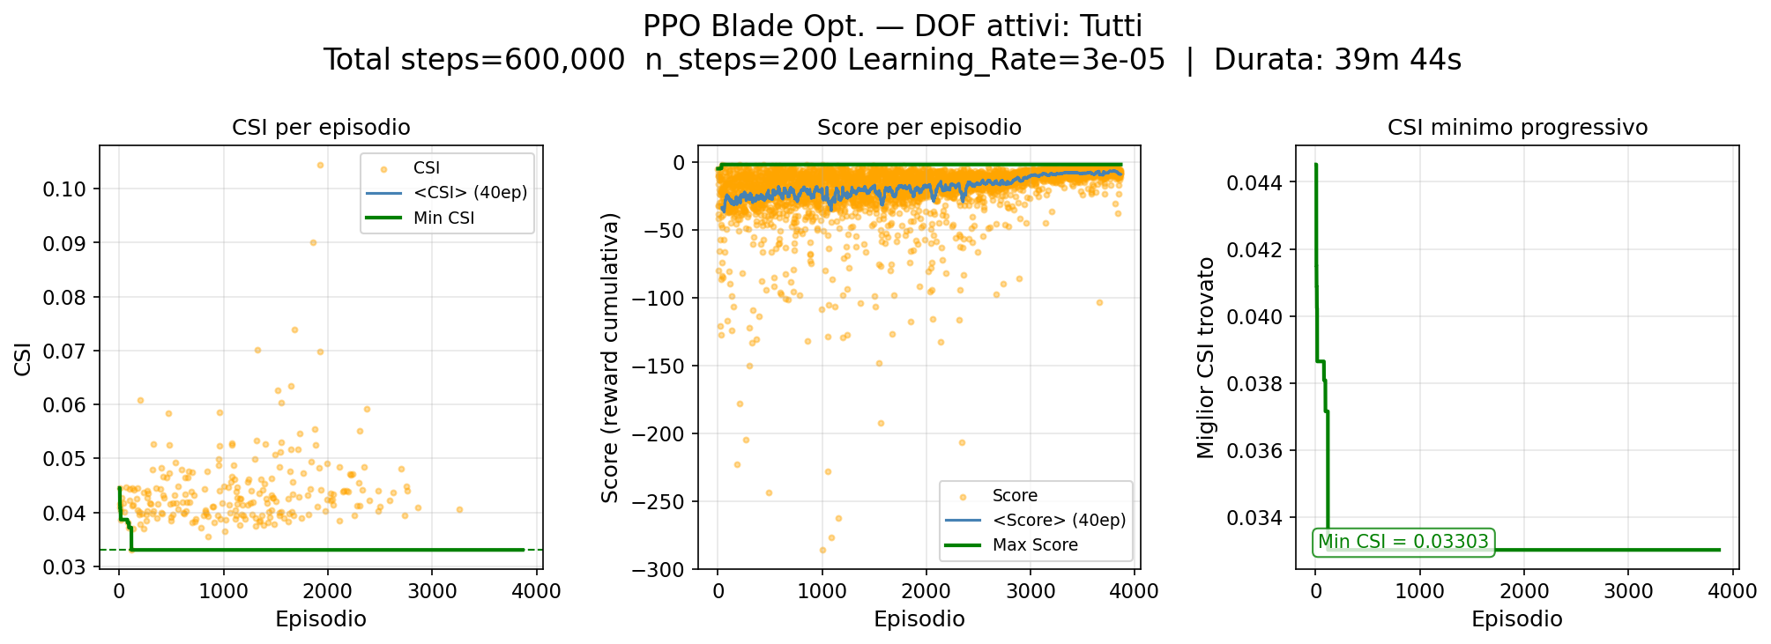
Risultati Training

Slide 5
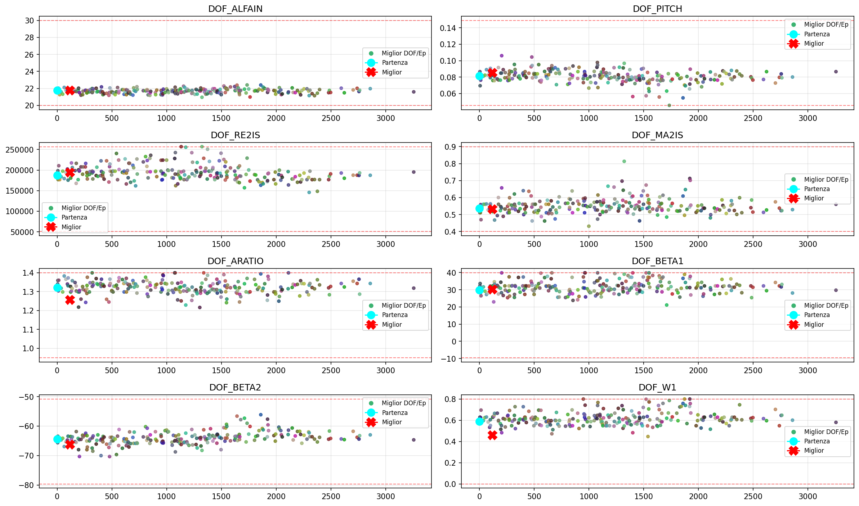
Evoluzione DOF - 1

Slide 6
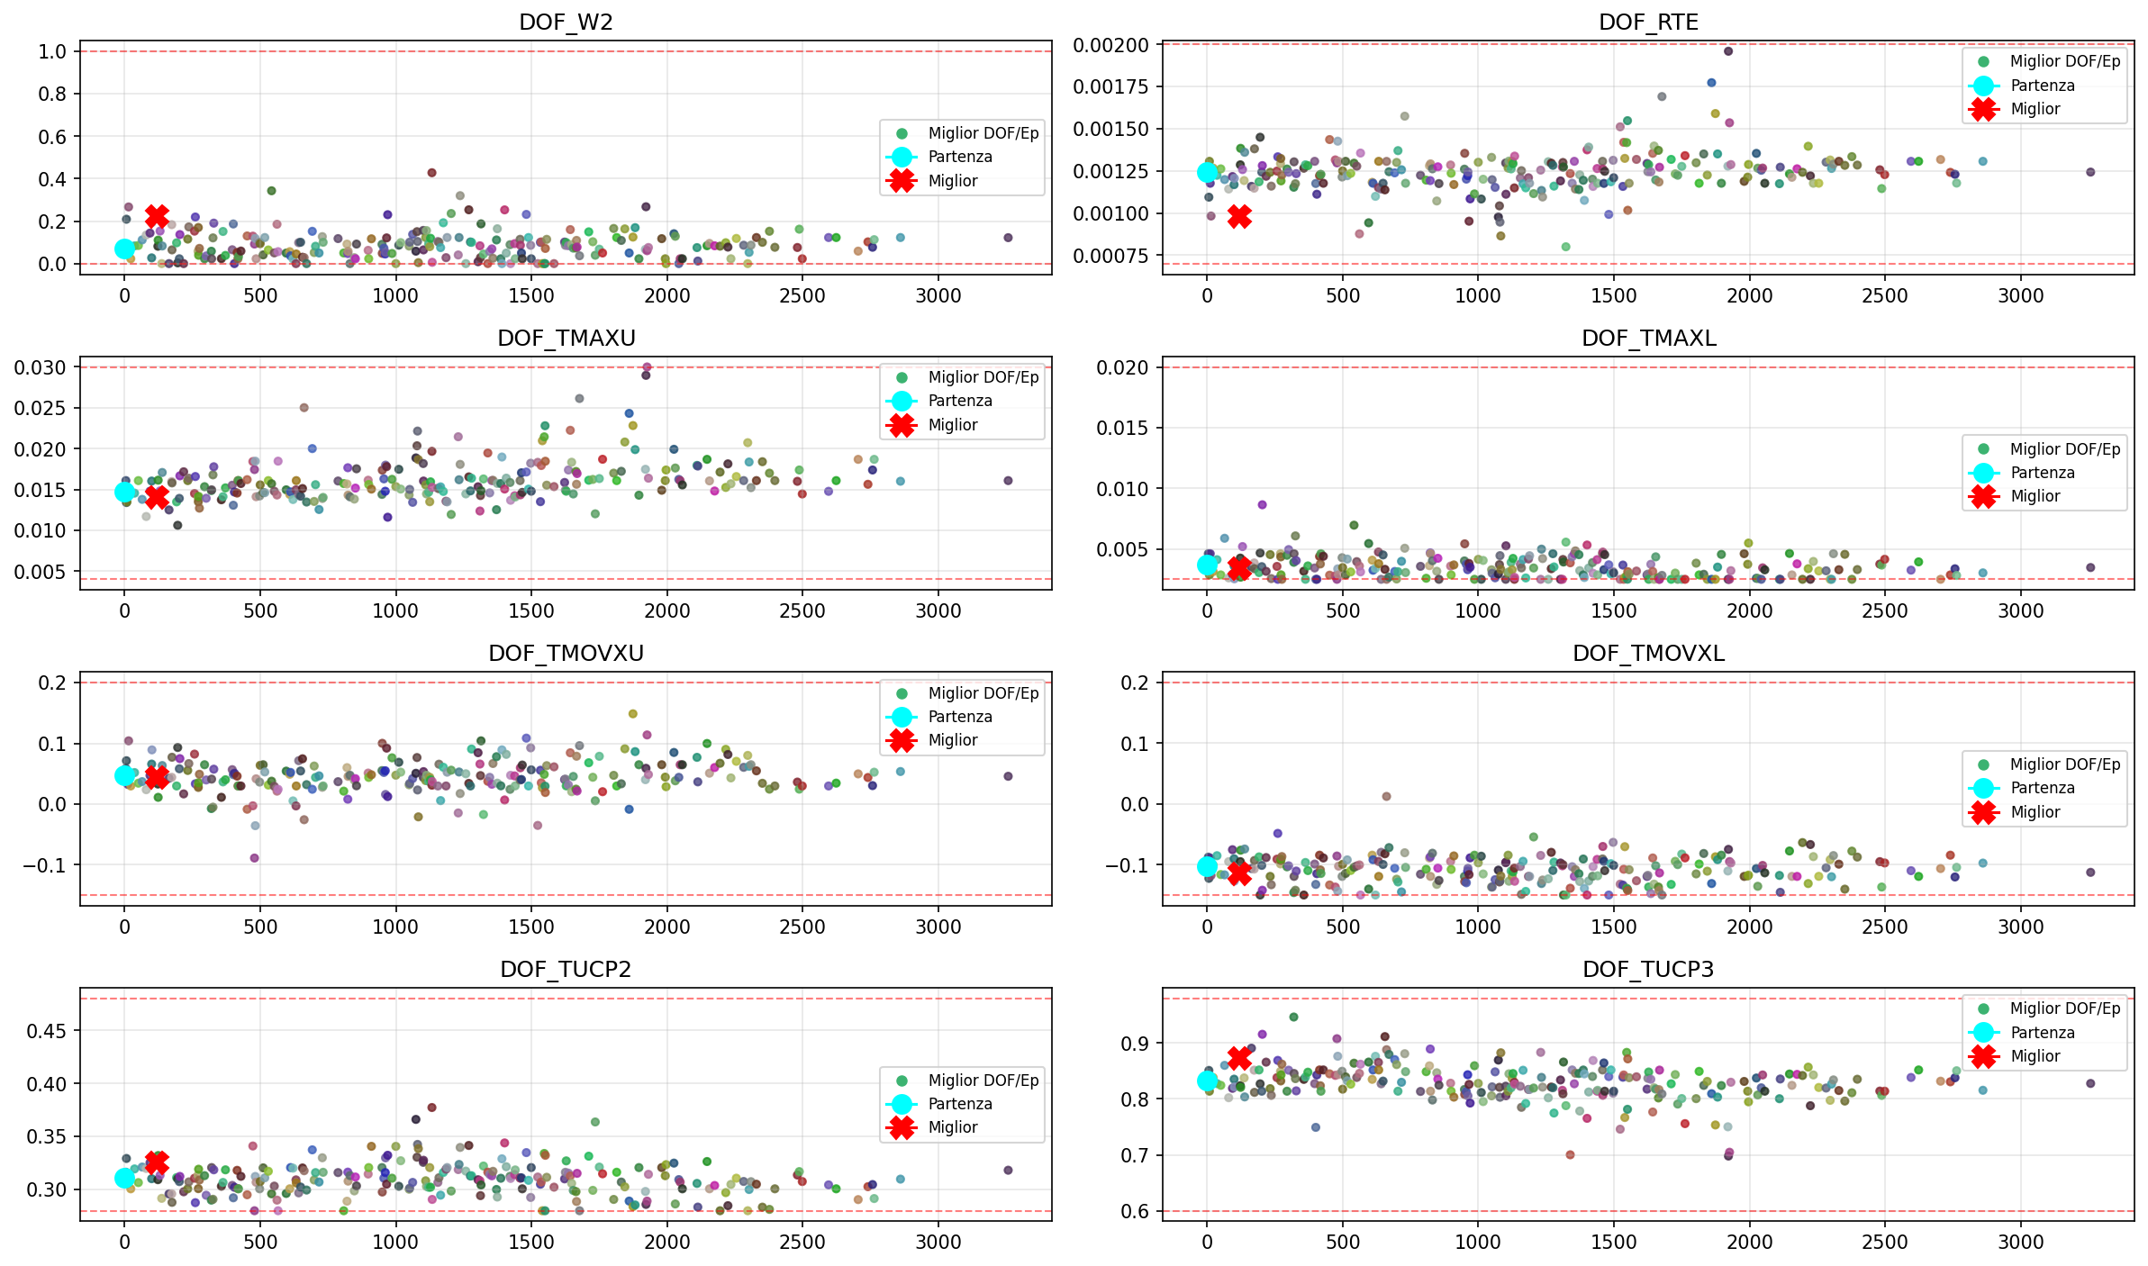
Evoluzione DOF - 2

Slide 7
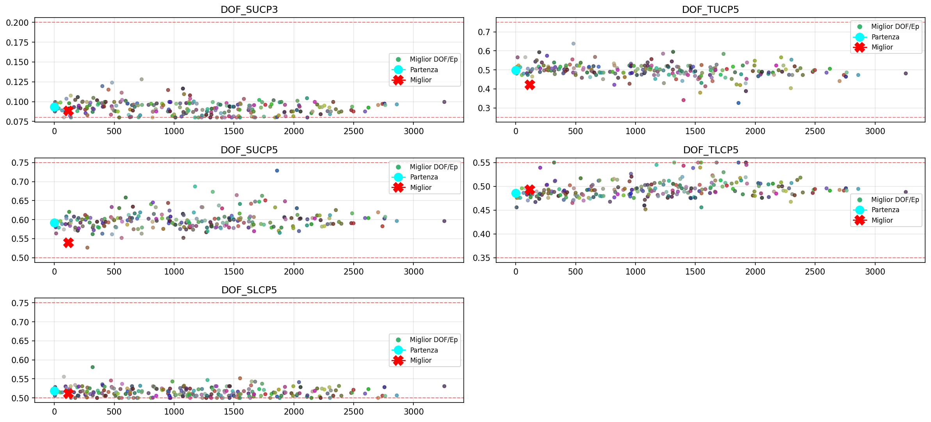
Evoluzione DOF - 3

Slide 8
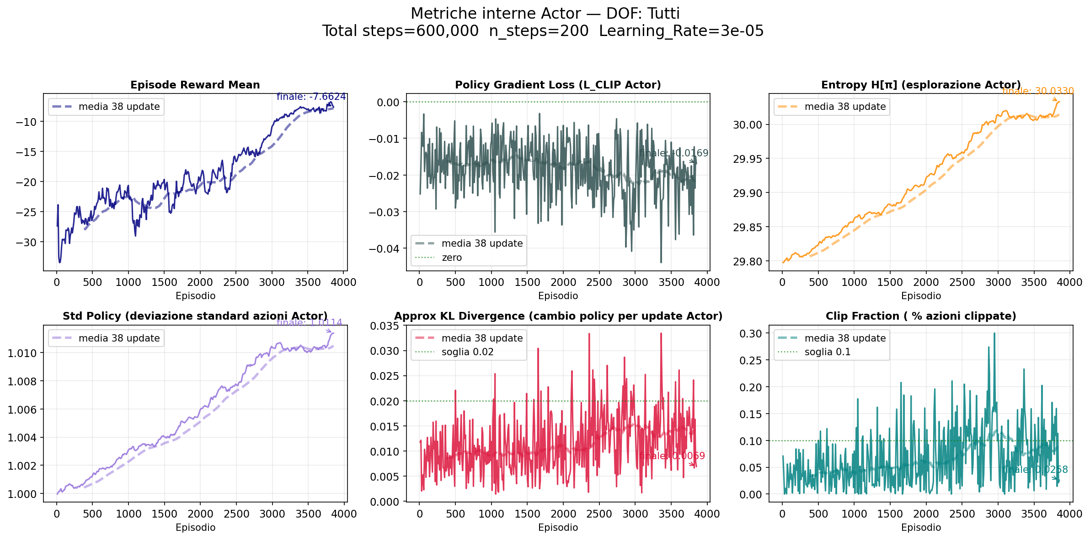
Metriche Actor

Slide 9
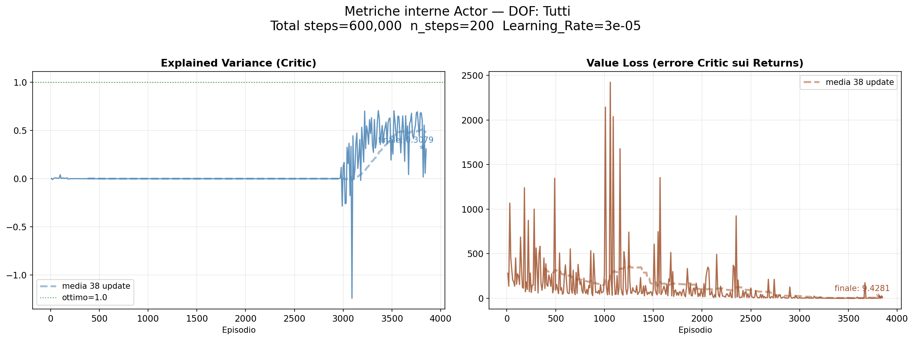
Metriche Critic

Slide 10
Miglior Profilo Ottimizzato
OF Risultanti:
OF_alfa_ex_FL = -60.897537 da -60.702000
OF_Cpt_FL = 0.037447 da 0.045200
OF_CSI_FL = 0.033026 da 0.040530
OF_phi_FL = 0.720658 da 0.723085
OF_psi_FL = 1.570212 da 1.577256
OF_Zwc_FL = 1.084737 da 1.135337
OF_DFss_mis_LO = 1.241065 da 1.291000
OF_Ds_cp_LO = 1.696038 da 0.701600
OF_Tmax_GM = 0.015636 da 0.016253
OF_X_Tmax_GM = 0.015636 da 0.242935
OF_Wedge_TE_GM = 6.084597 da 8.156338
OF_UGT_GM = 26.625618 da 26.647480
OF_Area_GM = 0.001197 da 0.001314
DOF Ottimali:
DOF_ALFAIN (*) = 21.790724 da 21.760000
DOF_PITCH (*) = 0.085340 da 0.081490
DOF_RE2IS (*) = 194114.031250 da 187020.000000
DOF_MA2IS (*) = 0.532754 da 0.535770
DOF_ARATIO (*) = 1.256427 da 1.320926
DOF_BETA1 (*) = 30.293982 da 29.784542
DOF_BETA2 (*) = -66.209175 da -64.409477
DOF_W1 (*) = 0.458771 da 0.588428
DOF_W2 (*) = 0.221791 da 0.072815
DOF_RTE (*) = 0.000984 da 0.001241
DOF_TMAXU (*) = 0.014105 da 0.014789
DOF_TMAXL (*) = 0.003401 da 0.003738
DOF_TMOVXU (*) = 0.044155 da 0.047238
DOF_TMOVXL (*) = -0.115018 da -0.101828
DOF_TUCP2 (*) = 0.325868 da 0.310676
DOF_TUCP3 (*) = 0.873268 da 0.832884
DOF_SUCP3 (*) = 0.088527 da 0.093616
DOF_TUCP5 (*) = 0.422187 da 0.498199
DOF_SUCP5 (*) = 0.540101 da 0.591599
DOF_TLCP5 (*) = 0.492854 da 0.485828
DOF_SLCP5 (*) = 0.511202 da 0.518265
Deflessione (ε) = 82.688°
Curvatura camber (θ) = 96.503°

Slide 11
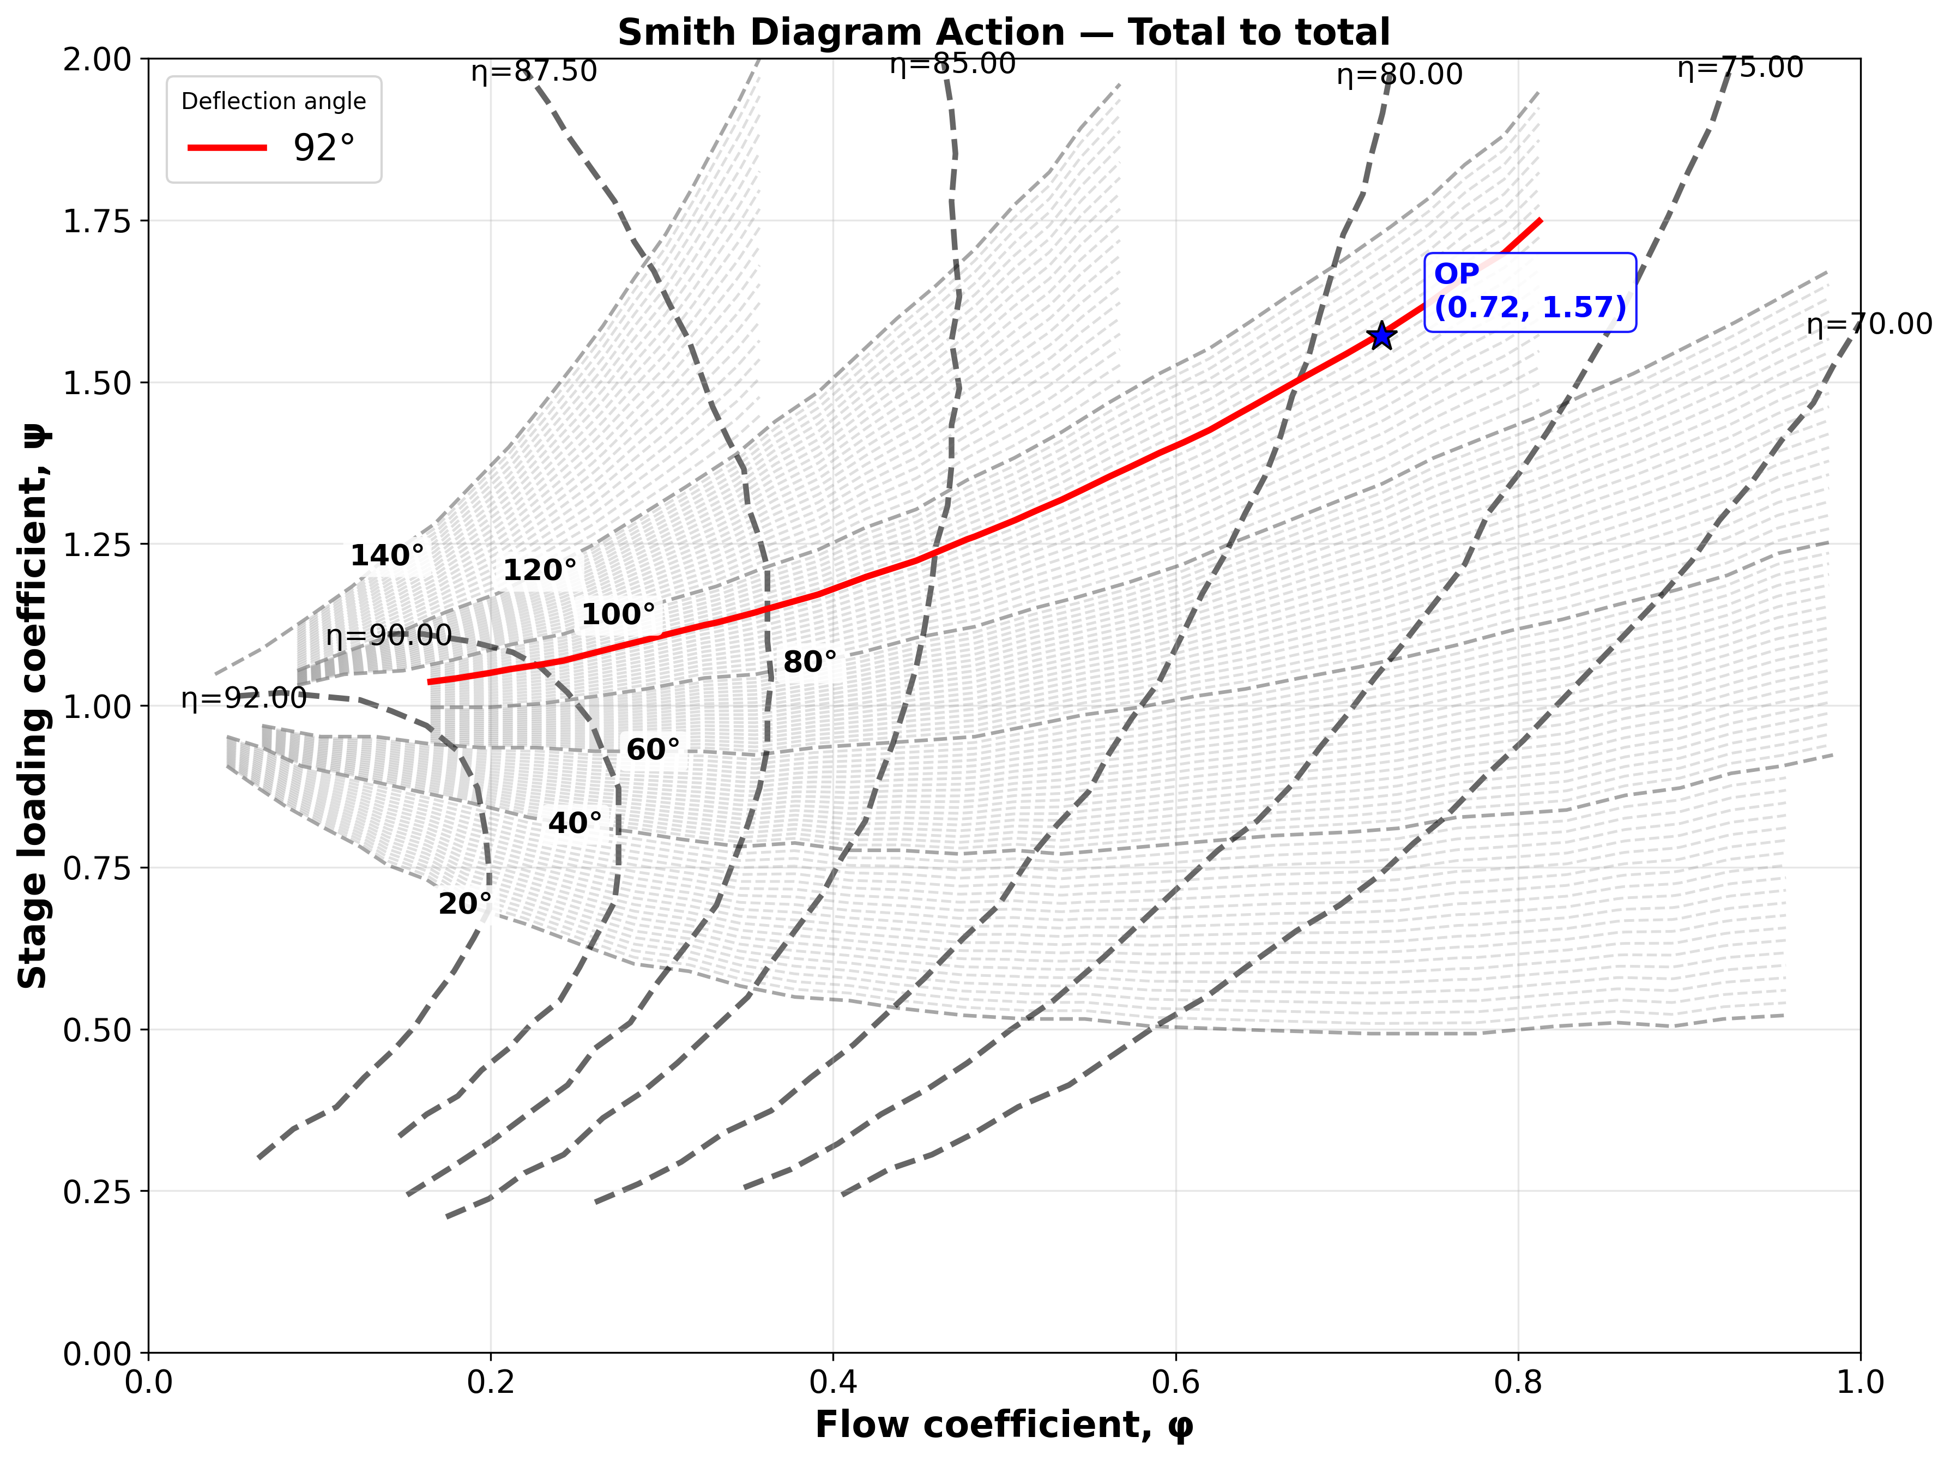
Smith Diagram Action - Axial exit

Slide 12
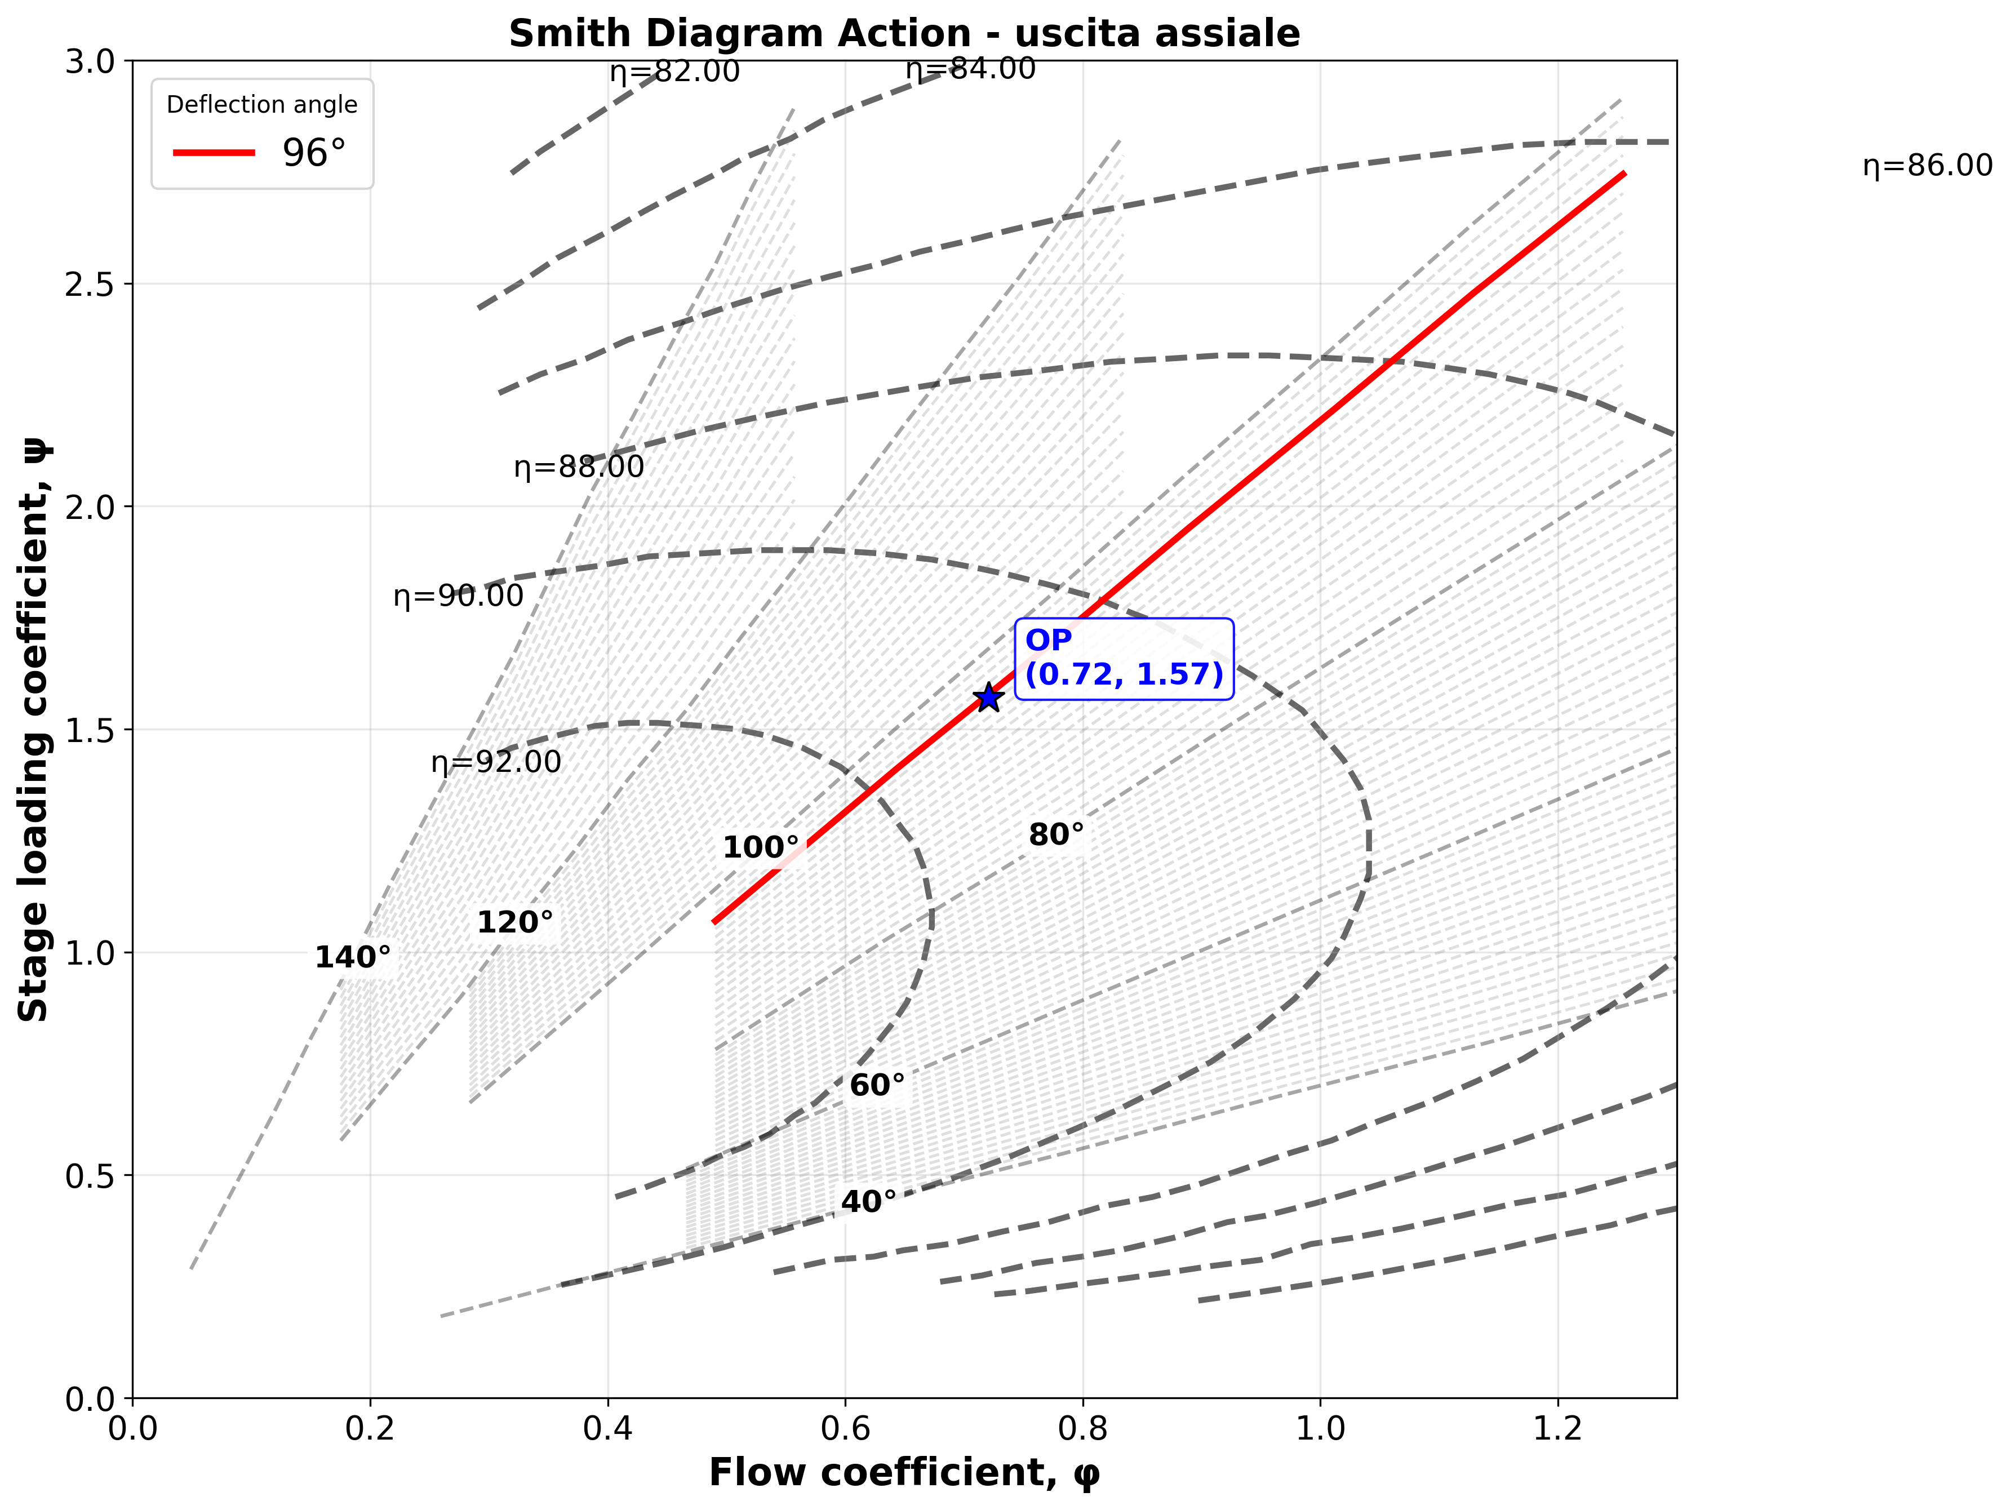
Smith Diagram Action - Total to Total

Slide 13
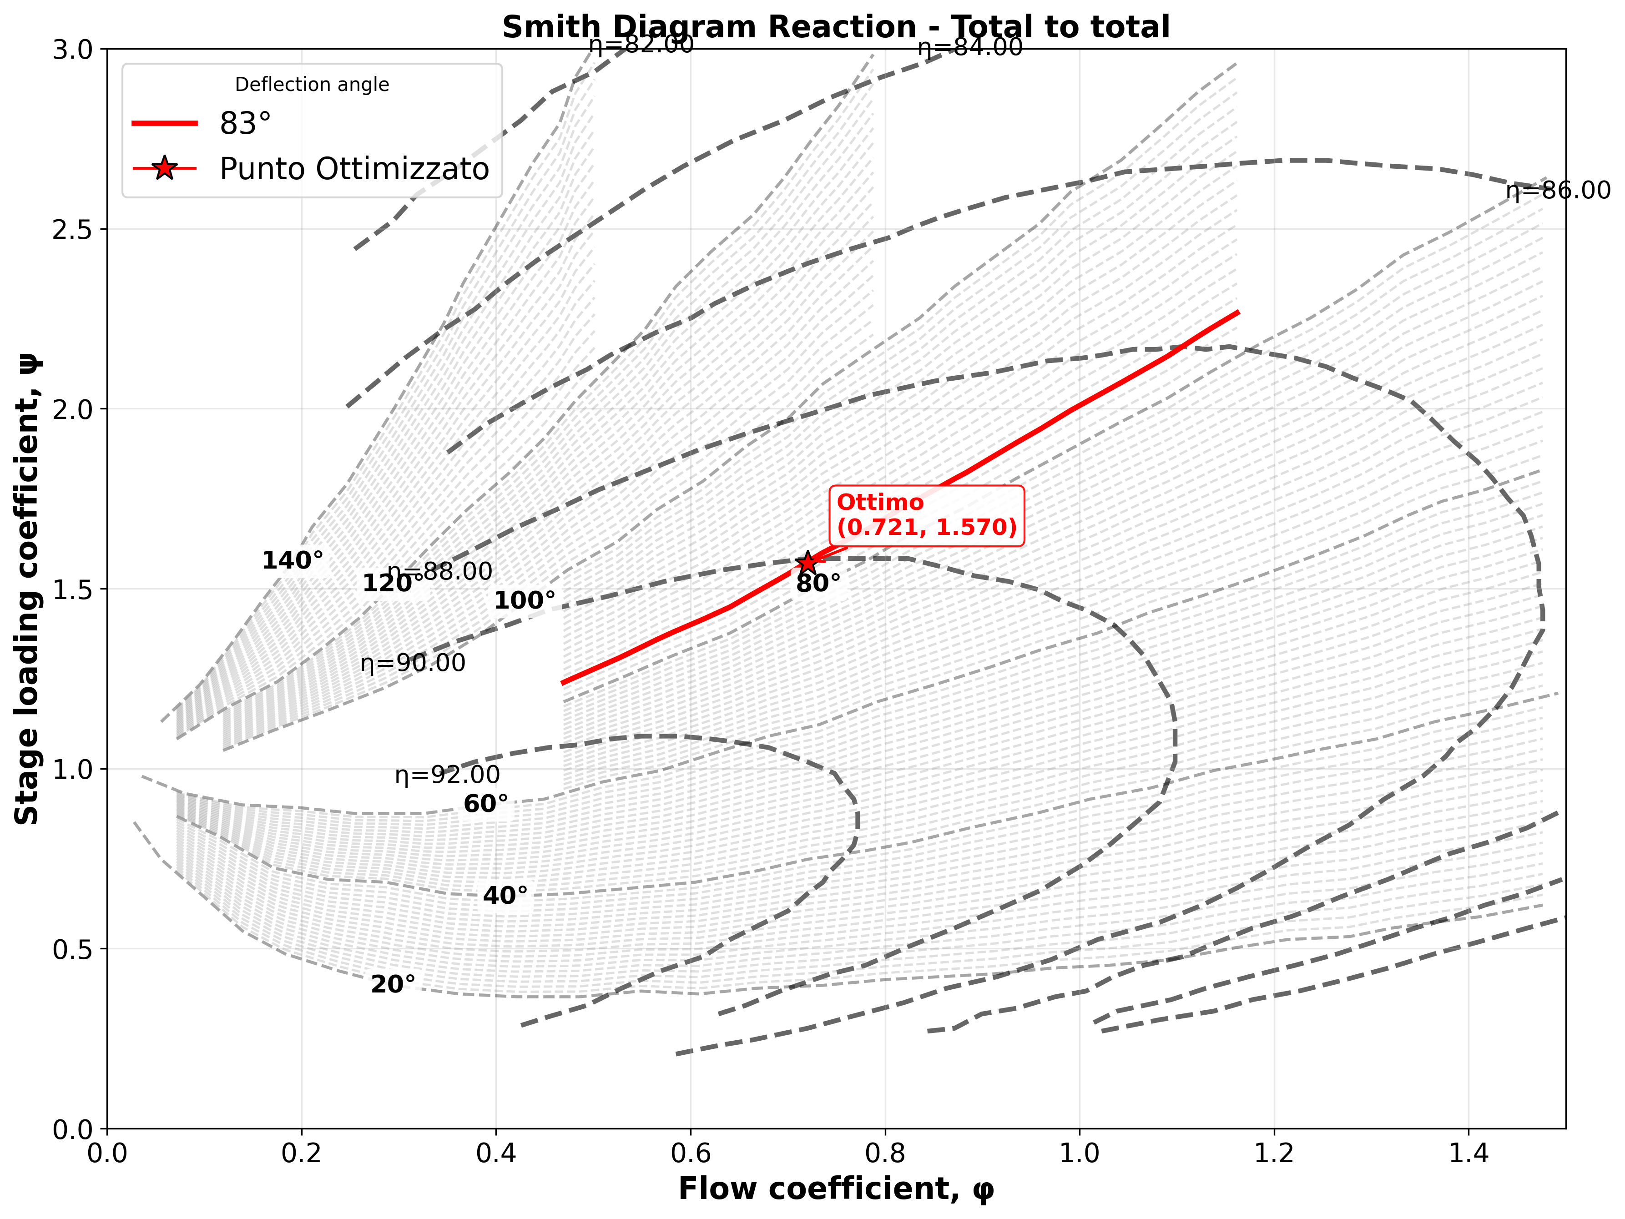
Smith Diagram Reaction - Total to Total

Slide 14
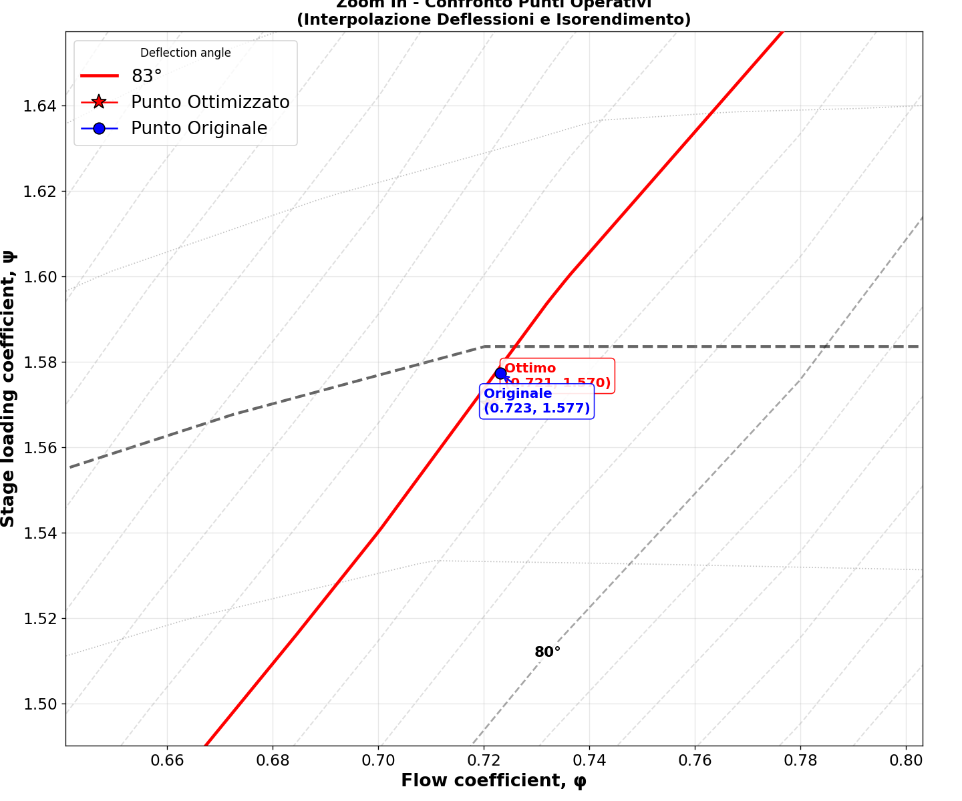
Smith Diagram Reaction - Total to Total

