Slide 1
Task 1 - Run Casuale
Partenza da profilo completamente casuale

Slide 2
Parametri PPO
n_epochs = 10
gamma = 0.99
gae_lambda = 0.95
clip_range = 0.2
ent_coef = 0.01
vf_coef = 0.5
max_grad_norm = 0.5
verbose = 1

Slide 3
Punto di partenza simulazione con LR = 3e-05
Tipo = Casuale (No Dataset)
Episode Length = 60
N steps = 200
Batch size = 64
Learning Rate = 3e-05
Best CSI trovato = 0.027502
DOF attivi modificati:
DOF_ALFAIN
DOF_PITCH
DOF_RE2IS
DOF_MA2IS
DOF_ARATIO
DOF_BETA1
DOF_BETA2
DOF_W1
DOF_W2
DOF_RTE
DOF_TMAXU
DOF_TMAXL
DOF_TMOVXU
DOF_TMOVXL
DOF_TUCP2
DOF_TUCP3
DOF_SUCP3
DOF_TUCP5
DOF_SUCP5
DOF_TLCP5
DOF_SLCP5
Limiti operativi (DOF Bounds):
DOF_ALFAIN = [20.0, 30.0]
DOF_PITCH = [0.04560844344, 0.1489434866]
DOF_RE2IS = [50820.0, 256750.0]
DOF_MA2IS = [0.40001, 0.89993]
DOF_ARATIO = [0.950024, 1.399712]
DOF_BETA1 = [-9.54361, 39.858401]
DOF_BETA2 = [-79.62194, -50.804227]
DOF_W1 = [0.0002319336, 0.7997925]
DOF_W2 = [5.340576e-05, 0.9997559]
DOF_RTE = [0.0007000397, 0.001999911]
DOF_TMAXU = [0.004015076, 0.02998889]
DOF_TMAXL = [0.002500534, 0.01999947]
DOF_TMOVXU = [-0.1499146, 0.1999332]
DOF_TMOVXL = [-0.1499893, 0.1999012]
DOF_TUCP2 = [0.280032, 0.4799954]
DOF_TUCP3 = [0.6000522, 0.9799333]
DOF_SUCP3 = [0.08003296, 0.1999982]
DOF_TUCP5 = [0.2500381, 0.7499733]
DOF_SUCP5 = [0.5000038, 0.7499638]
DOF_TLCP5 = [0.3500168, 0.5499741]
DOF_SLCP5 = [0.5000095, 0.7499924]

Slide 4
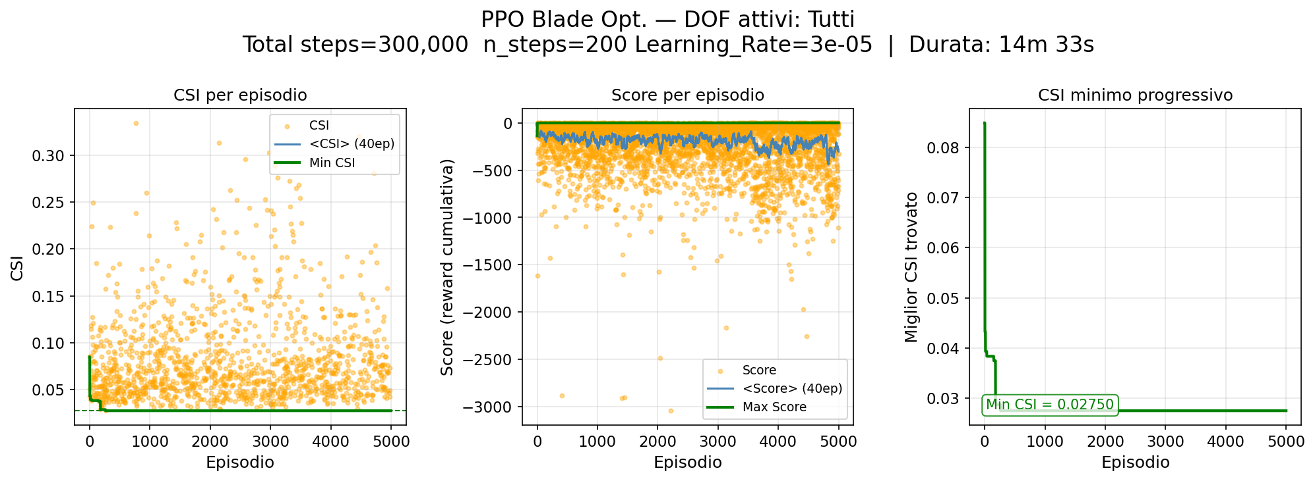
Risultati Training

Slide 5
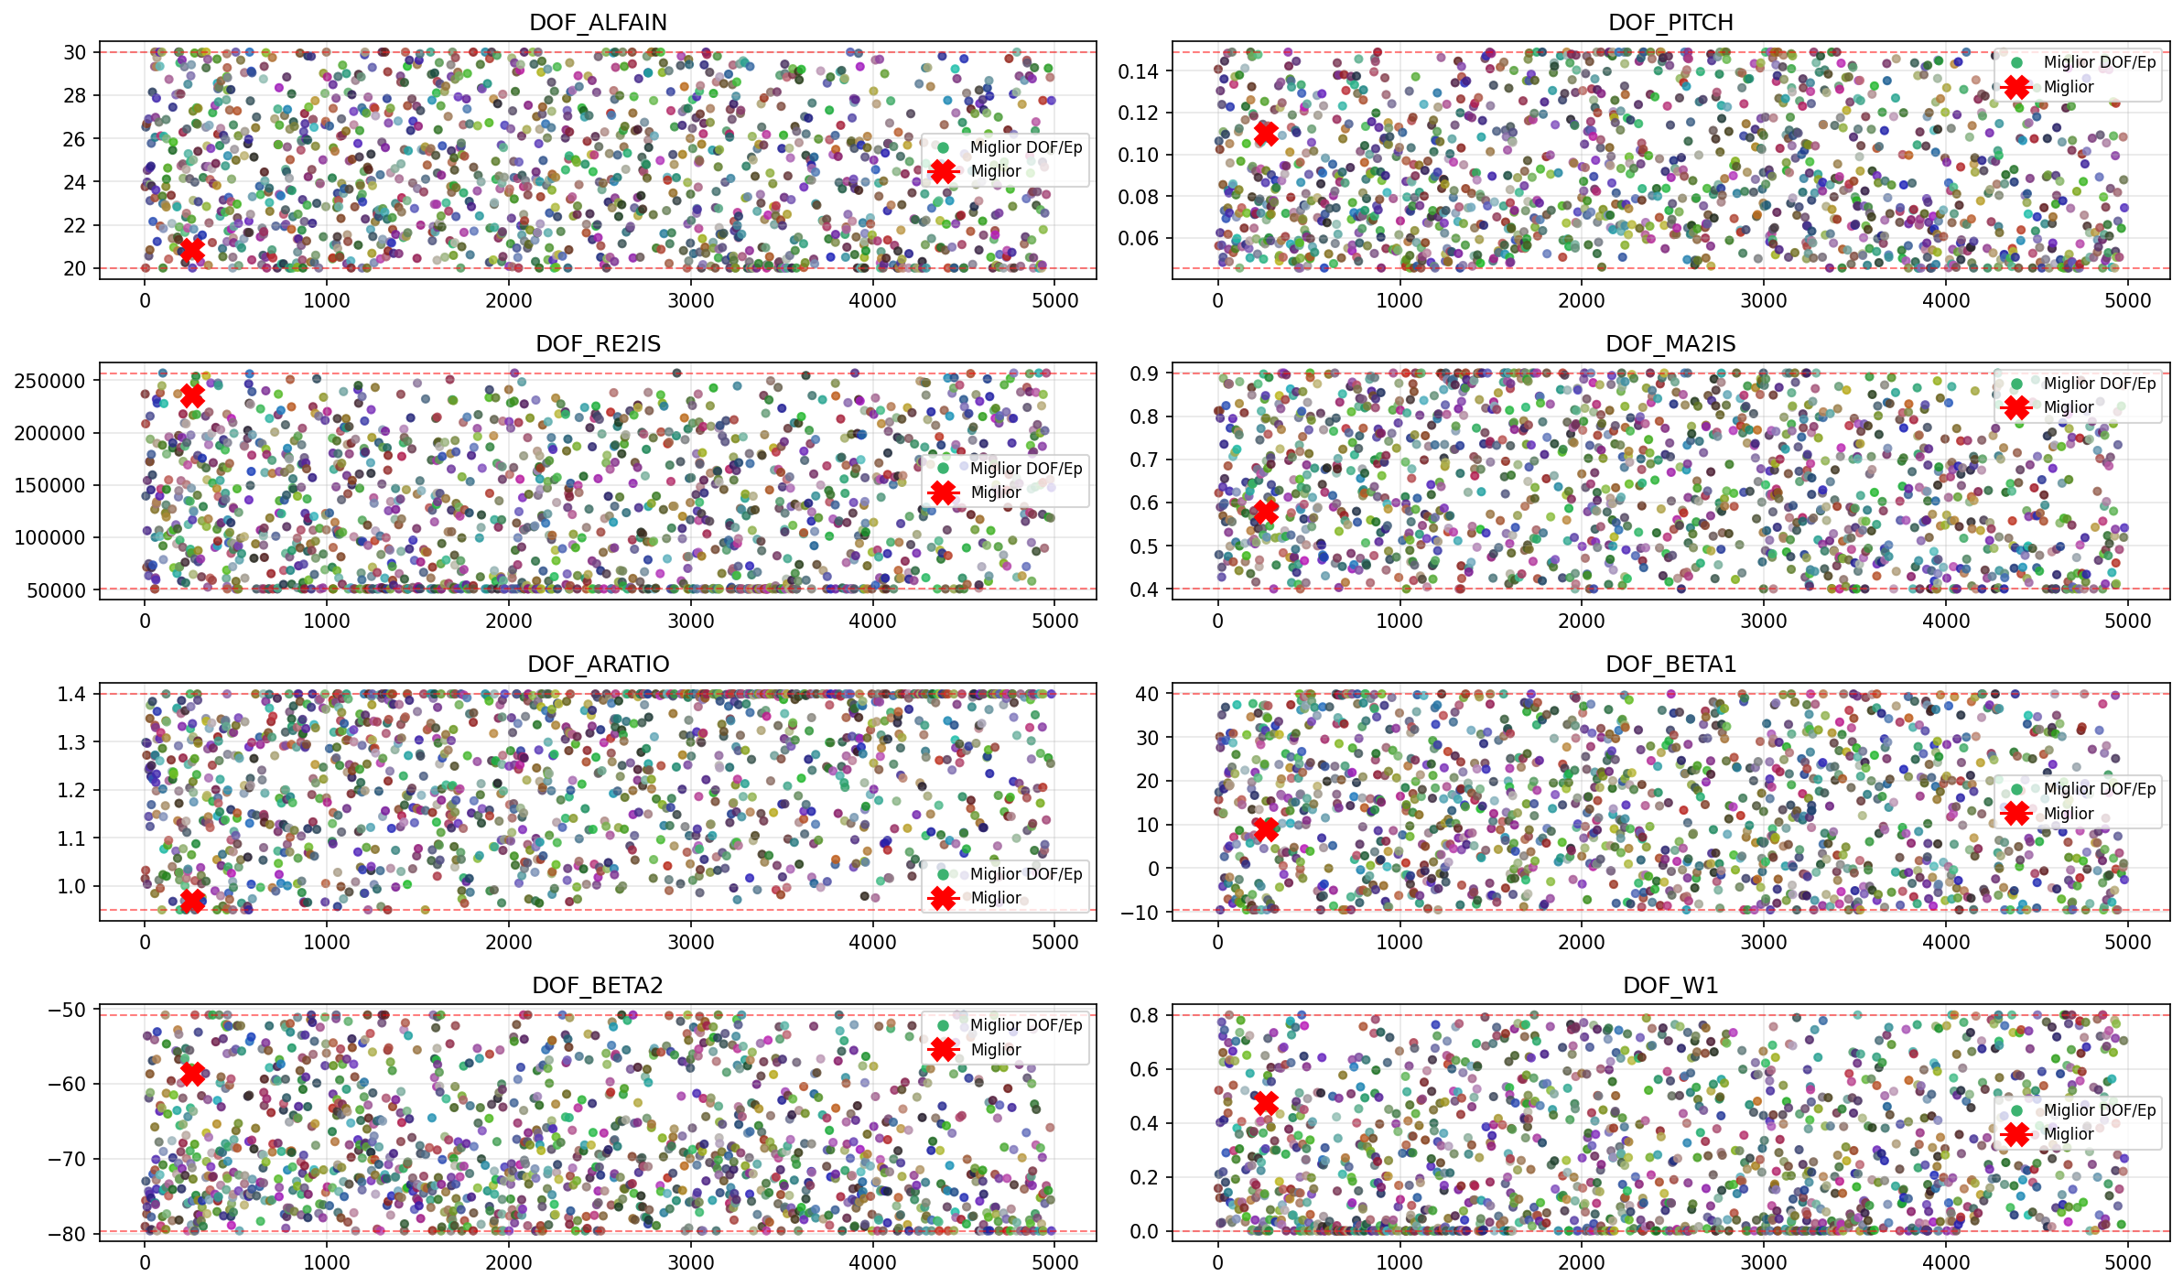
Evoluzione DOF - 1

Slide 6
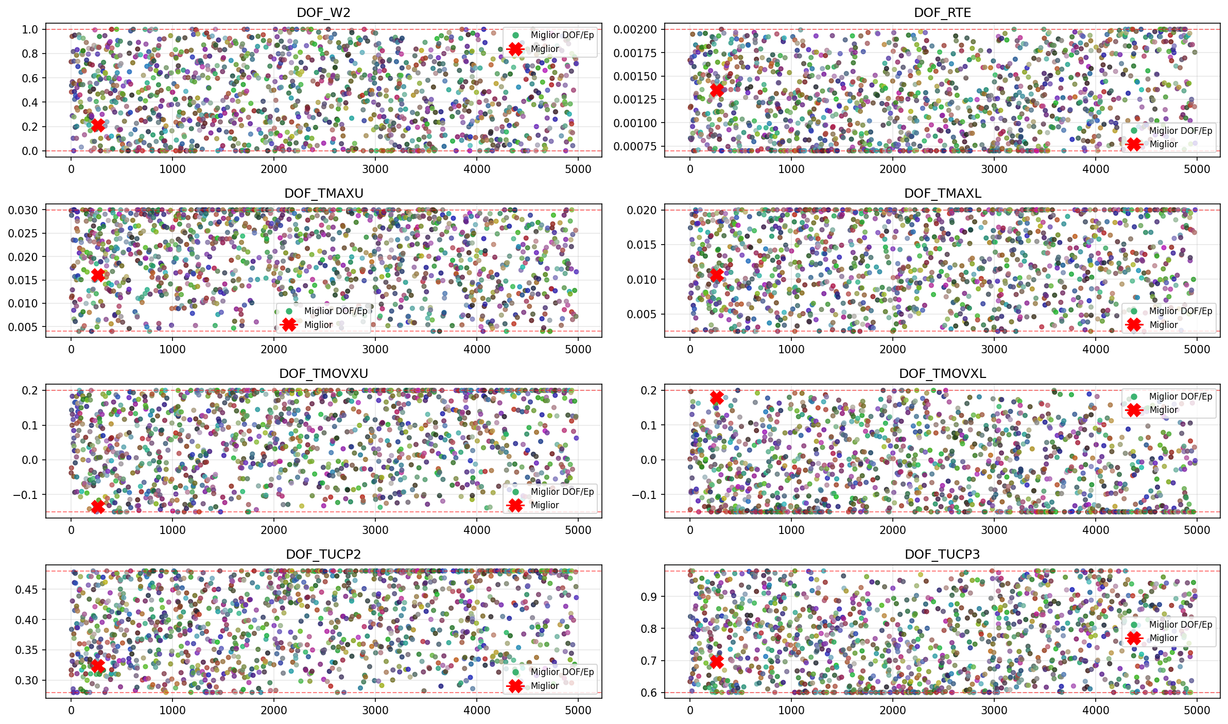
Evoluzione DOF - 2

Slide 7
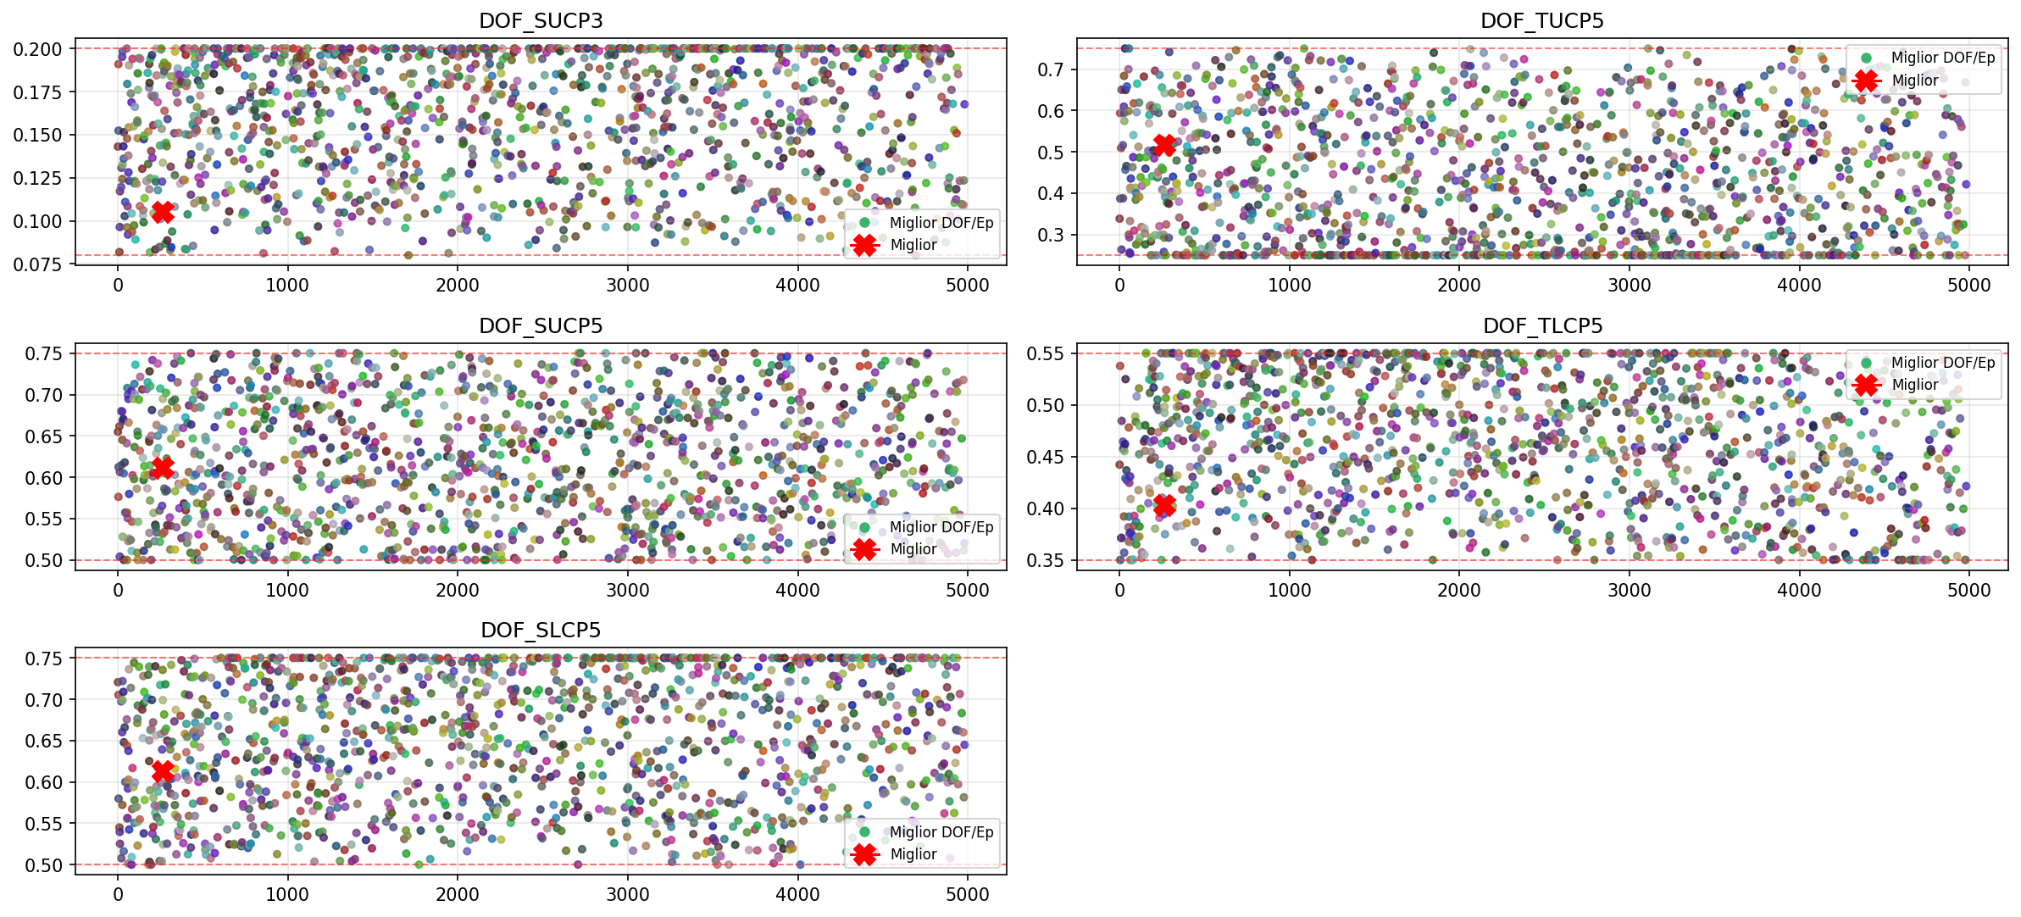
Evoluzione DOF - 3

Slide 8
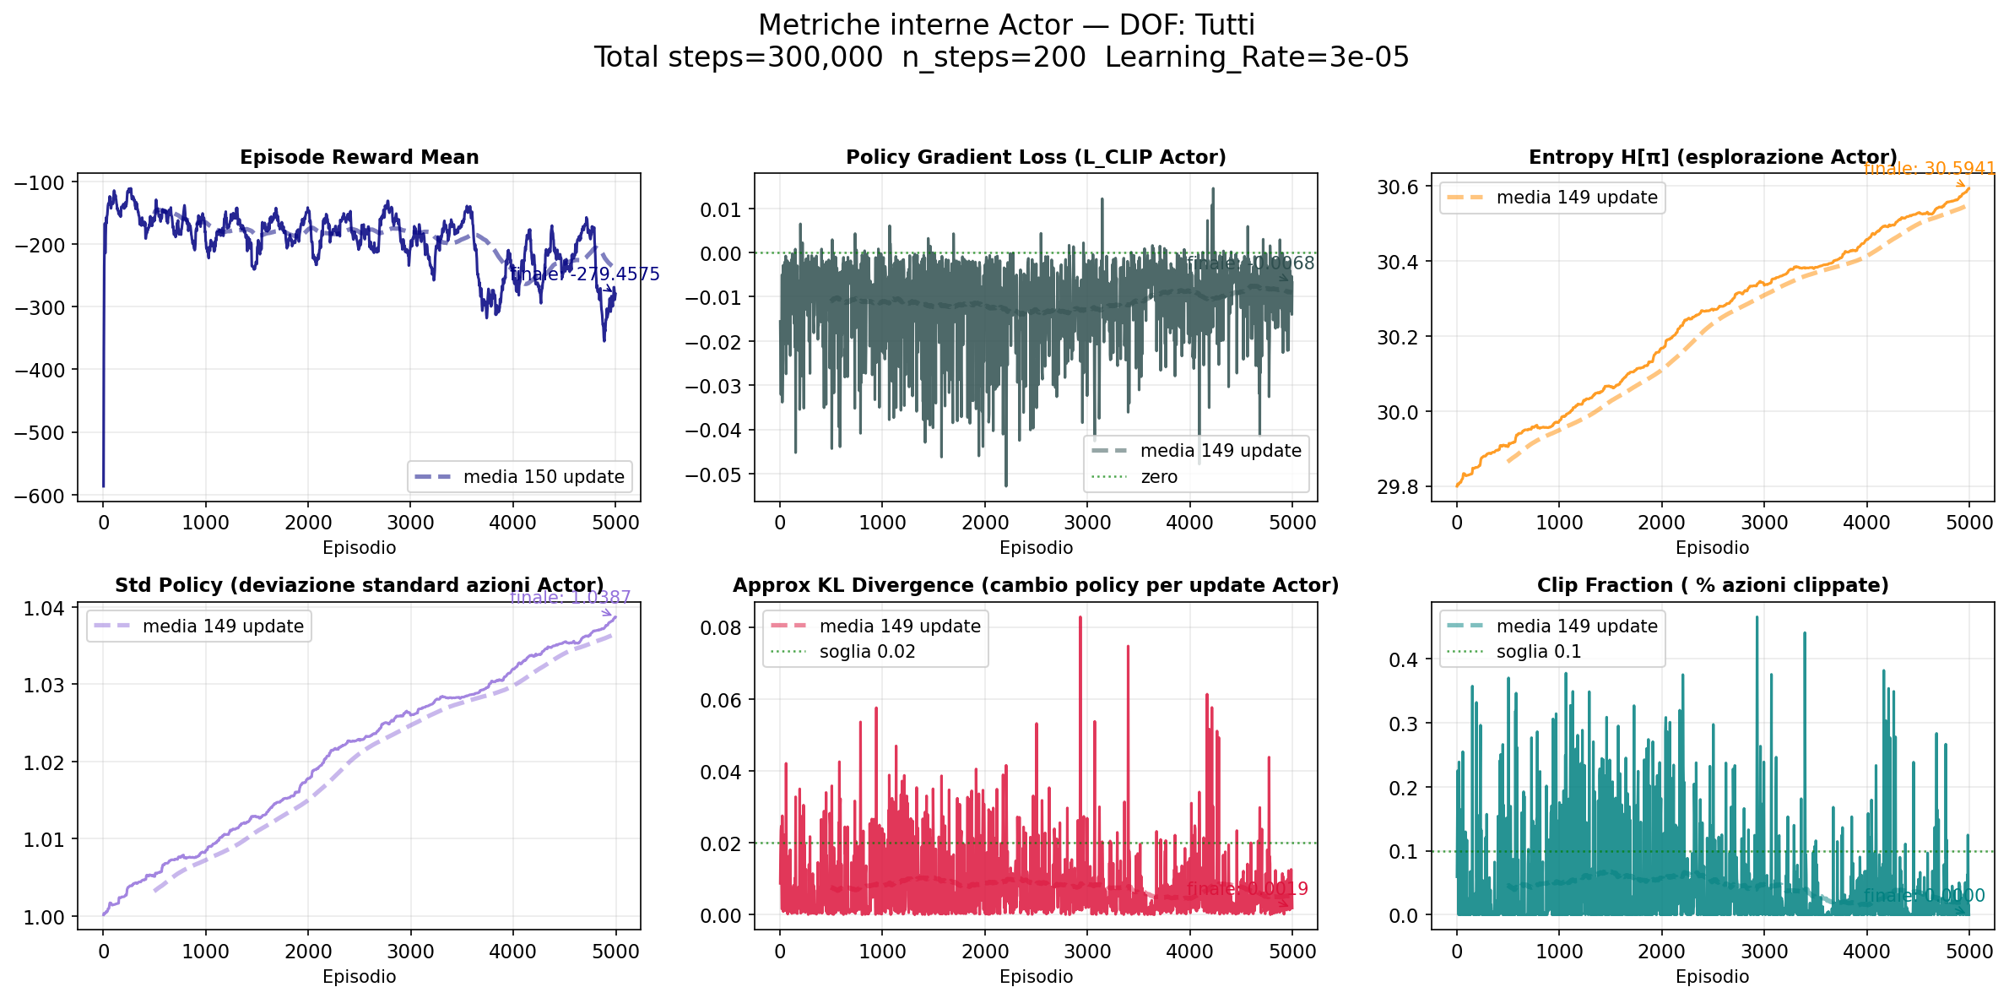
Metriche Actor

Slide 9
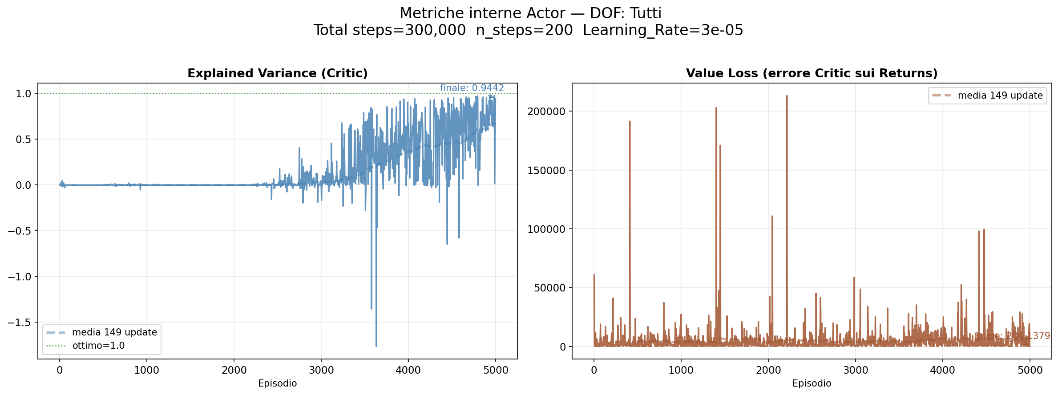
Metriche Critic

Slide 10
Miglior Profilo Ottimizzato
OF Risultanti:
OF_alfa_ex_FL = -53.162891
OF_Cpt_FL = 0.036699
OF_CSI_FL = 0.027502
OF_phi_FL = 1.120128
OF_psi_FL = 1.964976
OF_Zwc_FL = 1.354266
OF_DFss_mis_LO = 1.716913
OF_Ds_cp_LO = 1.415082
OF_Tmax_GM = 0.022035
OF_X_Tmax_GM = 0.022035
OF_Wedge_TE_GM = 11.721238
OF_UGT_GM = 24.342915
OF_Area_GM = 0.001800
DOF Ottimali:
DOF_ALFAIN (*) = 20.847374
DOF_PITCH (*) = 0.110022
DOF_RE2IS (*) = 235657.437500
DOF_MA2IS (*) = 0.578452
DOF_ARATIO (*) = 0.968319
DOF_BETA1 (*) = 8.926058
DOF_BETA2 (*) = -58.625008
DOF_W1 (*) = 0.472147
DOF_W2 (*) = 0.211254
DOF_RTE (*) = 0.001350
DOF_TMAXU (*) = 0.016068
DOF_TMAXL (*) = 0.010604
DOF_TMOVXU (*) = -0.135044
DOF_TMOVXL (*) = 0.179547
DOF_TUCP2 (*) = 0.323657
DOF_TUCP3 (*) = 0.695721
DOF_SUCP3 (*) = 0.105073
DOF_TUCP5 (*) = 0.516357
DOF_SUCP5 (*) = 0.611572
DOF_TLCP5 (*) = 0.402864
DOF_SLCP5 (*) = 0.612446
Deflessione (ε) = 74.010°
Curvatura camber (θ) = 67.551°

Slide 11
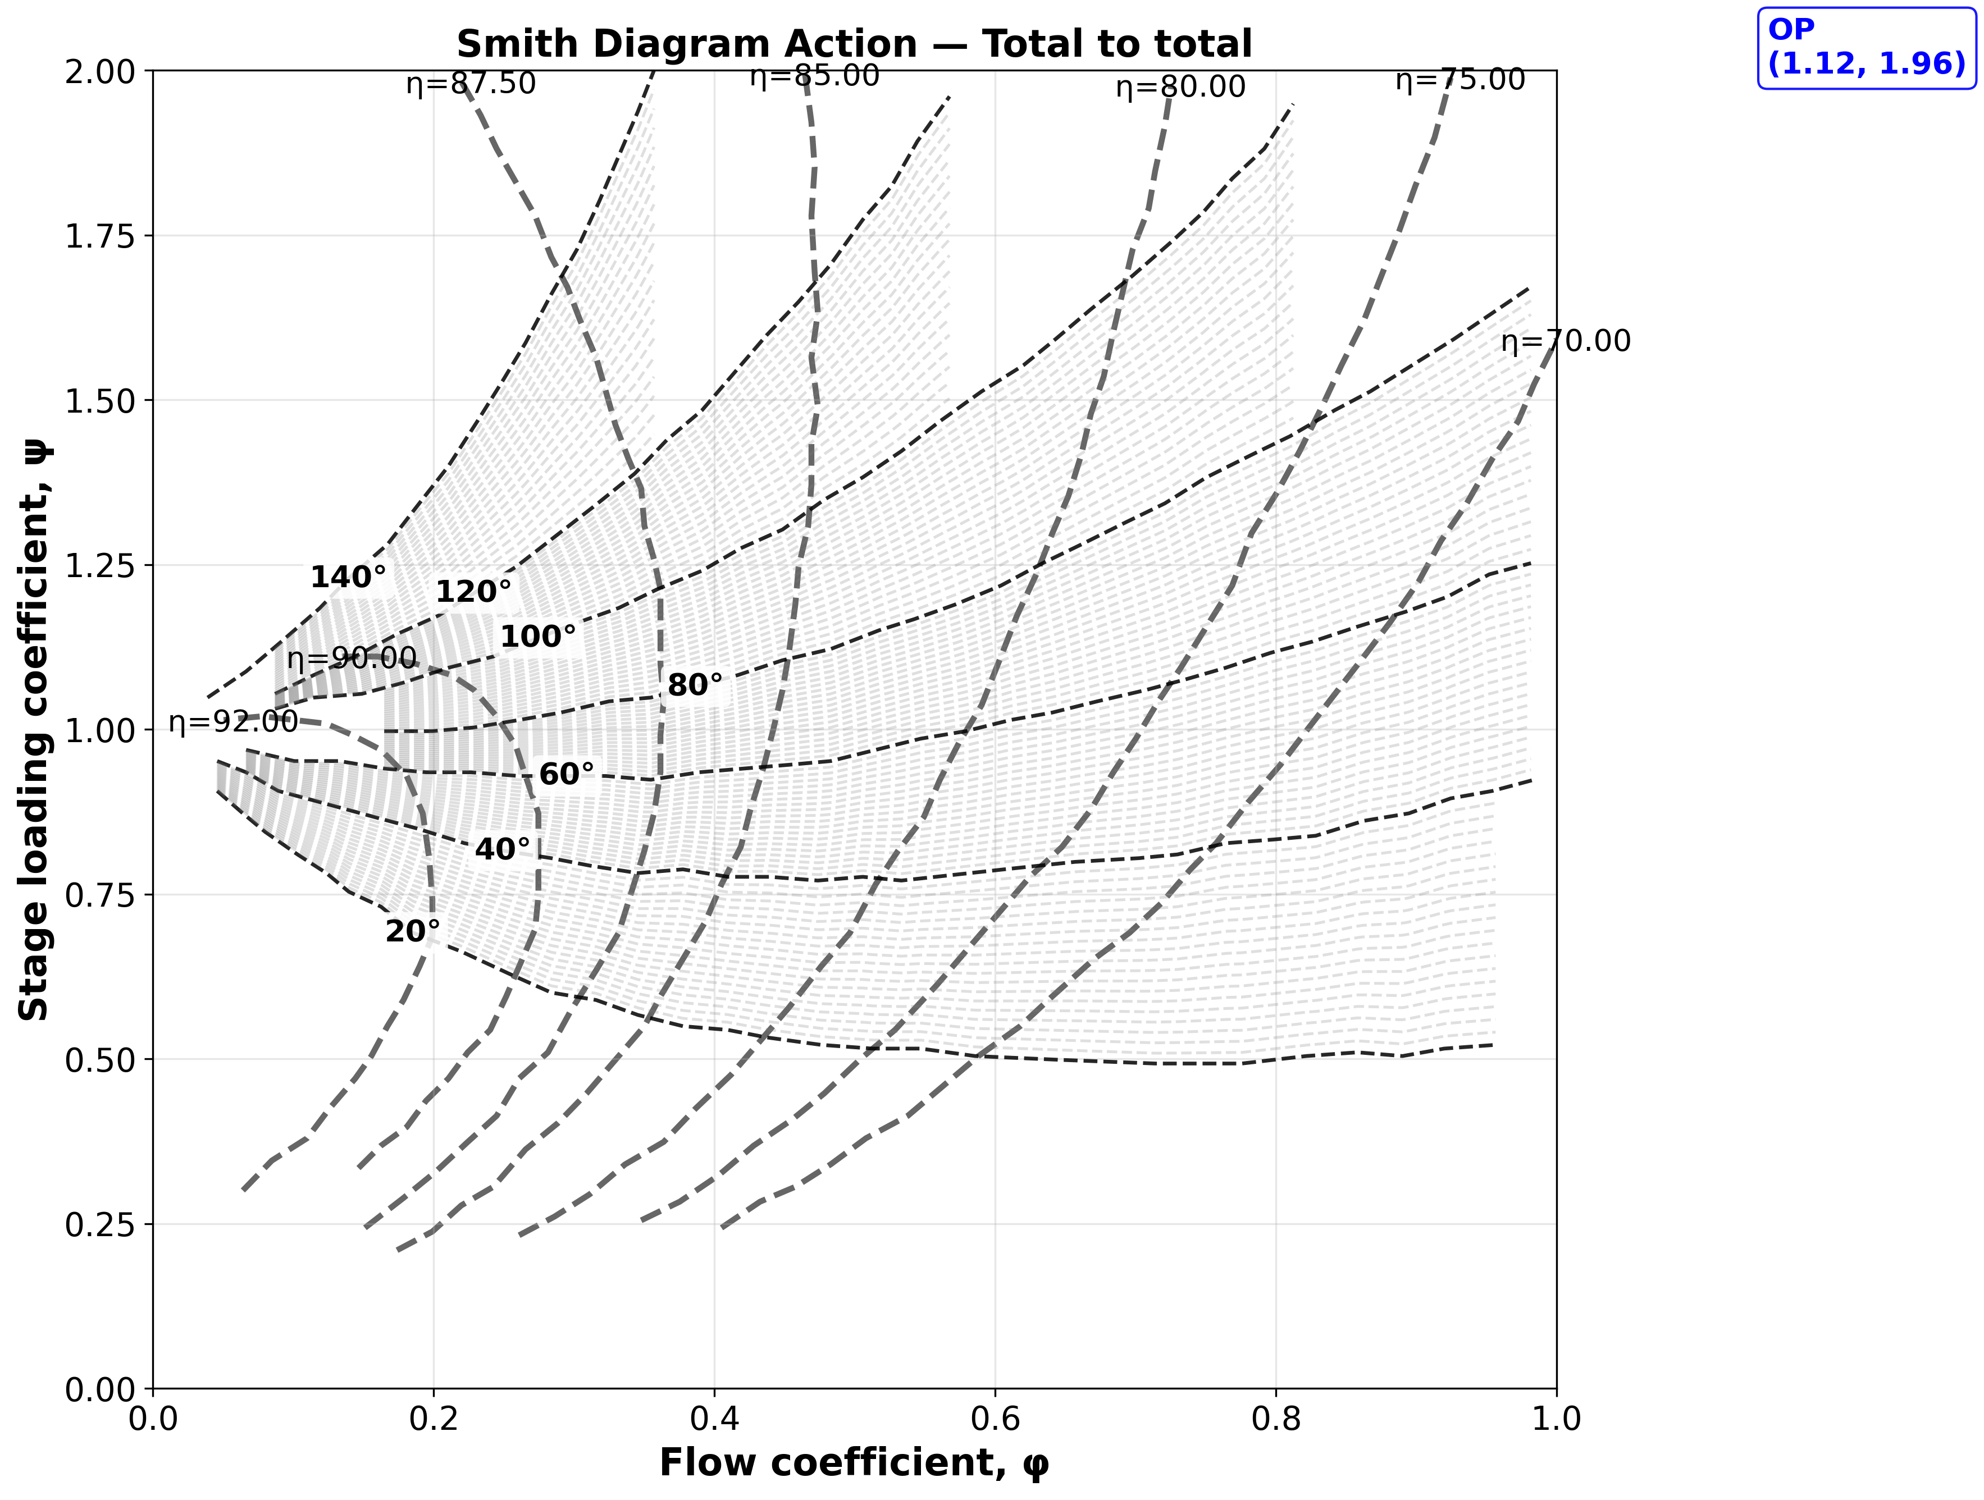
Smith Diagram Action - Axial exit

Slide 12
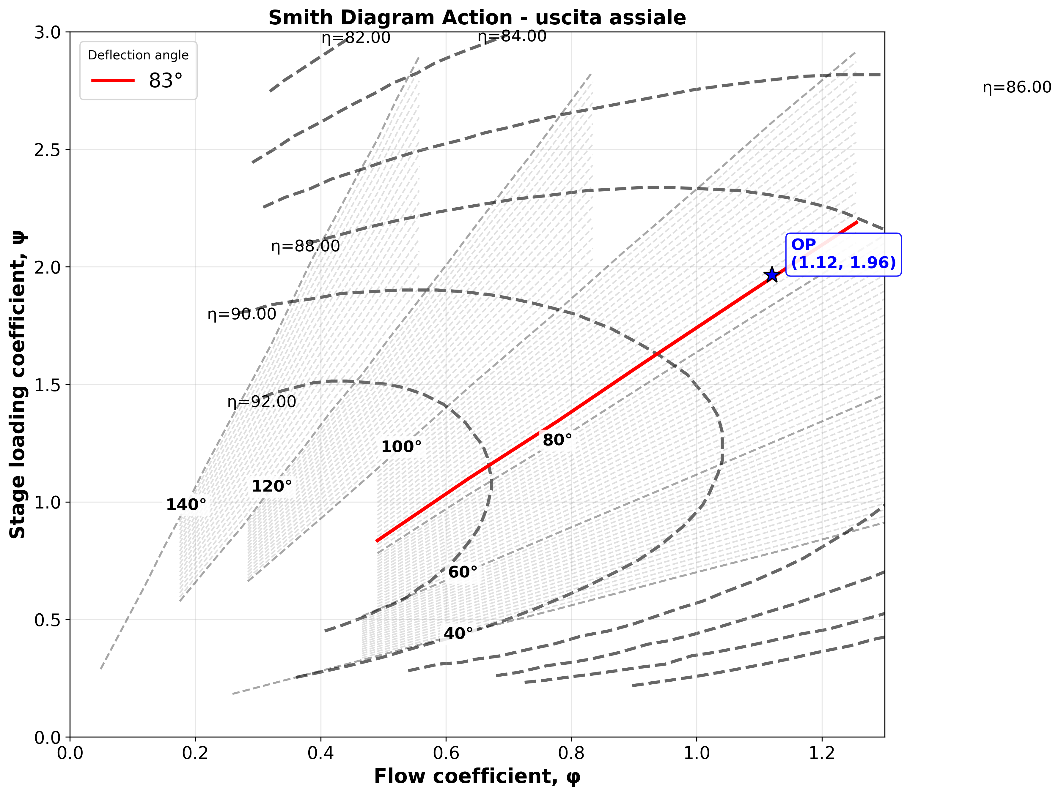
Smith Diagram Action - Total to Total

Slide 13
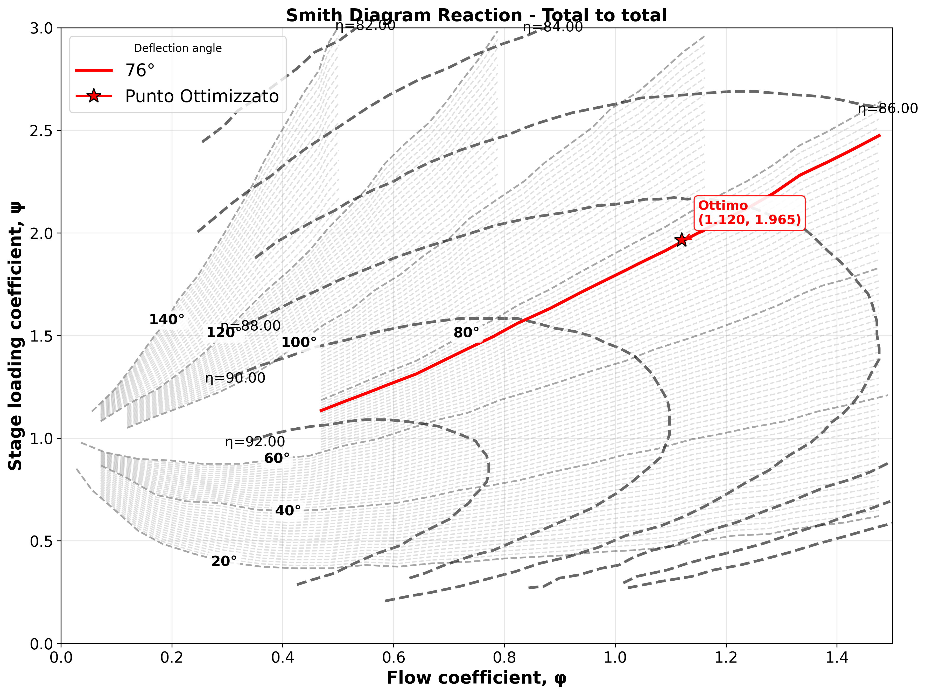
Smith Diagram Reaction - Total to Total

