Slide 1
Task 1 - Run Casuale
Partenza da profilo completamente casuale

Slide 2
Parametri PPO
n_epochs = 10
gamma = 0.99
gae_lambda = 0.95
clip_range = 0.2
ent_coef = 0.01
vf_coef = 0.5
max_grad_norm = 0.5
verbose = 1

Slide 3
Punto di partenza simulazione con LR = 3e-05
Tipo = Casuale (No Dataset)
Episode Length = 60
N steps = 200
Batch size = 64
Learning Rate = 3e-05
Best CSI trovato = 0.014737
DOF attivi modificati:
DOF_PITCH
DOF_BETA1
DOF_BETA2
DOF_W1
DOF_W2
DOF_TMOVXU
DOF_TMOVXL
Limiti operativi (DOF Bounds):
DOF_PITCH = [0.08425381393, 0.1401921907]
DOF_BETA1 = [0.03417969, 19.96643]
DOF_BETA2 = [-69.99573, -60.12146]
DOF_W1 = [0.0001708984, 0.7446777]
DOF_W2 = [0.0007019043, 0.9987183]
DOF_TMOVXU = [-0.1489105, 0.1993591]
DOF_TMOVXL = [-0.1498932, 0.1998077]

Slide 4
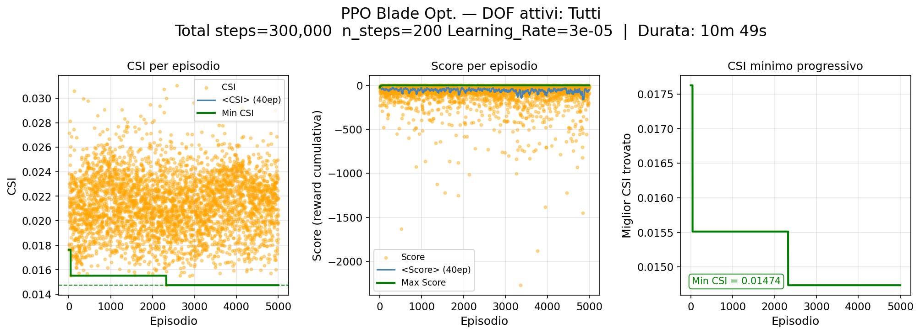
Risultati Training

Slide 5
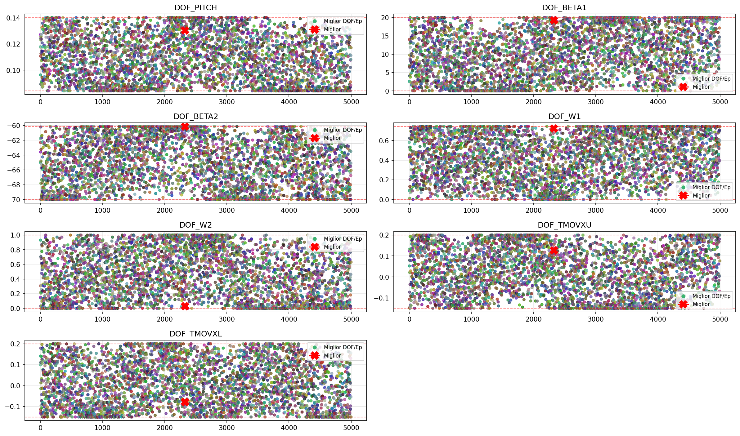
Evoluzione DOF - 1

Slide 6
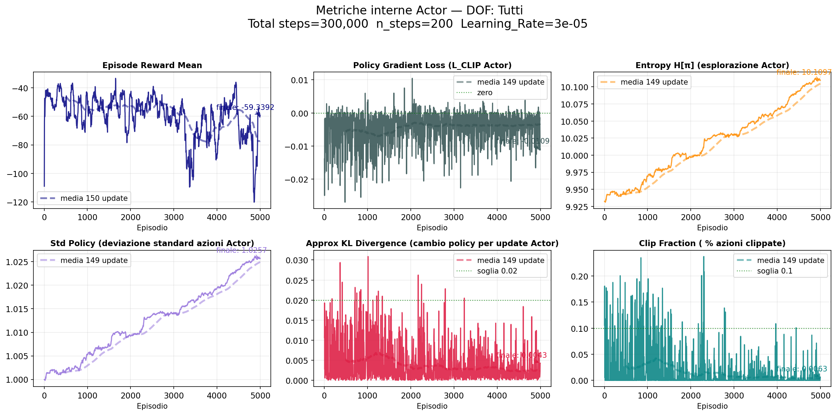
Metriche Actor

Slide 7
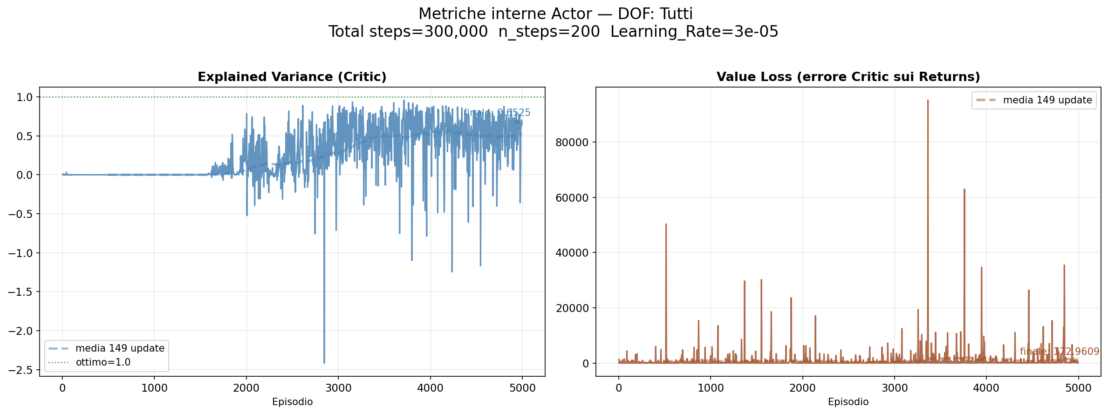
Metriche Critic

Slide 8
Miglior Profilo Ottimizzato
OF Risultanti:
OF_alfa_ex = -42.415844
OF_Cpt = 0.015158
OF_CSI = 0.014737
OF_phi = 1.104325
OF_psi = 1.391057
OF_Zwi = 1.635663
OF_Zwc = 1.563316
OF_DFss_mis = 1.550308
OF_DFss_cp = 0.888785
OF_Mis_peak = 0.565165
OF_s_peak = 0.502121
OF_s_diff_dim = 0.066948
OF_s_tot_SS = 0.113121
OF_Tmax = 0.011974
OF_X_Tmax = 0.338674
DOF Ottimali:
DOF_PITCH (*) = 0.130448
DOF_BETA1 (*) = 19.314230
DOF_BETA2 (*) = -60.121460
DOF_W1 (*) = 0.722860
DOF_W2 (*) = 0.028941
DOF_TMOVXU (*) = 0.127599
DOF_TMOVXL (*) = -0.078061
Deflessione (ε) = 52.416°
Curvatura camber (θ) = 79.436°

Slide 9
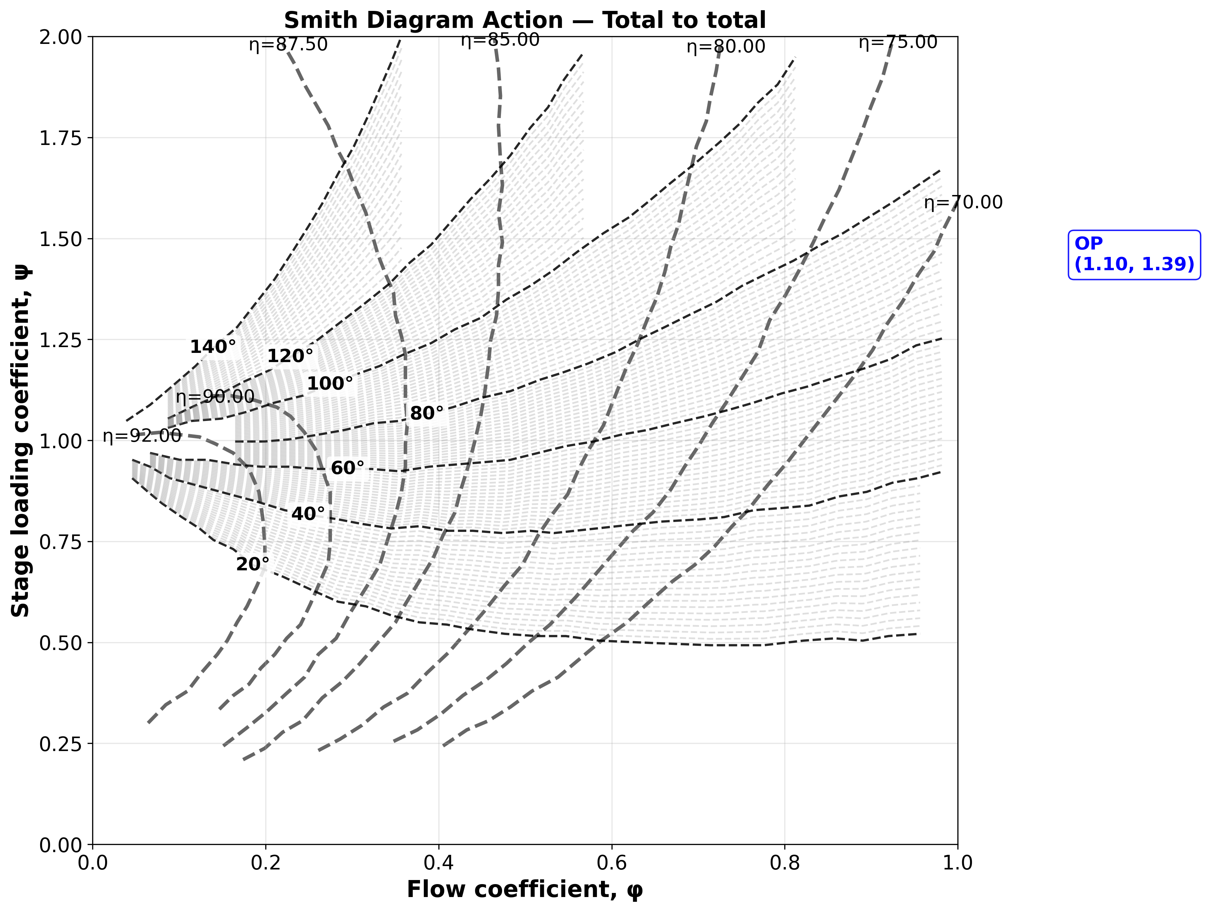
Smith Diagram Action - Axial exit

Slide 10
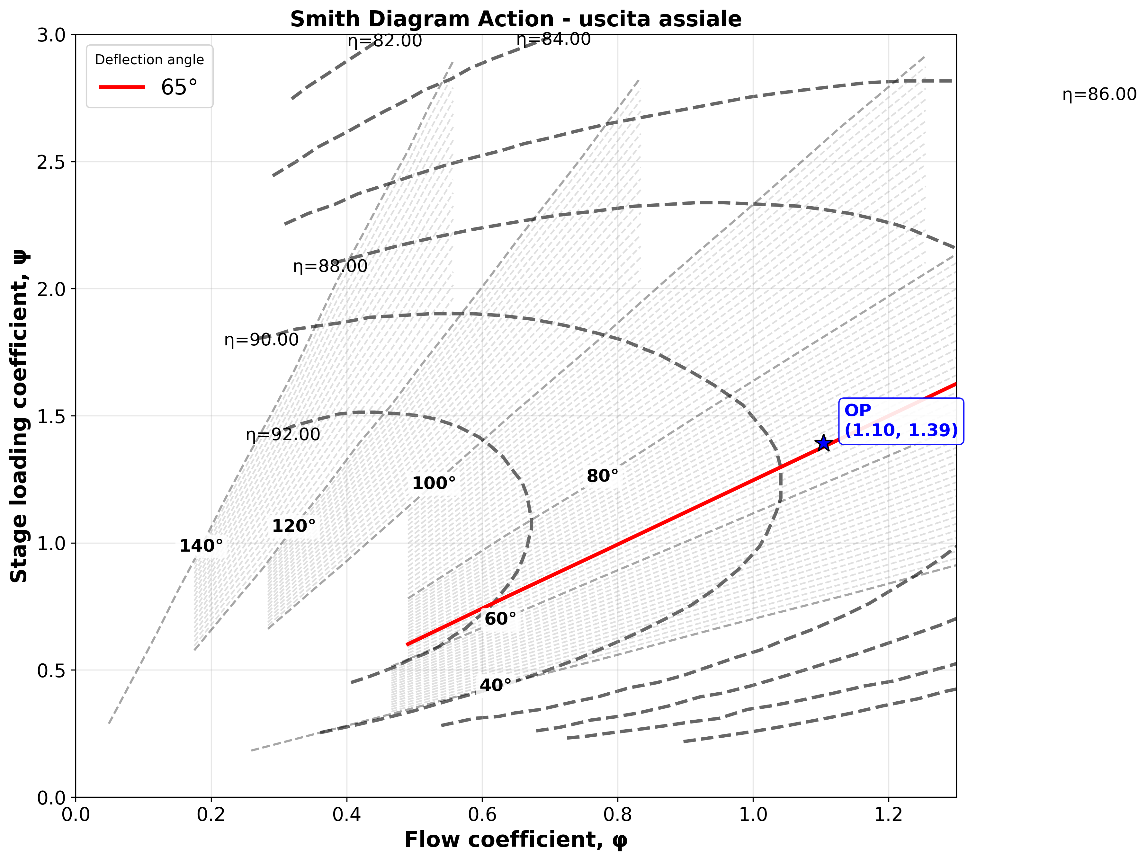
Smith Diagram Action - Total to Total

Slide 11
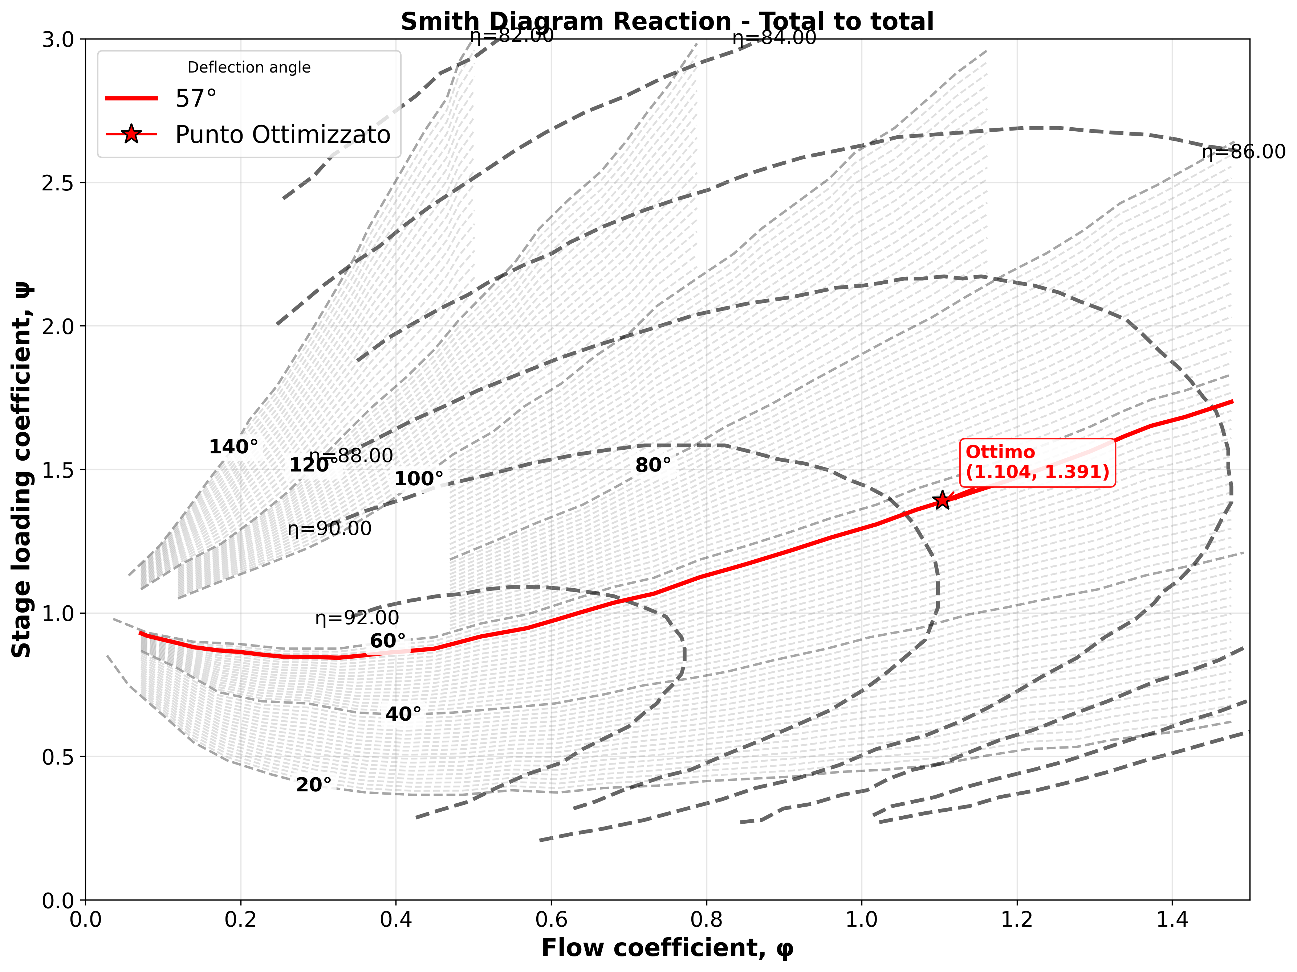
Smith Diagram Reaction - Total to Total

