Slide 1
Cassava Leaf Disease Classification
Pech Edward-Daniel
Parfenie Cristian-Ioan

Slide 2

Introduction
Cassava is the second-largest provider of carbohydrates in Africa, it is a key food security crop grown by smallholder farmers because it can withstand harsh conditions. At least 80% of household farms in Sub-Saharan Africa grow this starchy root, but viral diseases are major sources of poor yields.

Slide 3
The dataset
The dataset was acquired from Kaggle and is part of a competition in order to detect which disease the Cassava leaves have.
The dataset contains a total of 21,397 images with specific labels for each image. There are 5 different classes in the dataset that are available for this classification problem:
Class 0 represents the "Cassava Bacterial Blight" and has 1087 related images
Class 1 represents the "Cassava Brown Streak Disease" and has 2189 related images
Class 2 represents the "Cassava Green Mottle" and has 2386 related images
Class 3 represents the "Cassava Mosaic Disease" and has 13158 related images
Class 4 represents the "Healthy" and has 2577 related images

Slide 4
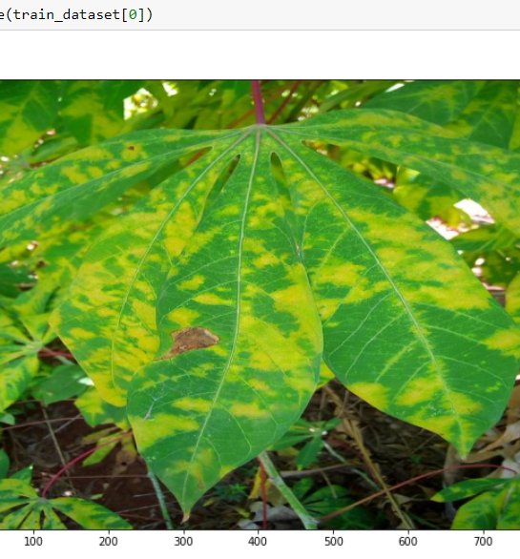
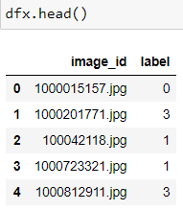
Sample photo
The csv file structure

Slide 5
Data augmentations
In order to improve the accuracy of the model, we can use a technique that allows us to get more data from the dataset that we already have. For this we can use augmentations - this technique is used in order to modify images so the model can be trained better (for example, cropped images, horizontally flipped images, vertically flipped images, shifted images, transposed images, etc.)
For this purpose, we can use a great library that is able to augmentate the images for us easily - it is called albumentations. Albumentations can also be used by the tez library to create the ImageDataset.

Slide 6
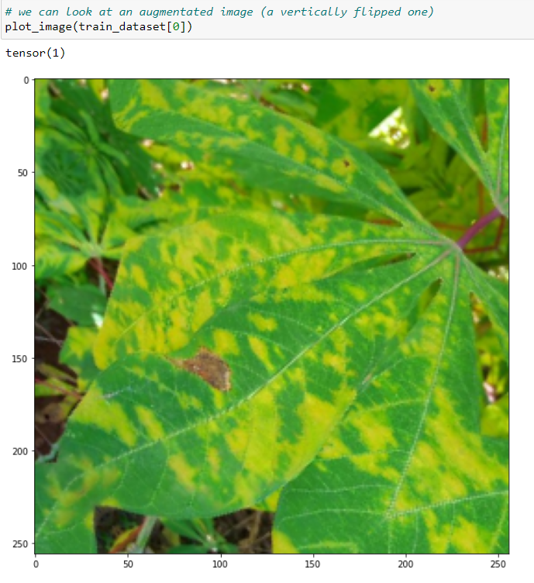
Transformed image using augmentation

Slide 7
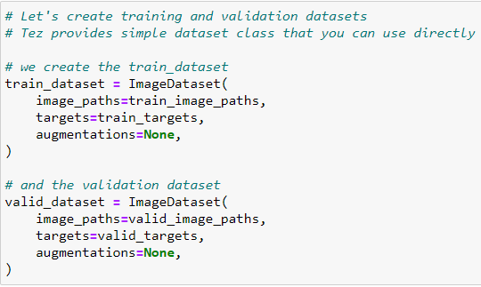
Data processing
The data processing will be done using pytorch datasets, not directly, but by using the tez library which provides a helpful class of ImageDataset, specific for these type of problems which is quite helpful.

Slide 8
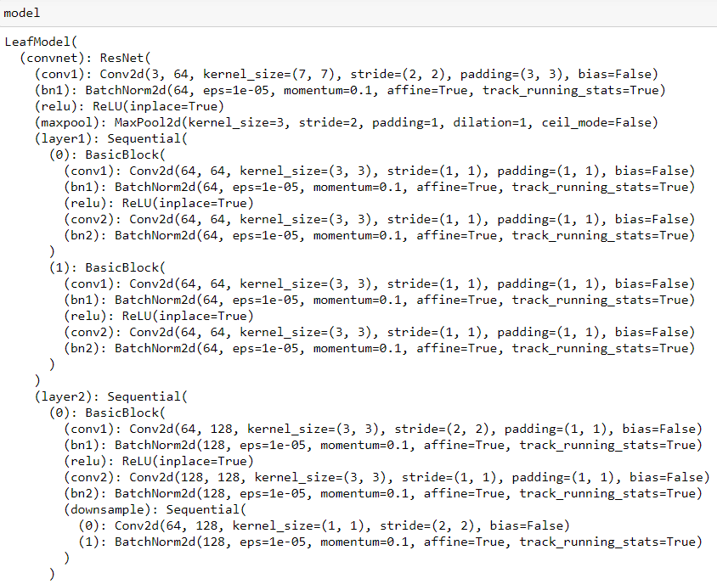
The model
The model is based on ResNet18 and a part of the structure can be observed in the picture below. The resnet18 was taken from torchvision.models.resnet18 and is a pretrained model, the fully connected layer of the network is replaced by a linear layer which has as output 5 possible values.

Slide 9
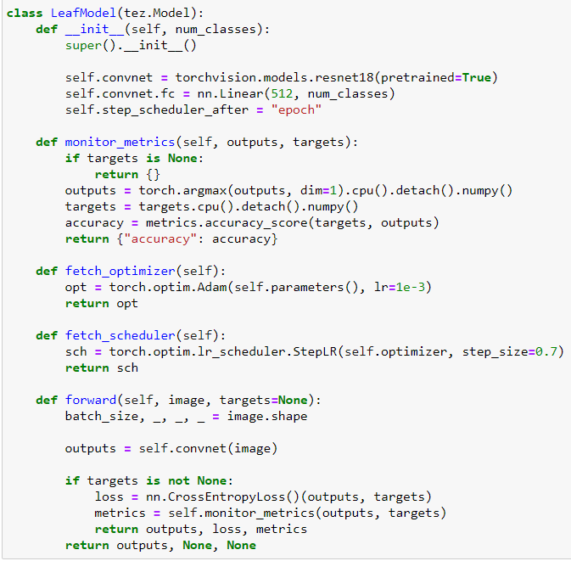
LeafModel implementation
The implementation of the LeafModel which uses the resnet18 network is created in such way to accommodate the inputs for this problem, in this case the images and targets or classes for the images, given as parameters.

Slide 10
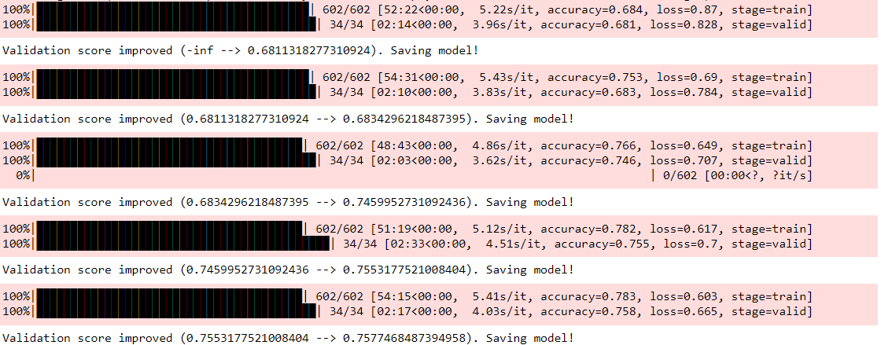
Results
After the training has finished for the implemented LeafModel using the pretrained ResNet18 network, we can observe the promising results of the model, which has only been trained for 5 epochs.
As can be seen in the picture above, the model shows promising results for as little as 5 epochs of training and the loss is getting lower with each epoch passing, the same as the accuracy is increasing with each epoch slightly.

