Slide 1

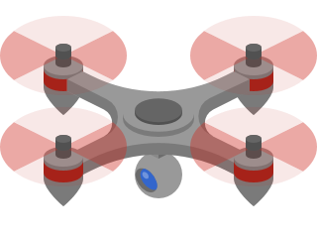







Plataforma de Drones Aéreos multi-tecnologia para suporte a comunicações críticas

Slide 2
Quick Start
This project has the objective of exploring the full potential of UAV’s in the context of supporting critical communications.

Slide 3
Quick Start
Implementation of WAVE (802.11p) vehicular orientated protocol.
Implementation of LoRa (Long Range)
Mechanism to change missions live
Mechanism to adapt data transfer rate dependente of signal quality

Slide 4
Quick Start
Enhanced dashboard
Display metrics & statistics from API
Develop user-friendly mission generator

Slide 5
Quick Start
Implementation of influx DB
Implementation of a Django API

Slide 6




















Architecture
Present
Past
Final
Drone Node
Web server application
Drone Gateway
Grounstation

Slide 7
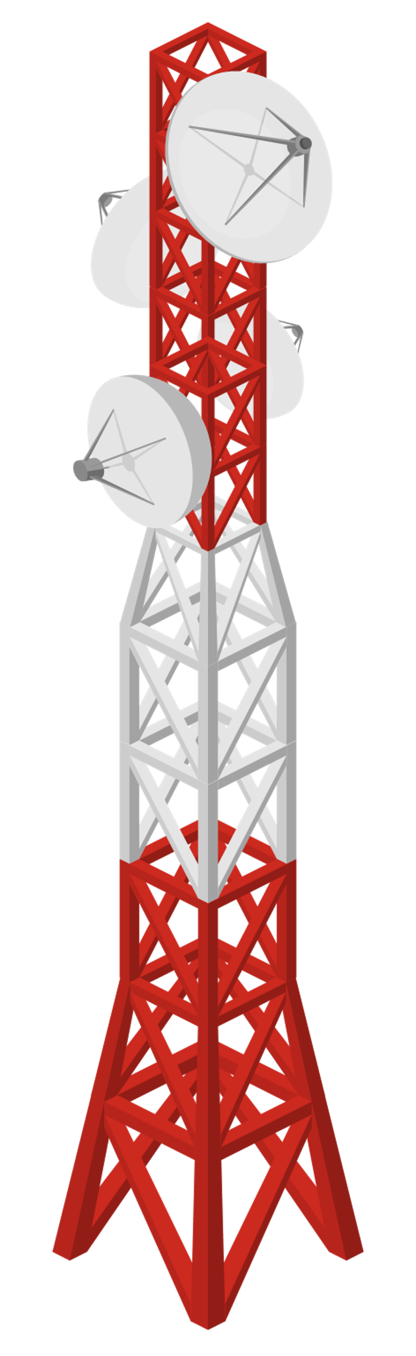


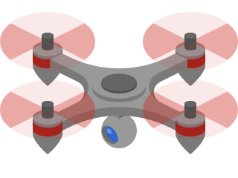

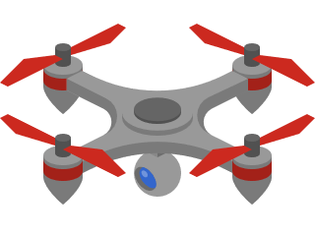

Mission: LoRa backup

Slide 8
Future work
API:
Integration of a built-in API with an already existing one.

Slide 9
Future work
Dashboard:
Design the 2 or 3 missions initially requested by the supervisors.
Interconnect the Grafana platform with the built API.
Implement even more advanced logic in mission generation, such as cycles, conditional statements, variables, etc. (if possible)

Slide 10
Future work
Comunication:
LoRa: Implementation of LoRa in node mode
LoRa: Creation of a mechanism to “swap” between gateway & node Automation: Creation of a mechanism to change missions live
Automation: Creation of a mechanism to adapt data transfer rate dependente of signal quality

Slide 11
Demos
Communication
Data persistence
Dashboard

