Slide 1

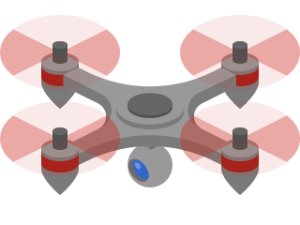







Plataforma de Drones Aéreos multi-tecnologia para suporte a comunicações críticas

Slide 2
State of art
In current market UAVs (Unmanned Aerial Vehicles) haven’t been used for complex tasks, being used mainly for deliveries. However much academic research on using them in complex scenarios has already been established
Margarida Silva thesis
Creating missions in groovy framework
Creating an import system for extra sensors
Creating a system for a relay of UAV’s

Slide 3
State of art
Unlike UAVs, WAVE(802.11p) has already seen commercial use, being the best example the project headed by Susana Sargento FUTURE-CITIES, nonetheless our work will be heavily influenced by academic works
Andreia Figueiredo thesis
Collecting data from several devices
Fusion and processing from said data
Dissemination of useful information for users and authorities
The introduction of Ad-hoc Networks and overview of Andreia’s thesis
Andreia’s thesis
Entities
Domain
Characteristics

Slide 4




Actors & Use cases
Create missions
Access historic
Access internal logs
Access SOS logs
Admin
View live mission
User base

Slide 5
Requirements gathering
The team identified the documented and undocumented problems
A brainstorm was performed to gather as many solutions as possible
The following solutions were filtered:
Create an interface to create missions like Scratch
Integrate LoRa as a mean of tracking the device like a “black box”
Integrate LoRa as a gateway to collect data from other devices
Create a database to allow persistence of information

Slide 6
Functional requirements
Server running InfluxDB and Django API
APU running an voyage with an image docker equipped with:
WAVE capable Wi-Fi board
LoRa WAN board
A ground station equipped with a WAVE capable Wi-Fi board and connected to the internet

Slide 7
Non-functional requirements
Usability: Creating and executing a mission must be intuitive as well as analysing the data
Efficiency: The system must be capable of showing live data with low latency as well as update persistence date in windows inferior to 10 seconds
Capacity: The system must capable of recording relevant historic of all deployed missions

Slide 8
Non-functional requirements
Availability: Since the system is used in a critical context its up time must be as close as possible to 100%
Security: The dashboard as well as the OBU’s must be secure and robust against attackers
Recoverability: In the event of crashing (software or hardware) the UAVs must be easily recoverable and deployable
Maintainability: The system must be constructed with future proofing in mind

Slide 9
Dependencies & Assumptions
The ground station has a constant connection to the internet
The UAVs when crashed will be stable enough to launch the SOS beacon
A server capable of processing data from missions

Slide 10
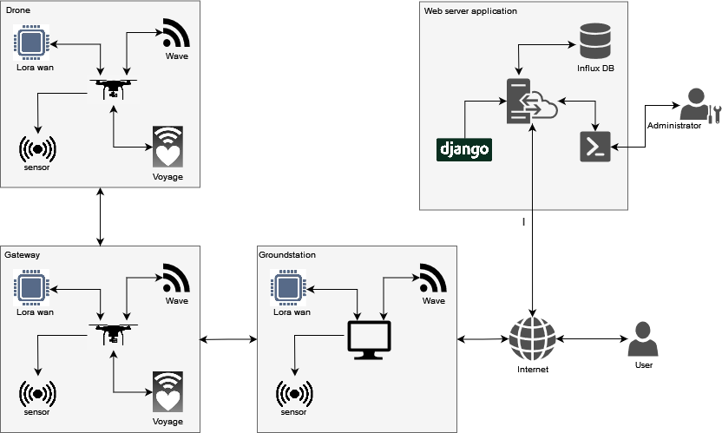
Deployment diagram

Slide 11
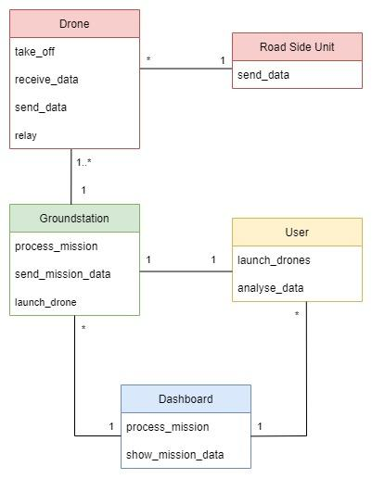
Domain model

Slide 12
Showcase

