Slide 1
Memory Management

Slide 2
Roadmap
Basic requirements of Memory Management
Memory Partitioning
Basic blocks of memory management
Paging
Segmentation
Notes:
Point out that memory partitioning isn’t used much except for special cases such as kernel memory management

Slide 3
The need for memory management
Memory is cheap today, and getting cheaper
But applications are demanding more and more memory, there is never enough!
Memory Management, involves swapping blocks of data from secondary storage.
Memory I/O is slow compared to a CPU
The OS must cleverly time the swapping to maximise the CPU’s efficiency
Notes:
Introduce by pointing out that in a uniprogramming system, main memory is divided into two parts:
one part for the operating system (resident monitor, kernel) and
one part for the program currently being executed.
In a multiprogramming system, the “user” part of memory must be further subdivided to accommodate multiple processes.
Emphasise that memory management is vital in a multiprogramming system. If only a few processes are in memory, then for much of the time all of the processes will be waiting
for I/O and the processor will be idle.
Thus memory needs to be allocated to ensure a reasonable supply of ready processes to consume available processor time.

Slide 4
Memory Management
Memory needs to be allocated to ensure a reasonable supply of ready processes to consume available processor time

Slide 5
Memory Management Requirements
Relocation
Protection
Sharing
Logical organisation
Physical organisation
Notes:
The following slides expand on these topics.

Slide 6
Requirements: Relocation
The programmer does not know where the program will be placed in memory when it is executed,
it may be swapped to disk and return to main memory at a different location (relocated)
Memory references must be translated to the actual physical memory address

Slide 7
Memory Management Terms
Table 7.1 Memory Management Terms
Term | Description
Frame | Fixed-length block of main memory.
Page | Fixed-length block of data in secondary memory (e.g. on disk).
Segment | Variable-length block of data that resides in secondary memory.

Slide 8
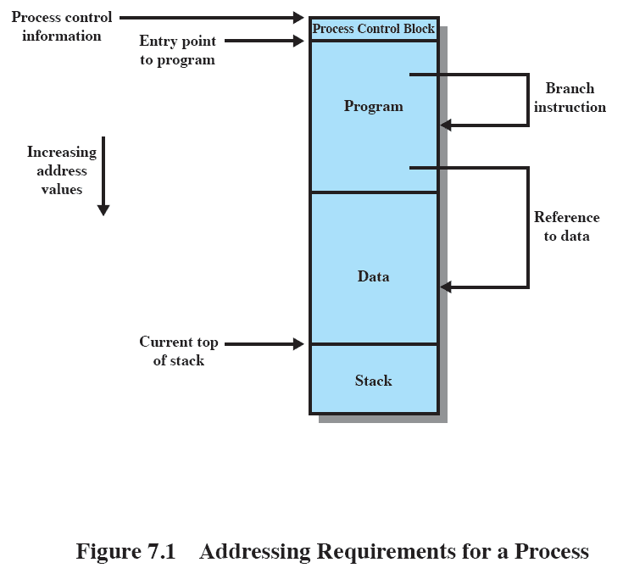
Addressing
Notes:
This figure depicts a process image. Talk the students through this diagram
Assume that the process image occupies a contiguous region of main memory.
The OS needs to know the location of:
process control information
the execution stack,
the entry point to begin execution of the program for this process.
Because the operating system knows this information because it is managing memory and is responsible for bringing this process into main memory. However, the processor must deal with memory references within the program. Branch instructions contain an address to reference the instruction to be executed next. Data reference instructions contain the address of the byte or word of data referenced. Somehow, the processor hardware and operating system software must be able to translate the memory references found in the code of the program into actual physical memory addresses, reflecting the current location of the program in main memory.

Slide 9
Requirements: Protection
Processes should not be able to reference memory locations in another process without permission
Impossible to check absolute addresses at compile time
Must be checked at run time
Notes:
Normally, a user process cannot access any portion of the operating system, neither program nor data.
Usually a program in one process cannot branch to an instruction in another process or access the data area of another process. The processor must be able to abort such instructions at the point of execution.
Note that the memory protection requirement must be satisfied by the processor (hardware) rather than the operating system (software) because the OS cannot anticipate all of the memory references that a program will make. It is only possible to assess the permissibility of a memory reference at the time of execution.
Consider asking the students “why” to point 1 & 2.
Why is it a Bad Thing for one process to be able to read, or even write, to memory occupied by a different process?
Why is it impossible to check absolute addresses at compile time (hint: see relocation)

Slide 10
Requirements: Sharing
Allow several processes to access the same portion of memory
Better to allow each process access to the same copy of the program rather than have their own separate copy
Notes:
Any protection mechanism must have the flexibility to allow several processes to access the same portion of main memory.
Processes that are cooperating on some task may need to share access to the same data structure.

Slide 11
Requirements: Logical Organization
Memory is organized linearly (usually)
Programs are written in modules
Modules can be written and compiled independently
Different degrees of protection given to modules (read-only, execute-only)
Share modules among processes
Segmentation helps here
Notes:
Main memory is usually organized as a linear, or one-dimensional, address space, consisting of a sequence of bytes or words.
Secondary memory, at its physical level, is similarly organized.
This does not correspond to the way in which programs are typically constructed. Most programs are organized into modules. If the operating system and computer hardware can effectively deal with user programs and data in the form of modules of some sort, then a number of advantages can be realized

Slide 12
Requirements: Physical Organization
Cannot leave the programmer with the responsibility to manage memory
Memory available for a program plus its data may be insufficient
Overlaying allows various modules to be assigned the same region of memory but is time consuming to program
Programmer does not know how much space will be available
Notes:
Because of this, it is clear that the task of moving information between the two levels of memory should be a system responsibility. This task is the essence of memory management.

Slide 13
Partitioning
An early method of managing memory
Pre-virtual memory
Not used much now
But, it will clarify the later discussion of virtual memory if we look first at partitioning
Virtual Memory has evolved from the partitioning methods

Slide 14
Types of Partitioning
Fixed Partitioning
Dynamic Partitioning
Simple Paging
Simple Segmentation
Virtual Memory Paging
Virtual Memory Segmentation
Notes:
Don’t dwell on this slide – it is just an indication on the various approaches which will be covered in further detail in other slides

Slide 15
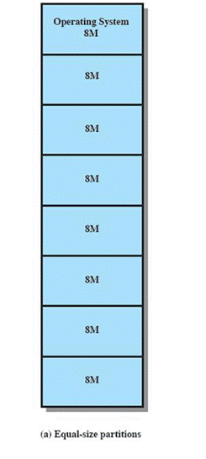
Fixed Partitioning
Equal-size partitions
Any process whose size is less than or equal to the partition size can be loaded into an available partition
The operating system can swap a process out of a partition
If none are in a ready or running state

Slide 16
Fixed Partitioning Problems
A program may not fit in a partition.
The programmer must design the program with overlays
Main memory use is inefficient.
Any program, no matter how small, occupies an entire partition.
This is results in internal fragmentation.

Slide 17
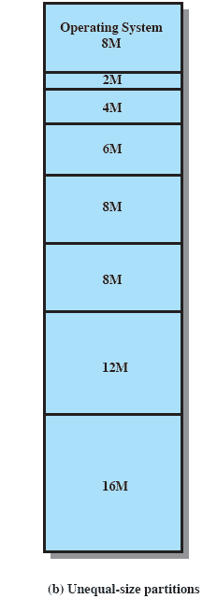
Solution – Unequal Size Partitions
Lessens both problems
but doesn’t solve completely
In Fig,
Programs up to 16M can be accommodated without overlay
Smaller programs can be placed in smaller partitions, reducing internal fragmentation

Slide 18
Placement Algorithm
Equal-size
Placement is trivial (no options)
Unequal-size
Can assign each process to the smallest partition within which it will fit
Queue for each partition
Processes are assigned in such a way as to minimize wasted memory within a partition

Slide 19
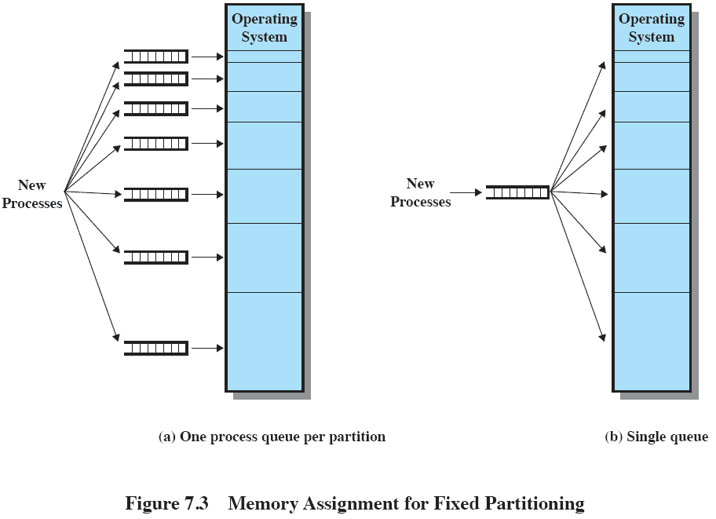
Fixed Partitioning

Slide 20
Remaining Problems with Fixed Partitions
The number of active processes is limited by the system
I.E limited by the pre-determined number of partitions
A large number of very small process will not use the space efficiently
In either fixed or variable length partition methods
Notes:
Finish by mentioning tat fixed partitioning is almost unknown today

Slide 21
Dynamic Partitioning
Partitions are of variable length and number
Process is allocated exactly as much memory as required

Slide 22
Dynamic Partitioning Example
OS (8M)
External Fragmentation
Memory external to all processes is fragmented
Can resolve using compaction
OS moves processes so that they are contiguous
Time consuming and wastes CPU time
P1
(20M)
P2
(14M)
Empty (6M)
P2
(14M)
P4(8M)
Empty (56M)
Empty (6M)
P3
(18M)
Empty (4M)
Notes:
Animated slide
Imagine a system with 64M RAM
Initially, main memory is empty, except for the operating system
Three processes are loaded in – leaving a ‘hole’ too small for any further process
At some point, none of the processes in memory is ready. The operating system swaps out process 2,
Which leaves sufficient room to load a new process, process 4 – but that creates another hole
Later, a point is reached at which none of the processes in main memory is ready, but process 2, in the Ready-Suspend state, is available. Because there is insufficient room in memory for process 2, the operating system swaps process 1 out and swaps process 2 back in leaving yet another hole
Explain External Fragmentation and compaction – mention that compaction implies the capability of dynamic relocation

Slide 23
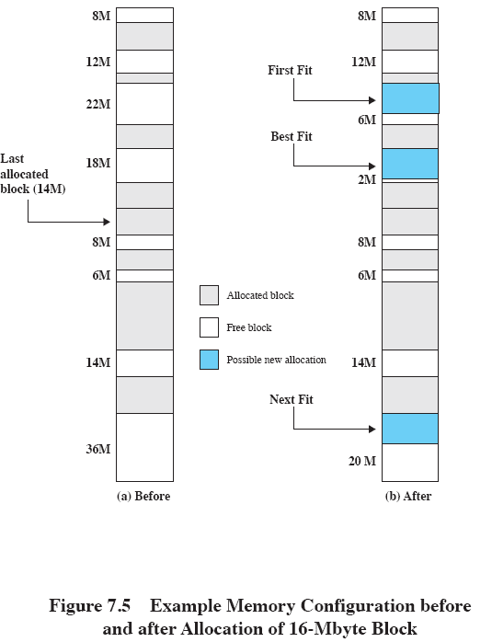
Allocation
Notes:
Slide shows Fig 7.5 - an example memory configuration after a number of placement and swapping-out operations.
The last block that was used was a 22-Mbyte block from which a 14-Mbyte partition was created.
Figure 7.5b shows the difference between the best, first, and next-fit placement algorithms in satisfying a 16-Mbyte allocation request.
Best-fit will search the entire list of available blocks and make use of the 18-Mbyte block, leaving a 2-Mbyte fragment.
First-fit results in a 6-Mbyte fragment, and
Next-fit results in a 20-Mbyte fragment.

Slide 24
Dynamic Partitioning
Operating system must decide which free block to allocate to a process
Best-fit algorithm
Chooses the block that is closest in size to the request
Worst performer overall
Since smallest block is found for process, the smallest amount of fragmentation is left
Memory compaction must be done more often

Slide 25
Dynamic Partitioning
First-fit algorithm
Scans memory form the beginning and chooses the first available block that is large enough
Fastest
May have many process loaded in the front end of memory that must be searched over when trying to find a free block

Slide 26
Dynamic Partitioning
Next-fit
Scans memory from the location of the last placement
More often allocate a block of memory at the end of memory where the largest block is found
The largest block of memory is broken up into smaller blocks
Compaction is required to obtain a large block at the end of memory

Slide 27
Buddy System
Entire space available is treated as a single block of 2^{U}
If a request of size s where 2^{U-1} < s <= 2^{U}
entire block is allocated
Otherwise block is split into two equal buddies
Process continues until smallest block greater than or equal to s is generated
Notes:
In a fixed partitioning scheme limits the number of active processes and may use space inefficiently if there is a poor match between available partition sizes and process sizes.
A dynamic partitioning scheme is more complex to maintain and includes the overhead of compaction.
An interesting compromise is the buddy system.

Slide 28
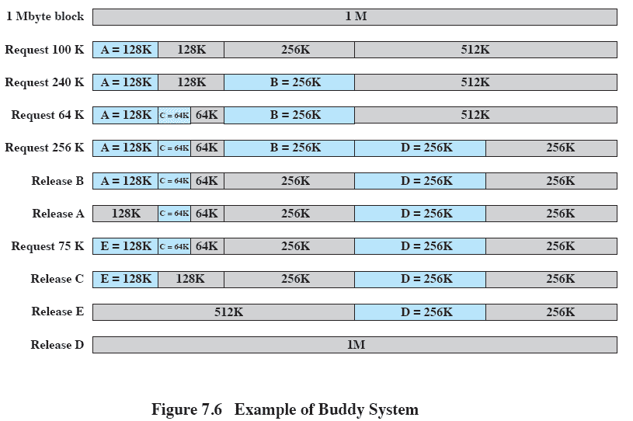
Example of Buddy System
Notes:
Figure 7.6 gives an example using a 1-Mbyte initial block.
The first request,A, is for 100 Kbytes, for which a 128K block is needed.
The initial block is divided into two 512K buddies.
The first of these is divided into two 256K buddies,
and the first of these is divided into two 128K buddies,
one of which is allocated to A.
The next request,B, requires a 256K block. Such a block is already available and is allocated.
The process continues with splitting and coalescing occurring as needed.
Note that when E is released,two 128K buddies are coalesced into a 256K block, which is immediately coalesced with its buddy

Slide 29
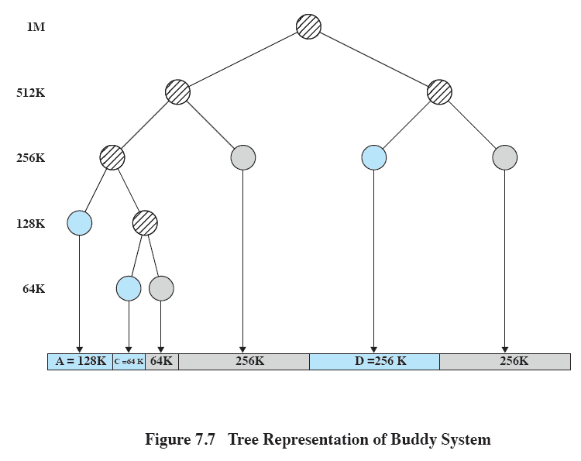
Tree Representation of Buddy System
Notes:
Figure 7.7 shows a binary tree representation of the buddy allocation immediately after the Release B request.
The leaf nodes represent the current partitioning the memory.
If two buddies are leaf nodes, then at least one must be allocated;
otherwise they would be coalesced into a larger block.
The buddy system is a reasonable compromise to overcome the disadvantages of both the fixed and variable partitioning schemes,
But in contemporary operating systems, virtual memory based on paging and segmentation is superior.
However, the buddy system has found application in parallel systems as an efficient means of allocation and release for parallel programs. A modified form of the buddy system is used for UNIX kernel memory allocation (described in Chapter 8).

Slide 30
Relocation
When program loaded into memory the actual (absolute) memory locations are determined
A process may occupy different partitions which means different absolute memory locations during execution
Swapping
Compaction

Slide 31
Addresses
Logical
Reference to a memory location independent of the current assignment of data to memory.
Relative
Address expressed as a location relative to some known point.
Physical or Absolute
The absolute address or actual location in main memory.
Notes:
A translation must be made from both Logical and Relative addresses to arrive at the Absolute address

Slide 32
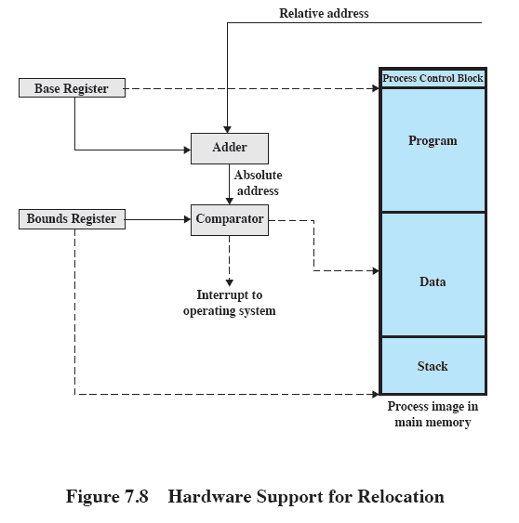
Relocation

Slide 33
Registers Used during Execution
Base register
Starting address for the process
Bounds register
Ending location of the process
These values are set when the process is loaded or when the process is swapped in

Slide 34
Registers Used during Execution
The value of the base register is added to a relative address to produce an absolute address
The resulting address is compared with the value in the bounds register
If the address is not within bounds, an interrupt is generated to the operating system

Slide 35
Paging
Partition memory into small equal fixed-size chunks and divide each process into the same size chunks
The chunks of a process are called pages
The chunks of memory are called frames

Slide 36
Paging
Operating system maintains a page table for each process
Contains the frame location for each page in the process
Memory address consist of a page number and offset within the page

Slide 37
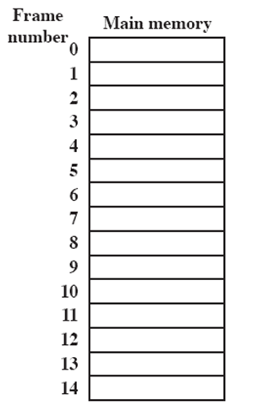
Processes and Frames
A.0
A.1
A.2
A.3
B.0
D.0
B.1
D.1
B.2
D.2
C.0
C.1
C.2
C.3
D.3
D.4
Notes:
Animated slide
System with a number of frames allocated
Process A, stored on disk, consists of four pages. When it comes time to load this process, the operating system finds four free frames and loads the four pages of process A into the four frames.
Process B, consisting of three pages, and process C, consisting of four pages, are subsequently loaded.
Then process B is suspended and is swapped out of main memory.
Later, all of the processes in main memory are blocked, and the operating system needs to bring in a new process, process D, which consists of five pages. The Operating System loads the pages into the available frames and updates the page table

Slide 38
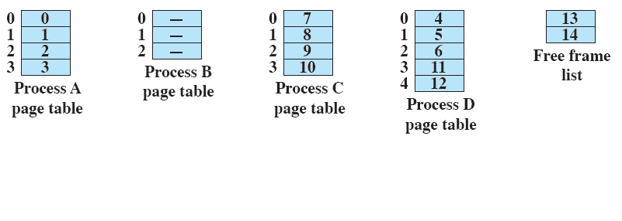
Page Table

Slide 39
Segmentation
A program can be subdivided into segments
Segments may vary in length
There is a maximum segment length
Addressing consist of two parts
a segment number and
an offset
Segmentation is similar to dynamic partitioning
Notes:
The difference with dynamic partitioning, is that with segmentation a program may occupy more than one partition, and these partitions need not be contiguous.
Segmentation eliminates internal fragmentation but suffers from external fragmentation (as does dynamic partitioning)
However, because a process is broken up into a number of smaller pieces, the external fragmentation should be less.
A consequence of unequal-size segments is that there is no simple relationship between logical addresses and physical addresses.
Analogous to paging, a simple segmentation scheme would make use of a segment table for each process and a list of free blocks of main memory. Each segment table entry would have to give
the starting address in main memory of the corresponding segment.
the length of the segment, to assure that invalid addresses are not used.
When a process enters the Running state, the address of its segment table is loaded into a special register used by the memory management hardware.

Slide 40
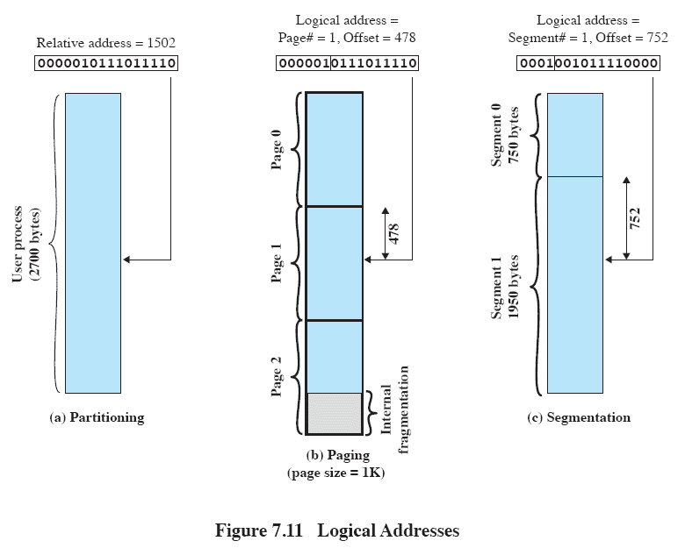
Logical Addresses
Notes:
In this example, 16-bit addresses are used, and the page size is 1K =1024 bytes.
The relative address 1502, in binary form, is 0000010111011110.
With a page size of 1K, an offset field of 10 bits is needed, leaving 6 bits for the page number.
Thus a program can consist of a maximum of 2⁶ =64 pages of 1K bytes each.
As Figure 7.11b shows, relative address 1502 corresponds to
an offset of 478 (0111011110) on page 1 (000001),
which yields the same 16-bit number, 0000010111011110.
Consider an address of n + m bits, where the leftmost n bits are the segment number and the rightmost m bits
are the offset.
In the example on the slide
n = 4 and
m =12.
Thus the maximum segment size is 2¹² = 4096.
The following steps are needed for address translation:
• Extract the segment number as the leftmost n bits of the logical address.
• Use the segment number as an index into the process segment table to find the starting physical address of the segment.
Compare the offset, expressed in the rightmost m bits, to the length of the segment. If the offset is greater than or equal to the length, the address is invalid.
The desired physical address is the sum of the starting physical address of the segment plus the offset.

Slide 41
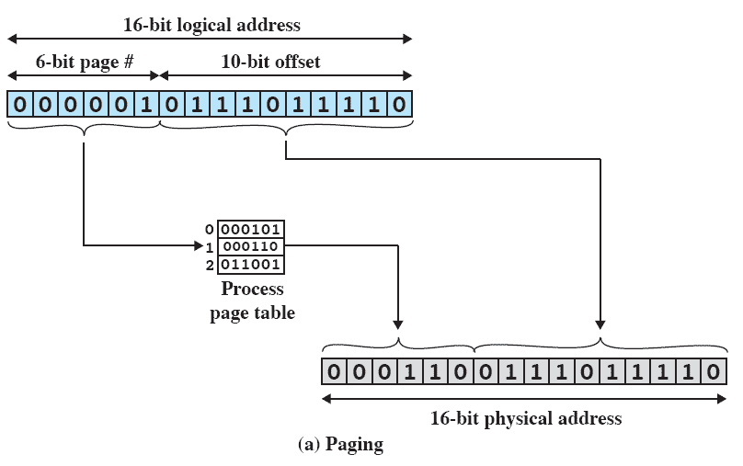
Paging
Notes:
In our example, we have the logical address 0000010111011110,
which is page number 1, offset 478.
Suppose that this page is residing in main memory frame 6 = binary 000110.
Then the physical address is frame number 6, offset 478 = 0001100111011110

Slide 42
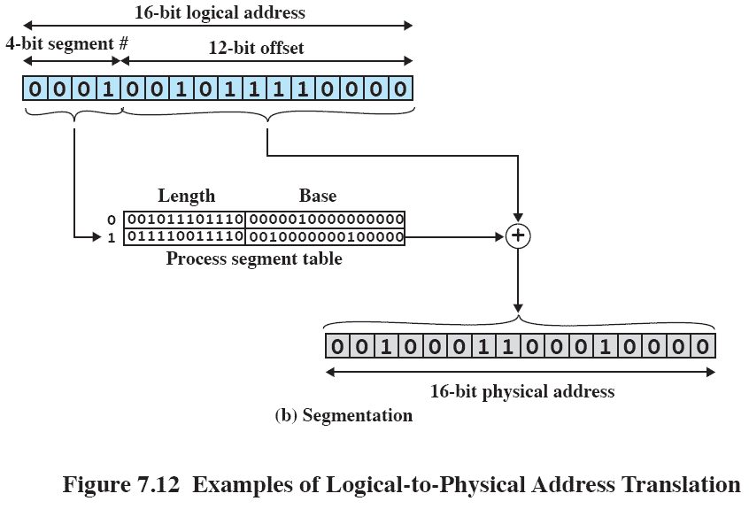
Segmentation
Notes:
In our example, we have the logical address 0001001011110000, which is segment number 1, offset 752.
Suppose that this segment is residing in main memory starting at physical address 0010000000100000.
Then the physical address is 0010000000100000 + 001011110000 = 0010001100010000

Slide 43
VIRTUAL MEMORY

Slide 44
Hardware and Control Structures
Memory references are dynamically translated into physical addresses at run time
A process may be swapped in and out of main memory such that it occupies different regions
A process may be broken up into pieces that do not need to located contiguously in main memory
All pieces of a process do not need to be loaded in main memory during execution

Slide 45
Execution of a Program
Operating system brings into main memory a few pieces of the program
Resident set - portion of process that is in main memory
An interrupt is generated when an address is needed that is not in main memory
Operating system places the process in a blocking state

Slide 46
Execution of a Program
Piece of process that contains the logical address is brought into main memory
Operating system issues a disk I/O Read request
Another process is dispatched to run while the disk I/O takes place
An interrupt is issued when disk I/O complete which causes the operating system to place the affected process in the Ready state

Slide 47
Advantages of Breaking up a Process
More processes may be maintained in main memory
Only load in some of the pieces of each process
With so many processes in main memory, it is very likely a process will be in the Ready state at any particular time
A process may be larger than all of main memory

Slide 48
Types of Memory
Real memory
Main memory
Virtual memory
Memory on disk
Allows for effective multiprogramming and relieves the user of tight constraints of main memory

Slide 49
Thrashing
Swapping out a piece of a process just before that piece is needed
The processor spends most of its time swapping pieces rather than executing user instructions

Slide 50
Principle of Locality
Program and data references within a process tend to cluster
Only a few pieces of a process will be needed over a short period of time
Possible to make intelligent guesses about which pieces will be needed in the future
This suggests that virtual memory may work efficiently

Slide 51
Support Needed for Virtual Memory
Hardware must support paging and segmentation
Operating system must be able to management the movement of pages and/or segments between secondary memory and main memory

Slide 52
Paging
Each process has its own page table
Each page table entry contains the frame number of the corresponding page in main memory
A bit is needed to indicate whether the page is in main memory or not

Slide 53
Modify Bit in Page Table
Another modify bit is needed to indicate if the page has been altered since it was last loaded into main memory
If no change has been made, the page does not have to be written to the disk when it needs to be swapped out

Slide 54
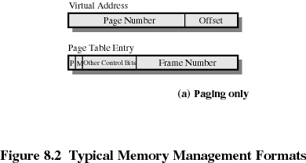
Page Table Entries

Slide 55
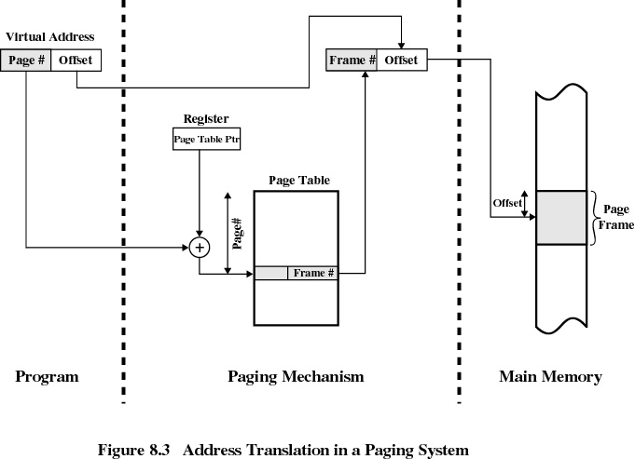

Slide 56
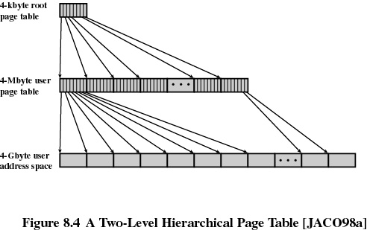
Two-Level Scheme for 32-bit Address

Slide 57
If we assume byte-level addressing and 4-kbyte (2¹²) pages,
then the 4-Gbyte (2³²) virtual address space is composed of 2²⁰pages.
If each of these pages is mapped by a 4-byte page table entry (PTE), we can create a user page table composed of 2²⁰ PTEs requiring 4 Mbyte (2²² ) bytes.
This huge user page table, occupying 2¹⁰ pages, can be kept in virtual memory and mapped by a root page table with 2¹⁰ PTEs occupying
4 Kbyte (2¹² ) of main memory.

Slide 58
Page Tables
The entire page table may take up too much main memory
Page tables are also stored in virtual memory
When a process is running, part of its page table is in main memory

Slide 59
The root page always remains in main memory.
The first 10 bits of a virtual address are used to index into the root page to find a PTE for a page of the user page table.
If that page is not in main memory, a page fault occurs.
If that page is in main memory, then the next 10 bits of the virtual address index into the user PTE page to find the PTE for the page that is referenced by the virtual address.

Slide 60
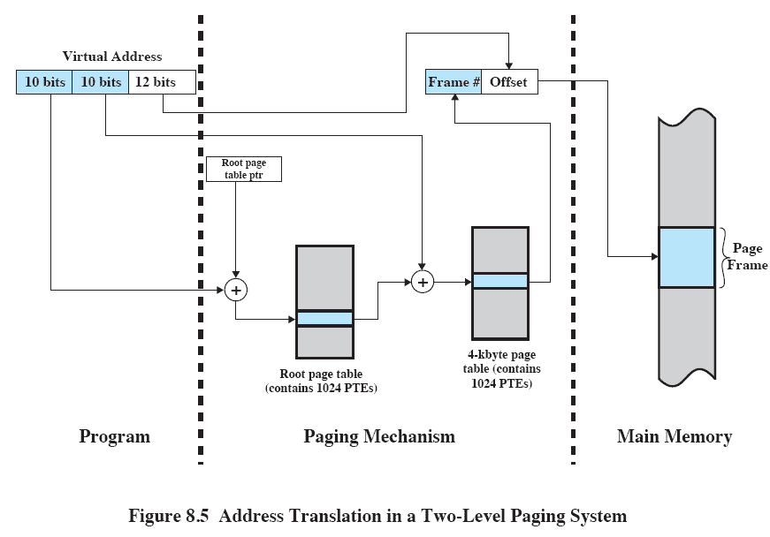
Address Translation for Hierarchical page table
Notes:
Figure 8.5 shows the steps involved in address translation for this scheme.
The root page always remains in main memory.
The first 10 bits of a virtual address are used to index into the root page to find a PTE for a page of the user page table.
If that page is not in main memory, a page fault occurs.
If that page is in main memory, then the next 10 bits of the virtual address index into the user PTE page to find the PTE for the page that is referenced by the virtual address.

