Slide 1
File Systems

Slide 2
File Systems
The best way to store information:
  Store all information in virtual memory address space
  Use ordinary memory read/write to access information
  Not feasible: no enough address space
  When process exits, information is lost
Another approach:
  Define named objects called files which hold programs and data
  Files are not part of the address space
  O.S. provides special operations (system calls) to create/destroy files
  Files are permanent records

Slide 3
File Systems
Essential requirements for long-term information storage:
It must be possible to store a very large amount of information.
The information must survive the termination of the process using it.
Multiple processes must be able to access the information concurrently.

Slide 4
File Systems
Think of a disk as a linear sequence of fixed-size blocks and supporting reading and writing of blocks. Questions that quickly arise:
How do you find information?
How do you keep one user from reading another’s data?
How do you know which blocks are free?

Slide 5
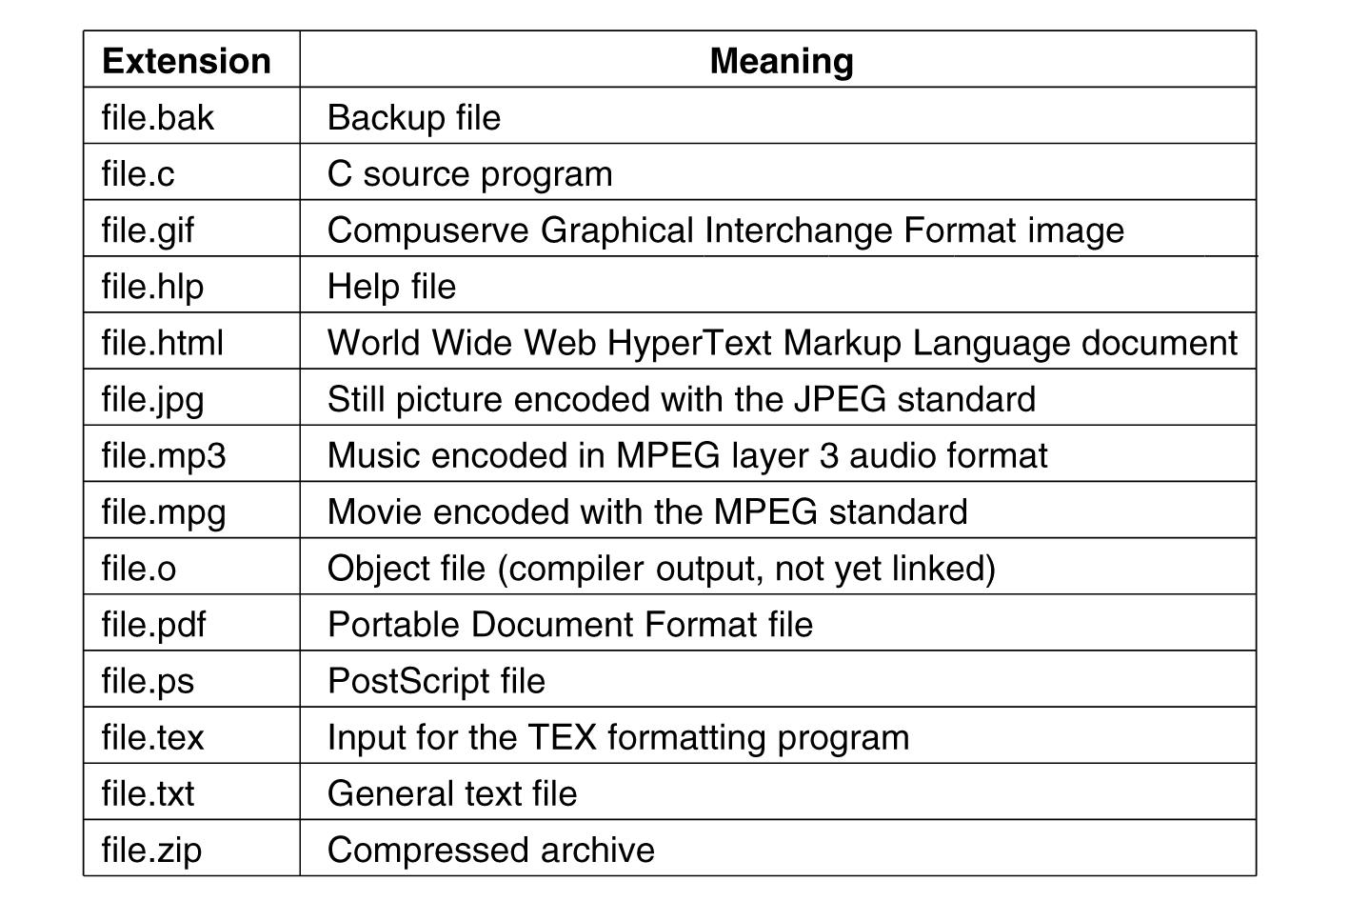
File Naming
Some typical file extensions.

Slide 6
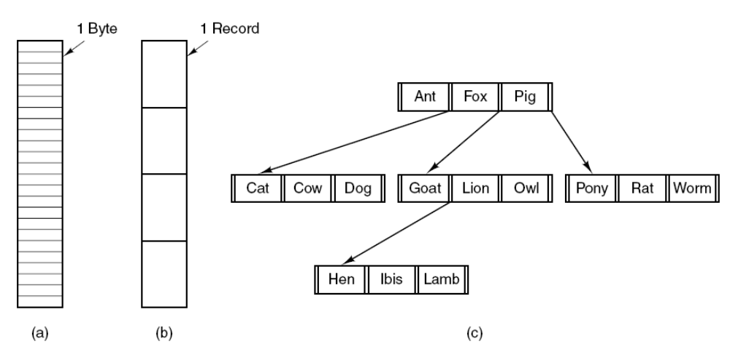
File Structure
Three kinds of files. (a) Byte sequence.
(b) Record sequence. (c) Tree.

Slide 7
File Types
Regular files: contain data bytes
Directories: contain the names of other files
Special files: I/O devices
  Character special files: e.g. terminals, printers
  Block special files: e.g. disks, tapes
File access methods
  Sequential access: start at the beginning, read the bytes or records in order
  Random access: read bytes or records in any order

Slide 8
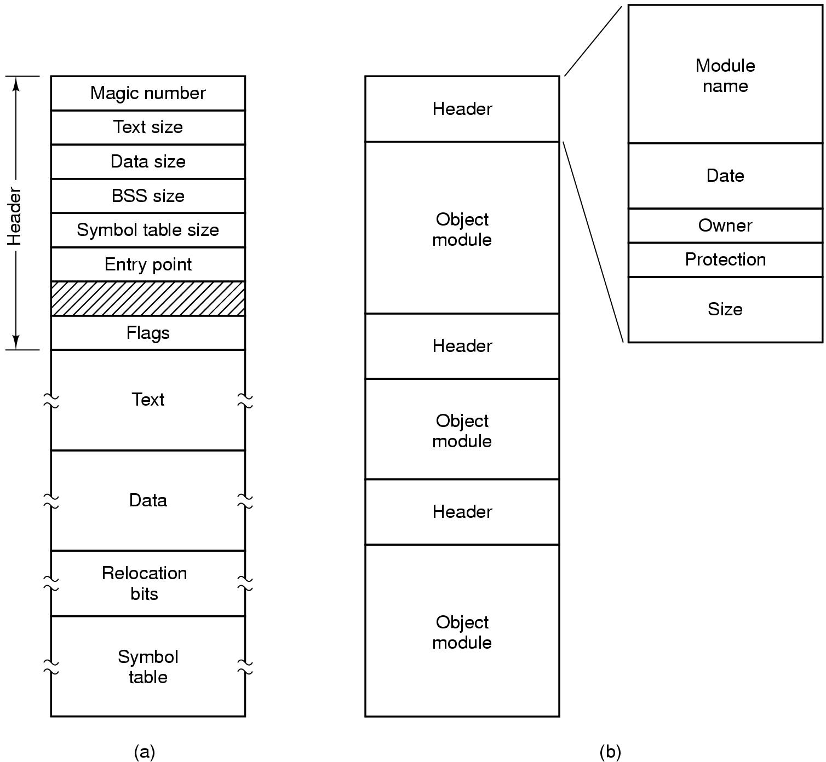
File Types
. (a) An executable file. (b) An archive.

Slide 9
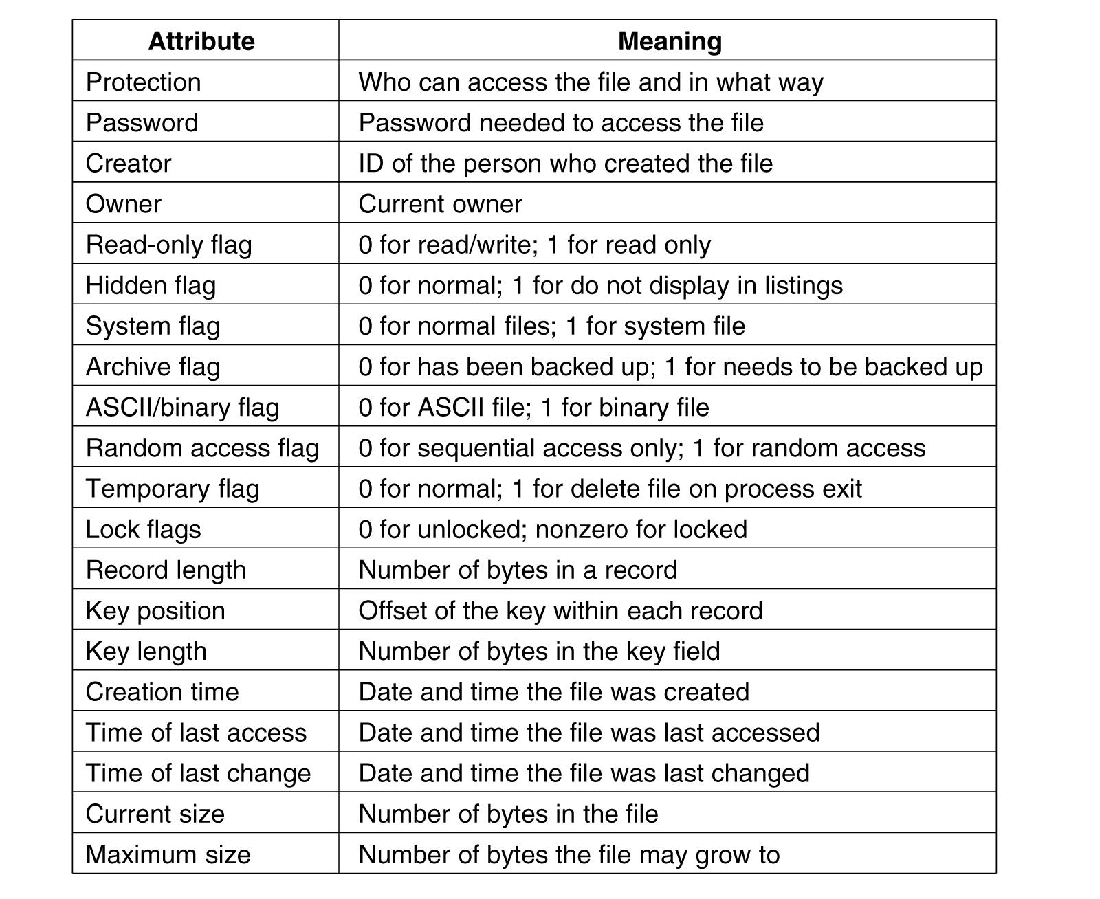
File Attributes
File attributes: Extra information associated with each file
Some possible file attributes.

Slide 10
File Operations
The most common system calls relating to files:
Create
Delete
Open
Close
Read
Write
Append
Seek
Get Attributes
Set Attributes
Rename
Open: bring attributes and disk addresses to memory for fast access
Close: put back to disk
Seek: put the pointer to a specific location in the file
Tanenbaum, Modern Operating Systems 3 e, (c) 2008 Prentice-Hall, Inc. All rights reserved. 0-13-6006639

Slide 11
Directories
1. Single directory shared by all users
  Different users cannot use the same file name.
2. One directory per user
  Different users can use the file name. But each user can keep only a sequence of files, no any group support.
3. Arbitrary tree per user
  Flexible. Used in Unix.

Slide 12
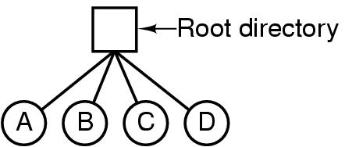
Hierarchical Directory Systems (1)
One Directory System
A single-level directory system containing four files.

Slide 13
Two Directories System
One directory per user
A
B
C
A
A
B
C
C
C

Slide 14
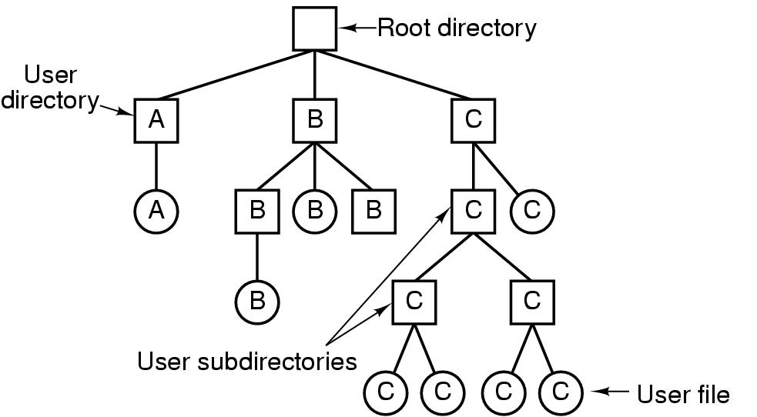
Hierarchical Directory Systems (2)
A hierarchical directory system.

Slide 15
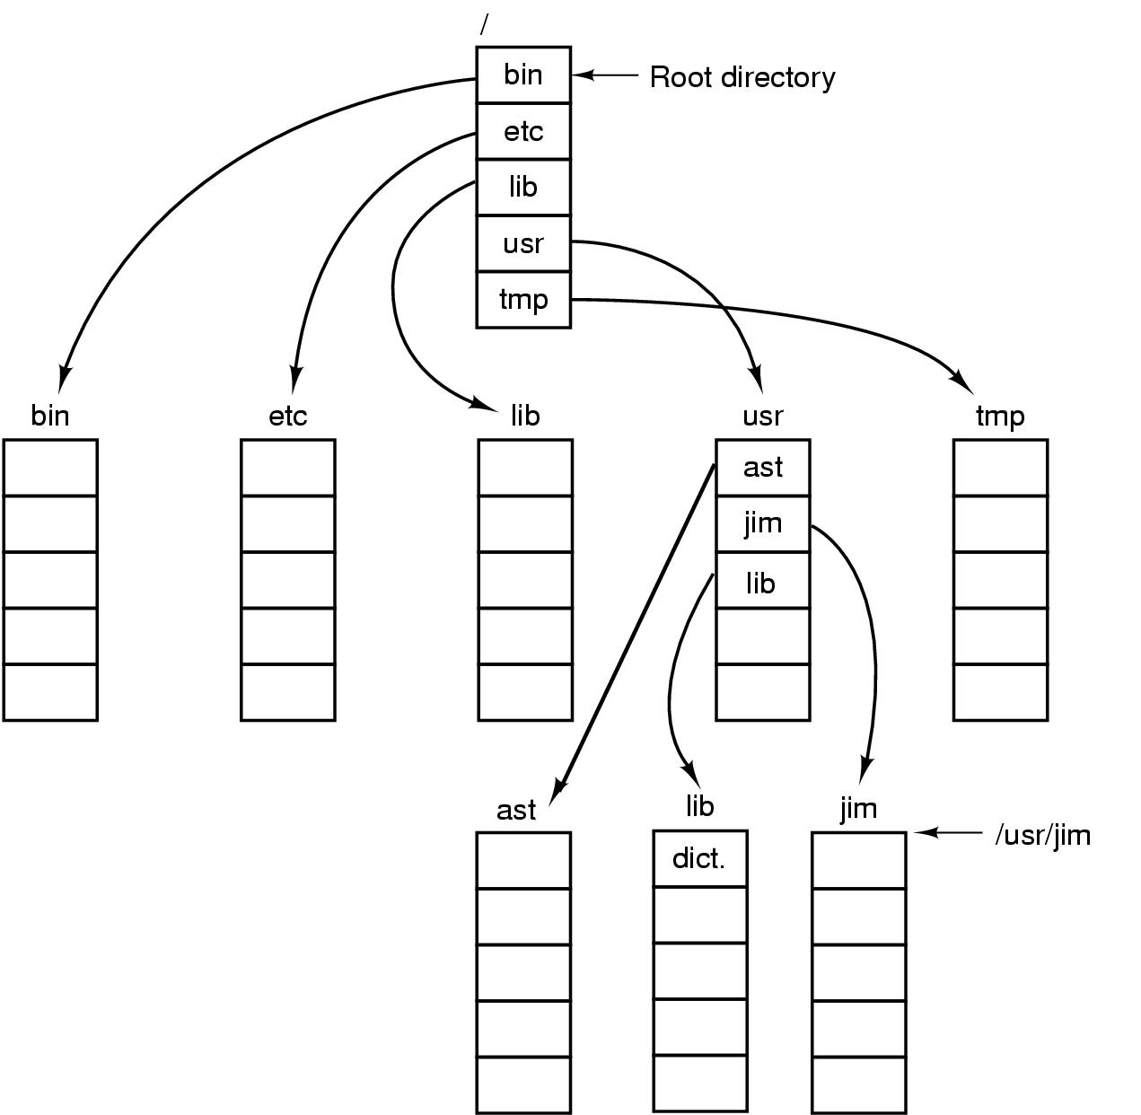
Path Names
Figure 4-8. A UNIX directory tree.

Slide 16
Directory Operations
System calls for managing directories:
Create
Delete
Opendir
Closedir
Readdir
Rename
Link
Uplink

Slide 17

Contiguous Allocation
(a) Contiguous allocation of disk space for 7 files.
(b) The state of the disk after files D and F have been removed.

Slide 18

Linked List Allocation
Storing a file as a linked list of disk blocks.

Slide 19
Linked List Allocation Using a Table in Memory
File allocation table (FAT)
A table has one entry for each disk block. All blocks of a file linked together.
The directory keeps the first block number of each file.
The table is stored in memory.
Example system: MS-DOS
Problem:
  Pointers for all files on the disk are mixed up in the same table. An entire FAT is potentially needed for accessing one file.

Slide 20
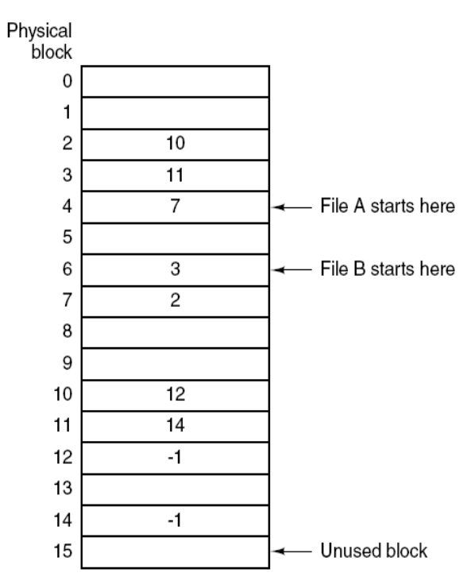
Linked List Allocation Using a Table in Memory
Linked list allocation using a file allocation table in main memory.

Slide 21
I-nodes
Keep the block lists for different files in different places
I-node (index node) in Unix.
Each file has a small table called I-node
I-node contains attributes, first 10 blocks of the file, and 3 indirect block numbers.
Single indirect block: points to data blocks
Double indirect block: points to single indirect blocks
Triple indirect block: points to double indirect blocks

Slide 22
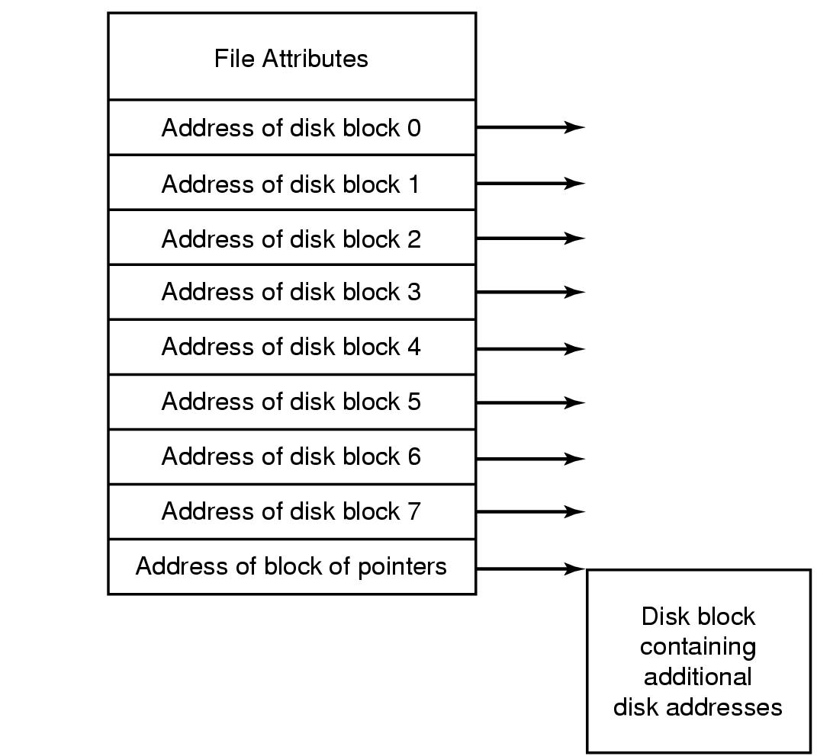
I-nodes
An example i-node.

Slide 23
I-nodes
Example:
For 1K disk block and 32-bit disk address, how large a file could be?
Single indirect block holds 256 disk addresses
Double indirect block holds 256 single indirect blocks
File size < 10 blocks: no indirect blocks
File size between 10 and 266 blocks: single indirect
File size between 267 and 266 + 256 x 256 = 65802K blocks, use double indirect
File size between 64M and 16G, triple indirect
File size > 16 G, cannot handle

Slide 24
I-nodes
Advantage: fast random access
At most three disk references are needed to locate the disk address of any byte in the file.
When the file is open, its I-node is brought into memory until the file is closed.
Example of finding the 300th block in a file:
300 - 266 = 34
Follow double indirect to the first single indirect, the 34th block.
No need to follow the 299 blocks before this block as in the linked list case.

Slide 25
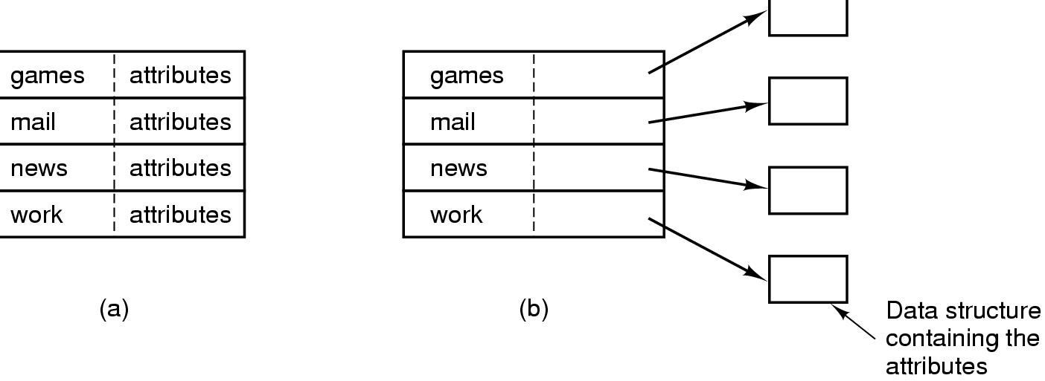
Implementing Directories (1)
(a) A simple directory containing fixed-size entries with the disk addresses and attributes in the directory entry. (b) A directory in which each entry just refers to an i-node.

Slide 26
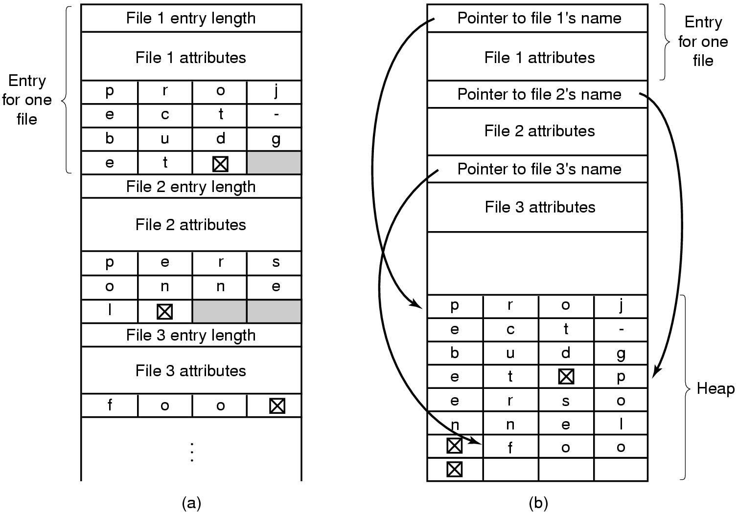
Implementing Directories (2)
Two ways of handling long file names in a directory. (a) In-line. (b) In a heap.

Slide 27
Shared Files
A shared file appears simultaneously in different directories belonging to different users
File system is a directed acyclic graph, not a tree
Problems: When directories contain disk addresses (e.g. CP/M), cannot share files.
Solution: Directory does not point to disk addresses. Point to a data structure associated with the file. Use Link Count to record how many users are sharing the file.
When performing ``remove file", only when count = 0, remove the file, otherwise reduce the Link Count.

Slide 28
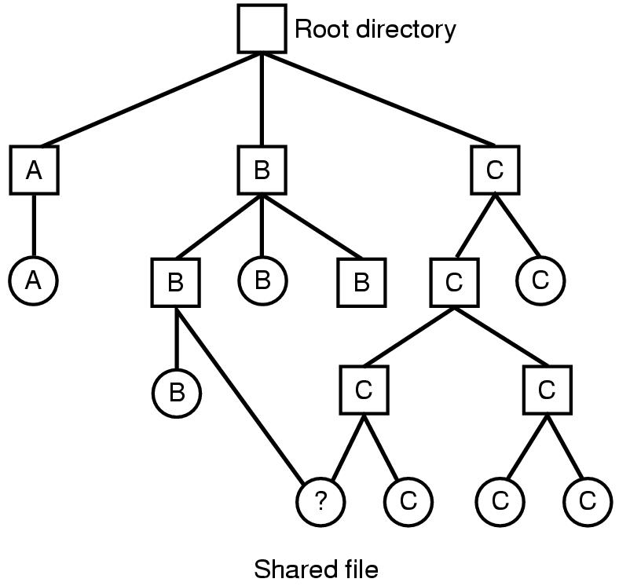
Shared Files
Figure 4-16. File system containing a shared file.

Slide 29
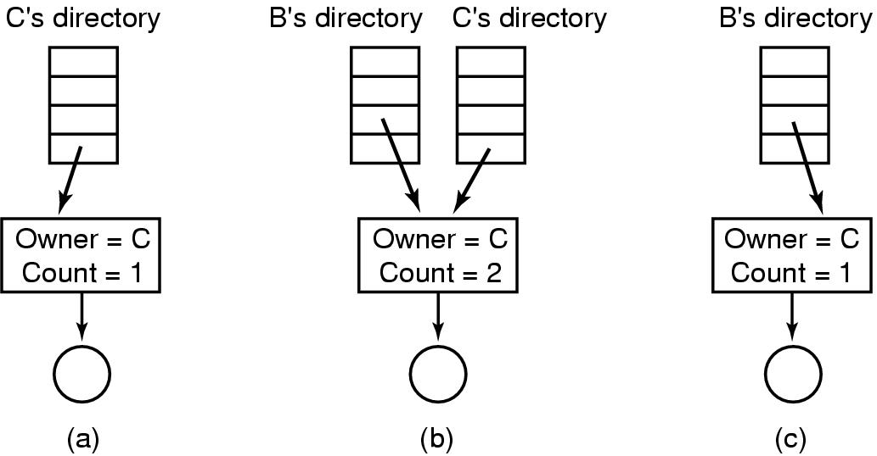
Shared Files
Figure 4-17. (a) Situation prior to linking. (b) After the link is created. (c) After the original owner removes the file.

Slide 30
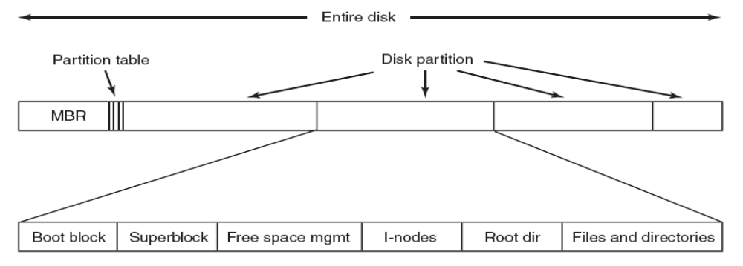
File System Layout
A possible file system layout.

Slide 31
Journaling File Systems
The basic idea here is to keep a log of what the file system is going to do before it does it.
Example: NTFS, EXT3, ReiserFS.

Slide 32
Journaling File Systems
Operations required to remove a file in UNIX on Windows:
Remove the file from its directory.
Release the i-node to the pool of free i-nodes.
Return all the disk blocks to the pool of free disk blocks.

Slide 33
Journaling File Systems
The journaling file system does is first write a log entry listing the three actions to be completed. The log entry is then written to disk (and for good measure, possibly read back from the disk to verify that it was, in fact, written correctly). Only after the log entry has been written, do the various operations begin. After the operations complete successfully, the log entry is erased. If the system now crashes, upon recovery the file system can check the log to see if any operations were pending. If so, all of them can be rerun (multiple times in the event of repeated crashes) until the file is correctly removed.

Slide 34
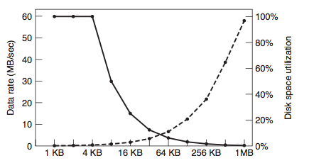
Management of file systems
All files size 4 Kb.

Slide 35
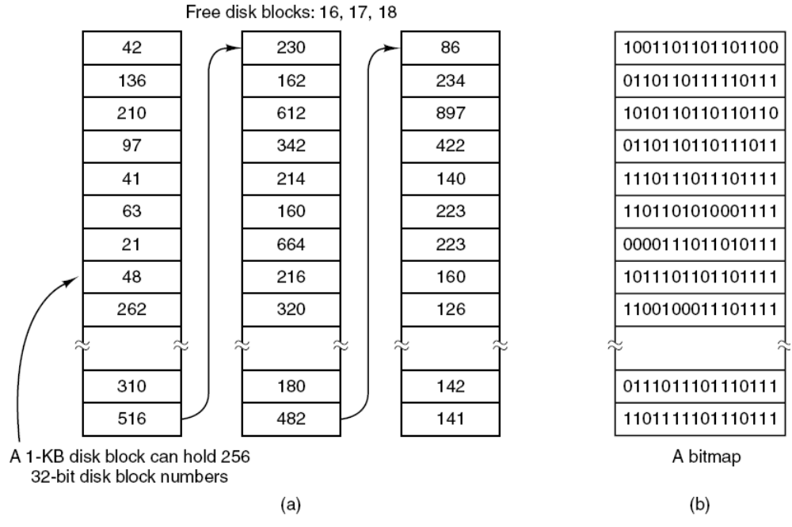
Keeping Track of Free Blocks
. (a) Storing the free list on a linked list. (b) A bitmap.

