Slide 1
Deadlocks

Slide 2
The Deadlock Problem
A Computing example: record scanned document
System has 1 scanner and 1 CD Recorder
2 processes each need both devices.
P₀ acquires scanner and waits for CD
P₁ acquires CD and waits for scanner

Slide 3
Preemptable and Nonpreemptable Resources
Sequence of events required to use a resource:
Request the resource.
Use the resource.
Release the resource.

Slide 4
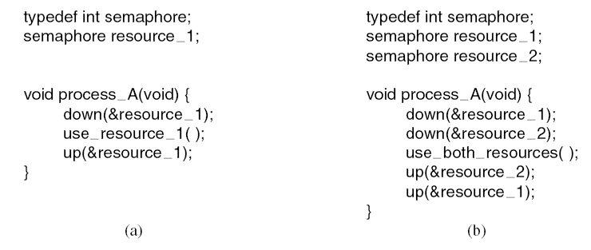
Resource Acquisition (1)
Figure 6-1. Using a semaphore to protect resources. (a) One resource. (b) Two resources.

Slide 5
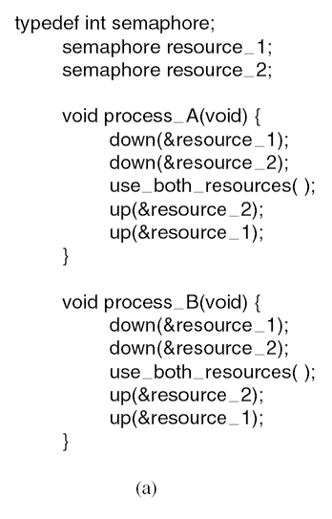
Resource Acquisition (2)
Figure 6-2. (a) Deadlock-free code.

Slide 6
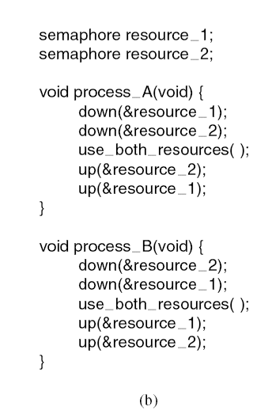
Resource Acquisition (3)
Figure 6-2. (b) Code with a potential deadlock.

Slide 7
Introduction To Deadlocks
Deadlock can be defined formally as follows:
A set of processes is deadlocked if each process in the set is waiting for an event that only another process in the set can cause.

Slide 8
Conditions for Resource Deadlocks
Mutual exclusion condition
Hold and wait condition.
No preemption condition.
Circular wait condition.

Slide 9
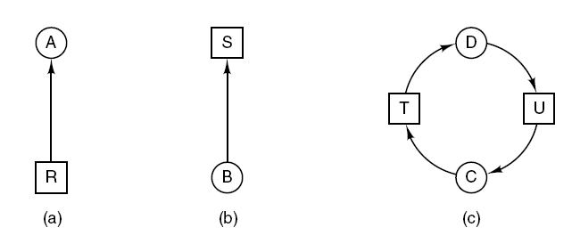
Deadlock Modeling (1)
Figure 6-3. Resource allocation graphs. (a) Holding a resource. (b) Requesting a resource. (c) Deadlock.

Slide 10
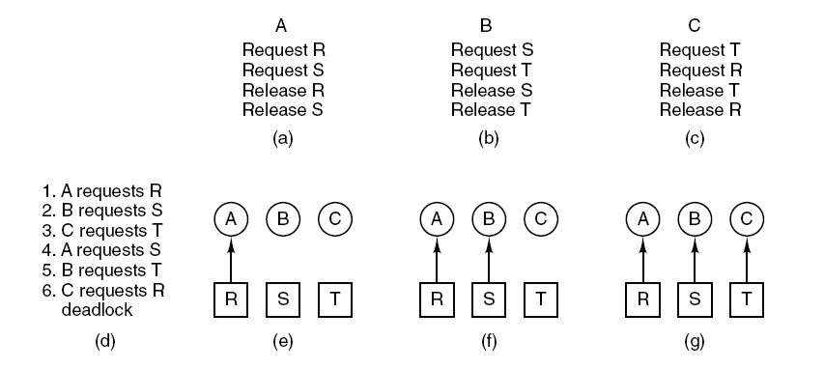
Deadlock Modeling (2)
Figure 6-4. An example of how deadlock occurs and how it can be avoided.

Slide 11
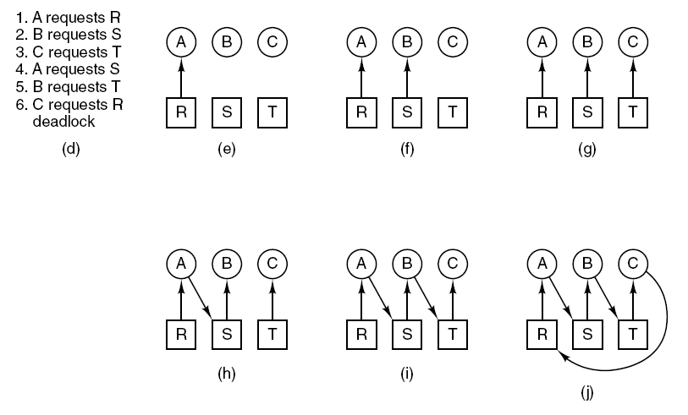
Deadlock Modeling (3)
Figure 6-4. An example of how deadlock occurs and how it can be avoided.

Slide 12
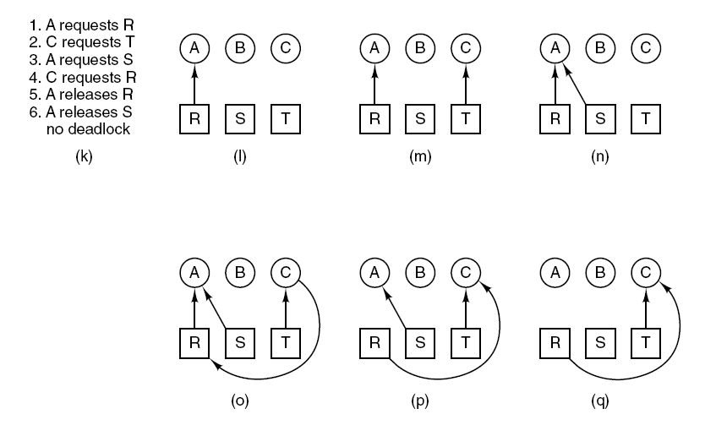
Deadlock Modeling (4)
Figure 6-4. An example of how deadlock occurs and how it can be avoided.

