Slide 1
Threads

Slide 2
Thread usage
In traditional operating systems, each process has an address space and a single thread of control.

Slide 3
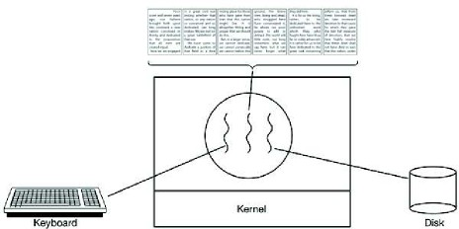
A word processor with three threads

Slide 4

A multithreaded Web server.

Slide 5
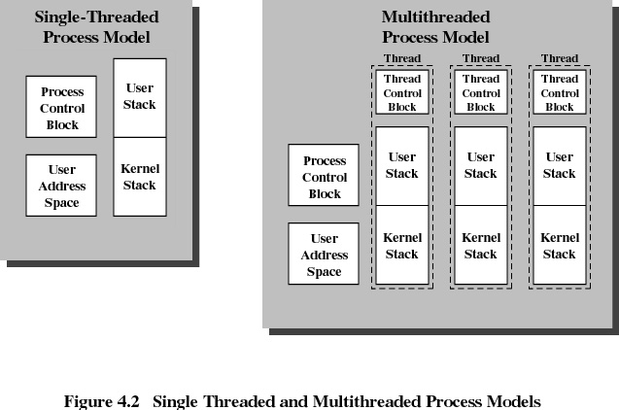

Slide 6
Benefits of Threads
Takes less time to create a new thread than a process
Less time to terminate a thread than a process
Less time to switch between two threads within the same process
Since threads within the same process share memory and files, they can communicate with each other without invoking the kernel

Slide 7
Threads
Suspending a process involves suspending all threads of the process since all threads share the same address space
Termination of a process, terminates all threads within the process

Slide 8
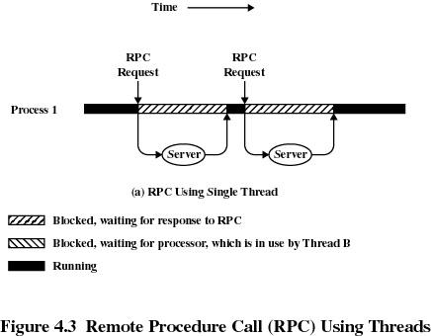
Remote Procedure Call Using Threads

Slide 9
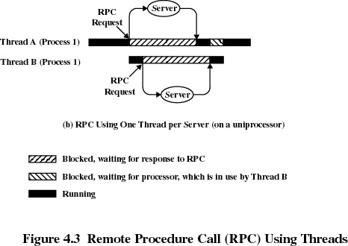
Remote Procedure Call Using Threads

Slide 10
User-Level Threads
All thread management is done by the application
The kernel is not aware of the existence of threads

Slide 11
Kernel-Level Threads
W2K, Linux, and OS/2 are examples of this approach
Kernel maintains context information for the process and the threads
Scheduling is done on a thread basis

Slide 12
Combined Approaches
Example is Solaris
Thread creation done in the user space
Bulk of scheduling and synchronization of threads done in the user space

Slide 13
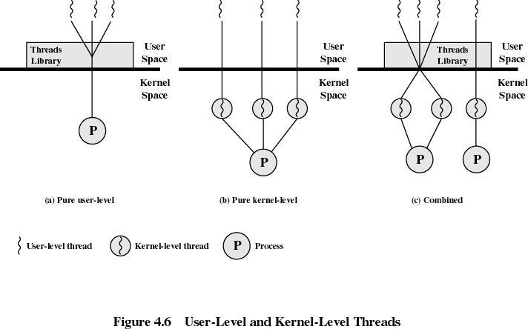

Slide 14
Relationship Between Threads and Processes
Threads:Process
Description
Example Systems
1:1
Each thread of execution is a
unique process with its own
address space and resources.
Traditional UNIX implementations
M:1
A process defines an address
space and dynamic resource
ownership. Multiple threads
may be created and executed
within that process.
Windows NT, Solaris, OS/2,
OS/390, MACH

Slide 15
Three ways to construct a server.
Model | Characteristics
Threads | Parallelism, blocking system calls
Single-threaded process | No parallelism, blocking system calls
Finite-state machine | Parallelism, nonblocking system calls, interrupts

