Slide 1
Processes

Slide 2
Processes
Programmers baking a cake
Cake recipe
Kitchen
Ingredients: eggs, milk, sugar, vanilla and etc.
Process: programmers (CPU) reading a recipe (program), put ingredients (input data) and baking a cake.

Slide 3
Processes
Comes son and saying he has stung by a bee.
Records where he was in the recipe (the state of the current process is saving).
Switch from one process (baking) to higher-priority process (medical care)
When finished medical care come back to baking.

Slide 4
Processes
The main functions of the OS
Interrupts handling
Processes management
Resources management
File system

Slide 5
Processes
A process, being an abstraction of the computer, is largely defined by:
• Its CPU state (register values). • Its address space (memory contents). • Its environment (as reflected in operating system tables).
Each additional level gives a wider context for the computation.

Slide 6
Processes
The CPU registers contain the current state
The current state of the CPU is given by the contents of its registers. These can be grouped as follows:
Processor Status Word (PSW): includes bits specifying things like the mode (privileged or normal), the outcome of the last arithmetic operation (zero, negative, overflow, or carry), and the interrupt level (which interrupts are allowed and which are blocked).
Instruction Register (IR) with the current instruction being executed.

Slide 7
Processes
Program Counter (PC): the address of the next instruction to be executed.
Stack Pointer (SP): the address of the current stack frame, including the function’s local variables and return information.
General purpose registers used to store addresses and data values as directed by the compiler. Using them effectively is an important topic in compilers, but does not involve the operating system.

Slide 8
Processes
The memory contains the program
Only a small part of an applications data can be stored in registers. The rest is in memory. This is typically divided into a few parts, sometimes called segments:
Text — the application’s code. This is typically read-only, and might be shared by a number of processes (e.g. multiple invocations of a popular application such as a text editor).
Data — the application’s predefined data structures.

Slide 9
Processes
Heap — an area from which space can be allocated dynamically at runtime, using functions like new or malloc. Stack — where register values are saved, local variables allocated, and return information kept, in order to support function calls.
All the addressable memory together is called the process’s address space. In modern systems this need not correspond directly to actual physical memory. We’ll discuss this later.

Slide 10
Processes
The environment contains the relationships with other entities
A process does not exist in a vacuum. It typically has connections with other entities, such as
• A terminal where the user is sitting. • Open files that are used for input and output. • Communication channels to other processes, possibly on other machines.
These are listed in various operating system tables.

Slide 11
Processes
All the data about a process is kept in the PCB
The operating system keeps all the data it needs about a process in the process control block (PCB) (thus another definition of a process is that it is “the entity described by a PCB”). This includes many of the data items described above, or at least pointers to where they can be found (e.g. for the address space). In addition, data needed by the operating system is included, for example:

Slide 12
Processes
Information for calculating the process’s priority relative to other processes. This may include accounting information about resource use so far, such as how long the process has run.
Information about the user running the process, used to decide the process’s ac- cess rights (e.g. a process can only access a file if the file’s permissions allow this for the user running the process). In fact, the process may be said to represent the user to the system.

Slide 13
Processes
The PCB may also contain space to save CPU register contents when the process is not running (some implementations specifically restrict the term “PCB” to this storage space).

Slide 14
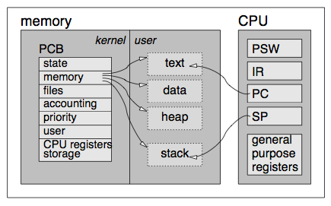
Processes

Slide 15
Processes
Process States
One of the important items in the PCB is the process state. Processes change state during their execution, sometimes by themselves (e.g. by making a system call), and sometimes due to an external event (e.g. when the CPU gets a timer interrupt).

Slide 16
Processes
The PCB is more than just a data structure that contains information about the process. It actually represents the process.
Processes changes their state over time
An important point is that a process may change its state. It can be ready to run at one instant, and blocked the next.

Slide 17
Processes
At each moment, at most one process is in the running state, and occupying the CPU. Several processes may be ready to run (but can’t because we only have one processor). Several others may be blocked waiting for different types of events, such as a disk interrupt or a timer going off.

Slide 18
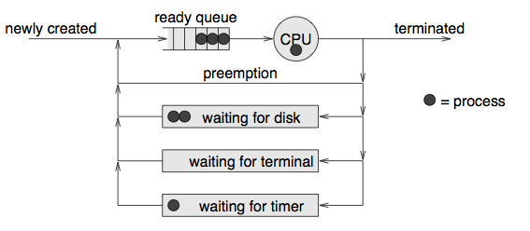
Processes

Slide 19
Processes
Processes are created in the ready state. A ready process may be scheduled to run by the operating system. When running, it may be preempted and returned to the ready state. A process may also block waiting for an event, such as an I/O operation. When the event occurs, the process becomes ready again. Such transitions continue until the process terminates.

Slide 20
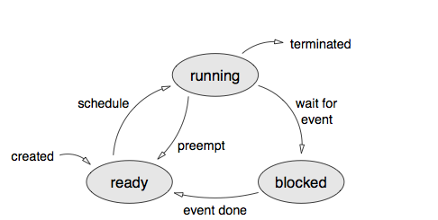
Processes

Slide 21
Processes
Process Creation
Events which cause process creation:
System initialization. (Daemons)
Execution of a process creation system call by a running process. (Check current mail)
A user request to create a new process. (Double click)
Initiation of a batch job. (Ms Word with document)

Slide 22
Processes
Process Termination
Events which cause process termination:
Normal exit (voluntary).
Error exit (voluntary) (no file exist).
Fatal error (involuntary) (division by zero).
Killed by another process (involuntary). (kill, TerminateProcess)

