Slide 1
Processes Scheduling

Slide 2
Processes Scheduling
In a multiprogramming operating system, the method for switching the CPU among multiple processes is called CPU scheduling. Scheduling is the operation of selecting a process which is to be serviced by the CPU. A good scheduling technique is very important in evaluating the performance of the system. Various scheduling techniques exist that influence the performance of the computer system.

Slide 3
Processes Scheduling
CPU time is expensive; thus it should be busy at all times. Ideally it is said that CPU utilization should be 100%, but practically it is difficult to achieve. During heavy loads, the CPU is busy almost 90% of the time and in lighter loads it is only active around 40% of the time.
The total number of processes that gets completed in unit time is called throughput. Throughput should be as high as possible.

Slide 4
Processes Scheduling
Turnaround time: The time span from submission of a process to the system, until its completion, is called turnaround time. Its value should be as low as possible.
Waiting time: The time spent by a process in different queues, while waiting for CPU, is called waiting time. Its value can also be calculated by subtracting the execution time from the turnaround time of the process. Its value should be as low as possible.

Slide 5
Processes Scheduling
The CPU scheduler performs the task of scheduling and is a part of the operating system. There could be two types of scheduling algorithms, preemptive or non-preemptive.
When the CPU switches from one process to another before its completion, then it is called preemptive scheduling.

Slide 6
Processes Scheduling
When to schedule?
A new job starts
The running job exits
The running job is blocked
I/O interrupt (some processes will be ready)
Timer interrupt

Slide 7
Processes Scheduling
Preemptive vs. Non-preemptive
Non-preemptive scheduling
The running process keeps the CPU until it voluntarily gives up the CPU
Process exits
Switch to blocked state
1 and 4 only (no 3 unless
calls yield)
Preemptive scheduling
The running process can be interrupted and must release the CPU

Slide 8
Processes Scheduling
First Come First Serve (FCFS))
Also called first-in first-out (FIFO)
Jobs are scheduled in order of arrival to ready queue
“Real-world” scheduling of people in lines (e.g., supermarket)
Typically non-preemptive (no context switching at market)

Slide 9
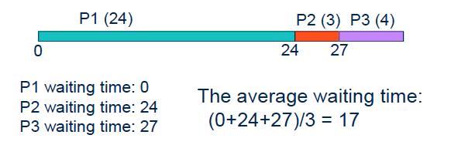
Processes Scheduling
Process | Duration | Order
P1 | 24 | 1
P2 | 3 | 2
P3 | 4 | 3

Slide 10
Processes Scheduling
Processes order
P2, P3, P1
Waiting time
P1 = 6; P2 = 0; P3 = 3;
Average of waiting time
(6+0+3)/3 = 3 , better..
Gantt diagram
P2
P3
P1
0
3
6
30

Slide 11

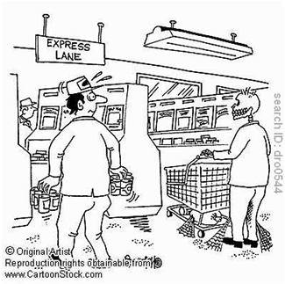
Processes Scheduling
Average waiting time can be large if small jobs wait behind long ones (high turnaround time)
Non-preemptive
You have a basket, but you’re stuck behind someone with a cart
Solution?
Express lane (12 items or less)

Slide 12
Processes Scheduling
Shortest Job First (SJF)
Shortest Job First (SJF)
Choose the job with the smallest expected duration first
Person with smallest number of items to buy
Requirement: the job duration needs to be known in advance
Used in Batch Systems
Optimal for Average Waiting Time if all jobs are available simultaneously (provable).
Real life analogy?
Express lane in supermarket
Shortest important task first

Slide 13
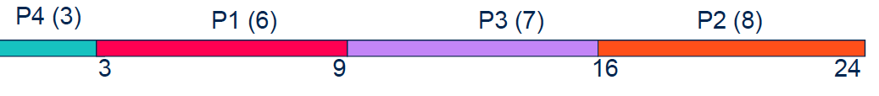
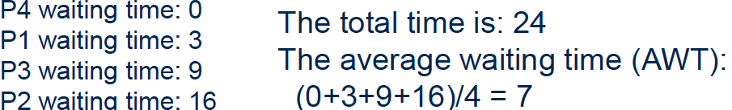
Processes Scheduling
Non-preemptive SJF: Example
Process | Duration | Order
P1 | 6 | 1
P2 | 8 | 2
P3 | 7 | 3
P4 | 3 | 4
0

Slide 14
Processes Scheduling
Non-Preemptive SJF Scheduling
Preemptive SJF Scheduling
Gantt Chart for Schedule
Gantt Chart for Schedule
P1
P3
P2
P4
P1
P2
P3
P2
P4
P1
0
7
8
12
16
0
2
4
5
7
11
16
Average waiting time =
(0+6+3+7)/4 = 4
Average waiting time =
(9+1+0+2)/4 = 3

