Slide 1

Green Pace
Security Policy Presentation
Developer: Michael Peck

Slide 2

OVERVIEW: DEFENSE IN DEPTH
What is a Security Policy?
Why do we need one?

Slide 3
THREATS MATRIX
Likely Dedicated/Denial-of-Service (DoS/DDoS) SQL Injections Service Provider Outages | Priority Malicious Insider Malware Injection Phishing / Social Engineering
Low priority Man-in-the-Middle (MitM) Human Error | Unlikely Shadow IT Dependency Vulnerabilities

Slide 4
10 PRINCIPLES
Validate Input Data
STD-003-CPP, STD-004-CPP, STD-008-CPP
Heed Compiler Warnings
STD-007-CPP
Architect and Design for Security Policies
STD-006-CPP, STD-009-CPP, STD-010-CPP
Keep it Simple
STD-001-CPP, STD-002-CPP, STD-003-CPP, STD-005-CPP, STD-006-CPP, STD-007-CPP, STD-008-CPP, STD-010-CPP
Default Deny
Adhere to the Principle of Least Privilege
Sanitize Data Sent to Other Systems
STD-004-CPP
Practice Defense in Depth
STD-004-CPP, STD-008-CPP, STD-009-STD
Use Effective Quality Assurance Techniques
STD-005-CPP, STD-006-CPP, STD-007-CPP
Adopt a Secure Coding Standard
STD-001-CPP, STD-002-CPP, STD-003-CPP, STD-005-CPP, STD-009-CPP, STD-010-CPP

Slide 5
CODING STANDARDS
High Priority
STD-002-CPP - Limitations on Expected Object Lifetime
STD-004-CPP – Mitigation of SQL Command Injection Flaws via I/O Parameterization
STD-005-CPP – Properly Manage Memory Allocation for Object Lifetime
Likely
STD-003-CPP – Mandate of Standard String Objects over Raw Char Arrays
STD-008-CPP – Verification of Container Reference Boundaries and Pointer Validity
STD-010-CPP – Mandate the use of Locks on Shared Objects to Maintain Consistency
Low Priority
STD-006-CPP – Isolation of Runtime Assertions to Non-Prod Releases
STD-009-CPP – Prohibition of Static or Predictable Seeds in Pseudo-Random Engines
Unlikely
STD-001-CPP – Prohibition of Reserved Global Identifiers and Macros
STD-007-CPP – Ordered Exception Handling from Most Specific to Generic

Slide 6
ENCRYPTION POLICIES
Encryption at Rest
Not actively processed
Encrypted in a physical storage medium
Encryption at Flight
Data currently in transit over public/private network
Data and decrypt key never travel together
Encryption in Use
Data currently being processed
Data is very vulnerable in this state

Slide 7
TRIPLE-A POLICIES
Authentication
Verification of user, device or system is why they say they are.
Multi-Factor Authentication
Digital Certificates
Authorization
Granting users and services rights based on their requirements
Principle of Least Privilege
Accounting
Every action is logged and stored for review

Slide 8
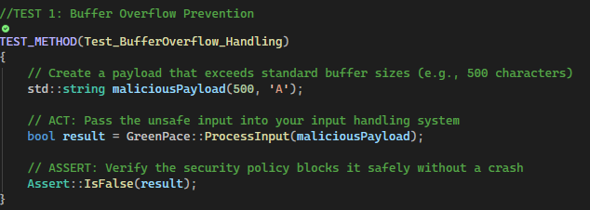
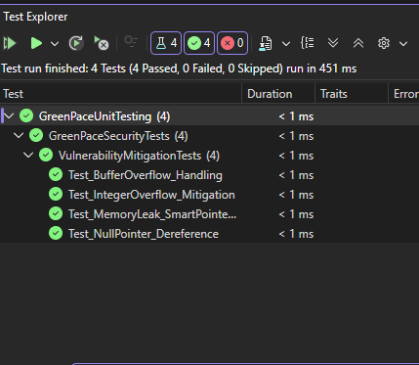
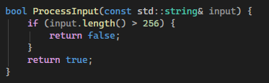
Unit Testing – Buffer Overflow
Test Function
Test Results

Slide 9
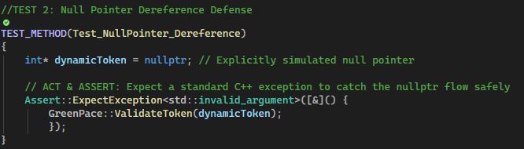

Unit Testing – Null Pointer References
Test Function
Test Result

Slide 10
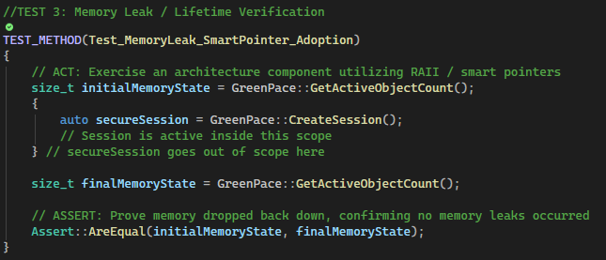
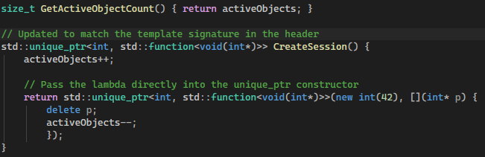
Unit Testing – Memory Leaks
Test Function
Test Result

Slide 11
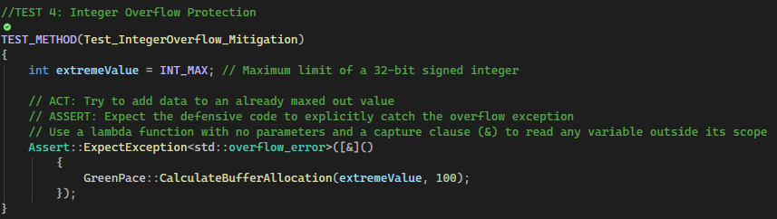
Unit Testing – Integer Overflow Protection
Test Function
Test Result

Slide 12

AUTOMATION SUMMARY

Slide 13
TOOLS
CppCheck
Static analysis tool for C/C++
Finds bugs/security flaws/severe programming errors
Does not validate syntax
Clang
Compiler for C/C++
Can be integrated into existing IDEs (Visual Studio, VS Code, etc.)
Exceptionally precise error/warning messages
ClangTidy
Automated reviewer
Automated refactoring to modern C++ syntax

Slide 14
RISKS AND BENEFITS
If we wait:
Increased development cost
Incorporating the policy will cause refactoring time.
Vulnerabilities may be missed, and assets could be under attack.
Friction between developers/teams “finger-pointing”
If we act now:
Development time can be spent focusing on vulnerabilities
Assets would be more secure
Ensures a secure development culture.

Slide 15
RECOMMENDATIONS
Gaps and improvements will always exist for security policies
Incorporating early ensures quicker turn-around
Example:
In 2017, Equifax suffered a breach
148 million consumers impacted
A security patch did exist for a known vulnerability
Security checking was not automated/integrated
Patch was not checked if deployed
CEO, CIO, CISO all forced out
$1.4 billion in total damages (legal fees, fines, stocks)
Further gaps could include:
Flawed business logic
Third-Party dependency
Human error

Slide 16
CONCLUSIONS
Incorporate early
Improve constantly
The standards identified here are internal
Recommend use of external standards:
OWASP – Open Worldwide Application Security Project
Improves software security
Open-source projects
Tools
Educational Resources
NIST – National Institute of Standards and Technology
Develops foundational guidelines
Operates the NVD – National Vulnerability Database
150,000 known vulnerabilities

Slide 17
REFERENCES
Hoffman, B. (2018, February 7). Static checks with CMake/CDash (iwyu, clang-tidy, lwyu, cpplint and cppcheck). Kitware.Com. https://www.kitware.com/static-checks-with-cmake-cdash-iwyu-clang-tidy-lwyu-cpplint-and-cppcheck/
‌The Clang Team. (2021). Clang Compiler User’s Manual — Clang 23.0.0git documentation. Llvm.Org. https://clang.llvm.org/docs/UsersManual.html
Ludo Fourrage. (2023, December 20). What are the consequences of non-compliance with cybersecurity regulations? Nucamp; Nucamp Bootcamp. https://www.nucamp.co/blog/coding-bootcamp-cybersecurity-what-are-the-consequences-of-noncompliance-with-cybersecurity-regulations
Aram Hovsepyan. (2023, September 26). A comparison of NIST CSF 2.0 and OWASP SAMM. Codific. https://codific.com/a-comparison-of-nist-csf-and-owasp-samm/

