Slide 1
Economic Regionalization in US Counties
A data science project by Ben Peck

Slide 2
The Problem
Different interpretations of how to best break the United States into regions are omnipresent in media
These regionalizations inform our understanding and decision-making
To what extent are regions cultural constructs? To what extent do they statistically exist?
If regions are created based on demographic and economic information, will familiar regions appear?

Slide 3
The Data
Four csv files on education, population, poverty, and unemployment downloaded from the USDA Economic Research Service
Collected or created by various federal agencies
One additional shape file for current US county boundaries from the Census Bureau
FIPS coded county-level data

Slide 4
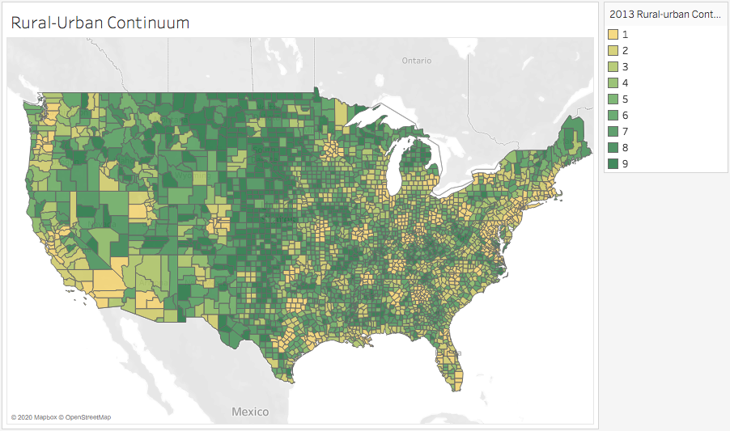

Slide 5
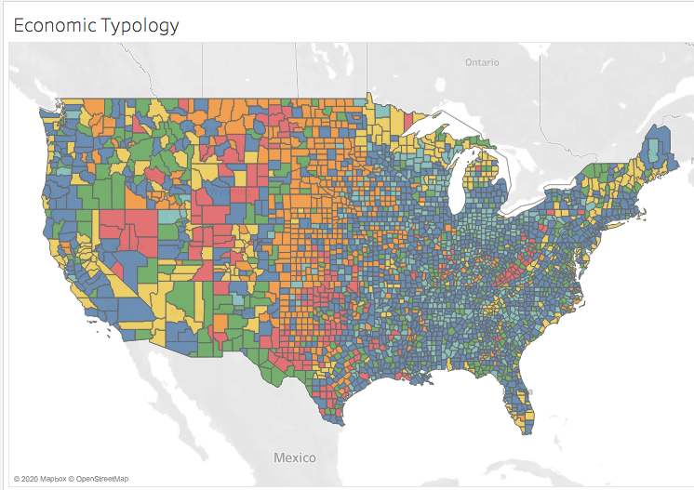

Slide 6
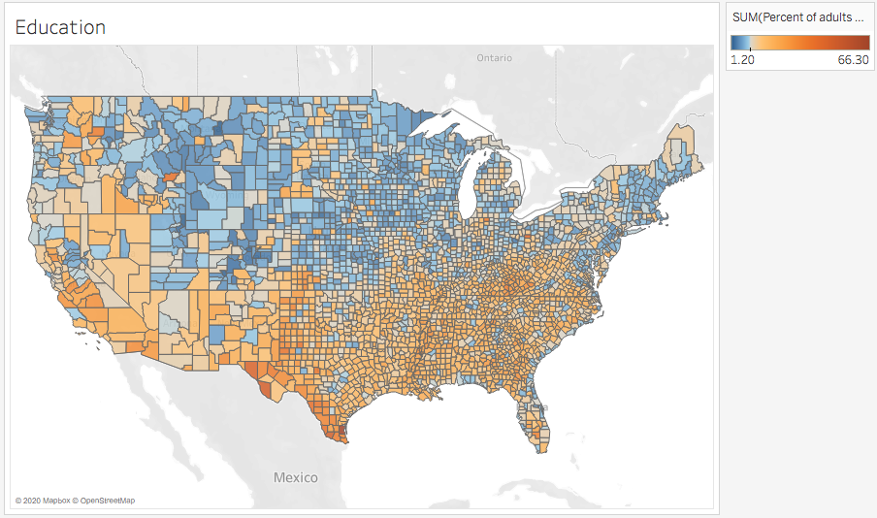

Slide 7
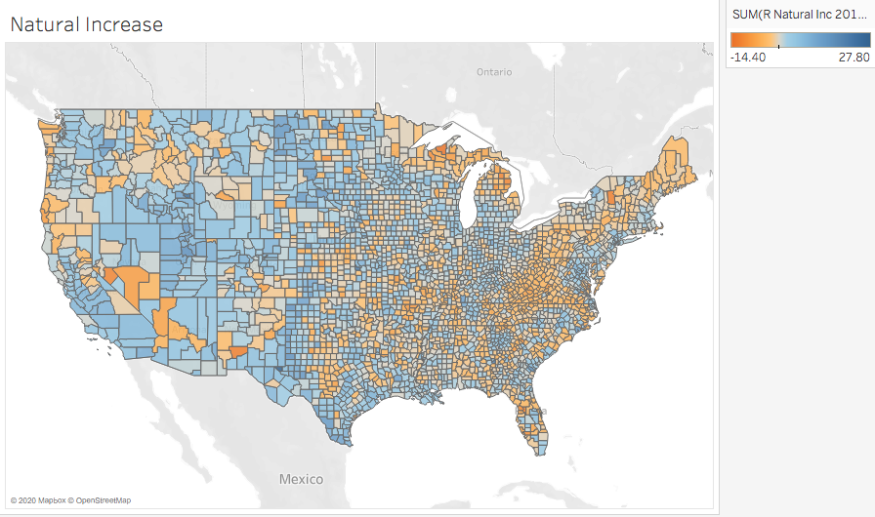

Slide 8
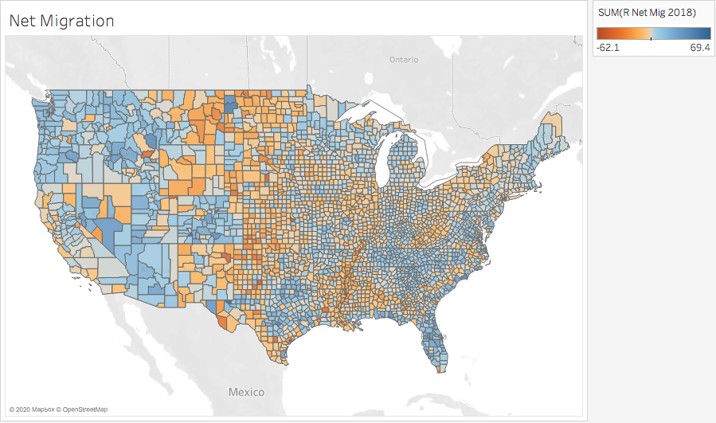

Slide 9
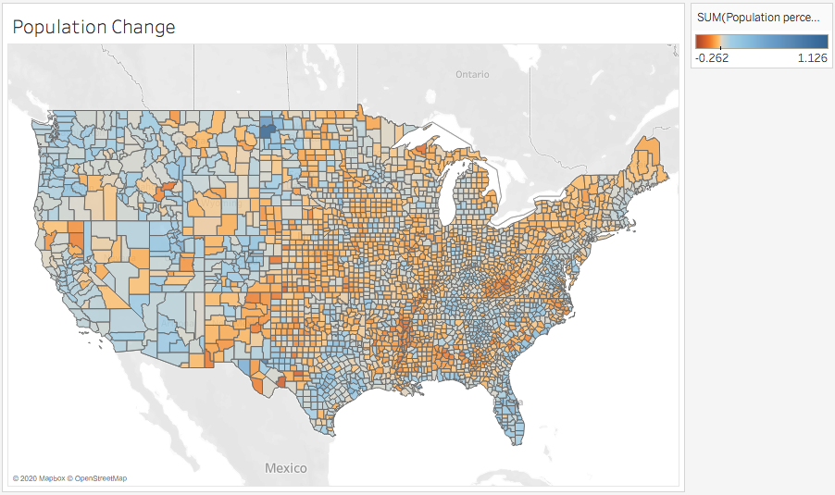

Slide 10
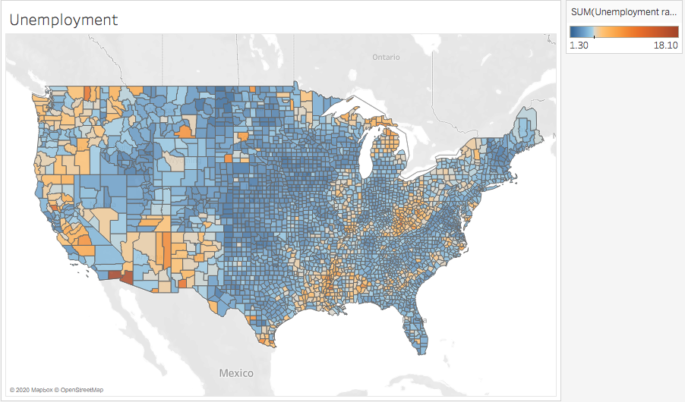

Slide 11
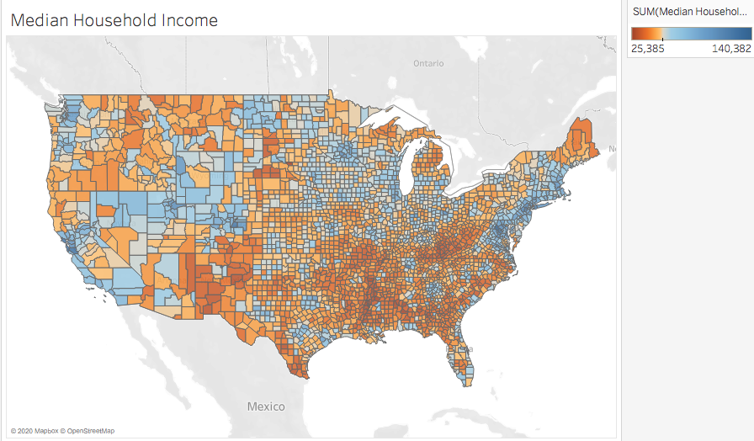

Slide 12
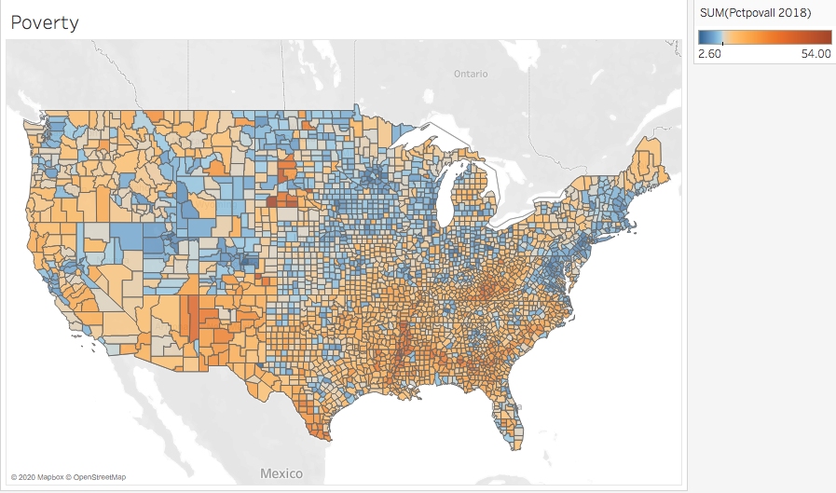

Slide 13
Linear Regression
'Percent of adults with less than a high school diploma, 2014-18': 1.5839374668620751
'R_NATURAL_INC_2018': 0.16244524029457486
'R_NET_MIG_2018': -0.7290382461177963
'Unemployment_rate_2018': 1.1595285774728532
'Median_Household_Income_2018': -3.6743668193870866
'Unemployment_change': -0.06622022003512973
'Population_percent_change': 0.4477115013134225
’2013 Rural-urban Continuum Code_2': -0.4039967144354428
'2013 Rural-urban Continuum Code_3': -0.38012258273844746
'2013 Rural-urban Continuum Code_4': -0.3655100953787107
'2013 Rural-urban Continuum Code_5': -0.1967603872936275
'2013 Rural-urban Continuum Code_6': -0.44203151067376567
'2013 Rural-urban Continuum Code_7': -0.49779714921553553
'2013 Rural-urban Continuum Code_8': -0.2663021416647211
'2013 Rural-urban Continuum Code_9': -0.48388822970361073
'Economic_typology_2015_1': -0.2878817225703228
'Economic_typology_2015_2': -0.09052342371380312
'Economic_typology_2015_3': -0.4196932822209574
'Economic_typology_2015_4': 0.6452139589125342
'Economic_typology_2015_5': -0.1868874165118567

Slide 14
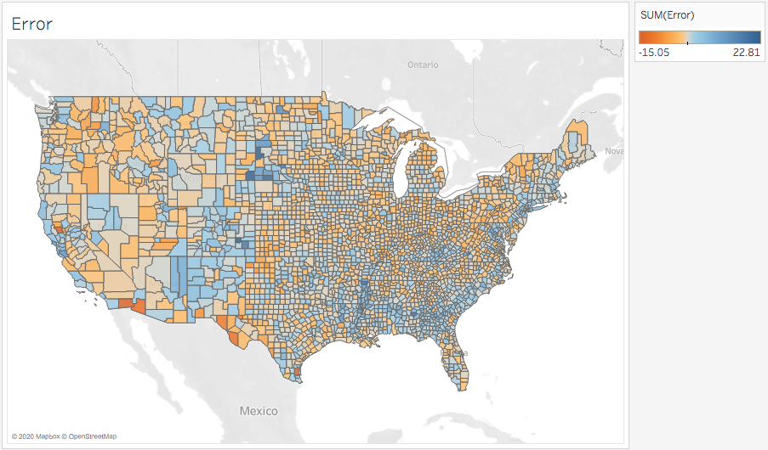

Slide 15
