Slide 1




Virtual Workshop: BALTO Jupyter Notebook
https://sites.google.com/vt.edu/balto/home
Welcome!
Today’s trainers:
Scott Peckham, he/him/his (Scott.Peckham@colorado.edu), University of Colorado, Boulder
Hongda Wang, he/him/his (Hongda.Wang@colorado.edu), University of Colorado, Boulder

Slide 2
The Anaconda Python Distribution
Main page: https://www.anaconda.com
Download: https://www.anaconda.com/products/individual
The Anaconda Python distribution for individuals is open-source, free, and very widely used.
Anaconda supports: MacOS, Linux and Windows.
Other Python distributions exist, and your computer (especially Linux or Mac) may come with a basic Python distribution.
Anaconda is a solid choice and really does make it easier to use Python on your computer, especially when you are working with many packages that could potentially conflict with one another.

Slide 3
Anaconda’s Package Manager: conda
The Anaconda Python distribution includes a package manager called conda that helps you do things with Python packages, such as: (1) download and install them, (2) update them & (3) uninstall them.
Install a package from Anaconda: conda install packname
Install a package from conda-forge: conda install -c conda-forge packname
Update a package: conda update packname
List the installed packages: conda list
Uninstall a package: conda remove packname
Pip is another widely-used package manager that is included with Anaconda. Lesser-known packages are often installed with pip.

Slide 4
What are conda channels?
A conda channel is a large collection of Python packages online.
Some Python packages are only available through a particular channel.
Conda allows you to install packages from different channels.
Anaconda’s own channel: https://docs.anaconda.com/anaconda/packages/pkg-docs/
Conda-forge:
https://conda-forge.org/feedstock-outputs/

Slide 5
Advantages of conda Environments
Create clean, isolated Python environments in which you can install all of the package dependencies for a project without affecting your other Python projects.
Really helps with reproducibility, sharing and trouble-shooting.
Create a named environment: conda create --name envname
Activate a named environment: conda activate envname
Deactivate environments: conda deactivate
List packages in current environment: conda list
More commands for managing conda environments: https://docs.conda.io/projects/conda/en/latest/user-guide/tasks/manage-environments.html

Slide 6
The Jupyter Project
Main page: https://jupyter.org/
Docs: https://jupyter.org/documentation
A non-profit, open-source project, started in 2014 with iPython.
Started with iPython, extended to many other interpreted languages.
Now supports over 40 programming languages, including: Python, R, Scalar, Julia, Ruby, Java, Matlab, Octave, Processing, Scheme, etc.
Kernels: https://github.com/jupyter/jupyter/wiki/Jupyter-kernels

Slide 7
Jupyter Notebooks
Jupyter Notebook is both an app and a type of interactive document.
Documents consist of cells that can contain: headings, text, any HTML, images, movies and most importantly -- executable code blocks.
While you can create Python programs in any text editor to be saved and executed, Jupyter notebooks are more accessible. They can serve as interactive textbooks due to the executable (and editable) code blocks.
They provide an easy onramp for people to play with and understand your code or your project. They promote hands-on learning and experimentation.
Jupyter notebooks are convenient because they run in a browser.
The idea of a notebook interface is not new. It was introduced 35 years (1986) ago in MathCad and used for Wolfram’s Mathematica in 1988. https://en.wikipedia.org/wiki/Notebook_interface

Slide 8
Jupyter Notebook Kernels
If you install the nb_conda package, it triggers installation of the packages nb_conda_kernels and notebook. This makes your Jupyter notebook app aware of your conda environments and available in the app as "kernels".
If you run the jupyter notebook or jupyter lab command in an environment that has nb_conda_kernels installed, you will have the ability to associate one of your available conda environments with any new notebook you create.
Different environments give rise to different kernels in Jupyter, and the kernel name includes the environment name, e.g. Python [conda env:balto]. The kernel name is displayed in the upper right corner. Notebooks typically open with the "environment kernel" they were created with. However, there is a Change Kernel option in the Kernel menu in the Jupyter app menu bar. (After changing the kernel, you may need to choose Restart from the Kernel menu.
Anaconda provides a helpful page on the Jupyter Notebook Extensions. That page also explains how you can enable or disable these extensions individually.

Slide 9
Jupyter Notebook Viewer
Purpose: This online tool is provided by the Jupyter project and lets you paste in the URL to your Jupyter notebook (often on GitHub) and then renders it quickly and while supporting internal and external links, etc.
Main page: https://nbviewer.jupyter.org/
GitHub also allows you to view Jupyter notebooks, but they are often slow to render and don’t work as well (e.g. links may not work).

Slide 10
Jupyter Lab
This is a next-generation app from the Jupyter project that provides a more flexible environment for working with Jupyter notebooks than the Jupyter Notebook app.
You can work with several notebooks at once via tabs. Each notebook can have its own associated environment (e.g. a conda environment or a particular version of Python or other language needed for that notebook).
Cells can be collapsed and/or expanded.
You can create views that consist of several separate panels, to see more of what you are working on in one view.
Install, then launch it at a command prompt with: % jupyter lab

Slide 11
JupyterHub
Purpose: Installed on a server to provide authenticated Jupyter notebook support to multiple users, including a customized set of pre-installed Python packages needed by their notebooks.
Main page: https://jupyter.org/hub
Docs: https://jupyterhub.readthedocs.io/en/stable/
CSDMS (Community Surface Dynamics Modeling System), an NSF-funded project, provides a JupyterHub. https://csdms.colorado.edu/wiki/JupyterHub
HydroShare, another NSF-funded project does as well. https://help.hydroshare.org/apps/CUAHSI-JupyterHub/

Slide 12
Jupyter Binder Project (for Jupyter Notebooks)
Purpose: The Binder project offers an easy place to share computing environments to everyone. If you share a Jupyter notebook with Binder (e.g. with a badge in a GitHub repo), a server in the cloud is spun up and all the Python packages needed by your notebook are installed on that remote server, making the notebook fully functional (not just viewable) in a person’s browser without them installing anything.
Main page: https://mybinder.org/
The person sharing the notebook via Binder creates a file called: environment.yml that describes the notebook’s dependencies.
While the concept is great, it often takes a long time to set up the remote server and then performance may not be very good.

Slide 13
Python Package: numpy
Purpose: Provides a very large collection of functions for mathematical operations & efficient, scientific computing in Python.
Numpy functions are compiled C code, so they’re very fast.
If you vectorize your Python/Numpy code (which partly means avoiding all spatial loops), performance is similar to C code.
Main page: https://numpy.org/
Docs: https://numpy.org/doc/

Slide 14
Python Package: ipywidgets
Purpose: Provides interactive HTML widgets (e.g. droplists, text boxes, buttons, sliders, etc.) in Jupyter notebooks and the Ipython kernel. (Also known as jupyter-widgets.)
Docs: https://ipywidgets.readthedocs.io/en/latest/

Slide 15
Python Package: ipyleaflet
Purpose: Provides interactive maps in Jupyter notebooks.
Docs: https://ipyleaflet.readthedocs.io/en/latest/

Slide 16
Python Package: matplotlib
Purpose: Provides visualization capabilities including publication-quality graphics and interactive figures to Python programs.
Docs: https://matplotlib.org/stable
Gallery: https://matplotlib.org/stable/gallery

Slide 17
Python Package: cartopy
Purpose: Provides geospatial data processing in order to produce maps and other geospatial data analyses.
Makes use of the powerful PROJ.4, NumPy and Shapely libraries and includes a programmatic interface built on top of Matplotlib for the creation of publication quality maps.
Docs: https://scitools.org.uk/cartopy/docs/latest/

Slide 18
Python Package: scipy
Purpose: Provides a Python-based ecosystem of open-source software for mathematics, science, and engineering.
Main page: https://www.scipy.org/
Docs: https://docs.scipy.org/doc/scipy/reference/

Slide 19
Python Package: pydap
Purpose: Provides a Python API to interact with data on an OpenDAP server (query, download, subset, etc.)
Docs: https://www.pydap.org/en/latest/
OpenDAP (Data Access Protocol): https://www.opendap.org/
OpenDAP Docs: https://www.opendap.org/support/user-documentation

Slide 20
What is OpenDAP (Data Access Protocol)?
Purpose: Provides a powerful, standard protocol for downloading array-based or tabular data from servers that provides brokering between various file formats, as well as subsetting capabilities and more.
Main page: https://www.opendap.org/
Docs: https://docs.scipy.org/doc/scipy/reference/
OpenDAP evolved from DODS (Distributed Oceanographic Data System), developed by BALTO Co-I James Gallagher and colleagues in 1993 at the University of Rhode Island with NASA funding.
Used worldwide “behind the scenes” for many data download platforms (e.g. by NASA, NOAA, DOE, USGS, CSIRO, UN FAO, etc.)
Featured prominently in OSTP (2016, Chapter 3, Data-Access Services), a report by the Executive Office of the President of the U.S., Office of Science and Technology Policy.
OPeNDAP compliance is advertised by a significant number of data-analysis applications, data-abstraction libraries, and even in some high-performance geoscience and semantic databases.
A non-profit corporation called OPeNDAP (Open-source Project for Network Data Access Protocol) was formed to maintain, evolve and promote DAP.

Slide 21
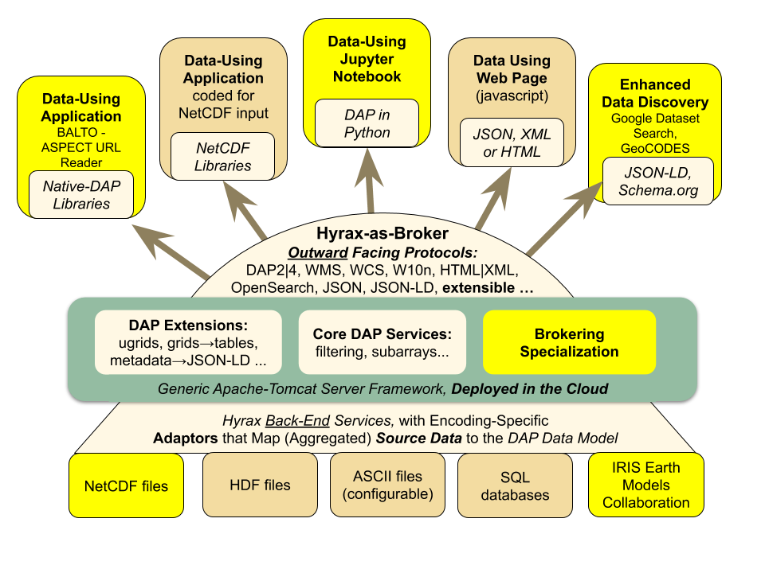
What is OpenDAP ?

Slide 22
Who Uses OpenDAP ?
NASA (EOSDIS, Earth Observing System Data and Information System; Goddard; JPL)
NOAA Operational Model Archive and Distribution System (NOMADS)
NOAA Unified Access Framework (UAF, https://geo-ide.noaa.gov/)
IPCC uses DAP to access and work with climate model output
US DOE (especially using PyDAP)
USGS & NASA - LPDAAC (Land Processes Distributed Active Archive Center)
USGS ScienceBase (https://www.sciencebase.gov/catalog/)
Australia: CSIRO (Commonwealth Science and Industrial Research Organization),
Australia: IMOS (Integrated Marine Observing System)
Australia: NCI (National Computational Infrastructure)/NERDIP (National Environmental Research Data Interoperability Platform)
Australia: TERN (Terrestrial Ecosystem Research Network),
CGIAR (Consortium of International Agricultural Research Centers)
Deltares - OpenEarth (website has tutorials for accessing OPeNDAP servers using ArcGIS, ncBrowse, Matlab, Python and R.)
HYCOM consortium, sponsored by the National Ocean Partnership Program (NOPP)
NSF OOI (Ocean Observatories Initiative)
United Nations FAO (Food and Agriculture Organization)

Slide 23
The BALTO Jupyter Notebook GUI
Purpose: Provides a graphical user interface (GUI) and interactive maps within a Jupyter notebook that allows users to interact with data sets available on servers that support the OpenDAP protocol. Users can (1) browse data set variables and attributes, (2) subset a data set by geographic region or time period, (3) download the subsetted data to the notebook’s Python session, (4) perform custom analysis and (5) visualize the data.
GitHub Repo: https://github.com/peckhams/balto_gui
This repo contains: (1) the Jupyter notebook with GUI, (2) the Python source code that powers the GUI (balto_gui.py), and (3) Python source code for a set of visualization tools (balto_plot.py).
The GUI uses: ipywidgets, ipyleaflet, pydap, matplotlib & cartopy.

Slide 24
Customizing the BALTO Jupyter Notebook GUI
The source code in the Python module (balto_gui.py) consists of around 3000 lines of code that illustrate how to create a wizard-style, tabbed GUI that includes an interactive map.
While this version is written to access data from servers that support the OpenDAP protocol, it would be relatively straight-forward to modify it to download data sets that use other file formats or data access protocols (DAPs).

Slide 25
Live Demo of the BALTO GUI

Slide 26
An Overview of the Python Source Code

Slide 27
Thank You!
For more information, please feel free to email me at:
Scott.Peckham@colorado.edu

Slide 28
Installing the Software on Your Computer (optional)

Slide 29
Install the Anaconda Python Distribution
(1) Go to this page on the Anaconda website:
https://www.anaconda.com/products/individual
(2) Click on the Download button, then chose the appropriate graphical installer for your operating system (Windows, MacOS or Linux).
(3) Open a Terminal window. (On Mac go to: /Applications/Utilities)
(4) At a Terminal prompt type: which python
You may then see: /usr/bin/python
This means you have another Python installation.
(5) If so, type: cd, then source .bash_profile
This will run a script and your prompt should now include (base).
Type this command again: which python

Slide 30
Install the BALTO GUI on Your Computer (1)
% conda update -n base -c defaults conda
% conda create --name balto
% conda activate balto
% conda list
% conda install -c conda-forge nb_conda
% conda install -c conda-forge ipywidgets
% conda install -c conda-forge ipyleaflet
% conda install -c conda-forge pydap
% conda install -c conda-forge matplotlib
% conda install -c conda-forge scipy
% conda install -c conda-forge cartopy
% conda install -c conda-forge jupyterlab
% jupyter labextension install jupyter-leaflet
% jupyter labextension install @jupyter-widgets/jupyterlab-manager

Slide 31
Install the BALTO GUI on Your Computer (2)
(1) Go to the GitHub repository for the BALTO GUI:
https://github.com/peckhams/balto_gui
(2) Click on the green button labeled “Code” and then “Download Zip”.
(3) Create a subdirectory in your home directory with a name like: balto_gui, then unzip this file and copy the contents into balto_gui.
(4) Open a terminal window and type: cd ~/balto_gui
(5) At the terminal prompt, type: conda activate balto
(6) At the terminal prompt, type: jupyter lab

Slide 32
Install the BALTO GUI on Your Computer (3)
(7) Use the left-side file browser to locate and click on the file called: BALTO_GUI_v2.ipynb
(8) Congratulations! You should now be able to run the notebook. To run a code cell, select the cell then press: Shift + Return

Slide 33
BALTO Jupyter Notebook Exit Survey
https://forms.gle/8qFXWSfpJ6fey7KW7

