Slide 1
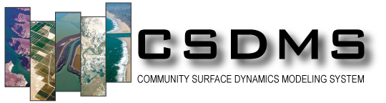



Introduction to BMI: Basic Model Interface
Dr. Scott D. Peckham
Former Chief Software Architect for CSDMS
January 14, 2021

Slide 2
Linking Component-based Models:
How Can Two Models Differ?
Programming language
(C, C++, Fortran, Java, Python, etc.)
Solution: Babel (multi-language bindings)
Computational grid
(triangles, rectangles, Voronoi, etc.)
Solution: ESMF regridder (parallel, spatial interpolation)
Timestepping scheme
(fixed, adaptive, local)
Solution: Temporal interpolation tool
Variable names
Need some means of “semantic mediation”
Solution: CSDMS Standard Names (& Scientific Variables Ontology)
Variable units
Solution: UDUNITS (Unidata)

Slide 3
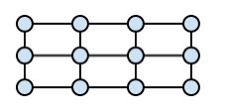

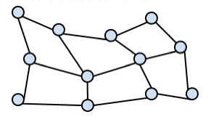
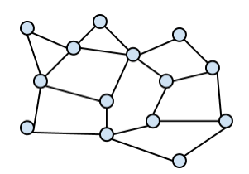
Different Types of Model Grids
Uniform
Rectilinear
Structured
Unstructured

Slide 4
Some Key Concepts and Terms
Model: State variables for some system of interest are discretized in space (on a computational grid) and new values are computed from previous values by marching forward in time according to a set of rules (e.g. laws of physics).
Model Component: A model that has been specially prepared for plug-and-play reusability. (i.e. wrapped with a standard interface & compiled for language interoperability).
Interface: A standardized set of functions, which a caller uses to interact with a resource such as a model, database or service. Heterogeneous resources wrapped with a standard interface then operate in a “familiar” way.
Modeling Framework: A software container in which pre-compiled model components are instantiated, configured and dynamically linked to rapidly create a customized model. (With a “birds-eye view” of all components.)

Slide 5
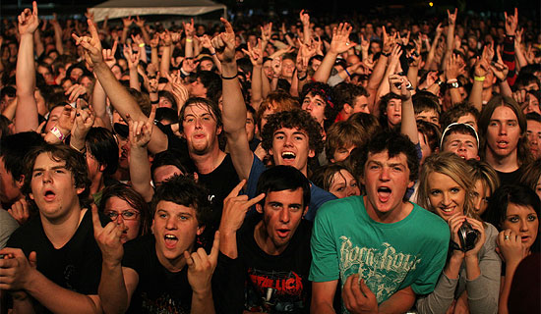
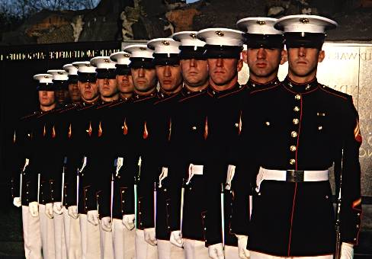
Taming Heterogeneity with Standardized Interfaces
Before:
Each resource is unique.
Own ways of doing things.
Respond to different commands.
Can become unstable.
Difficult to control.
After:
Uniform outward appearance.
Respond to same commands (halt, about face, march, etc.)
Interchangeable units.
Have a chain of command.
Work as a team.

Slide 6
The Basic Model Interface (BMI) Standard
BMI requires a developer to make some relatively simple, noninvasive, and framework-independent changes to his/her model source code, mostly by adding some new functions. Functions can be grouped into:
Model Control Functions (initialize, update, finalize)
Model Information Functions (e.g. time-stepping scheme)
Variable Information Functions (e.g. dimensions, data type, units)
Variable Getters and Setters
Grid Information Functions
These functions make the model self-describing (so the framework can “see” and reconcile model differences) and fully controllable.
CSDMS can automatically wrap BMI-enabled models to provide them with a CMI interface which allows them to be used in the CSDMS framework and to gain other new capabilities, including NetCDF output.

Slide 7
BMI in Framework, Adapter & Mediator Pattern
Model Coupling Framework
CSDMS,
EMELI,
ESMF,
OMS,
etc.
Mediators
Spatial regridding
Temporal interpolation
Unit conversion
Semantic mediation
Subsetting
Mediators
Hollywood Principle
“Don’t call us, we’ll call you.”
One-way communication.
Separation of Concerns
Models are only concerned with themselves. No direct communication with other components.
Pointers whenever possible.
CMI
CMI
CMI is an (optional) framework-dependent component interface
BMI is a framework-agnostic model interface
BMI
BMI
Model 1
Model 2

Slide 8
BMI Advantages: For Model Developers
Requires minimal effort.
Is noninvasive (adds no dependencies on CSDMS data structures or code. No interference with model developer’s design.
Allows model to still be used as before in a stand-alone mode.
Requires no new code intended to accommodate the needs of other models (unlike OpenMI 1.4).
Is framework agnostic and requires no modeling-framework specific knowledge (e.g. the CCA concept of ports); developers do not “code to” the framework.
Only requires developer to do things that would be necessary for the model to be used in any modeling framework.
Provides added value, e.g. ability to couple to other models and to write output variables to standardized NetCDF files.

Slide 9
BMI Advantages: For framework administrators
One “CMI wrapper” (code) can be used for any BMI-enabled model, instead of a unique wrapper code for each model.
Makes it possible to largely automate the conversion of contributed process models to CSDMS components.
Dramatically reduces code maintenance time.
Addresses the “frozen code” problem. i.e. minimal additional effort to bring a new version of the same model (e.g. with enhancements or bug fixes) into the framework.
Minimal impact on performance of the model.
Makes it possible for the CSDMS framework to automatically accommodate differences between models by calling mediators when needed.
The SE no longer needs to learn all about each model.

Slide 10
BMI Adoption: Added Value for Modelers
Easily couple and obtain input variables from other BMI-enabled models.
Easily couple and obtain input variables from various BMI-enabled data sets. This can include resampling to the model’s bounding box and spatial resolution, regridding to the model’s grid, conversion to the model’s units, etc.
Framework could provide support for different model stopping conditions. Examples include (1) for a specified time period, (2) for a specified number of time steps, (3) until a variable reaches steady-state, (4) until NaNs or other numerical issues are encountered in some field, etc.
Framework could write any model’s output to different file formats (e.g. netCDF) along with standardized metadata.

Slide 11
Quick Overview of BMI-Related Web Pages
Basic Model Interface (Landing Page)
http://csdms.colorado.edu/wiki/BMI_Description
Basic Model Interface (Technical Documentation)
https://bmi.readthedocs.io/en/latest/
BMI Forum on GitHub
https://github.com/bmi-forum
CSDMS Standard Names
http://csdms.colorado.edu/wiki/CSDMS_Standard_Names

Slide 12
Thank You!
If you’d like to discuss model metadata, model interfaces, model coupling, the Scientific Variable Ontology or MINT, please email me at:
Scott.Peckham@colorado.edu
For questions about how SVO is encoded with RDF, please email:
Maria.Stoica@colorado.edu

Slide 13
For More Information
Peckham, S.D., A. Kelbert, M. Hill and E. Hutton (2016) Towards uncertainty quantification and parameter estimation for Earth system models in a component-based modeling framework, special issue: Uncertainty and Sensitivity in Surface Dynamics Modeling, Computers & Geosciences, 90, 152-161, http://dx.doi.org/10.1016/j.cageo.2016.03.005.
Jiang, P., M. Elag, P. Kumar, S.D. Peckham, L. Marini, R. Liu (2017) A service-oriented architecture for coupling web service models using the Basic Model Interface (BMI), Environmental Modelling & Software, 92, 107-118, http://dx.doi.org/10.1016/j.envsoft.2017.01.021.
Peckham, S.D. (2009) Geomorphometry and spatial hydrologic modeling, In: Hengl, T. and Reuter, H.I. (Eds), Geomorphometry: Concepts, Software and Applications, Chapter 25, Developments in Soil Science, vol. 33, Elsevier, 579-602, http://dx.doi.org/10.1016/S0166-2481(08)00025-1. (TopoFlow)
Peckham, S.D., E.W.H. Hutton and B. Norris (2013) A component-based approach to integrated modeling in the geosciences: The Design of CSDMS, Computers & Geosciences, special issue: Modeling for Environmental Change, 53, 3-12, http://dx.doi.org/10.1016/j.cageo.2012.04.002.
Peckham, S.D. (2014) The CSDMS Standard Names: Cross-domain naming conventions for describing process models, data sets and their associated variables, Proceedings of the 7th Intl. Congress on Env. Modelling and Software, International Environmental Modelling and Software Society (iEMSs), San Diego, CA. (Eds. D.P. Ames, N.W.T. Quinn, A.E. Rizzoli), Paper 12. http://scholarsarchive.byu.edu/iemssconference/2014/Stream-A/12/

Slide 14
For More Information
Peckham, S.D., E.W.H. Hutton and B. Norris (2013) A component-based approach to integrated modeling in the geosciences: The Design of CSDMS, Computers & Geosciences, special issue: Modeling for Environmental Change, 53, 3-12 . http://dx.doi.org/10.1016/j.cageo.2012.04.002.
Peckham, S.D. (2014) The CSDMS Standard Names: Cross-domain naming conventions for describing process models, data sets and their associated variables, Proceedings of the 7th Intl. Congress on Env. Modelling and Software, International Environmental Modelling and Software Society (iEMSs), San Diego, CA. (Eds. D.P. Ames, N.W.T. Quinn, A.E. Rizzoli). http://www.iemss.org/sites/iemss2014/proceedings.php

Slide 15
For More Information
Peckham, S.D. and J.L. Goodall (2013) Driving plug-and-play models with data from web-services: A demonstration of interoperability between CSDMS and CUAHSI-HIS, Computers & Geosciences, special issue: Modeling for Environmental Change, 53, 154-161, http://dx.doi.org/10.1016/j.cageo.2012.04.019
Laniak, G.F., G. Olchin, J. Goodall, A. Voinov, M. Hill, P. Glynn, G. Whelan, G. Geller, N. Quinn, M. Blind, S. Peckham, S. Reaney, N. Gaber, R. Kennedy and A. Hughes (2013) Integrated environmental modeling: A vision and roadmap for the future, 39, 3-23, Environmental Modeling & Software, http://dx.doi.org/10.1016/j.envsoft.2012.09.006

Slide 16
For More Information
Peckham, S.D. (2014) EMELI 1.0: An experimental smart modeling framework for automatic coupling of self-describing models, Proceedings of HIC 2014, 11th International Conf. on Hydroinformatics, New York, NY. http://academicworks.cuny.edu/cc_conf_hic/464/
Peckham, S.D., A. Kelbert, M.C. Hill and E.W.H. Hutton (2016) Towards uncertainty quantification and parameter estimation for Earth system models in a component-based modeling framework, Computers & Geosciences, special issue: Uncertainty and Sensitivity in Surface Dynamics Modeling, 90(B), 152-161 . http://dx.doi.org/10.1016/j.cageo.2016.03.005

Slide 18


Functional Similarity of Data Sets and Models
Variable 1
Computational
Model
Variable 4
Variable 2
Variable 5
Variable 6
Variable 3
A data set is like a model that has no inputs.
It is actually the values of variables that are passed,
which may be spatially distributed scalar, vector or tensor fields on some grid.
Data Set
Variable 7
Variable 2
Variable 3

Slide 19

Example: A Simple Water Tank Model
Input Variables
rainrate
rain duration
top area
outlet area
initial water depth
rainrate(t)
top area
Output Variables
water depth
water volume
outflow speed
depth
volume
outflow
speed

Slide 20
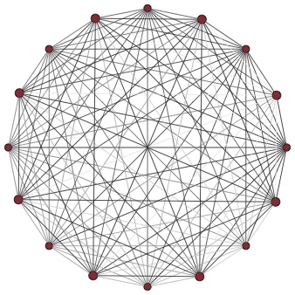
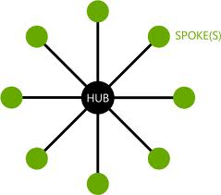
Reconciling Differences with Standards
vs.
Introduce a new, generic or standard representation (the “hub”), then map resources to and from it. The amount of work, maintenance, etc. drops to:
Cost(N) = N.
If we reconcile differences between the resources in a pairwise manner, the amount of work, etc. grows fast:
Cost(N) = N (N-1) / 2 ~ N².

