Slide 1
Hello

Slide 2
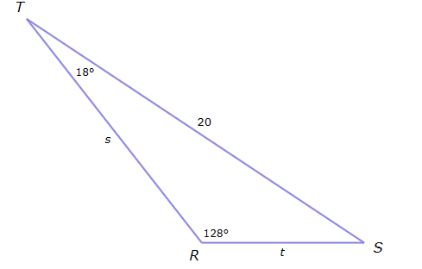
Look at this triangle
What is angle S?

Slide 3
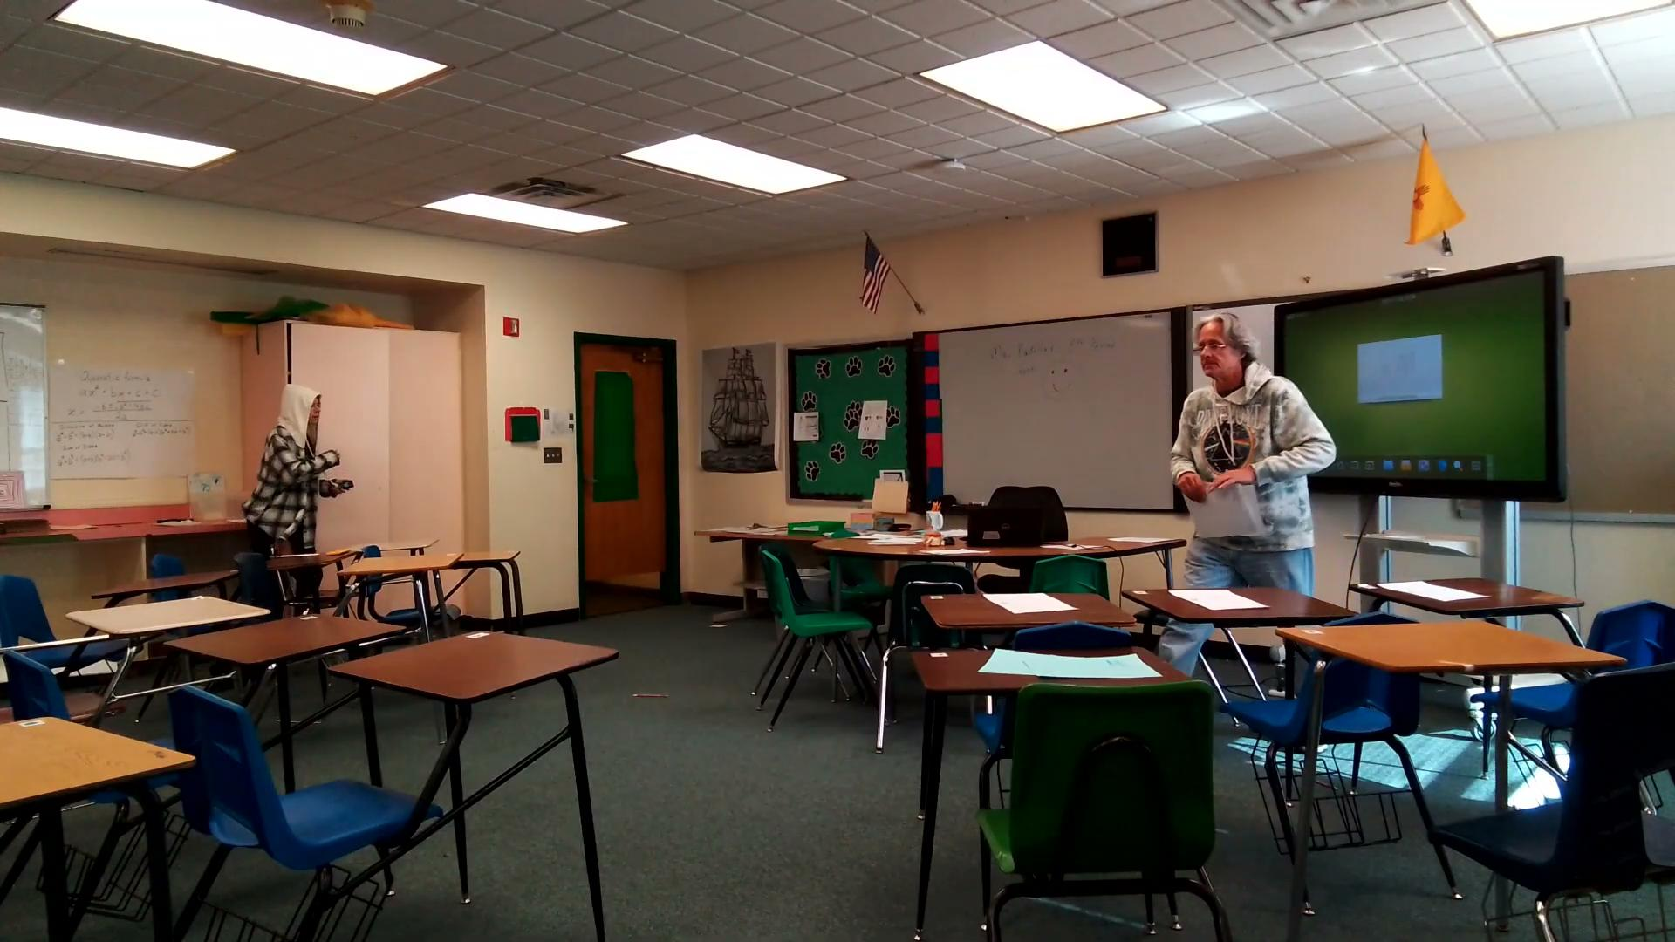

Slide 4


