Slide 1





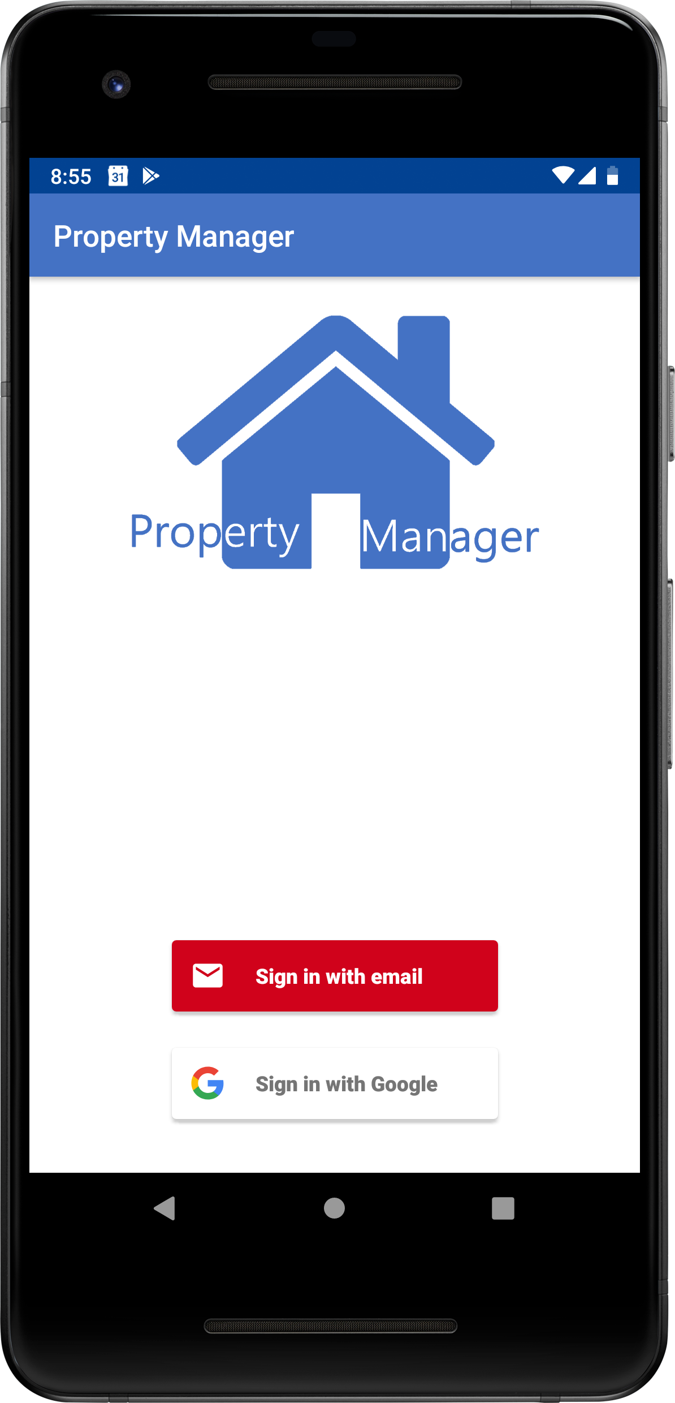
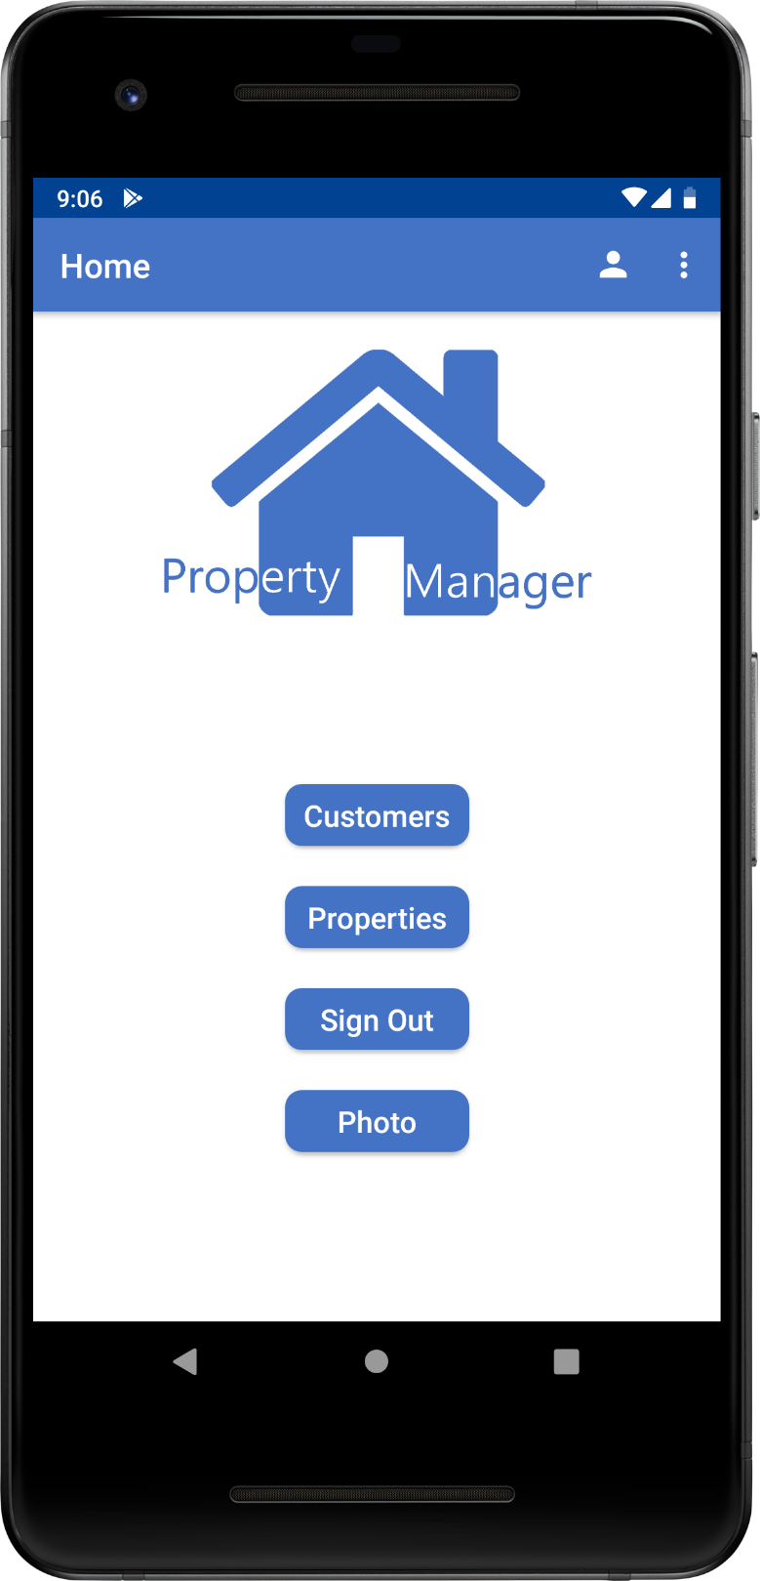
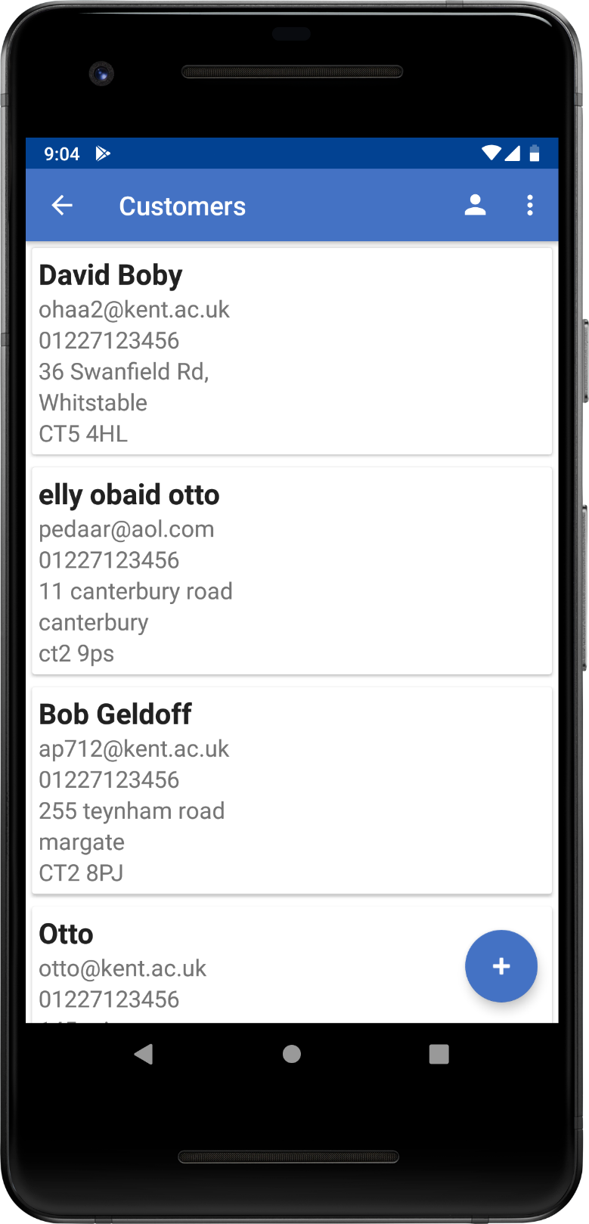


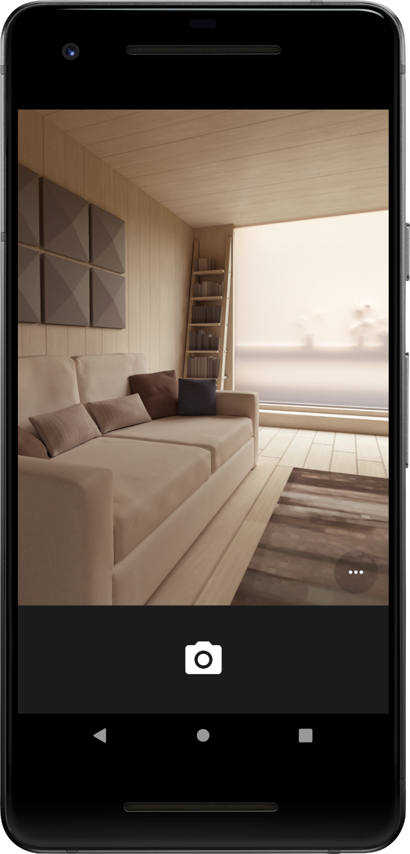
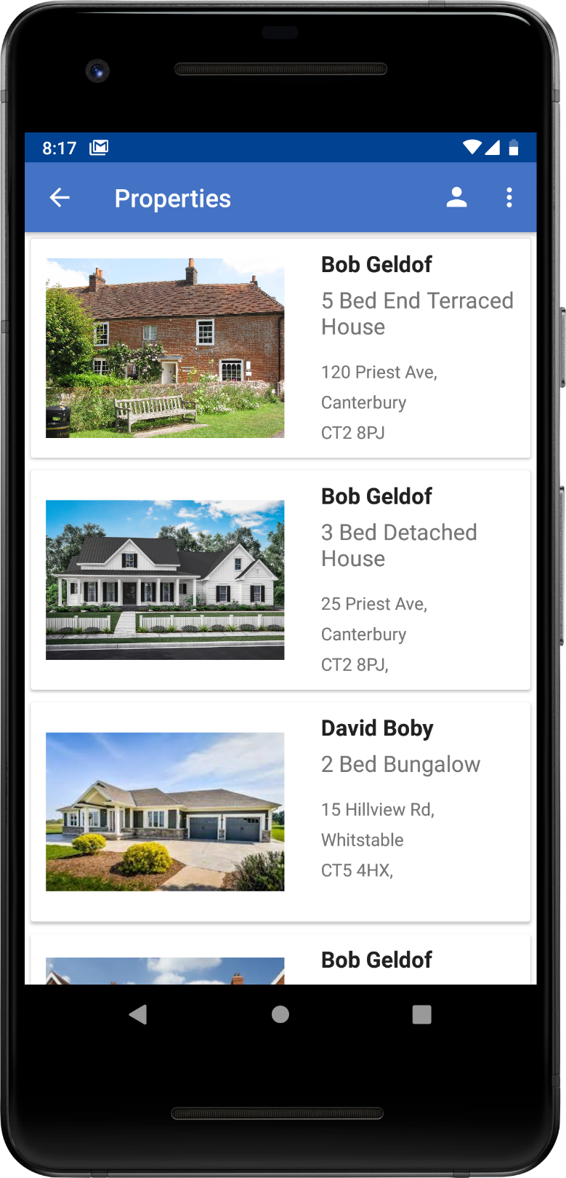
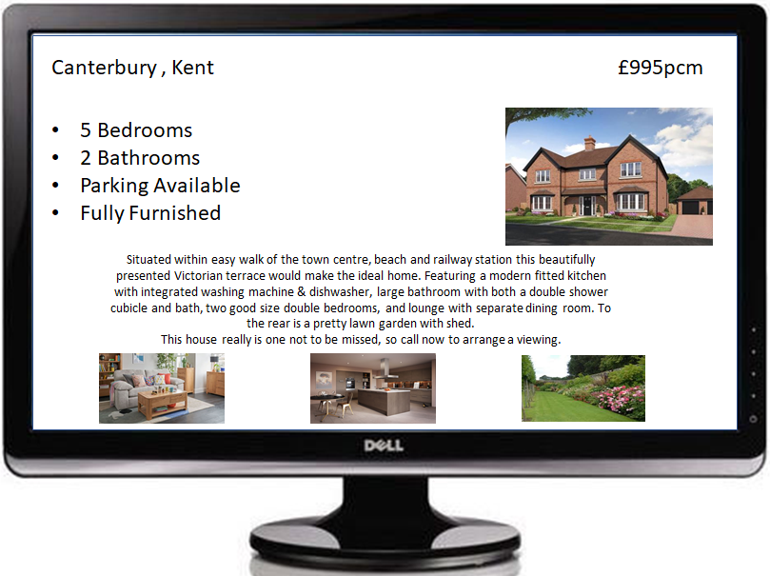



A tool for Estate Agents to accelerate and simplify the property advertising process
AUTHENTICATION
HOME SCREEN
CUSTOMER DETAILS
Sign in to the application using Firebase Authentication
Customer details can be created, viewed and edited
TAKE PHOTOS
PROPERTY DETAILS
ADVERT
Take photos of the property within the application to build the property advert
Property details can be created, viewed and edited
The details are then converted into a full advert
Aaron Pedwell
AP712
Obaid AlMansoori
OHAA2
Elly Winder
EW315
Otto Lijji
OL61

