Slide 1


Accelerated and Refined VOIP SPAM CALL Detection
Team: Calling COPS

Slide 2

Team Members
Satyadhar(E18CSE163)
Hemanth(E18CSE164)
Praveen(E18CSE146)
Saish(E18CSE157)
Ravi (E18CSE145)

Slide 3
Introduction
This project will focus on time reduction for the detection of spam on Voice Over Internet Protocol (VoIP) calls using machine learning.
We trained 3 modules i.e Logistic regression, Desicision Tree, Random Forest parallelly at a time unlike implementing parallely one after the other.
We implemented the parallel programming with libraries like Pymp, Joblib, Multiprocessing. We used KNN as the prediction algorithm.

Slide 4
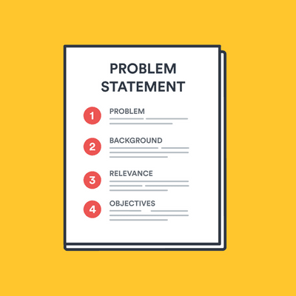
Problem Statement
To detect VOIP(Voice Over Internet Protocol) spam calls to make the user experience easier. We optimized KNN Algorithm by adding HPC components to it.
The problem is that spam calls will cause more inconvenience to user compared to other spams as it makes the phone ring rather than just notifications.

Slide 5

Aim:
Our main aim is to implement parallel computing libraries in our Machine Learning Algorithms.
Compare Parallel execution with the serial execution with the help of Visualization.
We primarily used libraries like Pymp, Joblib, Multiprocessing.

Slide 6
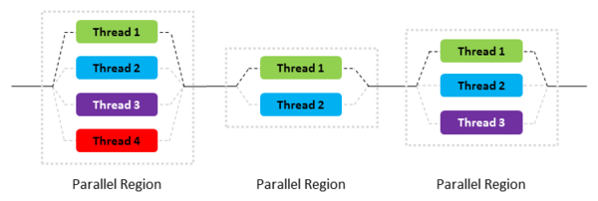

Solution
​Inefficient use of computing Resources is the main problem which we are currently facing.
To Overcome this problem we implemented parallel computing resources like Multiprocessing,Pymp and Joblib.
Convenience and scheduling mechanism is the main difference between Multiprocessing,Pymp and Joblib.

Slide 7

Methodology
Modules:
1)Pymp
2)Joblib
3)Multiprocessing
PyMP is a Python module which lets you create parallel loops where all or several iterations of the loop are run at once.​
Joblib is optimized to be fast and robust on large data and has specific optimizations for NumPy arrays.
Multiprocessing module(similar to threading module) includes a very simple and intuitive API for dividing work between multiple processes.

Slide 8

Procedure
Import the dataset
DATA PREPROCESSING
Feature engineering on the dataset(if required)
Pymp is applied both inside and outside the algorithm where as Joblib,Multiprocessing is applied only outside the algorithm, to give each testing instance to a separate processor while execution outside the algorithm to give each test datapoint to a separate processor.​
Taking a fraction of dataset, conducted trails with different number of processors with each parallel libraries.

Slide 9
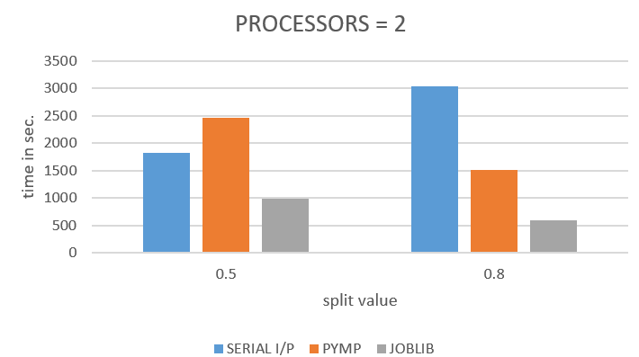
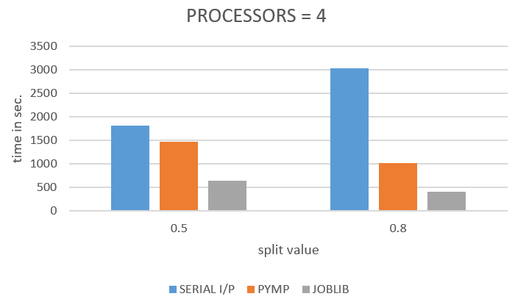
Visualization

Slide 10
Comparison study

Slide 11

Results
When compared with parallel execution ,serial execution takes more time.
Number of processors is inversely proportional to the time taken for execution. More the processors lesser is the time taken for execution.
Initially joblib per formed well but as the number of processors increased pymp outperformed joblib.

Slide 12

Conclusions
We conclude that, Parallel processing is preferred over serial processing.
10 men doing same work is better time efficient than 1 man doing the same work.

Slide 13

References
[1] Goode, B. (2002). Voice over internet protocol (VoIP). Proceedings of the IEEE, 90(9),1495-1517
[2] Dantu, Ram, and Prakash Kolan. "Detecting Spam in VoIP Networks." SRUTI 5 (2005): 5-5.

Slide 14


