Slide 1
Fisk App

Slide 2

Tech Stack
Material : https://v4.mui.com/
https://react-redux.js.org/

Slide 3
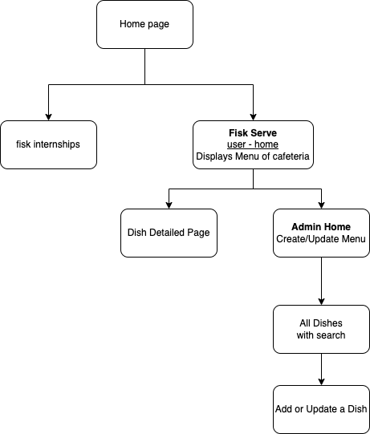
User Flow
SSO

