Slide 1

AIT 580-003
ANALYSIS OF BANK MARKETING STRATEGIES AND CUSTOMER BEHAVIOUR
Description of Dataset:
The Bank Marketing dataset is an extensive collection of customer information The dataset includes various features such as customer demographics, financial indicators, and previous marketing campaign outcomes. With over 40,000 instances, the dataset provides rich and diverse information to predict customer responses to marketing campaigns, aiding in the development of targeted and effective marketing strategies.

Slide 2
Description of Research Questions
AIT 580-003
Which sector of customers (job-wise or education-wise) would most probably show interest in the campaign?
Does the mode of contact (cellular, telephone) play a role in marketing campaign success?
Are day or month important aspects for marketing campaign success?

Slide 3
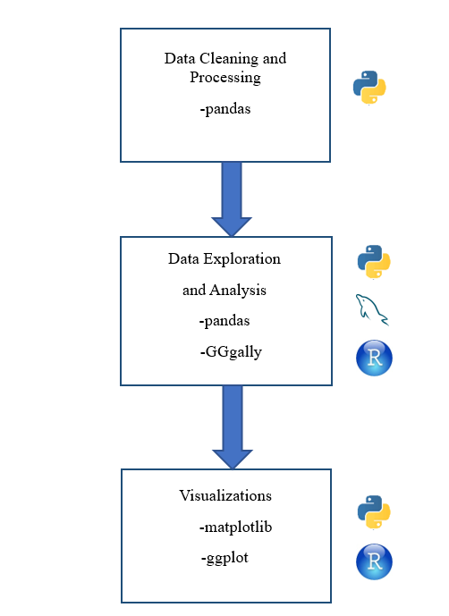
AIT 580-003
Summary of Methods

Slide 4
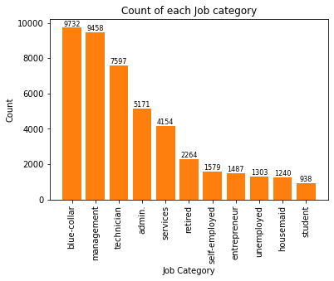
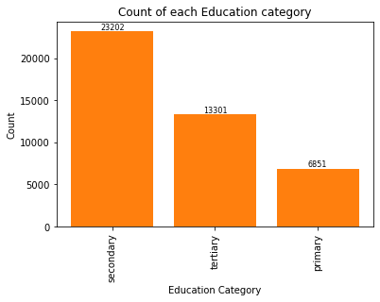
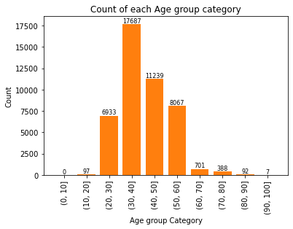
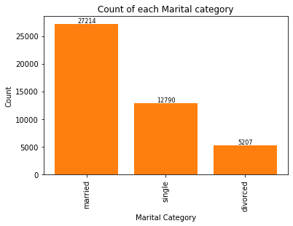
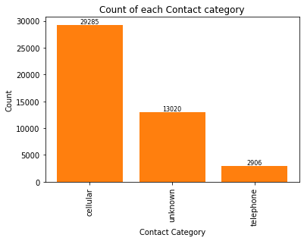
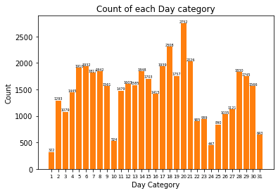
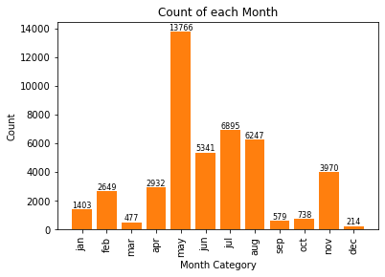
Summary of Findings
AIT 580-003

Slide 5
Discussion of Lessons Learned
AIT 580-003
Exploratory Data Analysis
Multiple Linear Regression
Data Preprocessing
Data Cleaning
Data Transformation
Data Reduction

