Slide 1
Explore Zomato restaurants dataset in the city of Bengaluru

Slide 2
Introduction
Bengaluru is the Silicon city of India. It is a part of the city of Karnataka 4 districts. The city itself has a population of 84.3 lakhs.
The center of Indias high-tech industry, the city is also known for its parks and nightlife.
With its diverse culture , comes diverse food items. There are many restaurants in New Delhi City, each belonging to different categories like Chinese , Italian , French etc.
So as part of this project , we will list and visualize all major parts of Bengaluru .

Slide 3
Objectives
Questions that can be asked using the above mentioned datasets
What is best location in Bengaluru City for Chinese Cuisine ?
Which areas have large number of North Indian Restaurent Market ?
Which all areas have less number of restaurant ?
Which is the best place to stay if I prefer Chinese Cuisine ?
What places are have best restaurant in Bengaluru?

Slide 4
Data
For this project we need the following data :
New Delhi Restaurants data that contains list Locality, Restaurant name,Rating along with their latitude and longitude.
Data source : Zomato kaggel dataset
Description : This data set contains the required information. And we will use this data set to explore various locality of Bengaluru.
Nearby places in each locality of new delhi city.
Data source : Fousquare API
Description : By using this api we will get all the venues in each neighborhood.

Slide 5
Approach
Collect the Bengaluru city data from Zomato kaggel dataset
Using FourSquare API we will find all venues for each neighborhood.
Filter out all venues that are nearby by locality.
Using aggregative rating for each resturant to find the best places.
Visualize the Ranking of neighborhoods using folium library(python)

Slide 6
Results

Slide 7
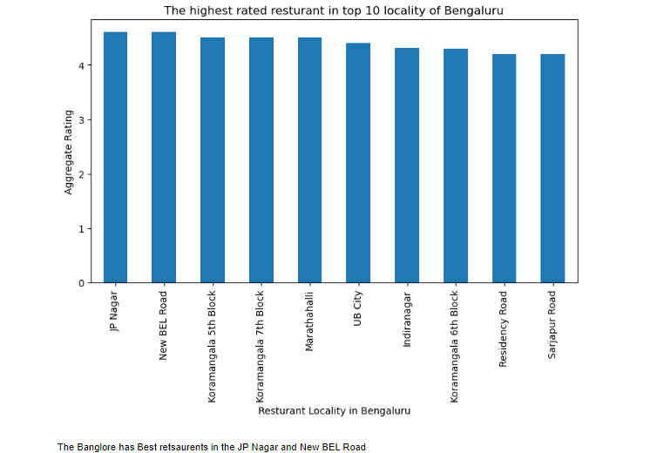

Slide 8
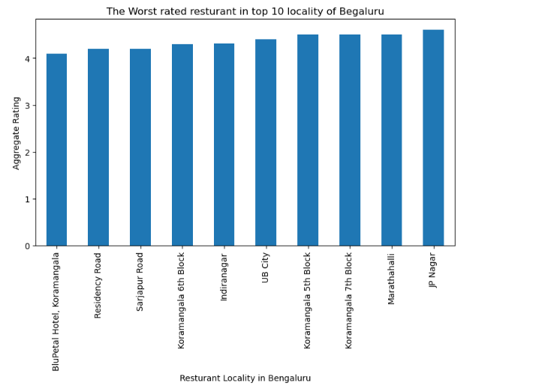

Slide 10
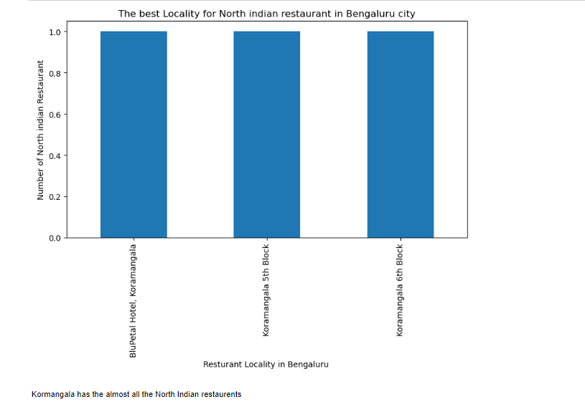

Slide 11
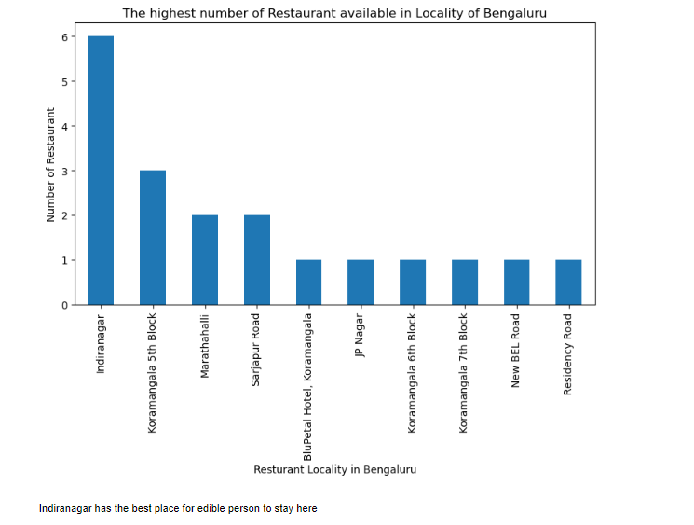

Slide 12
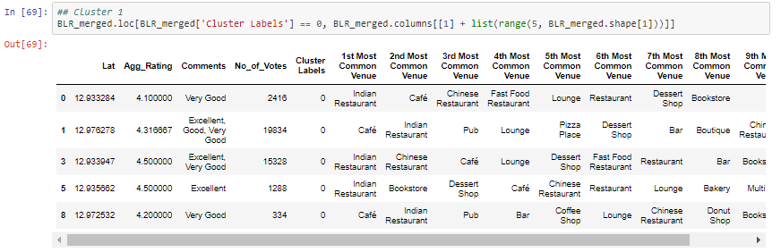
Cluster 1:
The Indian restaurants are most recommended venues nearby the locations.

Slide 13
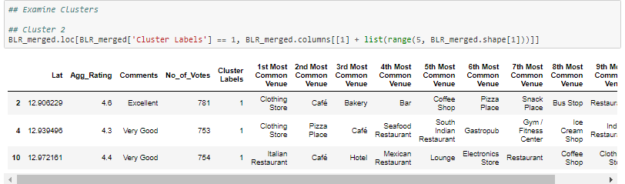
Cluster 2:
It is recommended for the and bakeries:

Slide 14
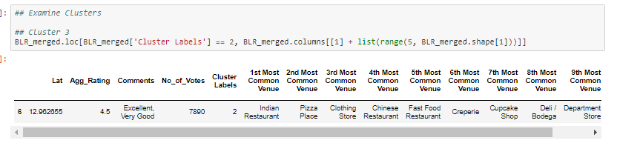
Cluster 3:
It seems like pizza place,

Slide 15
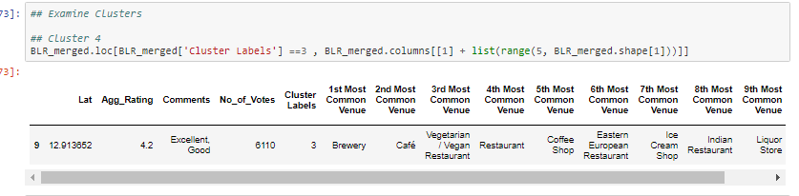
Cluster 4:
It’s most recommended for cafes

Slide 16
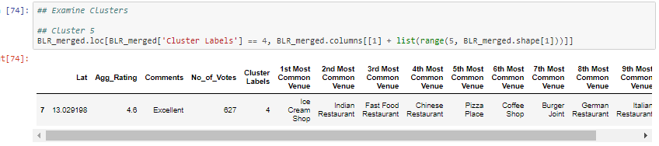
Cluster 5:
Fast food, cafes are the most recommended venues

Slide 17
Conclusion
) The Banglore has Best retsaurents in the JP Nagar and New BEL Road. 2) The Bengaluru has the worst restaurents in Koramangla,Residency Road. 3) Indiranagar has the best place for edible person to stay here. 4) Kormangala has the almost all the North Indian restaurents.

