Slide 1




Capstone project
Clinic Appointment & Prescription Management System
A Java Capstone Project — Streamlining Healthcare Operations Through Digital Innovation
2620030312 :-Peddinti Sri Parniths Sai
2620030311 :- Neerukonda Chrishma Chowdari
Section 2

Slide 2

1. Introduction and Abstraction
This Java-based digital solution is designed to streamline clinic operations by bringing patient registration, appointment scheduling, and prescription management together in one efficient platform.
The Clinic Appointment Module replaces manual appointment books with organized digital scheduling, helping clinics manage patient visits more effectively and reduce confusion in daily operations.
The Prescription Manager Module supports digital prescription creation, secure storage, and easier patient access, making the prescription process faster and more reliable.
By combining these capabilities into a unified platform, the system eliminates paperwork and enables smoother communication between patients and healthcare providers.

Slide 3
2. Project Objectives
Appointment System
Prescription System
Enable patients to self-book by selecting health problems and available doctors; give doctors instant access to patient information
Replace handwritten prescriptions with accurate digital records
Administrative Relief
Complete Patient Journey
Reduce staff workload through automation, improving clinic efficiency and patient satisfaction
Manage every step — from registration through consultation to prescription — in one integrated system

Slide 4
Clinic Appointment System
Patient Registration
1
Enter personal & health information, select health problems, create unique profile
2
Time Slot Booking
View available slots based on doctor schedules and confirm appointment
Doctor Selection
3
System displays doctors specialized in the patient's selected medical field
4
Instant Confirmation
Receive digital appointment card with date, time, doctor name, and clinic details
Doctor Dashboard
5
Doctors access patient details, medical history, and scheduled appointments instantly

Slide 5

Prescription Manager System
How It Works
1
Digital Prescription Creation
Doctor enters diagnosis, selects medications, and specifies dosage instructions
2
Timestamp & Secure Storage
Prescriptions stored digitally with automatic timestamp, linked to the patient profile
3
Accuracy & Safety
Eliminates errors from illegible handwriting and ensures medication safety
4
Patient Access & History
Patients access prescriptions on personal devices anytime; complete searchable history maintained

Slide 6
3. Advantages
For Patients
For Doctors
Easy self-service appointment booking
Instant digital confirmation
Quick access to prescriptions anytime
Reduced wait times
Organized patient data at fingertips
Efficient consultations
Digital prescriptions reduce handwriting errors
Better record-keeping
For the Clinic
System-Wide
No double-booking with automated scheduling
Reduced administrative workload
Better resource management
Improved patient satisfaction
Reduced medication errors
Faster service delivery
Better data security
Improved healthcare quality

Slide 7
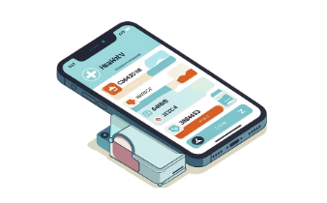
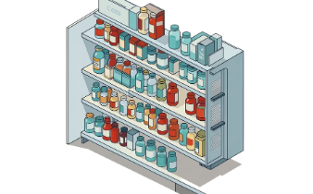
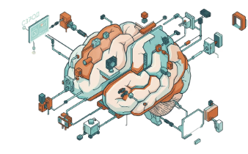

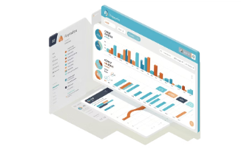
5. Future Scope & Enhancements
Mobile Integration
Pharmacy Integration
Intelligent Scheduling
Telemedicine
iOS/Android app for on-the-go appointment management and prescription access
Automated prescription fulfillment and medication tracking via connected pharmacy systems
AI-based appointment optimization and doctor availability prediction
Enable remote consultations and video appointments for greater accessibility
Analytics Dashboard
Clinic performance metrics, patient statistics, and comprehensive reporting tools

Slide 8

CO's covered
co1 | Understanding computational thinking, algorithms, flowcharts, and the fundamentals of Java programming and data types.
co2 | Applying java control-flow statements such as conditional statements, switch, and loops to solve problems.
co3 | Developing modular Java programs using methods, recursion, 1D and 2D arrays, and basic array-processing techniques.
co4 | .Object-oriented programming, classes, objects, inheritance, encapsulation and exception handling.
co5 | .String manipulation, searching, sorting and file handling.
co6 | . Collections, generics, lambda expressions and stream processing.

Slide 9

Topics covered
Module Concepts used in the clinic app
Module 1 Variables, data types, operators, Scanner, input/output
Module 2 if-else, switch, while loops
Module 3 Methods, parameters, return values, arrays
Module 4 Classes & Objects, constructors, encapsulation
Module 5 Inheritance, method overriding, polymorphism
Module 6 Exception handling, storing data

Slide 10
Project Development
The Clinic Appointment and Prescription Manager was developed using Java in Visual Studio Code (VS Code). The project uses the Scanner class to take input from the user and arrays to store patient, appointment, doctor, and prescription details. The system was developed using a modular and menu-driven approach, where different tasks such as booking appointments, searching patients, selecting doctors, creating prescriptions, and managing records are handled through separate methods. The project uses a console-based interface, allowing users to interact with the system through simple menu options and text input. The development was carried out step by step, starting with patient registration and appointment management, followed by doctor selection and prescription management.

Slide 11
Technology used
Programming Language: Java — The project was developed using Java.
Input Handling: Scanner — The Scanner class is used to take patient and appointment details from the user.
Development Environment: Visual Studio Code (VS Code) — VS Code was used to write, edit, and run the Java program.
Data Storage: Arrays — Arrays are used to temporarily store patient, appointment, doctor, and prescription information.
Methodology: Modular and Menu-driven Programming — The project is divided into separate methods and uses menus to let the user choose different operations.
Interface: Console-based User Interface — The user interacts with the program through text displayed in the VS Code terminal.

Slide 12

thank you

