Slide 1

DataGPT
Theme: Building Intelligent LLM Agents for Database Interaction & Visualization
TEAM NAME : QUANTUM QUERIES
Presented by:
PEDDINTI UDAYASREE
DASI SAI CHARAN TEJA
EMANI LAKSHMI MEGHANA
II YEAR CSE-AIML(INTEL)
iTech AI Innovation Hackathon 2026

Slide 2
PROBLEM STATEMENT
Problem Statement
Traditional database systems require users to know SQL to retrieve information . Many users cannot write SQL queries or understand database schemas.
Our Solution
DataGPT enables users to:
Ask questions in natural language
Automatically generate SQL queries
Retrieve database information
Visualize results using charts
Explain data using

Slide 3
SYSTEM ARCHITECTURE
ER Diagram
User
Diagram Tool
Chat Interface
History
Bar/Line/Pie Chart
FastAPI Backend
Gemini AI
Chart Tool
SQL Agent
SQLite Database

Slide 4
TECHNOLOGY STACK
Frontend – HTML , CSS , JavaScript
Backend – FastAPI
Database – SQLite
ORM – SQLAlchemy
LLM – Google Gemini
Charts – Matplotlib
Language – Python
Version Control – Git & GitHub

Slide 5

KEY FEATURES
✅ Natural Language to SQL
✅ SQL Query Display
✅ AI Explanation
✅ Data Insights
✅ Query History
✅ Database Schema Viewer
✅ Bar Chart
✅ Line Chart
✅ Pie Chart
✅ ER Diagram

Slide 6
WORKFLOW
User Question
Generate SQL
Execute Query
Gemini AI
Return Response
Generate Insights
Generate Charts
Retrieve Data

Slide 7
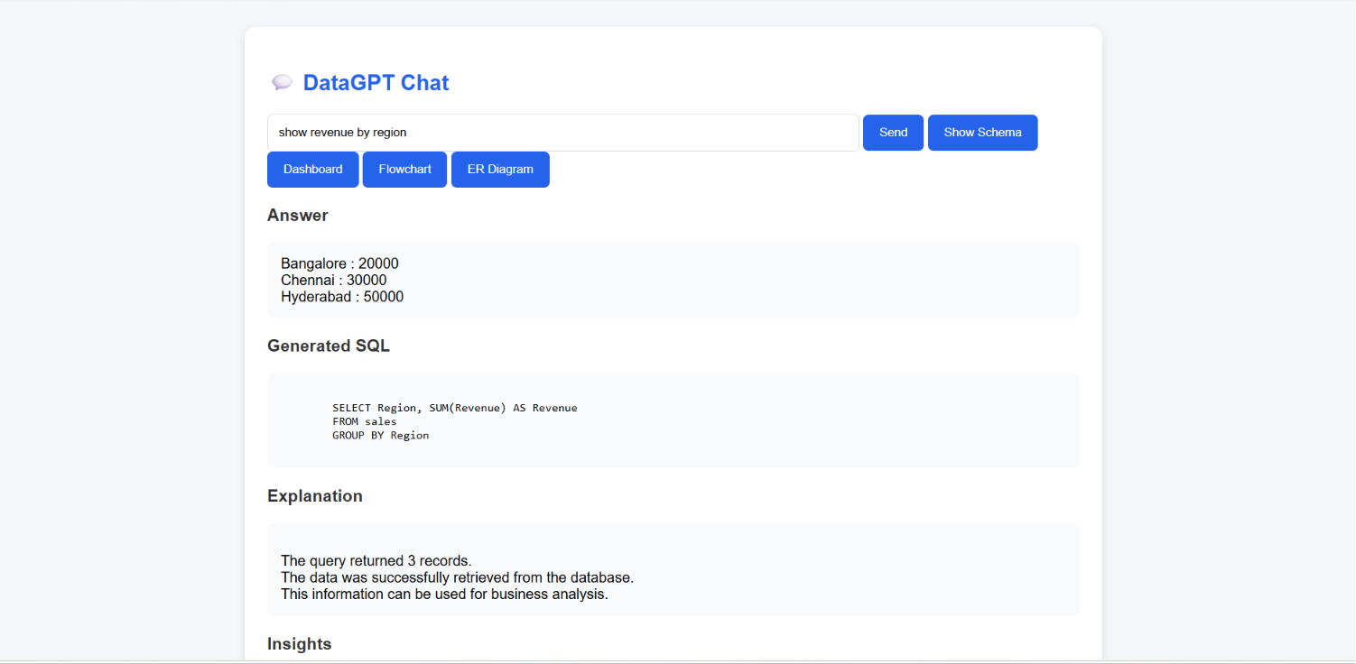
DEMO – CHART INTERFACE

Slide 8
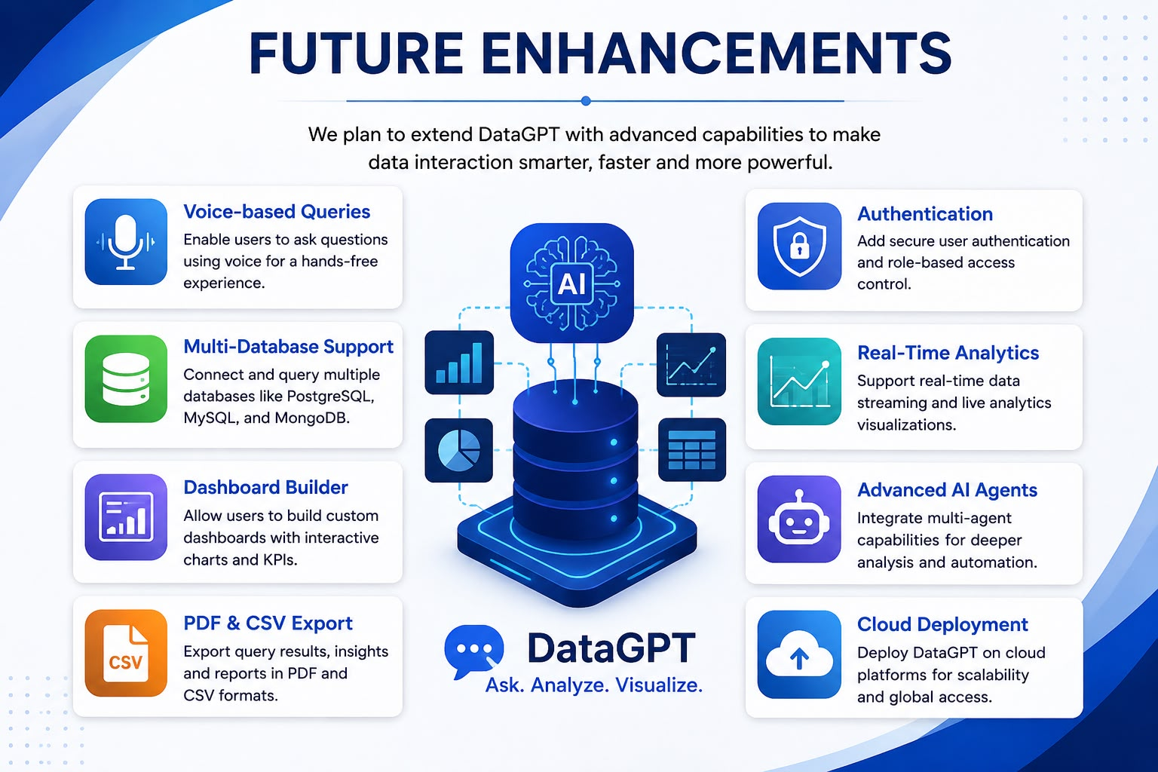

Slide 9
THANK YOU

