Slide 1
AI Assisted Coding -2
Name : Sharath Peddi
H.No : 2403A52008
Batch : 02
Subject : AI Assisted Coding
1)Use Gemini in Colab to write a function that filters out all negative numbers froma given list.

Slide 2
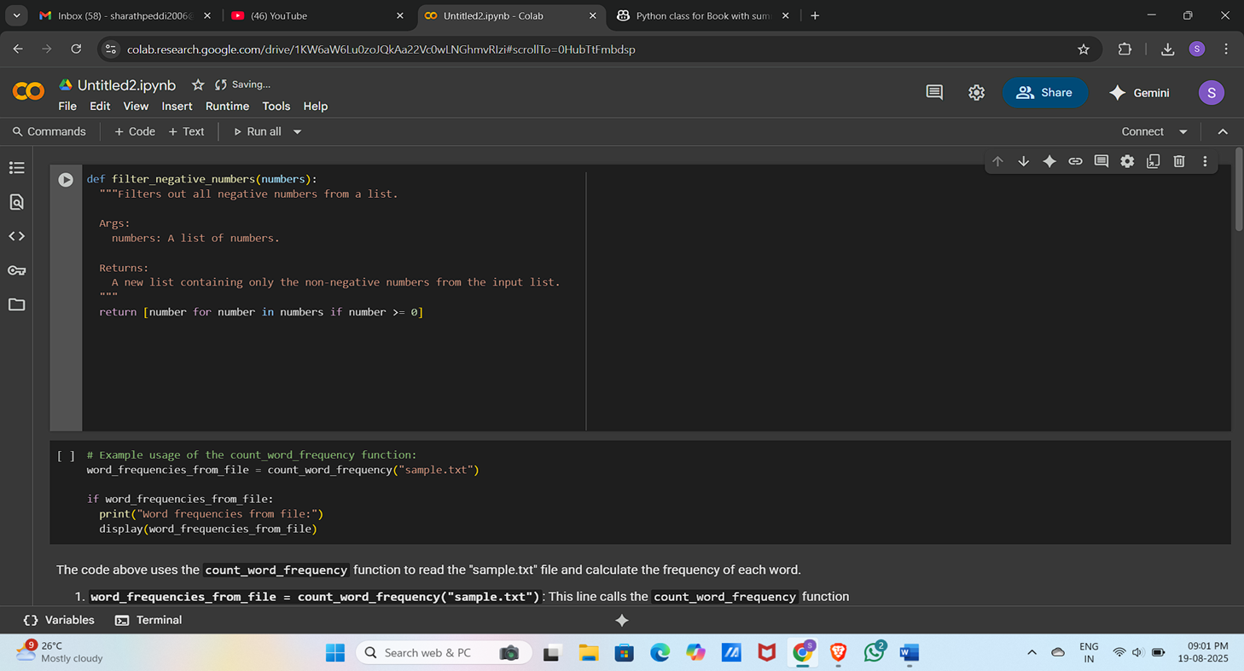

Slide 3
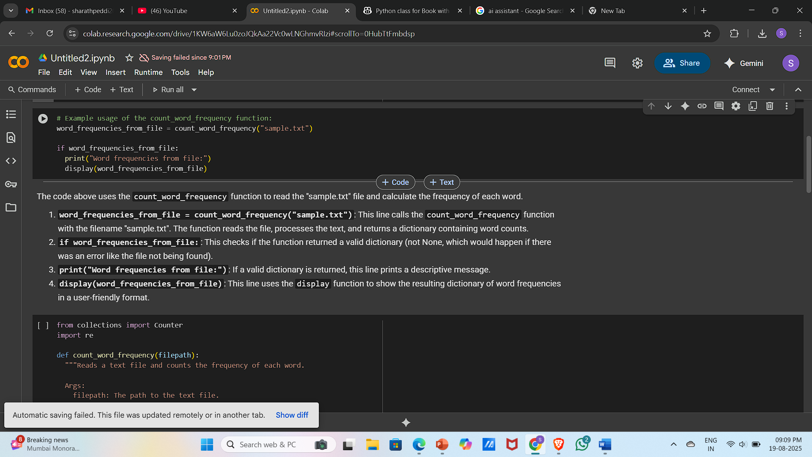
2)Ask Gemini to generate code that reads a text file and counts the frequency of each word. Then ask it to explain the code

Slide 4
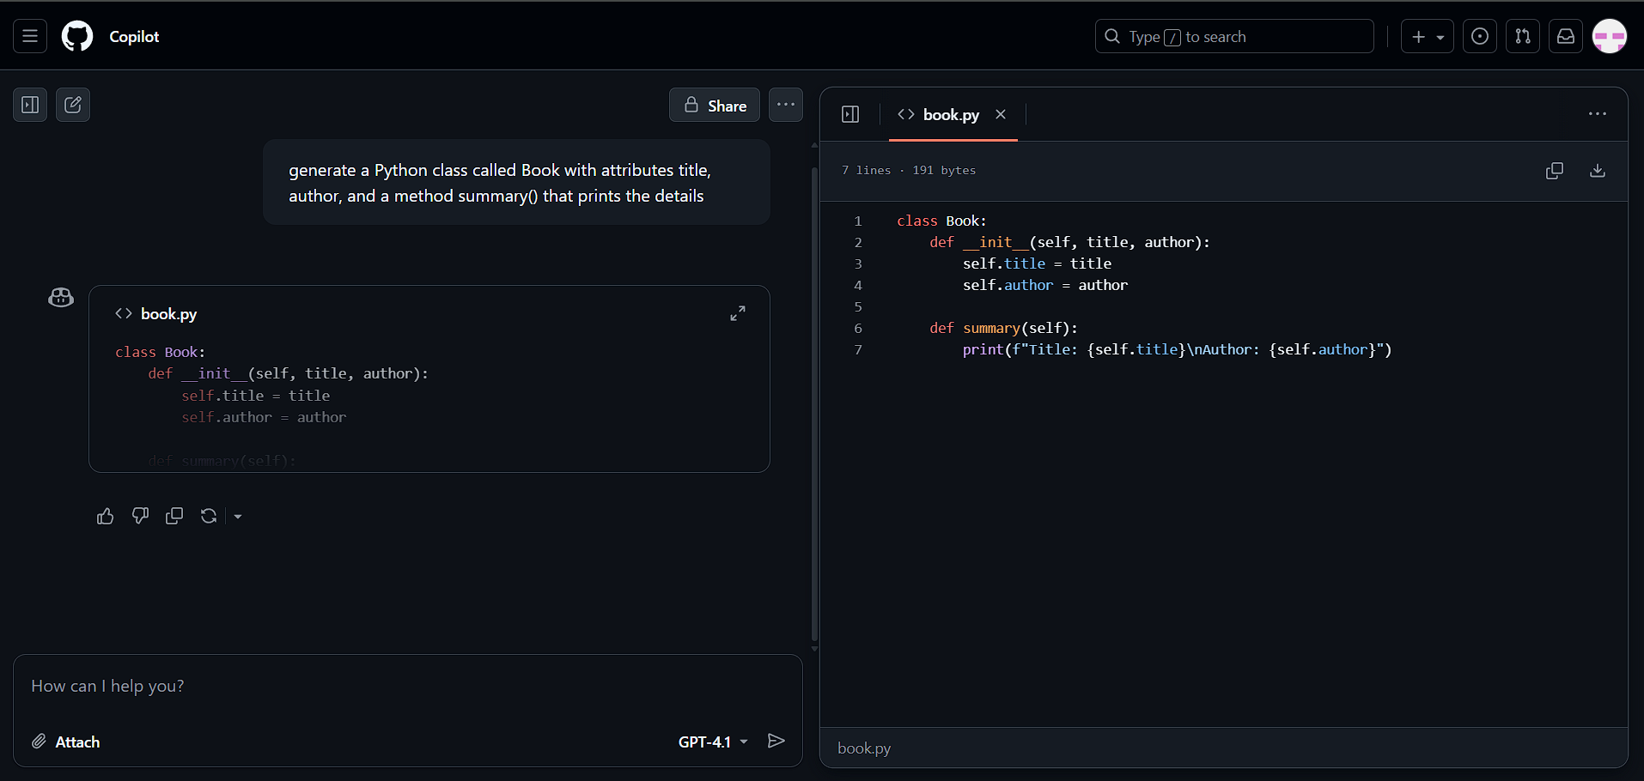
3)Use Cursor AI to generate a Python class called Book with attributes title, author, and a method summary() that prints the details

Slide 5
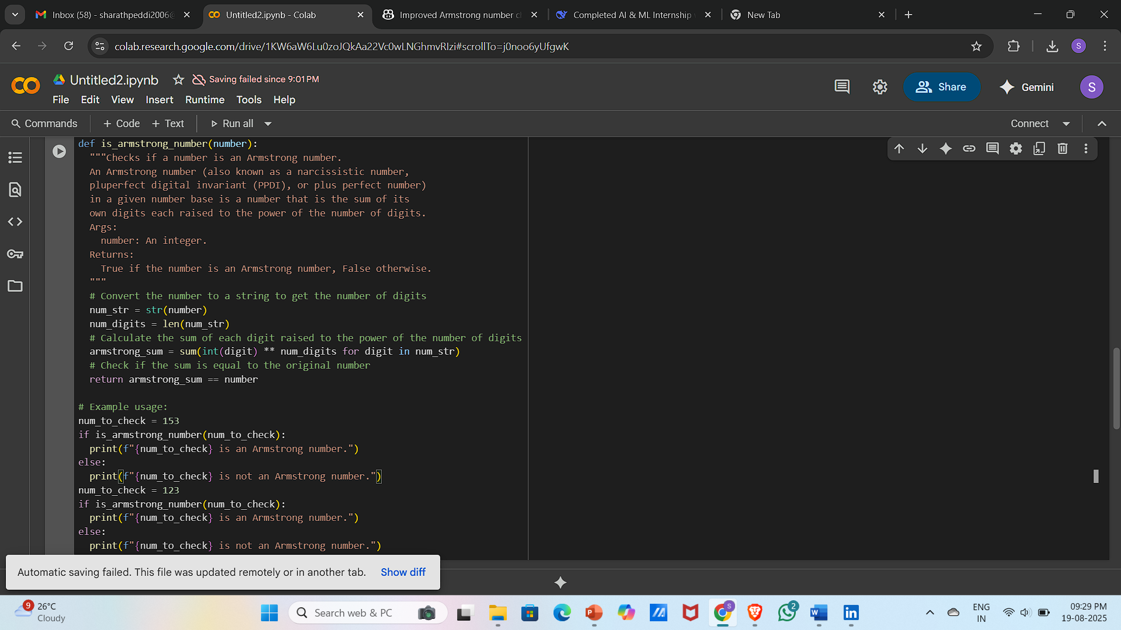
4) Ask Gemini to write a program that checks whether a number is an Armstrong number, and then modify it using Cursor AI to improve performance or structure

Slide 6
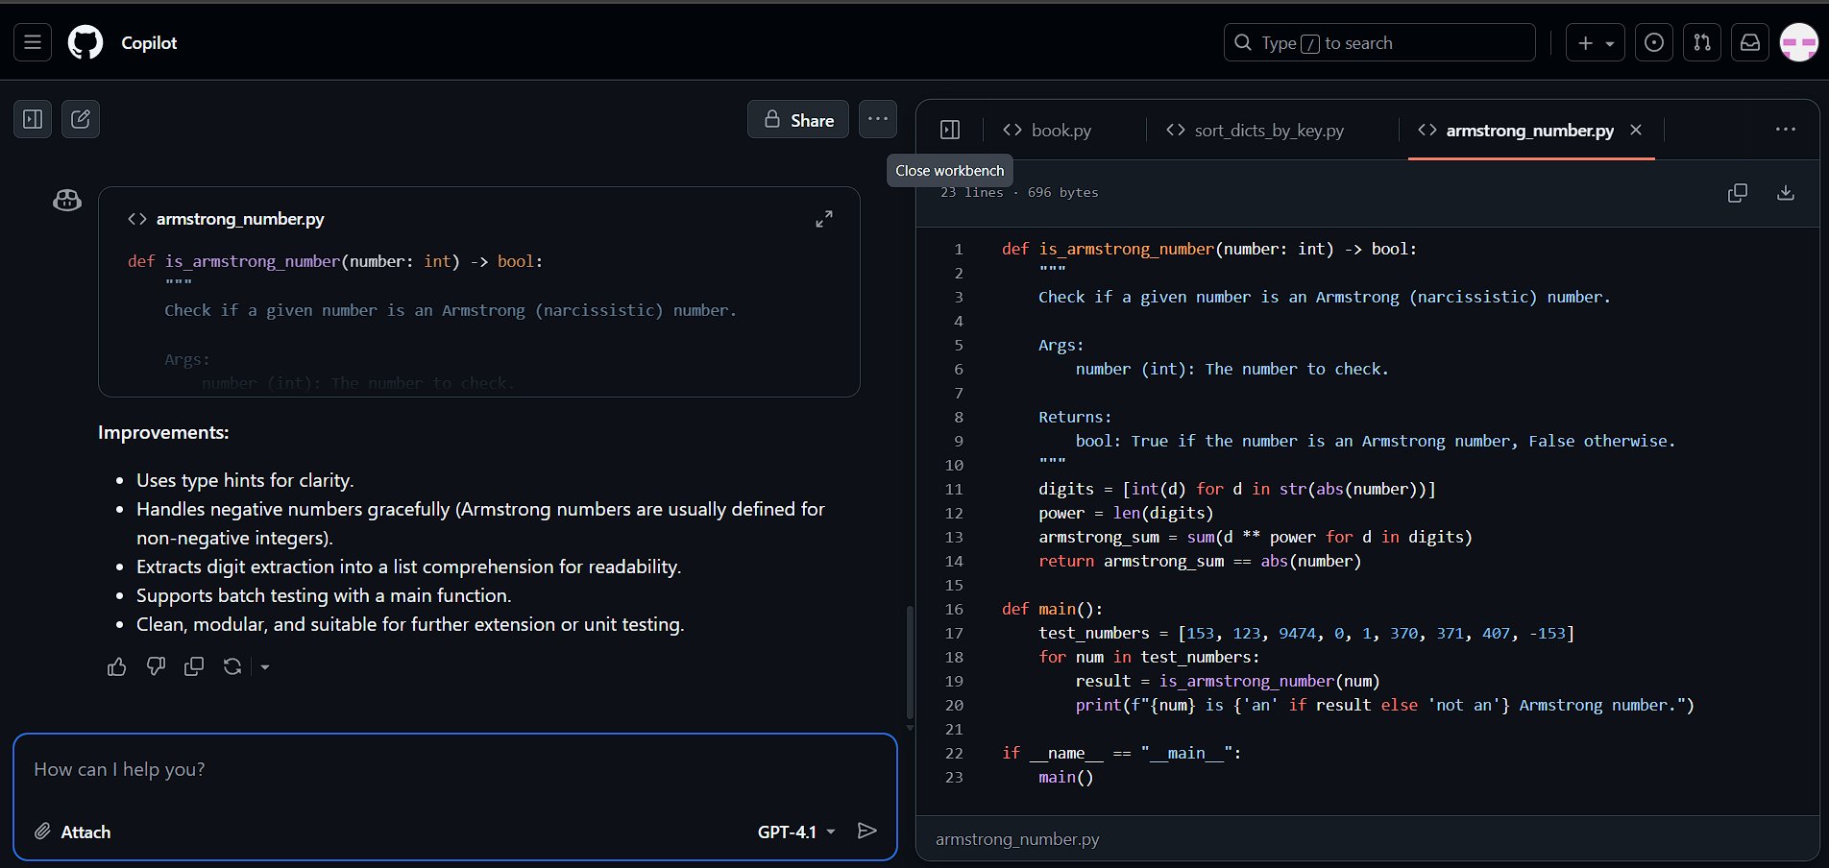

Slide 7
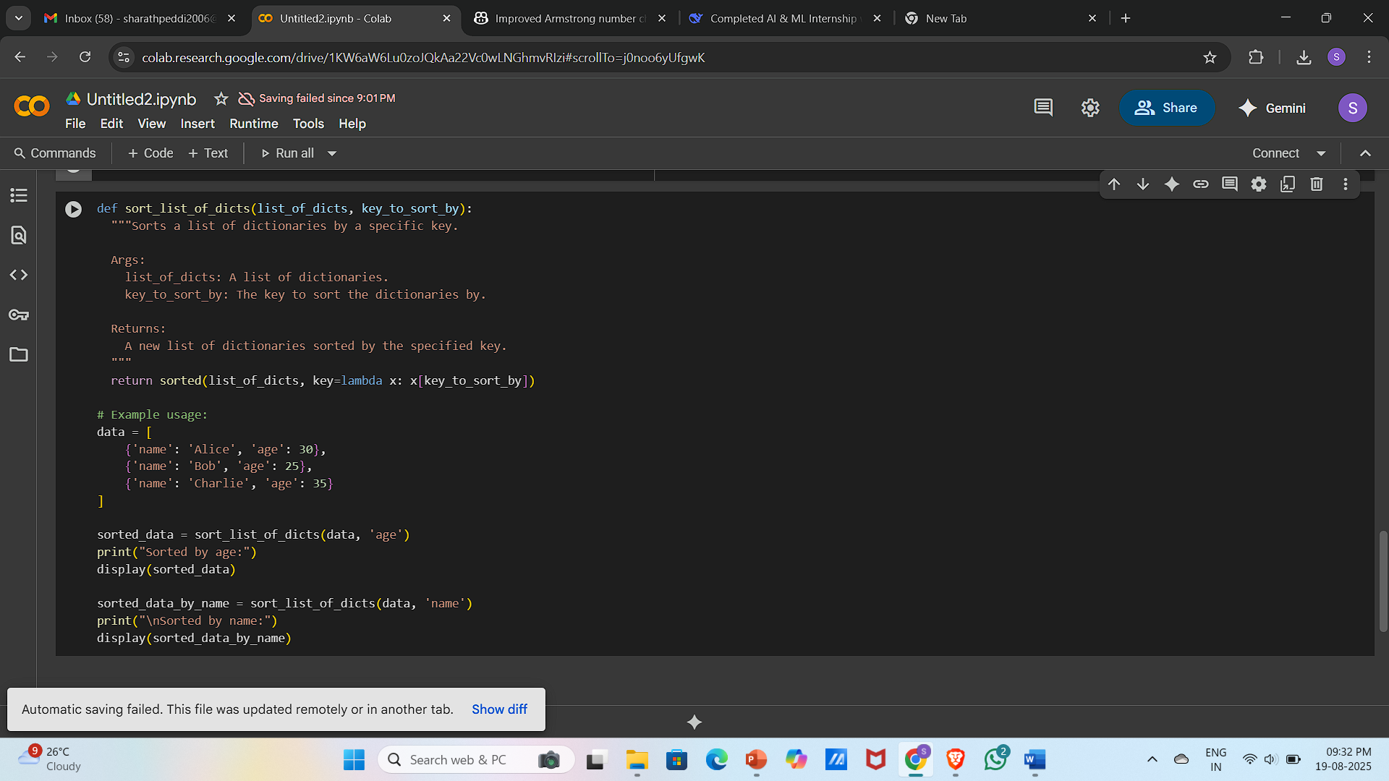
5) Use both Gemini and Cursor AI to generate code for sorting a list of dictionaries by a specific key (e.g., age).

Slide 8
