Slide 1

Employee Management System

Slide 2
About Me
Name: P.Harika
Batch No: 506
Background?
B Tech (computer science engineering)
Why you want to learn Data Science
-> I want to learn Data Science to understand data and find useful information from it. ->It helps me solve real-world problems in a better way. -> I also want to build a good career in the IT field.
Any work experience
No Experience
Share your LinkedIn and GitHub profile URLs
Linkedin link: www.linkedin.com/in/peddolla-harika

Slide 3
Objective of the Project
The main objective of this project is to design an Employee Management System to store and manage employee data efficiently.
It helps track employee details, job roles, salary, leaves, and payroll in a structured way.
It also ensures data accuracy and helps in analyzing information for better decision-making.

Slide 4
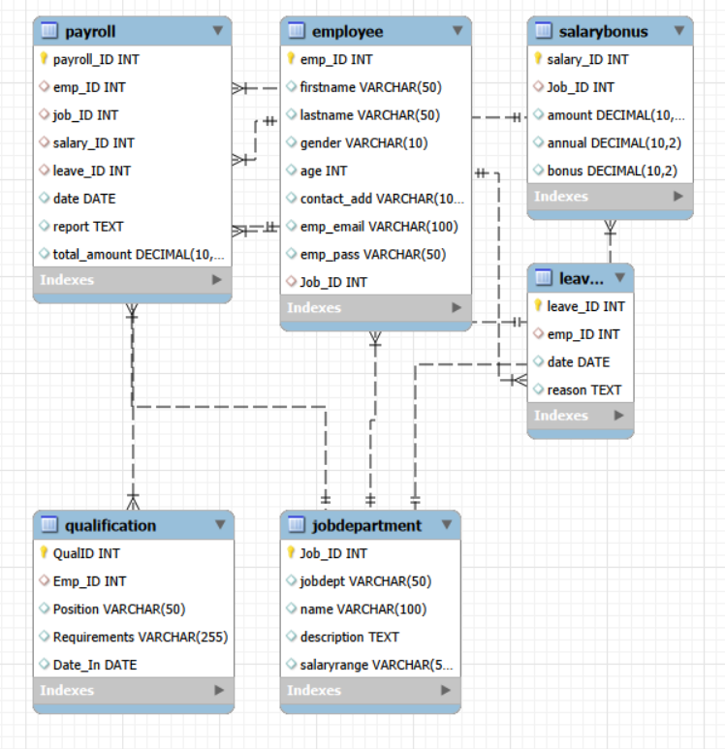
EER Diagram(Enhanced Entity-Relationship)
The ER diagram represents the structure of the Employee Management System and shows how different tables are connected. The Employee table is the central entity, linked to departments, salary, leaves, qualifications, and payroll using foreign keys. It includes relationships like one-to-many (one employee can have multiple leaves, qualifications, and payroll records) and many-to-one (many employees belong to one department).

Slide 5
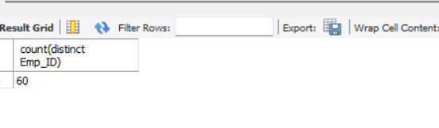
1. EMPLOYEE INSIGHTS
How many unique employees are currently in the system?
Output:
observations: The system contains 60 employees, which shows the total workforce of the organization. This helps in understanding the size of the company and planning resources accordingly.

Slide 6
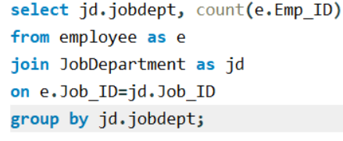
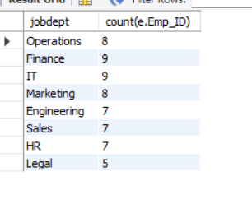
2. Which departments have the highest number of employees?
Output:
Observations: The IT and Finance departments have the highest number of employees (9 each), which means these departments are more important and require more manpower compared to others.

Slide 7
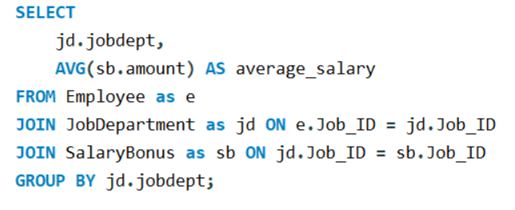
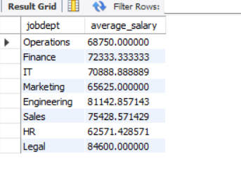
3.What is the average salary per department?
Output:
Observations The average salary in all departments is between 62K and 84K, showing that the company maintains a balanced and consistent salary structure across departments.

Slide 8
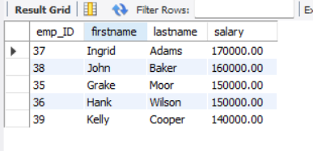
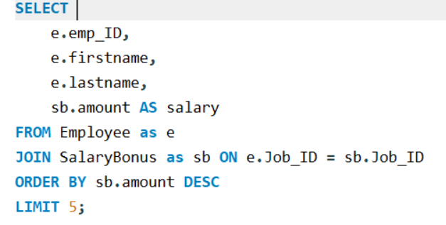
4. Who are the top 5 highest-paid employees? Output:
Observation: A few employees like Ingrid, John, Grake, Hank, and Kelly earn the highest salaries, which indicates that they are likely in senior or specialized roles in the organization.

Slide 9

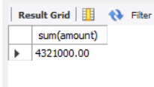
5. What is the total salary expenditure across the company?
Output:
Observation: The total salary expenditure of the company is 4,321,000, indicating the overall payroll cost.

Slide 10
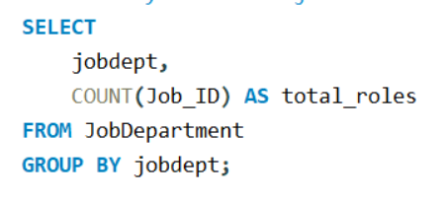
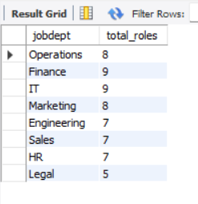
2. JOB ROLE AND DEPARTMENT ANALYSIS
1.How many different job roles exist in each department? Output:
Observation: Finance and IT departments have the highest number of job roles (9), so they have more work and different responsibilities. Departments like Legal have fewer roles (5), so they have less variety in jobs. Overall, each department has a different number of roles depending on its work.

Slide 11
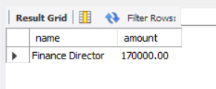
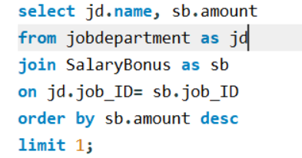
3. Which job roles offer the highest salary? Output:
Observation: The Finance Director role has the highest salary of 170,000, which shows that this is the most important and highest-level position in the organization.

Slide 12
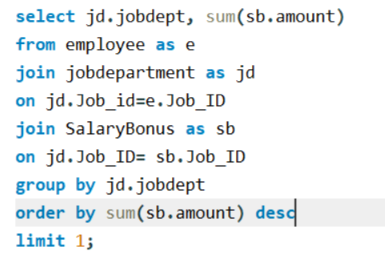
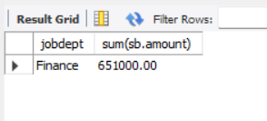
4.Which departments have the highest total salary allocation? Output:
Observation: The Finance department has the highest total salary allocation of 651,000, which means the company spends the most on this department. This may be because it has more employees or higher-paying job roles.

Slide 13

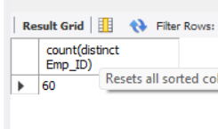
3. QUALIFICATION AND SKILLS ANALYSIS
1. How many employees have at least one qualification listed?
Output:
Observation: All 60 employees have at least one qualification, which shows that every employee in the organization is qualified.

Slide 14
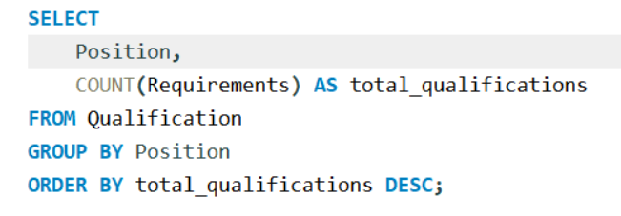
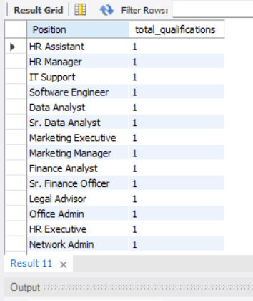
2. Which positions require the most qualifications? Output:
Observation: All positions have the same number of
qualifications (1), indicating uniform qualification requirements. There is no variation across different roles in terms of required
qualifications.

Slide 15
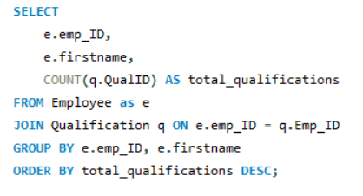
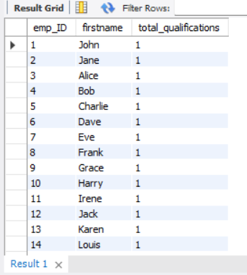
3. Which employees have the highest number of qualifications? Output:
Observation: All employees have only one qualification, so there
is no difference between employees in terms of qualifications. This shows that every employee has a similar level of
qualification.

Slide 16

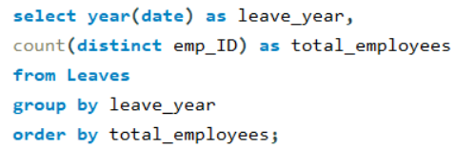
4. Leave and absence patterns
1. Which year had the most employees taking leaves? Output:
Observation: All 60 employees have taken leaves in the year 2024, which means every employee has at least one leave record in that year. There is no data for other years, so comparison between years is not possible. This shows that the dataset contains leave records only for one year.

Slide 17
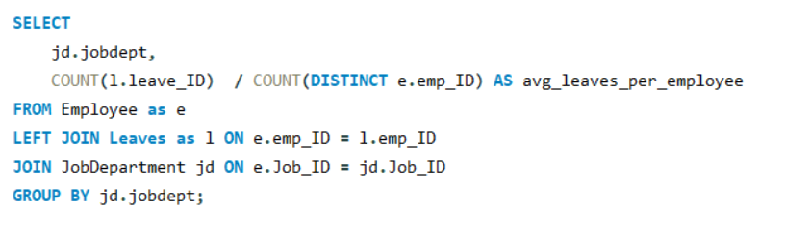
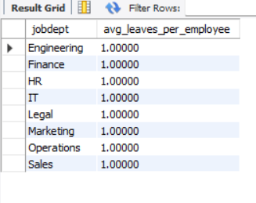
2. What is the average number of leave days taken by its employees per department? Output:
Observations: The average number of leaves per employee is 1 in all departments, which means every employee has taken only one leave. There is no difference in leave patterns between departments. This shows that employee leave behavior is uniform across the organization.

Slide 18
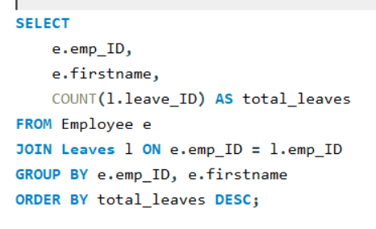
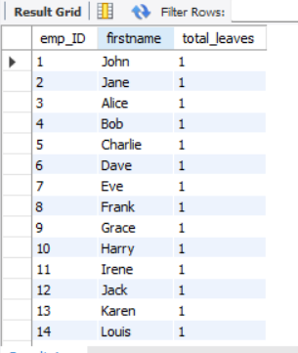
3. Which employees have taken the most leaves? Output:
Observation: All employees have taken only one leave, so
there is no difference between employees in terms of leave count. No employee has taken more leaves than others. This shows that leave distribution is equal among all employees.

Slide 19

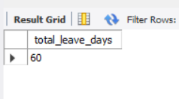
4.What is the total number of leave days taken company-wide?
Output:
Observation: The total leave count in the company is 60, indicating one leave per employee. This shows uniform leave usage across the organization.

Slide 20
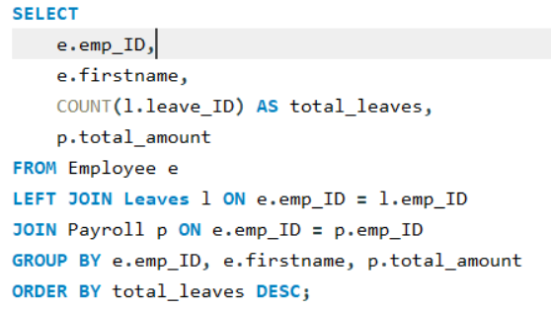
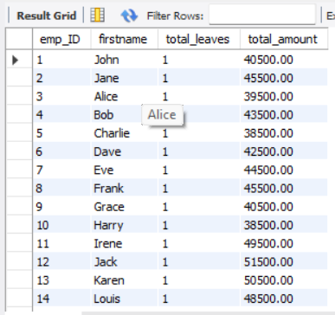
5.How do leave days correlate with payroll amounts? Output:
Observation: Although all employees have the same number of leaves, their payroll amounts vary significantly. This indicates that leave does not strongly affect payroll in this dataset.

Slide 21
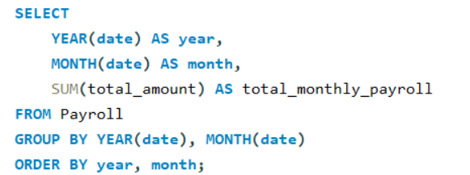
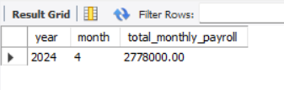
5. Payroll and compensation analysis
What is the total monthly payroll processed? Output:
Observation: The total payroll processed in April 2024 is 2,778,000, which shows the total salary paid to all employees for that month.

Slide 22
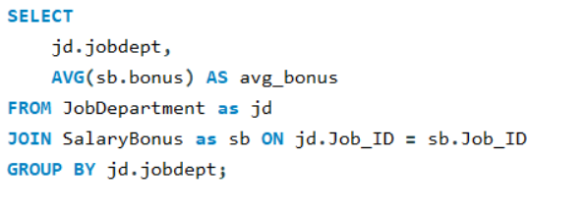
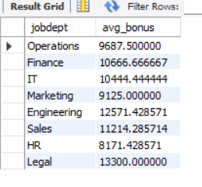
2.What is the average bonus given per department? Output:
Observation: The Legal department has the highest average
bonus (13,300), followed by Engineering and Sales, showing that these departments receive higher incentives. HR has the lowest average bonus (8,171), indicating lower bonus distribution.

Slide 23
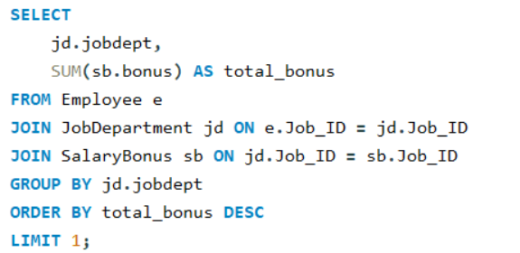
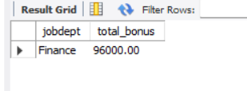
3. Which department receives the highest total bonuses? Output:
Observation: The Finance department receives the highest total bonus of 96,000, which shows that more incentives are given in this department. This may be because it has more employees or higher salary roles. It indicates that Finance plays an important role in the organization

Slide 24

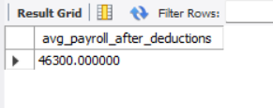
4. What is the average value of total amount after considering leave deductions?
Output:
Observation: The average payroll after deductions is 46,300, indicating the average net salary received by employees. Since leave counts are similar, deductions have minimal impact on salary. This shows a stable and consistent payroll system.

Slide 25
Conclusion
From this project, we can understand that the company has 60 employees, and most of them are working in IT and Finance departments, so these departments are more important in the organization. The salary in all departments is almost similar, but a few employees are getting higher salaries because of their roles or experience.
The leave analysis shows that most employees are taking a similar number of leaves, so there is not much difference between employees. Because of this, the payroll and bonus system is also stable and consistent across the company.
Overall, this project shows that employee data is well organized, and by using SQL queries, we can easily understand important details like salary, leaves, and performance. These insights can help the company make better decisions and improve their work in the future.

Slide 26
Experience/Challenges working
During this project, I learned how to design a database and manage data using SQL. I understood how different tables are connected using primary keys and foreign keys, and how to use joins to combine data from multiple tables.
One of the main challenges I faced was writing complex queries, especially using GROUP BY, JOINs, and subqueries. Sometimes I was getting unexpected results, and I had to carefully check the data and understand the logic behind each query.
I also faced difficulty in understanding how to calculate values like average leaves and payroll correctly, but by practicing and testing queries, I was able to solve them. Overall, this project helped me improve my SQL skills and gave me a better understanding of how data is used in real-world applications.

Slide 27

THANK YOU

