Slide 1
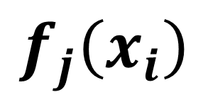
$$f_{j}\left(x_{i}\right)$$
$$β_{j1}⋅f_{j1}\left(x_{i}\right)+β_{j2}⋅f_{j2}\left(x_{i}\right)+β_{j3}⋅f_{j3}\left(x_{i}\right)…$$

Slide 2
Random effects:
Only differences from the average penalized
Thin plate splines, cubic splines:
Penalty on the total average derivatives of the function
Abundance
Abundance
Time
Time
Markov Random fields:
Connected observations get pulled toward one another
Cyclic splines:
End points of the curve are assumed to be equal to each other
Abundance
Abundance
Time
Time

Slide 3
1
2
3
4
3
1
5
2
4
1 | -1 | -1 | 0 | 0
-1 | 3 | -1 | -1 | 0
-1 | -1 | 2 | 0 | 0
0 | -1 | 0 | 2 | -1
0 | 0 | 0 | -1 | 1
1 | -1 | 0 | 0
-1 | 2 | -1 | 0
0 | -1 | 1 | -1
0 | 0 | -1 | 1

