Slide 1
Anypoint Platform Metrics
<customer_name>
20xx-xx-xx

Slide 3
Benefits of the Anypoint Platform
The expected benefits of using the Anypoint Platform include:
Unlocking data from legacy systems, rapidly connecting legacy assets to SaaS technologies, and reducing integration costs—without disrupting existing business processes.
Increase in developer productivity and decrease in development times through open technologies that promote reusability, modularity and collaboration.
Reduces time to resolution by managing all resources from a single pane of glass.
Increases agility with a flexible architecture that evolves with the business.

Slide 4
Tracking the Value of the Anypoint Platform
In order to fully realize the benefits of the Anypoint Platform, key performance indicators (KPIs) should be developed to ensure that the platform is providing value to the organization.
Anypoint Anypoint Platform KPIs are developed with customer input and should align with the customer's Anypoint Platform vision.
The KPIs should be measured periodically (ideally weekly) and should be regularly revised to ensure relevancy and alignment to business objectives.
The Anypoint Platform provides a variety of metrics that can be utilized when constructing these KPIs.

Slide 5
Anypoint Platform Metrics
Anypoint Platform Metrics can be broken down into the following areas:
Adoption
Measures the continued usage of the platform to develop new integrations and APIs.
Availability & Reliability
Measures the stability of the overall platform as well as planning for future adoption.
Foundational Service Reuse
Tracks reuse of standard foundational services provided along with the Anypoint Platform.
Supportability
Measures the growing footprint of platform and the organization’s ability to support it.
Governance
Measures the number of applications that are leveraging automated build and deployment processes.

Slide 6
Anypoint Platform Metrics
Each metric is defined using the following criteria:
Name
The name of the metric.
Description
A description of what the metric is capturing.
Calculation
How the metric is calculated.
Format
How the metric is represented.
Source
The data source from which the metric is collected.

Slide 7
Adoption
Anypoint Platform Metrics

Slide 8
Anypoint Platform Metrics - Adoption
Adoption metrics are a critical component when evaluating the continued use and expansion of the Anypoint Platform.
Potential Adoption Metrics
Total number of business groups defined.
Total number of business groups that have been created.
Total number of deployed applications and active APIs.
Percentage of active APIs that have more than one consumer.
Total number of deployed applications and active APIs per environment.
Percentage of active APIs that have more than one consumer.
Total number of users registered.
Total number of users that have accounts on the platform.
Total number of messages processed.
Total number of messages processed by active APIs/integrations.

Slide 9
Adoption Details
Anypoint Platform Metric Examples

Slide 10
Number of Active APIs
Planned vs. Actual

Slide 11
Number of Active APIs
Planned vs. Actual
Description: This metric tracks the number of APIs in the Production environment based on type. This metric captures the number of active and planned APIs for the current month.
Name | Description/Calculation | Format | Source
Number of Experience APIs Planned | The number of planned Experience APIs for the current month. | Integer | Expectation set by Leadership
Number of Experience APIs Actual | The number of Experience APIs whose status is STARTED. | Integer | Anypoint Platform APIs
Number of Process APIs Planned | The number of planned Process APIs for the current month. | Integer | Expectation set by Leadership
Number of Process APIs Actual | The number of Process APIs whose status is STARTED. | Integer | Anypoint Platform APIs
Number of System APIs Planned | The number of planned System APIs for the current month. | Integer | Expectation set by Leadership
Number of System APIs Actual | The number of System APIs whose status is STARTED. | Integer | Anypoint Platform APIs
Notes:
API whose name contains “experience-api” in the Production environment.
API whose name contains “process-api” in the Production environment.
API whose name contains “system-api” in the Production environment.

Slide 12
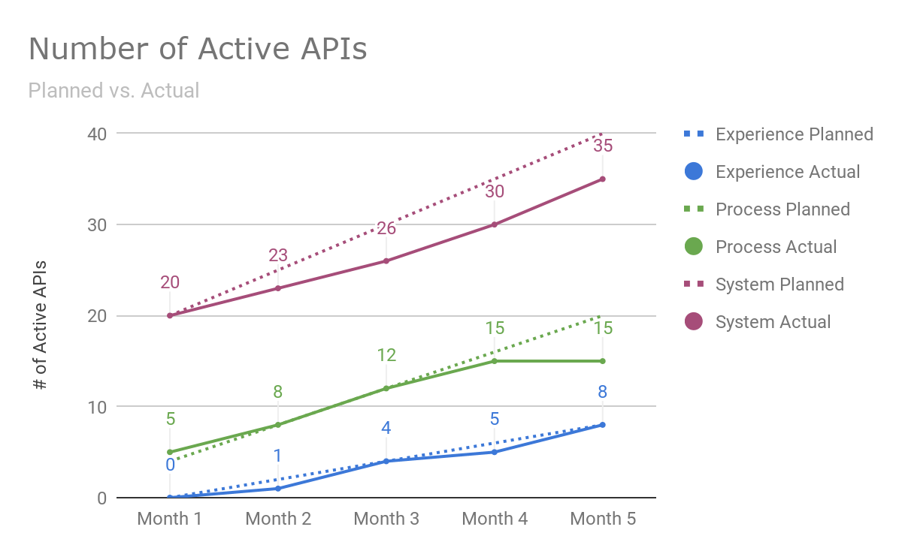
Number of Active APIs
Planned vs. Actual

Slide 13
Number of APIs per Environment
Planned vs. Actual

Slide 14
Number of APIs per Environment
Planned vs. Actual
Description: This metric tracks the number of APIs per environment. This metric captures the number of APIs planned and delivered per environment and provides insight into the APIs that are planned for a Production deployment against those that actually are delivered.
Name | Description/Calculation | Format | Source
Number of APIs in Development Planned | The number of planned APIs in Development for the current month. | Integer | Expectation set by Leadership
Number of APIs in Development Actual | The number of APIs in Development whose status is STARTED. | Integer | Anypoint Platform APIs
Number of APIs in QA Planned | The number of planned APIs in QA for the current month. | Integer | Expectation set by Leadership
Number of APIs in QA Actual | The number of APIs in QA whose status is STARTED. | Integer | Anypoint Platform APIs
Number of APIs in Production Planned | The number of APIs in Production for the current month. | Integer | Expectation set by Leadership
Number of APIs in Production Actual | The number of APIs in Production whose status is STARTED. | Integer | Anypoint Platform APIs
Notes:
API in Development
API that is currently deployed to the Development environment.
API in QA
API that is currently deployed to the QA environment.
API in Production
API that is currently deployed to the Production environment.

Slide 15
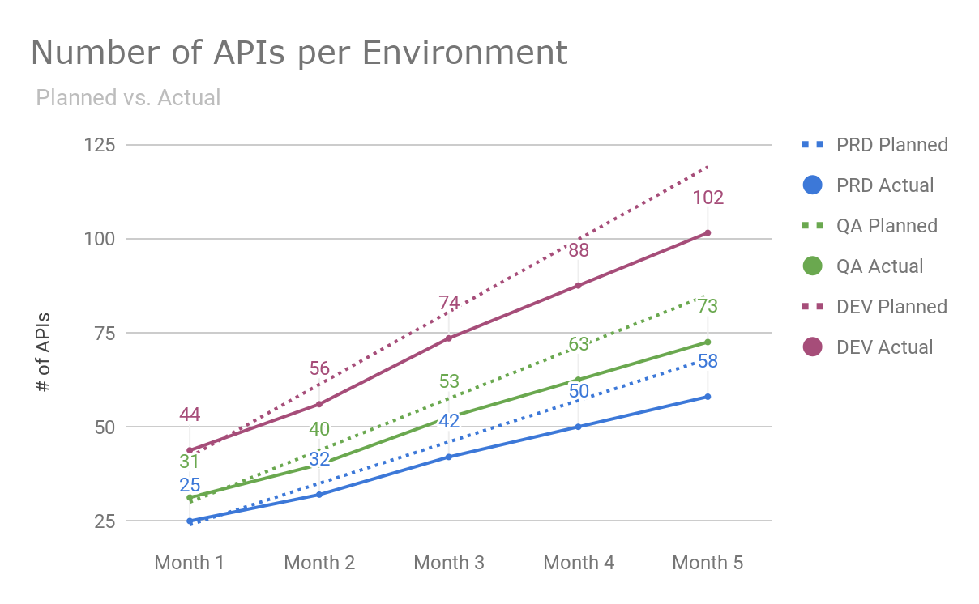
Number of APIs per Environment
Planned vs. Actual

Slide 16
Availability and Reliability
Anypoint Platform Metrics

Slide 17
Anypoint Platform Metrics - Availability & Reliability
Availability and Reliability metrics are useful for monitoring platform downtime and outages against established SLAs.
Availability and Reliability metrics are also useful for capacity planning and potential platform expansion.
Potential Availability and Reliability Metrics
Management Plane Uptime
Management plane uptime measured against an established SLA.
Runtime Availability/Uptime
Runtime availability and uptime measured against an established SLA.
vCore Usage
Measures the total number of Sandbox and Production vCores used across all environments.
Provides a proactive means for planning future scalability and availability requirements.

Slide 18
Availability and Reliability
Anypoint Platform Metric Examples

Slide 19
vCore Usage
Available vs. Consumed

Slide 20
vCore Usage
Available vs. Consumed
Description: This metric tracks the number of vCores used across Production and Sandbox environments. This metric captures the total number of Sandbox and Production vCores used across all environments which helps in platform capacity planning.
Name | Description/Calculation | Format | Source
Sandbox vCores Available | The number of Sandbox vCores provisioned for the month. | Decimal | Anypoint Platform APIs
Sandbox vCores Consumed | The number of Sandbox vCores consumed for the month. | Decimal | Anypoint Platform APIs
Production vCores Available | The number of Production vCores provisioned for the month. | Decimal | Anypoint Platform APIs
Production vCores Consumed | The number of Production vCores consumed for the month. | Decimal | Anypoint Platform APIs
Design vCores Available | The number of Design vCores provisioned for the month. | Decimal | Anypoint Platform APIs
Design vCores Consumed | The number of Design vCores consumed for the month. | Decimal | Anypoint Platform APIs
Notes:
Sandbox vCores
Capacity for environments for development and testing of applications.
Production vCores
Capacity for environments for production applications.
Design vCores
Capacity for testing and running applications in Flow Designer.

Slide 21
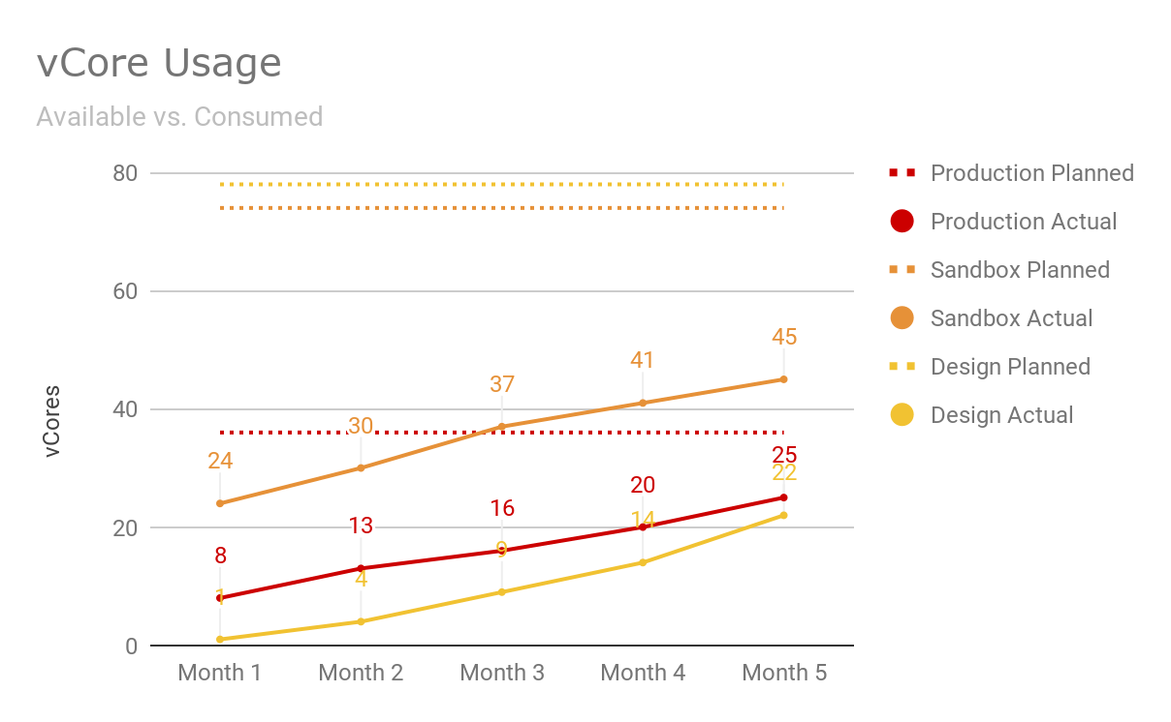
vCore Usage
Available vs. Consumed

Slide 22
Foundational Service Reuse
Anypoint Platform Metrics

Slide 23
Anypoint Platform Metrics - Foundational Service Reuse
When the Anypoint Platform is initially installed and configured, there are a number of foundational services (e.g. logging, security, exception-handling, etc.) that are developed and delivered along with the platform.
Foundational Service Reuse metrics measure the usage of these foundational services and track their continued use by projects.
Potential Foundational Service Reuse Metrics
Reuse of logging/auditing foundational service capability.
Percentage of active APIs that are leveraging the foundational logging/auditing libraries.
Reuse of error/exception-handling foundational service capability.
Percentage of active APIs that are leveraging the foundational exception-handling libraries.
Reuse of security foundational service capability.
Percentage of active APIs that are leveraging the foundational security libraries or policies.
Reuse of service-level agreements (SLAs).
Percentage of active APIs that are leveraging a foundational SLA and its enforcement policies.

Slide 24
Supportability
Anypoint Platform Metrics

Slide 25
Anypoint Platform Metrics - Supportability
Supportability Metrics are identified to help evaluate the costs necessary to support operations of the Anypoint Platform.
Platform supportability can be impacted if excessive business groups, environments, and runtime versions are required.
Potential Supportability Metrics
Total number of applications by type.
Captures the total number of applications by type (e.g. API, batch, event-driven) in Production.
Average number of API versions.
Demonstrates the operational overhead of maintaining multiple versions of the same API.
Number of runtime versions used.
Measures the total number of applications running on each runtime version per environment.
Number of environments per business group.
Demonstrates the the operational overhead of maintaining separate environments for each business group.

Slide 26
Supportability
Anypoint Platform Metric Examples

Slide 27
Average Number of API Versions

Slide 28
Average Number of API Versions
Description: This metric displays the number of API versions currently in Production by type. This metric demonstrates the operational overhead of maintaining multiple versions of the same API. Additional versions of the same API will negatively impact this metric.
Name | Description/Calculation | Format | Source
Average Number of Versions for Experience APIs | Number of API versions / Number of APIs that are Experience APIs in the Production Environment | Decimal | Anypoint Platform APIs
Average Number of Versions for Process APIs | Number of API versions / Number of APIs that are Process APIs in the Production Environment | Decimal | Anypoint Platform APIs
Average Number of Versions for Systems APIs | Number of API versions / Number of APIs that are System APIs in the Production Environment | Decimal | Anypoint Platform APIs
Number of Versions Goal | Maximum number of versions supported by operations. | Integer | Expectation set by Leadership
Notes:
Experience API
API whose name contains “experience-api” in the Production environment.
Process API
API whose name contains “process-api” in the Production environment.
System API
API whose name contains “system-api” in the Production environment.
Average Number of Versions
Average number of API versions available to be consumed.
Number of Versions Goal
The maximum number of Production versions for a given API.

Slide 29
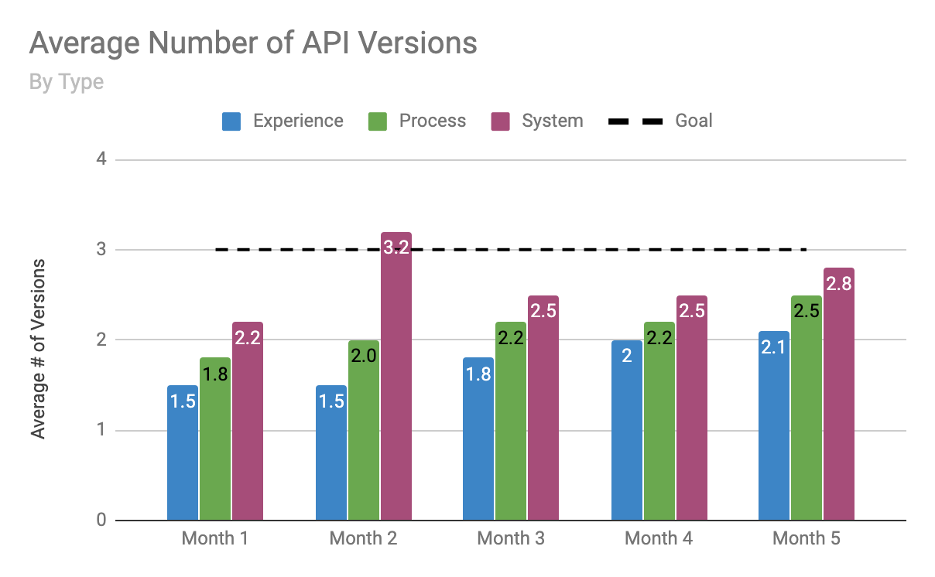
Average Number of API Versions

Slide 30
Number of API Versions

Slide 31
Number of API Versions
Description: This metrics displays the top 10 APIs ranked on total number of versions in the Production environment.
Name | Description/Calculation | Format | Source
Number of API Versions | The number of versions available for a given API in the Production environment from most to least. | Integer | Anypoint Platform APIs
Number of API Versions Goal | The maximum number of Production versions for a given API. | Integer | Expectation set by Leadership

Slide 32
Top 10 - Number of API Versions
API | Number of API Versions
Exception Routing System API | 7
Audit System API | 5
Customer MDM Data API | 4
Account DB System API | 4
GOAL | 3
Salesforce Accounts System API | 3
ServiceNow System API | 3
CMDB System API | 3
AD Authentication System API | 3
ServiceNow System API | 2
Account Update Process API | 2

Slide 33
Runtime Versions Used

Slide 34
Runtime Versions Used
Description: This metric captures the the total number of applications running on each runtime version per environment and provides insight on planning future runtime upgrades.
Name | Description/Calculation | Format | Source
Development Runtime Versions | Total Number of Applications hosted by Runtime Version in Development Environment | Integer | Anypoint Platform APIs
QA Runtime Versions | Total Number of Applications hosted by Runtime Version in QA Environment | Integer | Anypoint Platform APIs
PPD Runtime Versions | Total Number of Applications hosted by Runtime Version in PPD Environment | Integer | Anypoint Platform APIs
UAT Runtime Versions | Total Number of Applications hosted by Runtime Version in UAT Environment | Integer | Anypoint Platform APIs
Production Runtime Versions | Total Number of Applications hosted by Runtime Version in Production Environment | Integer | Anypoint Platform APIs

Slide 35
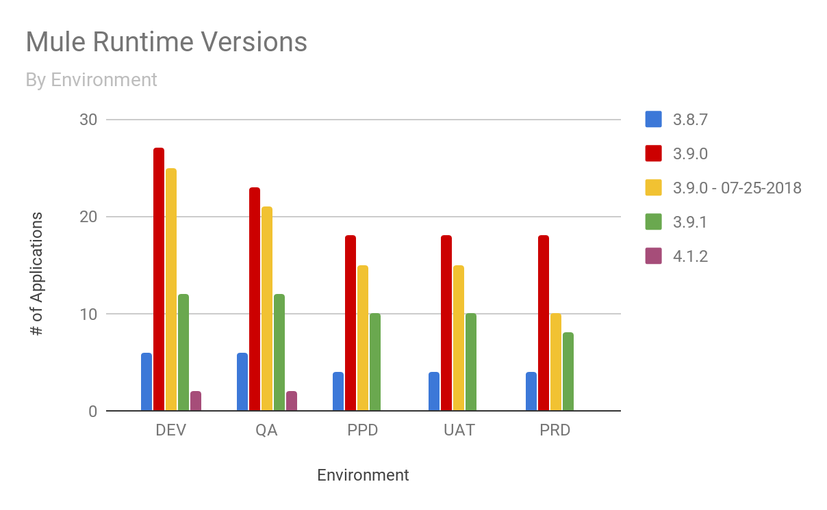
Runtime Versions Used

Slide 36
Governance
Anypoint Platform Metrics

Slide 37
Anypoint Platform Metrics - Governance
Platform governance helps to insure that applications are developed using agreed-upon standards and best practices.
Platform governance metrics can also measure adherence to specific design, development and testing strategies.
Potential Governance Metrics
Percentage of unsecured applications.
Percentage of applications that aren’t using security.
Percentage of applications that aren’t leveraging foundational services.
Percentage of applications that aren’t using pre-approved platform foundational services (e.g. logging, exception-handling, caching, auditing).
Percentage of applications that are deployed manually.
Percentage of applications that aren’t leveraging a Continuous Integration/Delivery platform and thus are not benefitting from a repeatable build/deploy process.
Percentage of application that have been peer-reviewed.
Percentage of applications that have undergone a design or code review.

Slide 38
Thank You

