Slide 1
Applied Architecture Patterns in Java (The simple way)
Andres Cespedes Morales

Slide 2




Hello!
I am Andres
You can find me at @andrespedes

Slide 3
Agenda
Bringing patterns into reality with simplicity
Fault Tolerant Architectures
Long Running Actions (Sagas with ease)
Event-Driven Architecture

Slide 4
Architecture Patterns, huh?
1.
Simple in theory, not quite in practice?

Slide 5
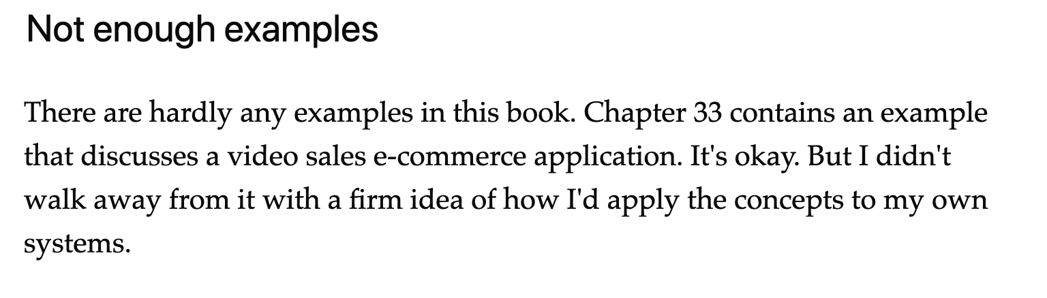
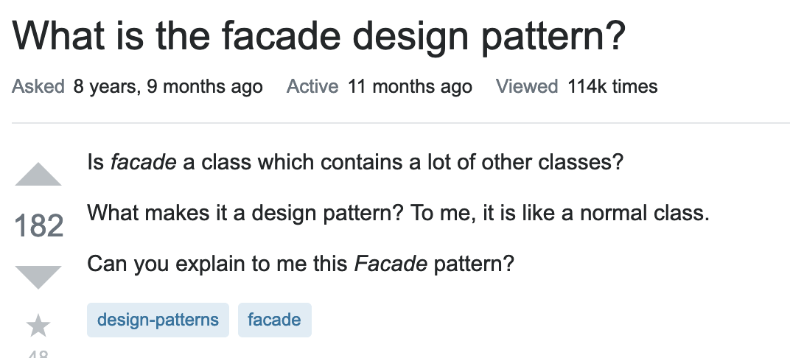
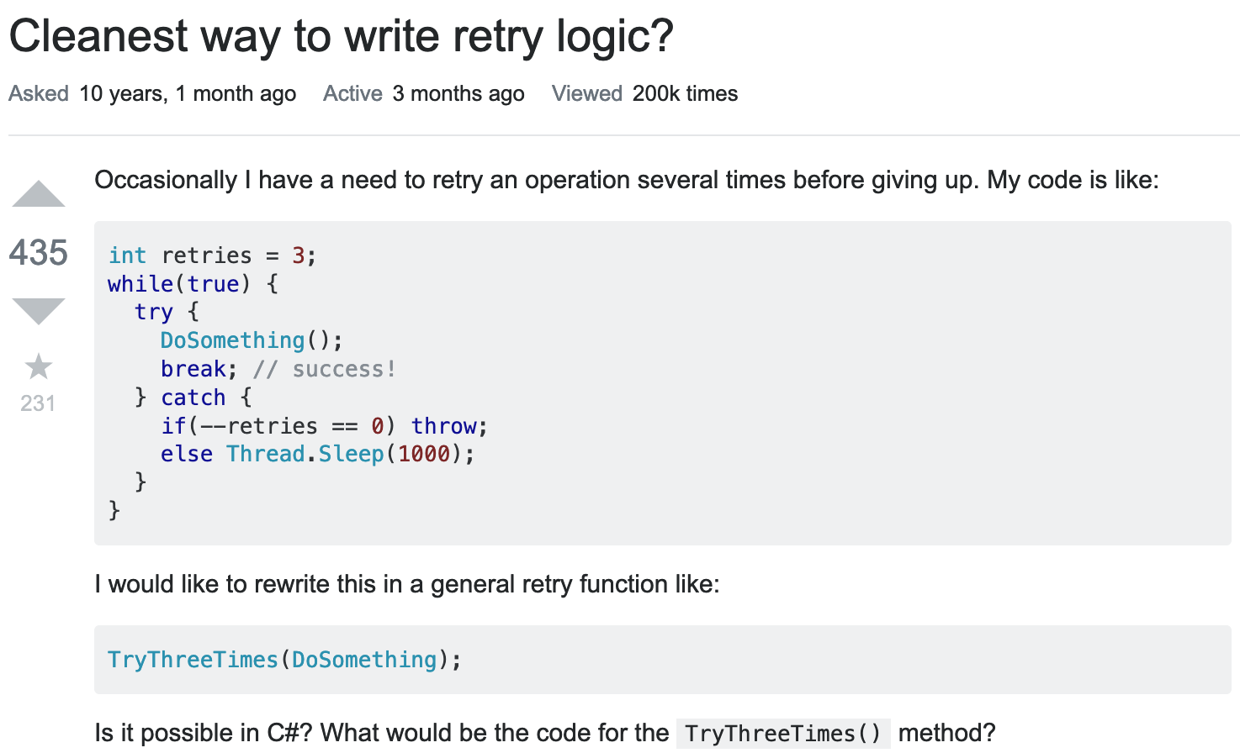
User Feedback

Slide 6
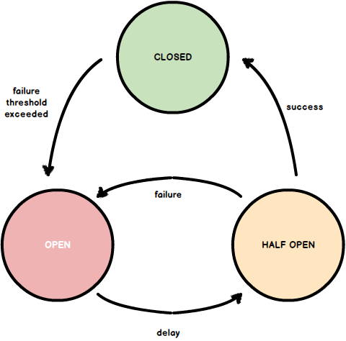
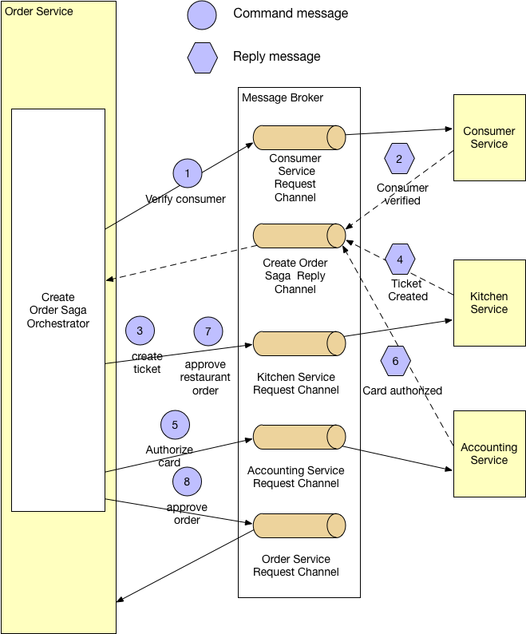
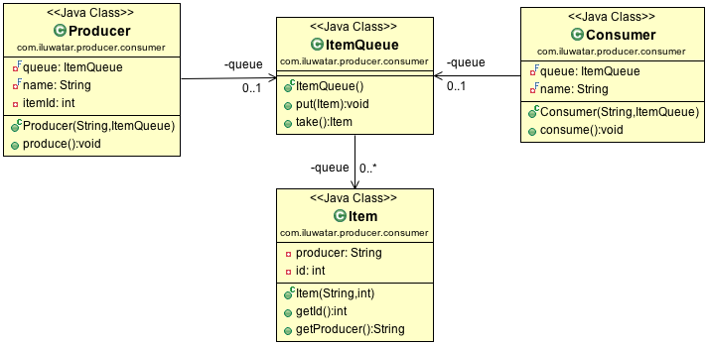
Translating Diagrams

Slide 7
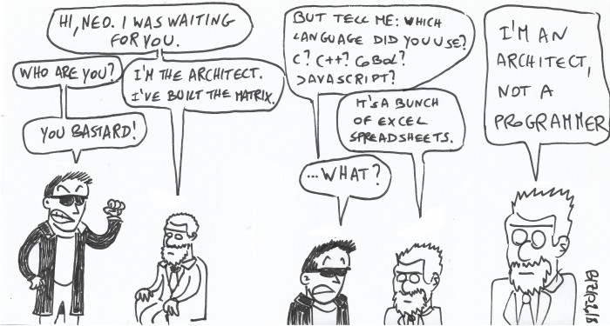
Hands Off Architect

Slide 8
Fault Tolerant Architectures
2.
How to avoid catastrophic failures with ease in a Microservice world

Slide 9
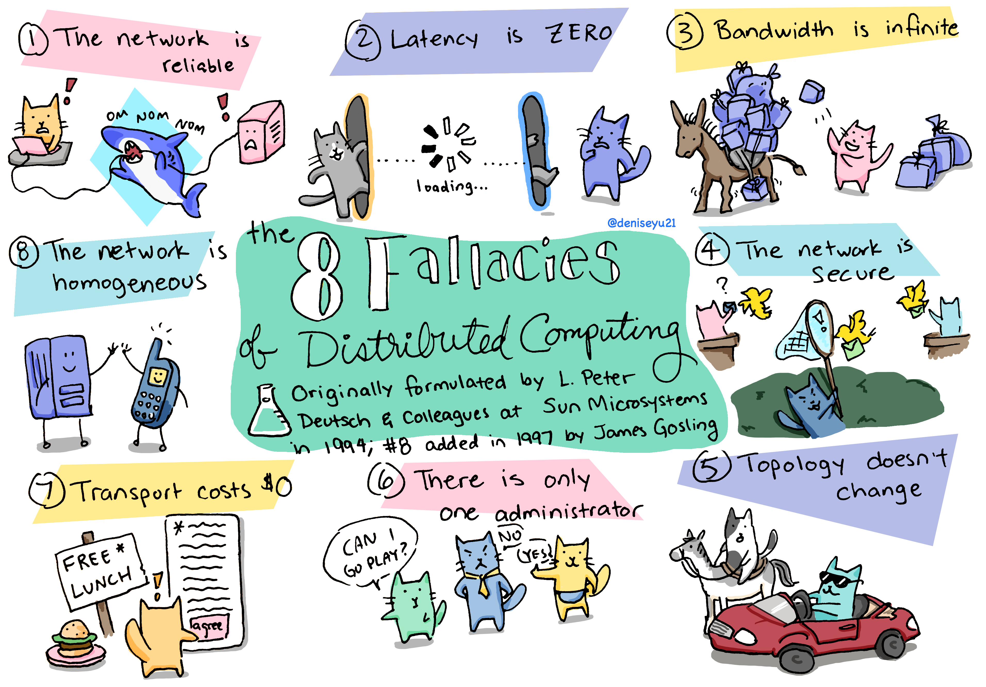

Slide 10



Resiliency Patterns
Retry
Fallback
Circuit Breaker

Slide 11


Technologies FTW

Slide 12

Demo

Slide 13
Distributed Architectures
3.
How to gracefully complete long running actions

Slide 14
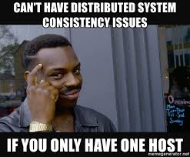
How hard could it be?

Slide 15
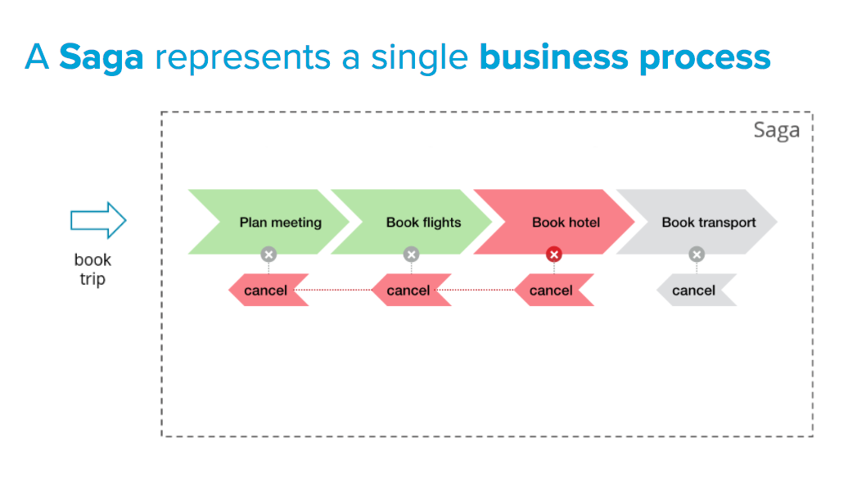
“Ultra-smart Solution”

Slide 16

Technologies FTW

Slide 17
Demo

Slide 18
Event-Driven Architectures
4.
Asynchronous communication: Did you mean letters?

Slide 19
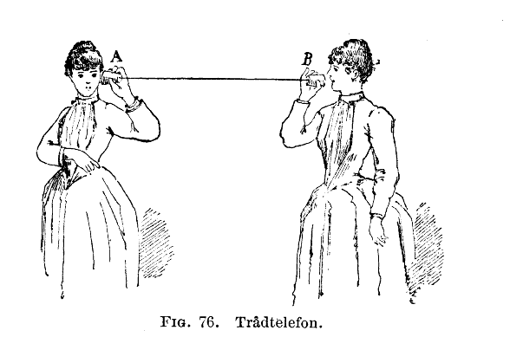
Once upon a time …
service
service

Slide 20
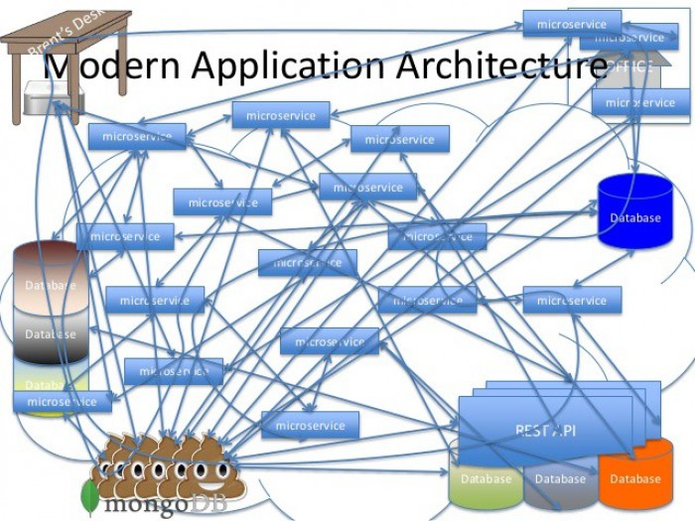
Async Choreography?

Slide 21


Technologies FTW

Slide 22
Demo

Slide 23
SIMPLICITY
Applying software architecture solutions and patterns can be done with it

Slide 24
Simplicity
is the ultimate sophistication

Slide 25
Thanks!
Any questions?
You can find me at
@andrespedes
https://www.linkedin.com/in/andrespedes12/

Slide 26
Credits
Special thanks to all the people who helped me and collaborated in one way or another with this talk:
SlidesCarnival
Chris Richardson
Guillaume Smet
Paul Parkinson
Denise Yu
Bruno Baptista
Jn Bernitt
Martin Stefanko

